Slide 1
Meter Working Group
March 31, 2021

Slide 2
Anti-Trust Admonition
Antitrust Admonition
To avoid raising concerns about antitrust liability, participants in ERCOT activities should refrain from proposing any action or measure that would exceed ERCOT’s authority under federal or state law. For additional information, stakeholders should consult the Statement of Position on Antitrust Issues for Members of ERCOT Committees, Subcommittees, and Working Groups, which is posted on the ERCOT website. http://www.ercot.com/about/governance/index.html
Disclaimer
All presentations and materials submitted by Market Participants or any other Entity to ERCOT staff for this meeting are received and posted with the acknowledgement that the information will
be considered public in accordance with the ERCOT Websites Content Management Operating Procedure.

Slide 3
Attendance Roll-call and Introductions
Brief review of WebEx attendees and meeting format
Introduction of Chair and Vice Chair

Slide 4
Update on NPRR1020 and SMOGRR024
SMOGRR024 was approved during the February 9th 2021 Board of Directors Meeting
SMOG changes were effective March 1st 2021, except for boxed language in section 4.1 that would require the calculation of WSL in ERCOT Data Aggregation System
Remaining boxed language will be implemented after ERCOT system changes
Changes of NPRR1020 were “un-gray boxed” on March 15th 2021
Allows for implementation with TDSP programming the WSL calculation in the meter
New forms approved at 11/18/20 MWG have been posted to the ERCOT website
New forms can be used now
Please use the new forms no later than 1/1/2022

Slide 5
Loss of Telemetry Update
ERCOT has an updated Translation Interface Module (TIM) that allows MV90 to collect loss of telemetry events in ION meters.
Example of Event Log from Schneider Electric ION Setup
Example of Event Log from MV90
This is only available for ION meters. If a different meter is going to be used, the meter manufacturer will need to contact Itron for an update to the MV90 TIM. Due to the reporting tools that the MDAS group uses, the same MV90 event log name will need to be used for telemetry signal failures.

Slide 6
Line Loss Compensation Discussion
Meter Working Group discussed possible language for loss compensation update in protocol and SMOG during the 11/18/20 MWG.
See key document “5. Line Loss Compensation Language Draft”
Review language to see if further edits are needed or MWG would like to continue with the proposed language.

Slide 7
ESR Auxiliary Load Dual Feed with Auto Transfer
Battery Energy Storage System developers are looking to mitigate extended gen-tie or main power transformer outages for transmission connected batteries
Large risk to the batteries if HVAC cannot be restored in a reasonable timeframe
Battery Energy Storage System developers proposal
Main feed for auxiliary loads behind the transmission interconnection
Alternate feed for auxiliary loads served from a Distribution Service Provider circuit
Utilize a break-before-make automatic transfer scheme
Settlement of energy flows to the auxiliary load
EPS Metering will follow standard netting rules for the sites with auxiliary loads behind the generation site POI
TDSP metering will follow the standard rules for provision of data to ERCOT for settlements

Slide 8
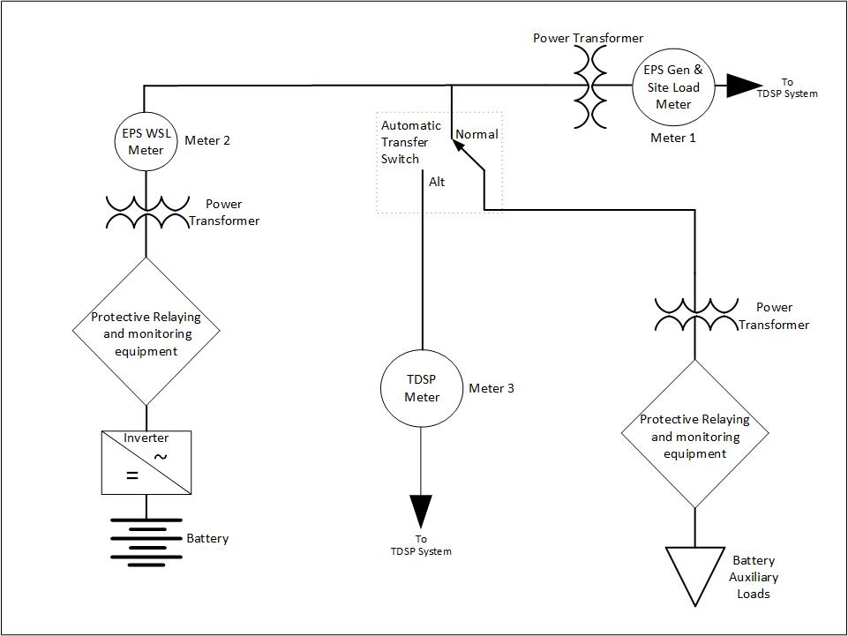
ESR Auxiliary Load Dual Feed with Auto Transfer

Slide 9
ESR Auxiliary Load Dual Feed with Auto Transfer
Protocol Section 10.3.2.3(5) provides guidance on the topic
All Load(s) included in the netting arrangement for an EPS Metering Facility shall only be electrically connected to the ERCOT Transmission Grid through the EPS metering point(s) for such Facility. Such Loads shall not be electrically connected to the ERCOT Transmission Grid through electrical connections that are not metered by the EPS metering point(s) for the Facility.
Does the MWG membership have a desire to present the utilization of an ATS for serving ESR BESS auxiliary loads to WMS with a request for direction to investigate
Discuss whether Protocol section 10.3.2.3(5) should be modified to accommodate the requested metering configuration and
If the MWG consensus recommendation is to support an automatic transfer scheme for a BESS/ESR
Provide a recommendation on Protocol language that could be submitted to implement the concept

Slide 10
Separately Metering Aux Loads for an ESR
Inquiries have been received in regards to separately metering the auxiliary loads located behind the ESR POI instead of separately metering the WSL
Inquiries received from TDSPs and generation developers
Protocol Section 10.3.2.3(3) & 11.1.6 provide guidance on the topic

Slide 11
Separately Metering Aux Loads for an ESR
10.3.2.3 Generation Netting for ERCOT-Polled Settlement Meters
(3) For Energy Storage Resource (ESR) sites, Wholesale Storage Load (WSL) must be separately metered from all other Loads and generation, and must be metered using EPS Metering Facilities.
(a) For configurations where the Resource Entity telemeters an auxiliary Load value to the EPS Meter:
(i) The total energy into the ESR must be separately metered from all other Loads and generation, and must be metered using EPS Metering Facilities and
(ii) The auxiliary Load energy shall be stored in the EPS Meter’s IDR, per channel assignments defined in the SMOG.
(b) For configurations where the WSL is not at the POI, it must be metered behind a single POI metering point, per the requirements in paragraph (3) or (3)(a) above; and
(c) WSL for a compressed air energy storage Load Resource is exempt from the requirement to be electrically connected to a common switchyard, as defined in paragraph (6) below.

Slide 12
Separately Metering Aux Loads for an ESR
11.1.6 ERCOT-Polled Settlement Meter Netting
As allowed by Section 10, Metering, of these Protocols, ERCOT will perform the approved netting schemes, which sum the meters at a given Generation Resource site.
(2) Both Load consumption and Generation Resource production meters will be combined together to obtain a total amount of Load or Resource.
(3) For a Generation Resource site with Wholesale Storage Load (WSL):
(a) WSL is measured by the corresponding EPS Meter, except that when a Resource Entity for an Energy Storage Resource (ESR) communicates its auxiliary Load value to the EPS Meter, WSL is calculated by subtracting the auxiliary Load from the total Load measured by the corresponding EPS meter. If the calculated auxiliary Load is greater than the total Load, WSL shall be zero.
(b) For WSL that is metered behind the POI metering point, the WSL will be added back into the POI metering point to determine the net flows for the POI metering point.
(c) For WSL that is separately metered at the POI, the WSL will not be included in the determination of whether the generation site is net generation or net Load for the purpose of Settlement.

Slide 13
Separately Metering Aux Loads for an ESR
ERCOT implementation for a configuration where the WSL and auxiliary loads are located behind the POI metering point
Energy flows for a site are captured at the POI to ensure all energy flows for Generation and Load settlements are captured
Site non-WSL (auxiliary Loads) are calculated based on the energy flows at the POI metering point and the separately metered WSL.
Implementation is traced back to the commission rules and also in ERCOT Protocols.
http://www.ercot.com/calendar/2012/11/2/33277-RCWG
NPRR1020 introduced a calculation for WSL using the “total ESR charging load” and a telemetered auxiliary load
A change in the ERCOT implementation for WSL treatment would need supporting Protocol language and associated ERCOT system changes
Account for all energy flowing through the POI being and
Comply with commission rules for eligible loads

Slide 14
Separately Metering Aux Loads for an ESR
Does the MWG membership have a desire to present the concept for metering the auxiliary loads connected behind the ESR BESS POI and then calculating the WSL to WMS with a request for direction to investigate
Discuss Protocol sections that would need to be modified to accommodate the requested metering configuration and
If the MWG consensus recommendation is to support metering aux load instead of WSL for configurations where the auxiliary loads are located behind the POI for a BESS/ESR
Provide a recommendation on Protocol language that could be submitted to implement the concept

Slide 15
EPS or TDSP Metering for DGR
Investigate the utilization of TDSP Metering for generation connected to a DSP system
Distributed Generation Resource
Energy Storage Resource; including WSL metering (future term DESR)
NPRR 995 (future implementation of WSL for SOES)
This topic would require analysis from multiple ERCOT teams
Mapping of metering point to electrical bus for price calculations
Currently managed by ERCOT metering team
Sign off required from Resource Entity through ERCOT process
TDSP communications for data setup and data submittal
Passport program implementation limits ERCOT analysis of new concepts
Concept does seem to merit market discussion, though timing needs to be considered

Slide 16
EPS or TDSP Metering for DGR
Does the MWG membership have a desire to present the concept for utilization of TDSP Metering for EPS metered generation connected to a DSP system to WMS with a request for direction to investigate
Discuss Protocol sections that would need to be modified to accommodate the use of TDSP meters for DGR metering
If the MWG consensus recommendation is to support metering the use of TDSP meters for DGR metering
Provide a recommendation on Protocol language that could be submitted to implement the concept

Slide 17
Reports on EPS Activities
See key document 9. Report on EPS Activities

Slide 18
Standing Reminder on NPRR949 Implementation
As a reminder, NPRR949 was approved 8/13/2019. Protocol 10.12.1 will be updated effective 1/1/2023. See updated language below.
10.12.1 ERCOT Acquisition of Meter Data
(1) ERCOT shall acquire meter data via the following communication links:
(a) ERCOT private communication network established by ERCOT for ERCOT Real-Time metered Entities; and
(b) Standard voice telephone circuit or other ERCOT-approved communication technology provided by the Transmission Service Provider (TSP) or Distribution Service Provider (DSP) for ERCOT-Polled Settlement (EPS) Meters.
[NPRR949: Replace Section 10.12.1 above with the following on January 1, 2023:] 10.12.1 ERCOT Acquisition of ERCOT-Polled Settlement (EPS) Meter Data (1) ERCOT shall acquire ERCOT-Polled Settlement (EPS) Meter data via the following communication links: (a) ERCOT private communication network established by ERCOT for ERCOT Real-Time metered Entities; or (b) Other ERCOT-approved communication technology provided by the Transmission Service Provider (TSP) or Distribution Service Provider (DSP).

Slide 19
New or Other Business Items
Initials on one and three line drawings submitted as part of site certification packages
Internal ERCOT process change to stamping design proposal and site certification documents
Request for any new or other business items

Slide 20
Meeting Summary and Closing Remarks
Thank you for your attendance and participation.
Notes from this meeting will be posted on the ERCOT website under the key documents for this meeting.
http://www.ercot.com/calendar/2021/3/31/224703-MWG

