Slide 1
System Protection Working Group
(SPWG)
Update to ROS
April 1st, 2021
Chair: Vincent Roberts, P.E.
Vice-Chair: Glenn Callaghan, P.E.

Slide 2
SPWG Meeting Overview
Meeting Held on March 2nd, 2021
Topics Discussed:
  2020 Q4 Misoperation Data
    Potential Outreach to Generator Owners
  Revised SPWG Case Building Procedure
  Transformer Impedance Clarifications (RRGRR028)
Next Meeting Scheduled for July 21st-22nd, 2021

Slide 3
Protection System Misoperations
2020 Q4

Slide 4
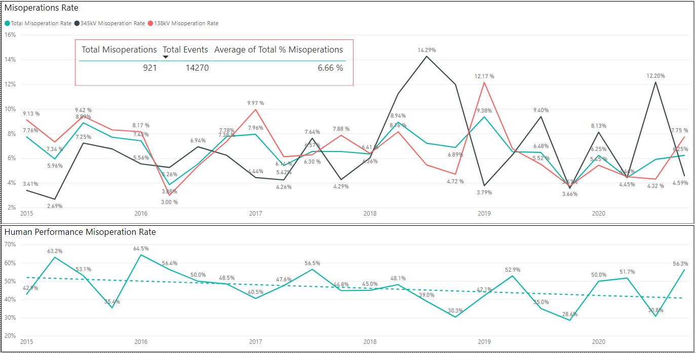
Protection System Misoperations: 2015-2020

Slide 5
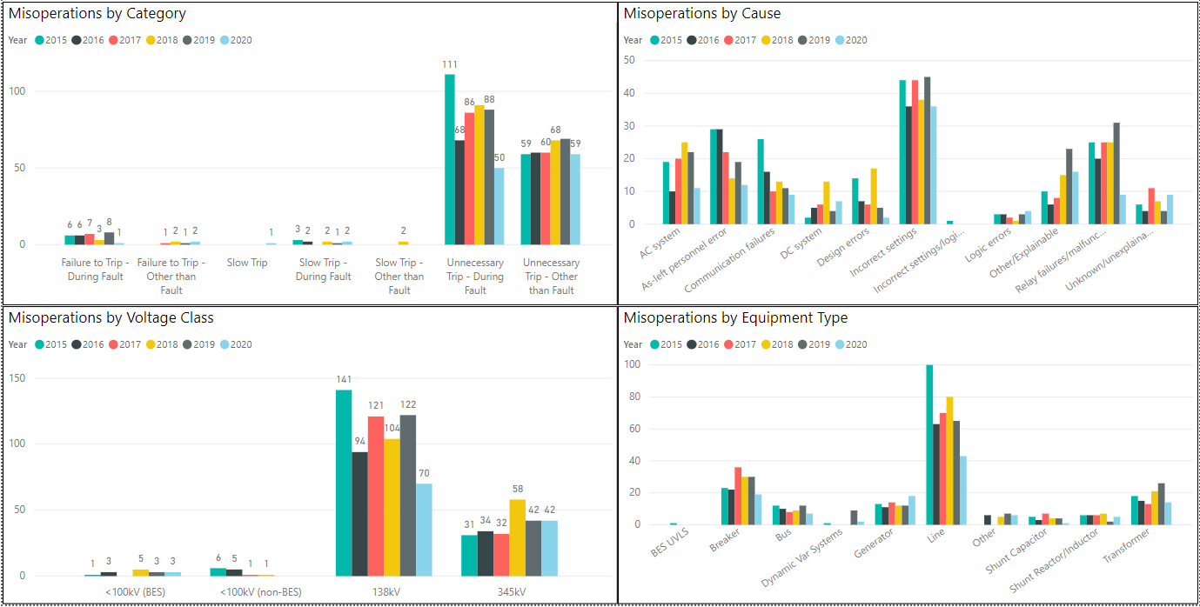
Protection System Misoperations: 2015-2020

Slide 6
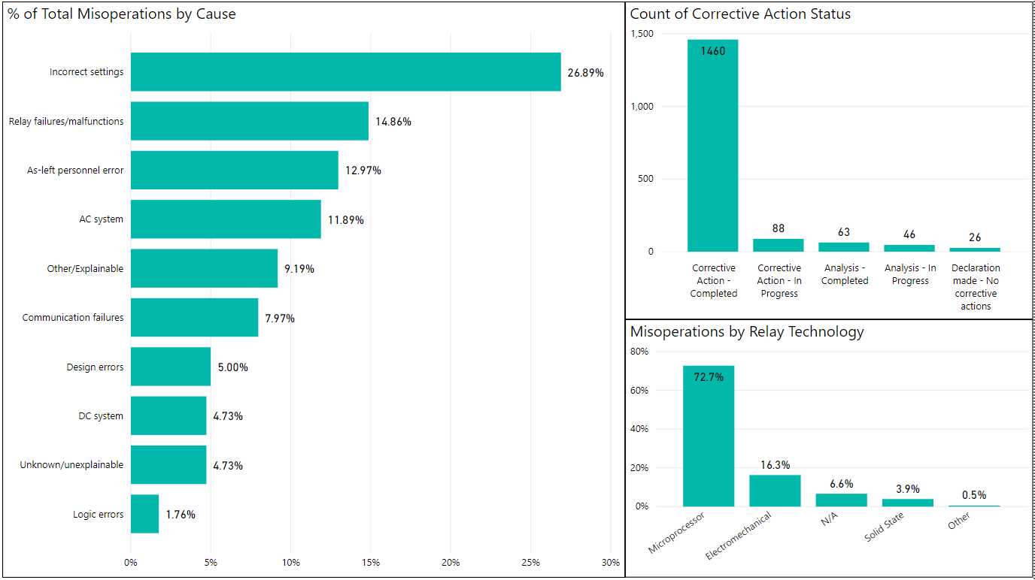
Protection System Misoperations: 2015-2020

Slide 7
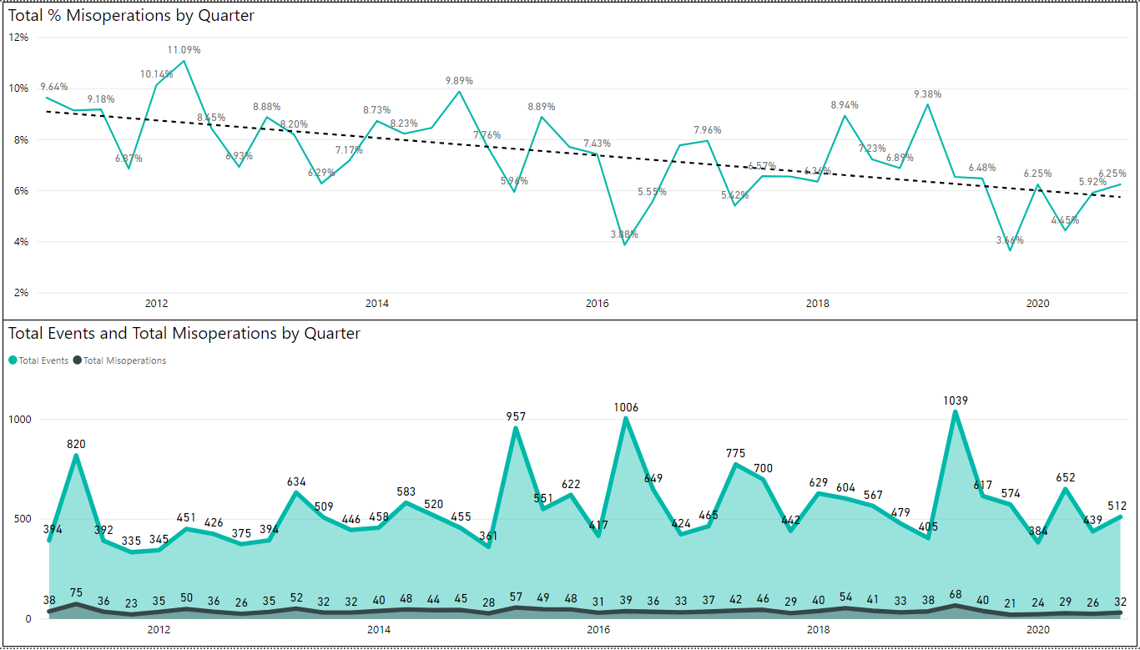
Protection System Misoperations: 2012-2020

Slide 8
Protection System Misoperations – 2020
 |  | Q4 | 2020
# of Misoperations | Total | 32 | 115
 | 345 kV | 10 | 42
 | 138 kV | 21 | 70
 | < 100 kV | 1 | 3
By Category | Failure to Trip | 1 | 3
 | Slow Trip | 0 | 3
 | Unnecessary Trip during Fault | 20 | 50
 | Unnecessary Trip – Non Fault | 11 | 59
 | SPS | 0 | 0
By Relay System Type | Electromechanical | 0 | 5
 | Solid State | 2 | 4
 | Microprocessor | 25 | 87
 | Other/ N/A | 5 | 19
By Equipment Protected | Line | 15 | 43
 | Transformer | 3 | 14
 | Generator | 5 | 18
 | Shunt/Series Capacitor | 1 | 1
 | Shunt/Series Reactor | 1 | 5
 | Dynamic VAR system | 0 | 2
 | Bus | 2 | 7
 | Breaker | 4 | 19
 | Other | 1 | 6

Slide 10
Protection System Misoperations 2020 Q4
Summary of Human Performance Issues noted for 2020 Q4:
138kV breaker failure misoperated due to an incorrect logic setting
138kV line misoperated during a fault due to an incorrect undervoltage element setting
345kV line terminal misoperated due to an incorrect ground direction control setting
138kV line terminal misoperated due to incorrect settings. Settings were not updated after a new substation was cut-in on the line
345kV auto transformer tripped due to incorrect CT ratios
138kV line terminal misoperated due to incorrect ground distance settings
138kV line terminal misoperated due to incorrect CT wiring
Failure to Trip/Slow Trip Misoperations in 2020 Q4:
Generator breaker failed to trip due to a bad trip coil

Slide 11
Definitions
Protection System –
  Protective relays which respond to electrical quantities,
  Communications systems necessary for correct operation of protective functions
  Voltage and current sensing devices providing inputs to protective relays,
  Station dc supply associated with protective functions (including station batteries, battery chargers, and non-battery-based dc supply), and
  Control circuitry associated with protective functions through the trip coil(s) of the circuit breakers or other interrupting devices

Slide 12
Definitions
Composite Protection System - The total complement of Protection System(s) that function collectively to protect an Element. Backup protection provided by a different Element’s Protection System(s) is excluded.
Misoperation – The failure a Composite Protection System to operate as intended for protection purposes. Any of the following is a Misoperation:
  Failure to Trip – During Fault – A failure of a Composite Protection system to operate for a Fault condition for which it is designed.
  Failure to Trip – Other than Fault - A failure of a Composite Protection system to operate for a non-Fault condition for which it is designed, such as a power swing, undervoltage, overexcitation, or loss of excitation.

Slide 13
Definitions
Misoperation – The failure a Composite Protection System to operate as intended for protection purposes. Any of the following is a Misoperation:
  Slow Trip – During Fault – A Composite Protection system that is slower than required for a Fault condition if the duration of its operating time resulted in the operation of at least one other Element’s Composite Protection System.
  Slow Trip – Other than Fault - A Composite Protection system that is slower than required for a non-Fault condition, such as a power swing, undervoltage, overexcitation, or loss of excitation, if the duration of its operating time resulted in the operation of at least one other Element’s Composite Protection System.

Slide 14
Definitions
Misoperation – The failure a Composite Protection System to operate as intended for protection purposes. Any of the following is a Misoperation:
  Unnecessary Trip – During Fault – An unnecessary Composite Protection system operation for a Fault condition on another Element.
  Unnecessary Trip – Other than Fault - An unnecessary Composite Protection system operation for a non-Fault condition. A Composite Protection System operation that is caused by personnel during on-site maintenance, testing, inspection, construction, or commissioning activities is not a Misoperation.

Slide 15
Outreach to Generators
TRE provides misoperation data to SPWG during each meeting.
Trends are reviewed to detect any areas of concern that may warrant further discussion
Misoperations rates for GO’s continue to trend upwards while misoperation rates on the transmission system have declined.
SPWG requests input from ROS on potential methods for reaching out to GO’s to address the number of misoperations.

Slide 16
Transformer Impedance Clarifications (RRGRR028)
SPWG completed a workshop in August 2020 to discuss the impact of IBRs on ERCOT Grid Protection and review the results of an IBR survey that was sent out to SPWG members
One finding during the discussion was a need for improved transformer data in models, specifically three-winding transformer information.
John Karlik, on behalf of SPWG, submitted RRGRR028 and this was posted on December 23rd, 2020.
The RRGRR proposed changes and additions to the Resource Registration Glossary to increase data transparency and improve the overall modeling process.

Slide 17
Transformer Impedance Clarifications (RRGRR028)
SPWG members met with Jay Teixeira in late January 2021 to discuss the proposed changes and solicit ERCOT feedback on the best approach
Additional changes to RRGRR028 were completed in early March 2021 in accordance with the ERCOT discussion in January and to account for baseline updates following the March 1st, 2021 incorporation of RRGRR027.
ERCOT to complete the Impact Analysis for RRGRR028 and submit for ROS review following this presentation.

Slide 18
End of SPWG Presentation
Next Meeting Scheduled for July 21st-22nd, 2021
ERCOT ROS Update will be Provided on August 5th, 2021
Thank You
Any Questions?

