Slide 1
NERC CIP-012-1 Update
Christine Hasha, Compliance
April 2021

Slide 2
CIP-012 - Communication between Control Centers (FERC Order)
R1. The Responsible Entity shall implement, except under CIP Exceptional Circumstances, one or more documented plan(s) to mitigate the risks posed by unauthorized disclosure and unauthorized modification of Real-time Assessment and Real-time monitoring data while being transmitted between any applicable Control Centers. The Responsible Entity is not required to include oral communications in its plan. The plan shall include: [Violation Risk Factor: Medium] [Time Horizon: Operations Planning]
1.1. Identification of security protection used to mitigate the risks posed by unauthorized disclosure and unauthorized modification of Real-time Assessment and Real-time monitoring data while being transmitted between Control Centers;
1.2. Identification of where the Responsible Entity applied security protection for transmitting Real-time Assessment and Real-time monitoring data between Control Centers; and
1.3. If the Control Centers are owned or operated by different Responsible Entities, identification of the responsibilities of each Responsible Entity for applying security protection to the transmission of Real-time Assessment and Real-time monitoring data between those Control Centers.

Slide 3
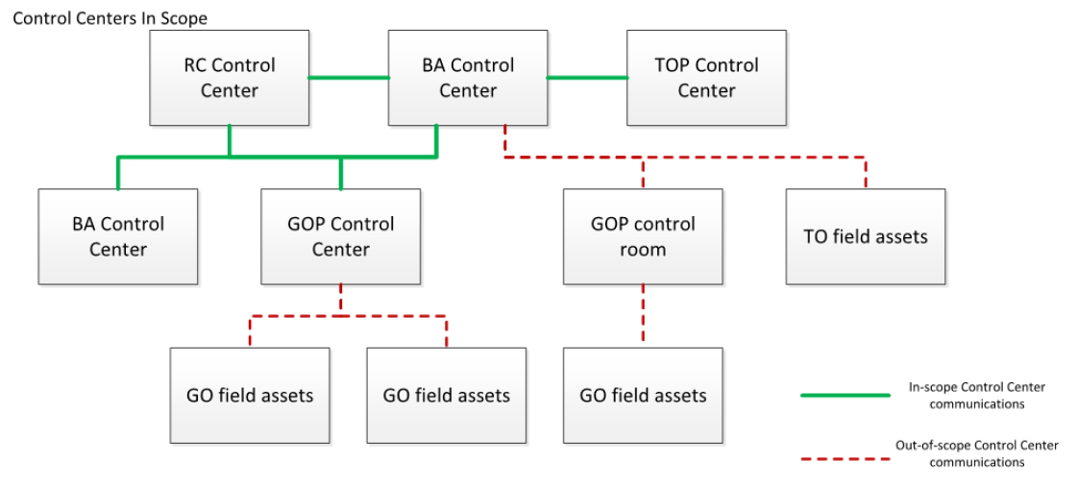
CIP-012-1 Scope

Slide 4
CIP-012-1 Implementation
Effective Date
7/1/2022
Significant Changes
Requires implementation of a plan to protect against unauthorized disclosure or modification of Real-time Assessment and Real-time monitoring data while being transmitted between any Control Center.
24 month implementation period.
Approved by FERC.
Initiatives
Limited to ICCP between ERCOT and Market Participants based on TOP-003 and IRO-010 data spec http://www.ercot.com/content/wcm/key_documents_lists/89338/NERC_IRO-010_and_TOP-003_Mapping_Document_V7.xlsx
New equipment being distributed under PR306-01 WAN Refresh—equipment includes VoIP and multi-point VPN capability.
Testing of WAN encryption in ERCOT test lab.
Testing with of WAN encryption with identified Market Participant volunteers.
Assumptions
Configurations will be consistent between ERCOT and Market Participants, regardless of NERC registration requirements.
Risks
Risk of data latency for ICCP telemetry due to use of encryption—expectation is that latency may be a few milliseconds at most.
More complex configurations to manage the encryption.
Lack of participation from Market Participants in scheduling and roll out of solution.
FERC has issued an order to increase scope of requirements.
Upcoming Readiness Milestones
Pilot in ERCOT test WAN.
Testing to Market Participant sites to obtain metrics on data latency.

Slide 5
CIP-012-1 Technical Rationale for Roles & Responsibilities
The requirements do not explicitly require formal agreements between Responsible Entities partnering for protection of applicable data. It is strongly recommended, however, that these partnering entities develop agreements, or use existing ones, to define responsibilities to ensure the security objective is met.
An example noted in FERC Order No. 822, paragraph 59 is, “if several registered entities have joint responsibility for a cryptographic key management system used between their respective Control Centers, they should have the prerogative to come to a consensus on which organization administers that particular key management system."

Slide 6
CIP-012-1 Considerations
Address roles and responsibilities in the WAN agreement (ERCOT Nodal Protocols Section 23 Form K) and Coordinated Functional Registration (CFR).
ERCOT’s role:
Management of WAN provider
Management of the encryption keys
Coordination of troubleshooting and maintenance
Physical security of WAN equipment located in ERCOT data centers
Market Participant’s role:
Physical security of WAN equipment located in MP data centers

Slide 7
CIP-012-1 Between Control Centers – In Scope

Slide 8
CIP-012-1 Between Control Centers – Out of Scope

