Slide 1
Day-Ahead Market (DAM) Performance Issue (DAM Delays)
(Follow-up from Jan 25th WMWG)
March 22nd, 2021 WMWG
ERCOT Staff

Slide 2
Overview
ERCOT presented at WMWG on January 25, 2021:
  Requested data was posted
  QSE vs CP counts shows increases
  PTP volume analysis resulted in 20% of CPs making up 83% of PTP intervals on average
  PTP analysis shows top 10 CPs make up 47% of PTP intervals on average
  Regression analysis shows strong correlation between PTP intervals and long-runtime.
  The average number of PTP intervals has doubled in the last 5 years.

Slide 3
Overview cont.
Market requests for March WMWG:
  CP affiliations check
  PTP sensitivity analysis
  Correlation analysis on awarded/un-awarded submissions versus DAM-run time
  Regression analysis with the number of constraints as the dependent variable

Slide 4
CP Affiliation
MPs suggested PTP limits be applied to CP affiliated entities (Holding Company)
ERCOT does not have a source table for CP affiliations
Our limited information shows the top 10 CPs have no affiliation, which means each CP with 1500 daily submission limit will still have up to 36,000 PTP interval submission opportunities

Slide 5
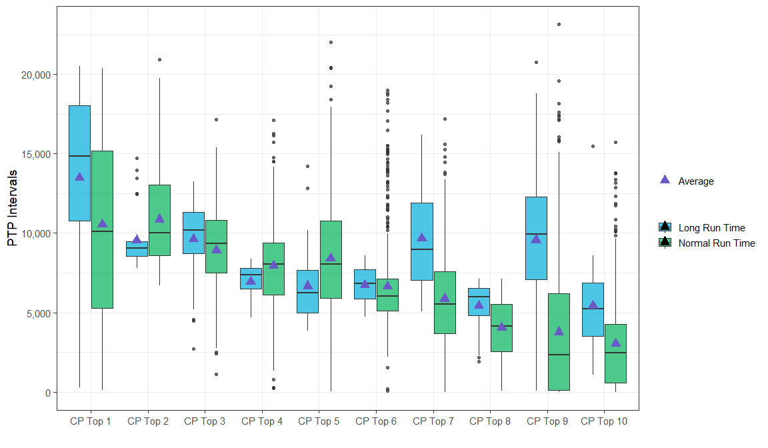
Comparison of PTP Submissions among Top 10 CP*
*Top 10 CP is determined by the median of daily PTP submissions.

Slide 6
PTP Sensitivity Studies
MPs requested studies with reduced PTP intervals
Four OD cases were selected with runtimes greater than 180 minutes, each study had 20% reduction of PTP intervals.
The results show an average runtime improvement ranging from 8% to 30%.
Operating Day | PTP int | PTP int-study | Performance Improvement
11/24/2020 | 208,512 | 166,815 | 16%
10/26/2020 | 173,686 | 138,949 | 27%
10/22/2020 | 200,282 | 160,225 | 8%
2/5/2020 | 170,592 | 136,474 | 30%

Slide 7
Regression Analysis
Explore the impact of awarded and un-awarded PTP Obligation Bids on DAM Run time
  Performed simple linear regression on 14 variables against DAM run time and ranked them based on model’s goodness of fit (R-squared)
    Comparison of R-squared for Awarded versus Non-awarded
    (i.e. Building a regression model using Awarded PTP quantity on DAM run time versus Building a regression model using Un-awarded PTP quantity on DAM run time)
  Comparison on awarded/un-awarded PTP percentage between normal days and long run time days.
Performed multiple regression analysis to assess the contributing factors to the number of constraints shown up in DAM

Slide 8
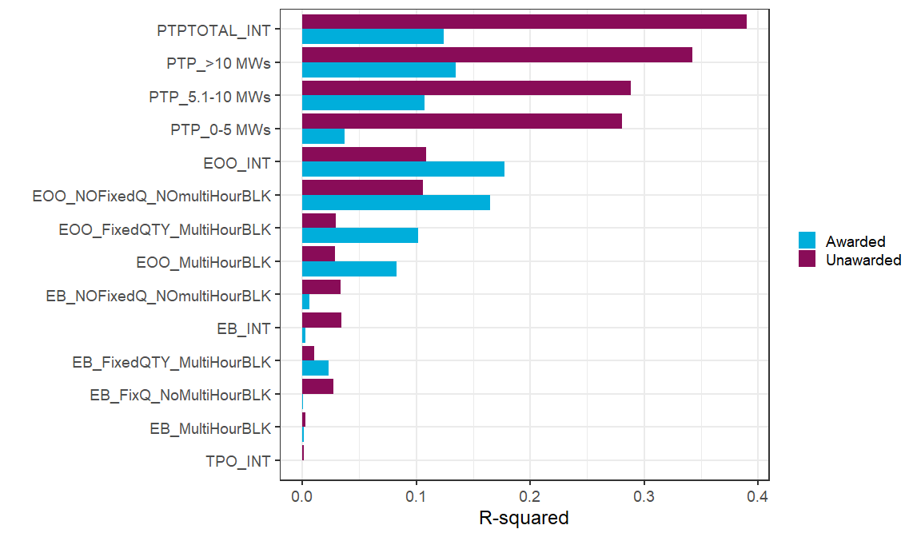
R squared Table (Simple Linear Regression)
  Un-awarded PTP Quantity has much higher correlation (on DAM Run Time) than Awarded PTP Quantity
  Un-awarded EOO Quantity seems to have slightly lower correlation (on DAM Run Time) then Awarded EOO Quantity

Slide 9
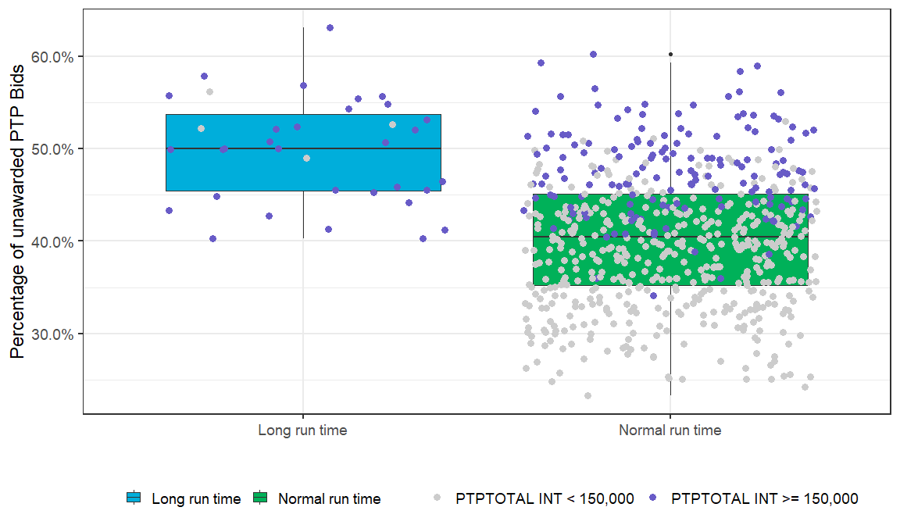
Comparison of Un-awarded and Awarded PTP Percentage
Median : 50.02 % or 87,481
Average: 49.76 % or 86,551
Median: 40.48 % or 55,641
Average: 40.25 % or 56,053

Slide 10
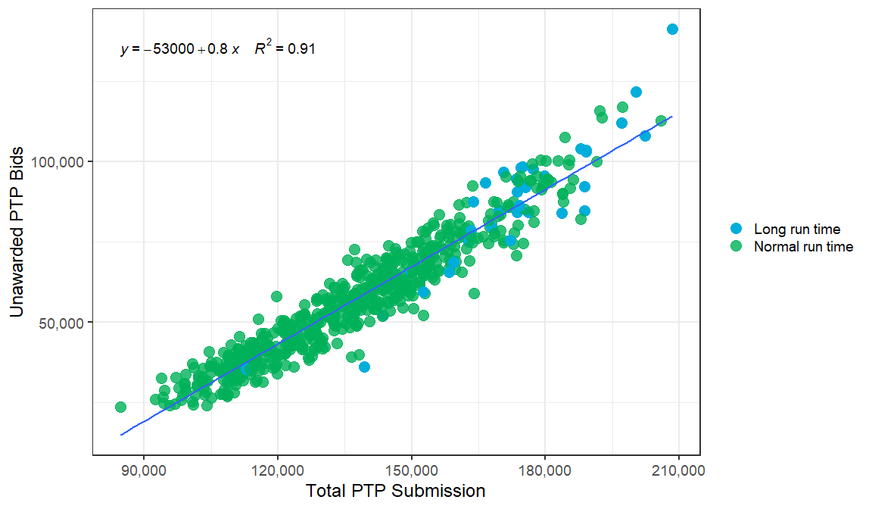
Higher PTP Submission correlates with higher un-awarded PTP Bids

Slide 11
Multiple Regression Analysis- Number of Constraints
 | Dependent Variable : Number of Constraint
Predictors | Estimates | 95 % Confidence Interval | p value
(Intercept) | 110 | - 41.91 ~ 261.91 | 0.156
PTPTOTAL_INT | 0.00427 | 0.0038 ~ 0.0047 | <0.001*
EOO_INT | -0.00654 | -0.0111 -0.0019 | 0.006*
TPO_INT | 0.0364 | 0.00897 0.0639 | 0.009*
EB_INT | 0.000916 | 0.00236 0.00419 | 0.583
Outages | 0.0209 | 0.0059 ~ 0.0358 | 0.006*
Observation | 636
Adjusted R squared | 0.455
*The effect of PTPTOTAL_INT, EOO_INT and TPO_INT and Outages on
Number of Constraints are found to be significant at 1% statistical significance level

Slide 12
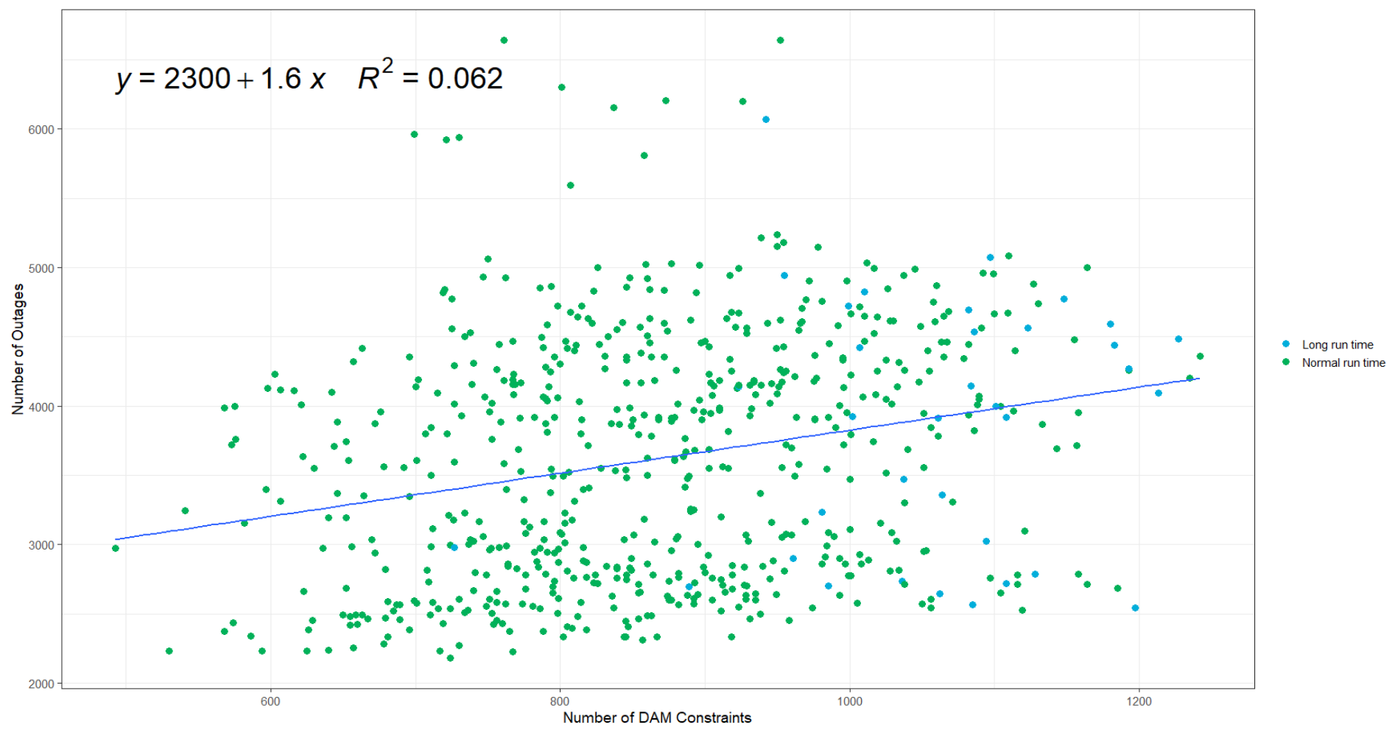
Outages vs. Number of Constraints
Mildly positive relationship between Outage Count and Number of Constraints is identified

Slide 13
Summary from Jan-25th WMWG meeting
Total PTP_Intervals, Total number of Constraints and Total Energy Only Offer (EOO) intervals appears to be the three most significant variables affecting the Total DAM Run time
  Of these three variables Total PTP Intervals is the most influential variable affecting Total DAM Run time, and
  Growing trend of Total PTP Intervals will exasperate the DAM performance issue
  Total number of Constraints is not an input to the DAM Optimization
  Total Number of Constraints appears to be highly correlated with the volume of total PTP intervals
Outages does not appear to be significant variable affecting the Total DAM Run time. There was some very small positive correlation between Outage Count and Number of Constraints
ERCOT at the January 6th WMS meeting had presented removing block bids as a way to reduce complexity and improve DAM Run time. The data does not show limiting block bids will be most effective in solving the performance problem.

Slide 14
Summary
The Top10 CPs are responsible for 47% of total PTP intervals submission
  The Top 10 CPs are not affiliated with other CPs
  Today we have daily CP limit of 1500 submissions which can translate to 36,000 PTP intervals submissions from a single CP
  Putting a daily submission limit at holding company level may not curtail the Top 10 CPs that are not affiliated
PTP Sensitivity analysis using four DAM ODs in 2020 with more than 170K PTP intervals showed that, 20% reduction in PTPs intervals reduces DAM runtime by 8% to 30%
Un-awarded PTP Quantity has much higher correlation to DAM Run Time than Awarded PTP Quantity

