Slide 1
Resource Integration Topics
Jay Teixeira
ERCOT
Resource Integration Working Group
March 17, 2021

Slide 2
Quarterly Stability Assessment (QSA)
Planning Guide 5.9
Next Deadline for QSA
If a GINR is not included in QSA, its Initial Synchronization date will be automatically delayed to the next quarter
All-Inclusive Generation Resource Initial Synchronization Date | Last Day for an IE to meet prerequisites as listed in paragraph (4) below | Completion of Quarterly Stability Assessment
Upcoming January, February, March | Prior August 1 | End of October
Upcoming April, May, June | Prior November 1 | End of January
Upcoming July, August, September | Prior February 1 | End of April
Upcoming October, November, December | Prior May 1 | End of July

Slide 3
Quarterly Stability Assessment (QSA)
Planning Guide 5.9, Quarterly Stability Assessment
Issue’s seen in previous QSA’s
  10 day comment period for FIS
    Needs to be complete before QSA deadline
    TSPs need to plan for it
  Dynamic Model Review
    Dependent on FIS Stability study
    Need to meet PG 6.9 15 to 30 days prior to QSA deadline
PSSE Model Quality Test Required
TSAT Model Required – If PSSE model is UDM, then TSAT model should be UDM by November 1, 2021
PSCAD Model Quality Test Required for May 1 QSA deadline

Slide 4
GINR Time Line (Fastest)

Slide 5
Self-Limiting Facilities and DC-Coupled Resources in the INR Process
NPRR1026, PGRR081, NPRR1029 and RRGRR023 related to Self-Limiting Facilities and DC-Coupled Resources approved by BOD on 12/8/2020. Implementation to take 7 to 10 months.
NPRR1029 will not be implemented until Passport around 2024. System changes for NPRR1026 not expected until 2023.
Too early for DC-Coupled resources to submit INR requests.
DC-Coupled will be tracked separately, but will be treated as SLF.
SLF Facilities in the INR process must have PLD after January 1, 2023.
If system changes delayed, part of the SLF may be allowed to proceed to PLD prior to 2023 if configuration and MW output was specifically studied in FIS.

Slide 6
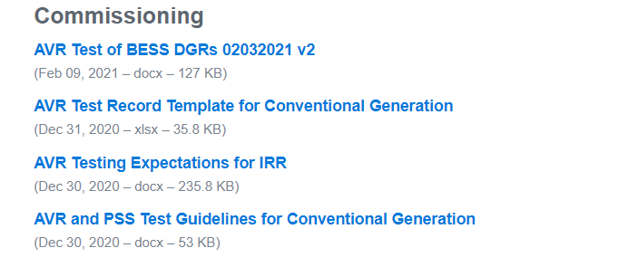
AVR Test for DGR

Slide 7
Active PGRR’s
RRGRR028, submitted by John Karlik on behalf of the SPWG on December 23, 2020, Transformer Impedance Clarifications. Comments submitted by SPWG and ERCOT. Tabled at ROS until next month.

Slide 8
Other contact information
ResourceIntegrationDepartment@ercot.com is distribution list for Resource Integration department
Mailing List
  RESOURCE_INTEGRATION@LISTS.ERCOT.COM

Slide 9

Questions?
Thank you!

