Slide 1
MarkeTrak and Inadvertent Gain Training

Slide 2
Antitrust Admonition
  To avoid raising concerns about antitrust liability, participants in ERCOT activities should refrain from proposing any action or measure that would exceed ERCOT’s authority under federal or state law. For additional information, stakeholders should consult the Statement of Position on Antitrust Issues for Members of ERCOT Committees, Subcommittees, and Working Groups, which is posted on the ERCOT website.¹

Slide 3

Housekeeping
Restrooms
Refreshments
Attendance sheet
Questions
  Please silence smart phones & other electronics

Slide 4
MarkeTrak Online Training
MarkeTrak online training is available on www.ercot.com and includes the following modules:
MarkeTrak Overview
Inadvertent Gain/Loss
Cancel With/Without Approval
Switch Hold Removal
Data Extract Variance (DEV) LSE Subtypes
Email Functionality
Usage/Billing Disputes
Additional Day to Day Subtypes
Bulk Insert
Admin Functionality
Data Extract Variance (DEV) Non-LSE Subtypes
Reporting
Modules typically can be completed in 30 minutes or less.

Slide 5
MarkeTrak Training Objectives
This training covers the following topics:
General MarkeTrak Navigation
Administrator Functionality
Email Notification
ListServ
Missing Enrollments
Usage & Billing
Switch Holds
Inadvertent Gains
  Rescission
  IAG Walkthrough
  Best Practices
  Reporting
Siebel Changes
DEV LSE/Non LSE
Bulk Insert
Additional D2D Subtypes
Other Subtype
Background Reporting

Slide 6

What is MarkeTrak?
A web-based database application used to track and manage ERCOT Retail Market data discrepancies
The ERCOT Retail Market Issue Resolution System used by CRs, TDSPs, and ERCOT to initiate, communicate, and resolve issues
Discovery, visibility, tracking, historical reporting, and status of issues
Available to ERCOT market participants with a current Digital Certificate and the MarkeTrak role

Slide 7
What is MarkeTrak?
There are two primary MarkeTrak issue types
Day to Day
( D2D )
Data Extract Variances
( DEVs )
An issue that can be resolved with a transaction
For example: syncing transaction status in ERCOT system with TDSP and CR systems (Completed to Cancelled)
An issue that cannot be resolved with a transaction
For example: inserting a Service History Row (for the 727 extract)
Represents 99% of MTs submitted
Represents 1% of MTs submitted

Slide 8
MarkeTrak Subtypes
There are several issue types including:
Market Rule volume due to Electricity Relief Program.
Usage/Billing – Missing & Missing Enrollment Transactions due to market participants system conversion.
Projects growth likely due to Meter Cycle Change requests.
Other activity could point to AMS/IDR activity notifications.

Slide 9
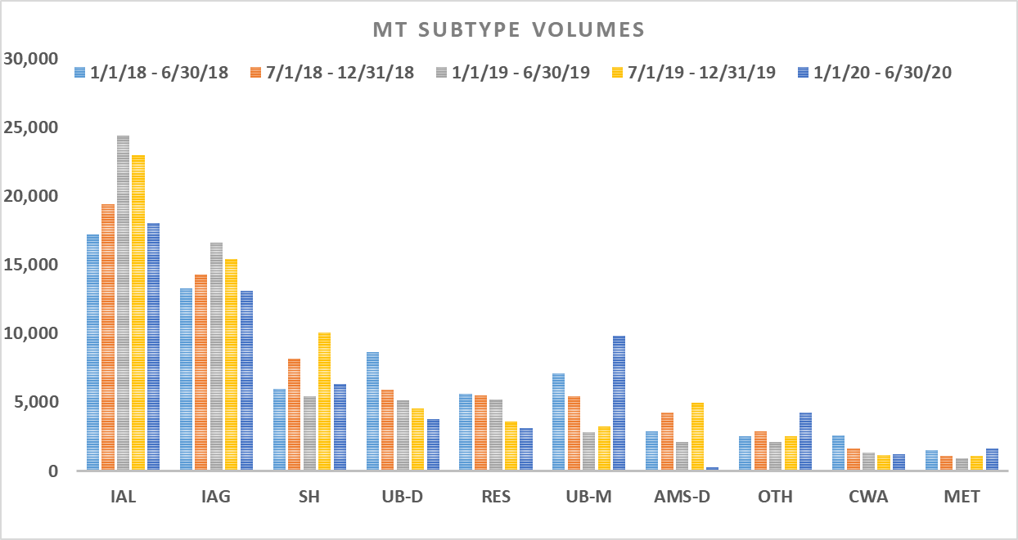
MarkeTrak Historical Volumes
Historically, IAGs/IALs and Rescissions have accounted for ~49% of overall MarkeTrak volume.
MarkeTrak volume trends point to market activity – impacts of COVID 19. .

Slide 10
MarkeTrak Training
General MarkeTrak Navigation

Slide 11
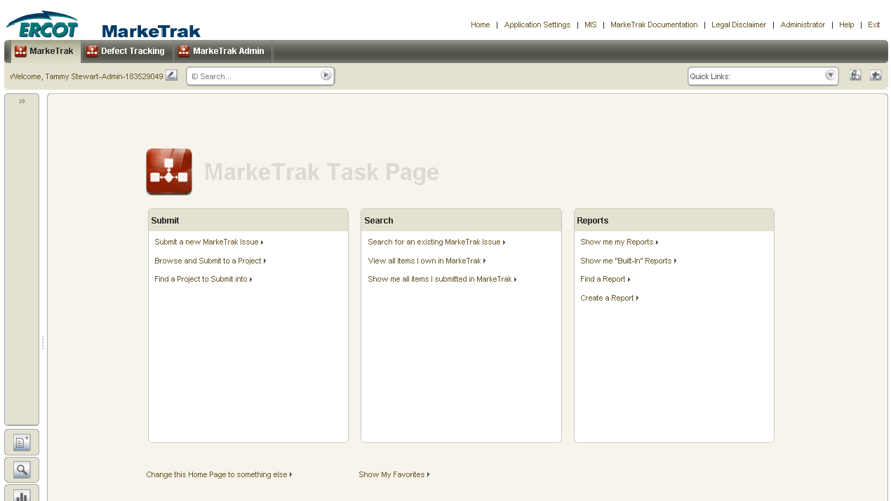
General Functionality: Navigating MarkeTrak
Launch Page
  Upon successful login, the user is initially taken to the MarkeTrak Task Page. The Task Page can be used as the starting point for each login or a specific Home Page Report can be selected as the default login page.

Slide 12
General Functionality: Navigating MarkeTrak
Setting a specific Home Page Report
  Select the link at the bottom of the Task Page to set a specific Home Page Report.

Slide 13
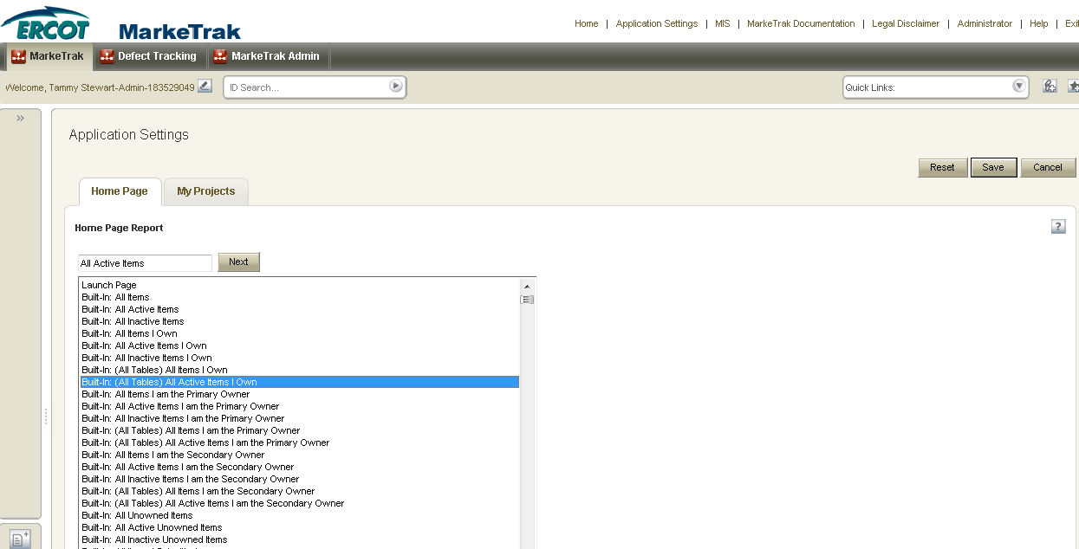
General Functionality: Navigating MarkeTrak
Select a report from the list displayed for your Home Page Report and click Save.

Slide 14
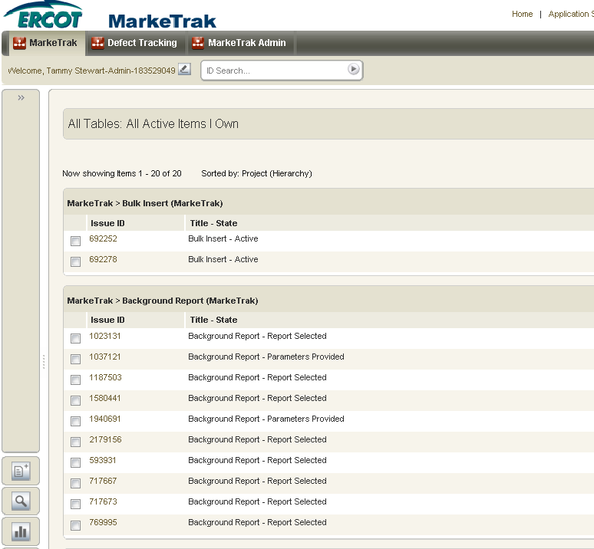
General Functionality: Navigating MarkeTrak
Home page now defaults to the selected report with each login.

Slide 15
General Functionality: Navigating MarkeTrak
MarkeTrak Tool Bar: The Home, Application Settings, MIS, MarkeTrak Documentation, Legal Disclaimer, Administrator, Help, and Exit links are available across the top of each window view in the MarkeTrak application.
  Home: This button returns the user to the Home Page Report.
  Application Settings: This link enables the user to select a Home Page Report and preferred projects for the application.
  MIS: This link will take you directly to the main page of the Market Information System website. From there, you can select the Reports and Extracts Index link which will take you to your reports and extracts.
  MarkeTrak Documentation: This link will take you to the MarkeTrak Information Page which contains several key documents such as the User Guide, Tips & Tricks document, bulk insert templates, etc.
  Legal Disclaimer: A quick link to the legal disclaimer relevant to the MarkeTrak application.
  Help: The help feature is an indexed and searchable resource with a thorough explanation of ‘out-of-the-box’ tool functionality. The purpose of this guide and appendix is to bridge the gap between the application and the ERCOT help documents
  Exit: This is the method to log out of the MarkeTrak tool.

Slide 16
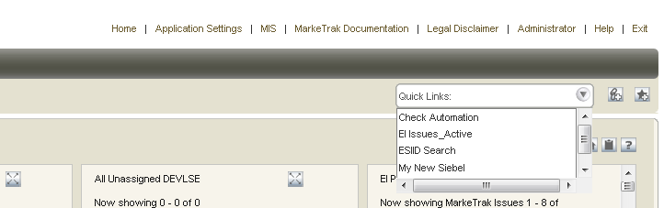
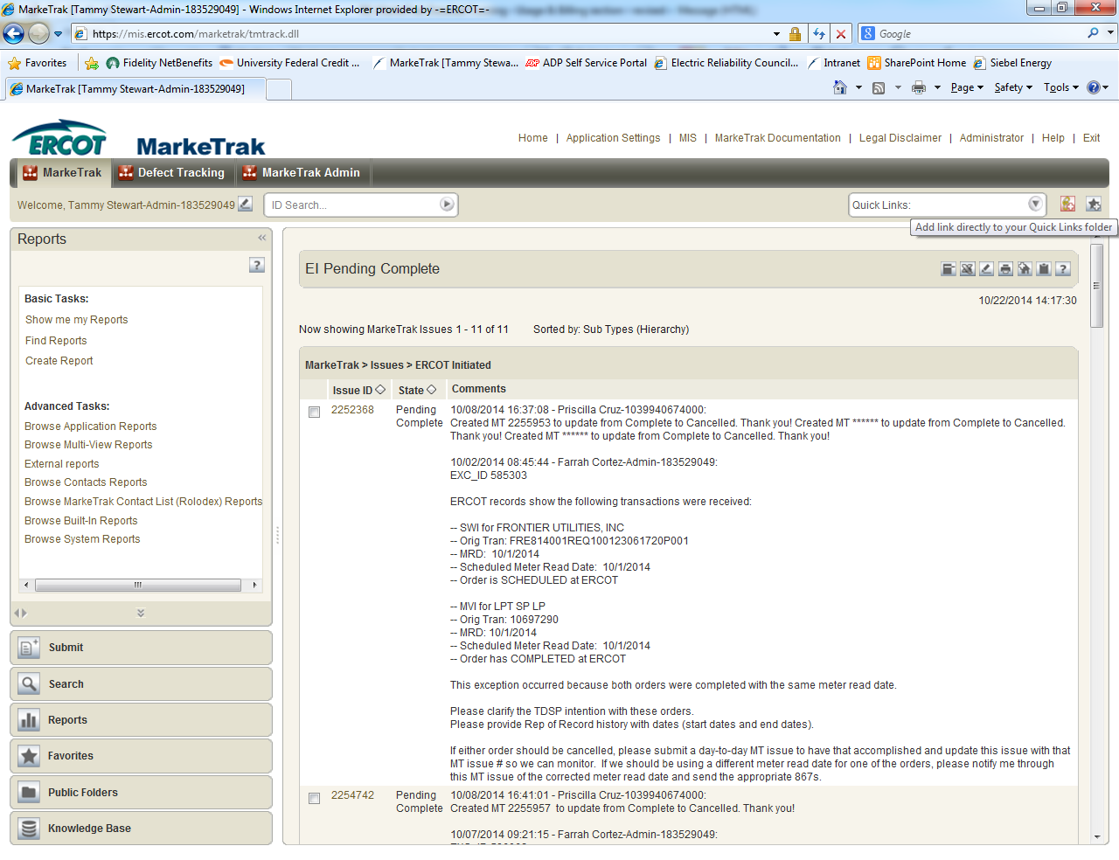
General Functionality: Navigating MarkeTrak
Quick Links: These are links updated to an individual user toolbar. This can include useful URLs such as ERCOT.com or common reports a user may wish to access in one click as demonstrated below:
To add a quick link:
  Navigate to the report, form, view, or page to which you want to create a link.
  Click the icon on the application toolbar. The Add to Quick Links dialog box opens.
  Type a name for the quick link. This name is used to label the quick link on the application toolbar and in the Favorites view. Click Save.

Slide 17
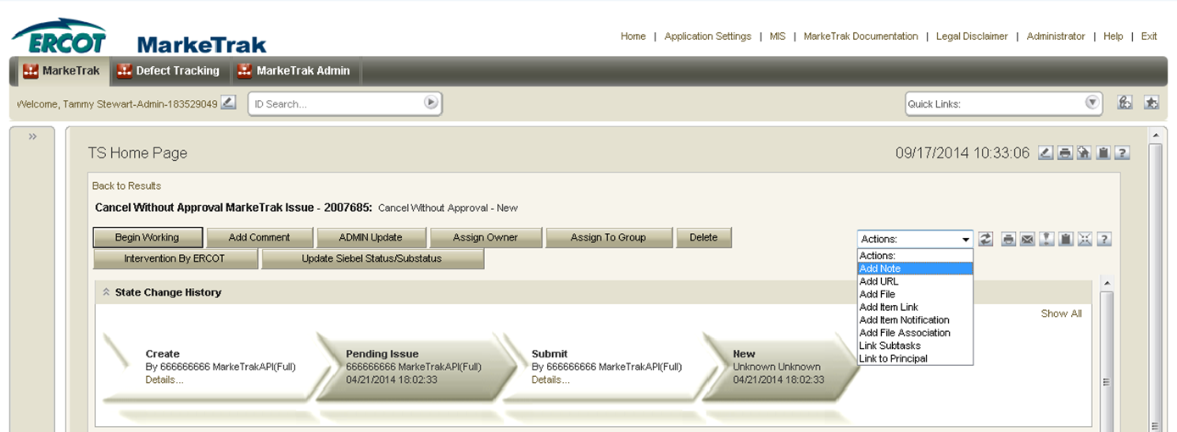
General Functionality: Navigating MarkeTrak
Actions dropdown: Available in the header of the issue details pane:
  Add Note: This allows the user to include a text message on the individual issue.
  Add URL: Creates a hyperlink on an individual issue to an external website.
  Add File: Allows the user to locate and attach an external file to an item which will be visible by all MPs Involved. This is not to be used to submit a file of ESI IDs to be researched on the issue.
  Add Item Link: This action gives the user the ability to create several different kinds of links to other issues within the MarkeTrak application. In order to successfully create these links, the current user must have visibility rights to both linked items.
  Add Item Notification: Selecting this action allows the user to choose one of five distinct item notifications. These differ from the system generated notifications in that they are selected individually on items by any user with visibility.

Slide 18
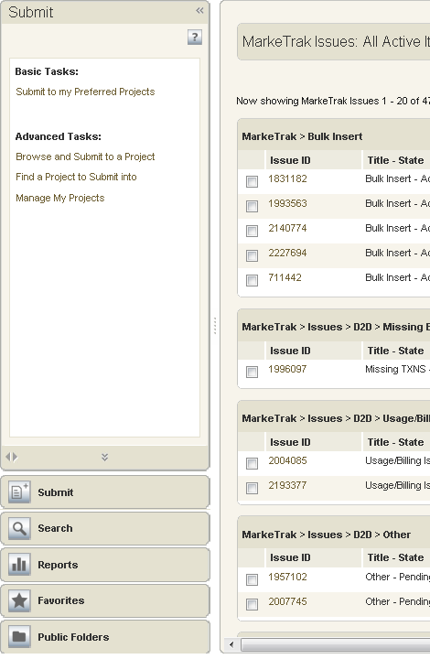
General Functionality: Navigating MarkeTrak
Navigation Pane: The navigation pane is available on the left side of the User Workspace. You can do the following in the navigation pane:
  Submit: The Submit view provides links to submit issue subtypes.
  Search: Provides links to the following search features in the MarkeTrak application.
  Reports: Provides links to reports the user has permissions to run, modify, or delete.
  Favorites: Favorites enable users to add links to frequently used features, items, and reports to folders that you create or that are provided by the system. Favorites can provide a personal view of items in the system; other users cannot view your favorites, nor can you view other users’ favorites.
  Public Folders: Displays links, reports, URLs, etc that can be viewed by all other MarkeTrak users unless specifically restricted by MarkeTrak Administrators.
Example

Slide 19
General Functionality: Navigating MarkeTrak
States and Transitions - All issues in the MarkeTrak tool are routed into one of several workflows based on the Type and Sub Type selected by the submitter. These Issue Type/Sub Types are: Day to Day Issues, Cancel with Approval, Cancel without Approval, and Inadvertent Gain related Sub Types as well as Data Extract Variance Issues- LSE Relationship.
States - A state is the position of an issue in the workflow process; this is often similar to the concept of an issue status combined with the issue’s current ‘owner’. Examples of this include: New (ERCOT), In Progress(Assignee), or Cancelled (Pending Complete).
Transitions - Transitions are the movement of an issue from one state to another. Available transitions are associated on the GUI with buttons. Selection of different buttons from the same state will typically result in the issue appearing in different states when the transition successfully completes. One example is a Day to Day Issue - Cancel with Approval currently in state In Progress with TDSP. If TDSP user selects transition button ERCOT Cancel, the item will move to state Auto Complete. Alternately if the TDSP user is unable to approve the cancel and selects transition button Unable to Cancel, the issue would appear in the submitting CR’s queue in state Unable to Cancel – (PC). Some transitions, such as Unable to Cancel, require additional steps to complete; in this case completion of a required field: Comments.

Slide 20
General Functionality: Navigating MarkeTrak
Issue Ownership: There are several varieties of ownership in the MarkeTrak application: Submitter, Responsible MP, MP’s Involved, and Assigned Owner.
  Submitter: The Submitter of the item is indicated near the top of each primary data pane on the issue details window. Submitter Duns number is also incorporated into the title of each issue and listed in the MPs Involved field discussed below.
  Responsible MP: Responsible MP is the single Duns number contained in the MPs Involved list that is considered to be the next participant responsible for transitioning the item towards a resolution. Examples include: the TDSP when an issue is waiting for approval to cancel a service order, ERCOT when the approval has been granted, and the CR when the cancel is complete and the issue is waiting for acceptance of the resolution.
  MP’s Involved: MP’s Involved is a list of all MP duns numbers which are party to an issue. As additional assignments are made to an item the MPs Involved field will be updated with the selected DUNs numbers, reflecting an increase in market participants with the ability to view the item. As ERCOT can always view any issue in the system, this will always be reflected in the MPs Involved list.
  Assigned Owner: Assigned Owner is null when an issue is initially assigned to a Market Participant. Assigned owners are individual users. These are assigned by the Responsible MP automatically as issue is acknowledged by way of transition, Begin Working. Taking this action will populate the associated individual’s user id as the Assigned Owner.

Slide 21
MarkeTrak Training
Admin Functionality

Slide 22
Admin Functionality: Roles & Responsibilities
The MP Administrator will be responsible for establishing and maintaining the users associated with their Market Participant organization. MP Administrators will only be able to establish or maintain users associated with their organization.
The MP Administrator will be responsible for maintaining the MarkeTrak Rolodex. This is the list owned by each MP Administrator which determines the destination of Notification Emails.
The MP Administrator will be responsible for maintaining the MarkeTrak Contacts List. This is the list owned by each MP Administrator which provides contact information for each MarkeTrak user for that company.
The MP Administrator will also be responsible for Report Management. – creating reports for use by multiple users registered under the same DUNS.

Slide 23
MarkeTrak Training
Email Notifications

Slide 24
Email Notifications
Automated Email Notifications
  An automated email generated by MarkeTrak’s Notification system is sent to each MP Administrator assigned contact nightly. Attached to the email is a list of issues that have exceeded the time allotted to complete the transition based upon the issue subtype.
  Examples of scenarios which trigger automated email notifications are:
      Issues that remain in a state of New for more than three calendar days
      Inadvertent Issues:
        Responsible MP Escalation: after 7 calendar days without transition
        ERCOT Escalation: 48 hours to update/transition the issue from the “New (ERCOT)” or “In Progress (ERCOT)” states
        Losing MP Escalation: The Regaining Transaction Status should be “Scheduled” or “Complete” within 72 hours of the “Regaining Transaction Submitted”
      All other D2D Sub Types without transition after 28 days

Slide 25
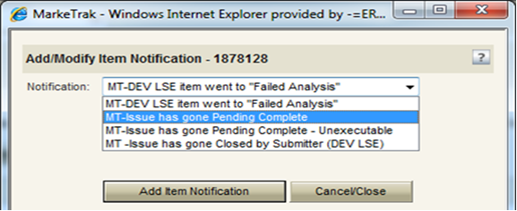
Email Notifications
Individual Email Notifications
  Each user with access to an item has the ability to manually select a notification related specifically to that individual issue. The email address entered in MarkeTrak for the user who selects this option from the Actions: drop down list will be the destination for this email notification.
Please Note: When notifications are established an email will be sent for every MT issue assigned to user.

Slide 26
MarkeTrak Training
ERCOT ListServ

Slide 27
ERCOT ListServ
To subscribe to an email distribution list on ERCOT ListServ, navigate to http://lists.ercot.com and create an account.
  Users will receive a confirmation email sent to the email address provided which will be used to log into the listserv application.
  Users will select the desired lists from the menu and click “submit”.
  Users will receive an email with a verification link requesting confirmation of subscription to each list selected.
  After clicking the link, the user will receive all subsequent emails sent to the selected list(s).
To unsubscribe to an email distribution list, users navigate to desired list and click “unsubscribe”.

Slide 28
Checkpoint Question
If a user no longer wants to receive notifications from the ListServ, what action should be taken?
Contact their ERCOT Account Manager
Reply to email requesting to be removed
Navigate to desired list and click unsubscribe
c. Navigate to desired list and click unsubscribe
Replying to the email will send the request to ALL subscribers and still will not remove you from notifications.

Slide 29
MarkeTrak Training
Missing Enrollment

Slide 30
D2D Issues: Missing Enrollment Transactions
Examples of missing enrollment transactions include a CR missing
  814’s
  867_04
  NOTE: The reprocessing of retail transactions by ERCOT is limited to one year from the original processing date. If the missing transaction is to be reprocessed, or dependent upon another transaction being reprocessed, the original transaction dates must be within one year of submission of the MarkeTrak issue.
Allow time for transaction processing to complete prior to submitting the MarkeTrak issue – especially new construction
A CR or TDSP can submit this subtype
Required Fields on Submit:
  Assignee
  ESI ID
  Original Tran ID
  Tran Type

Slide 31
MarkeTrak Training
Usage Billing Issues

Slide 32
D2D Issues: Usage Billing Subtypes
867/810s Usage & Billing
Missing – CR is missing 867_03, 867_03F, 810s
Dispute – CR has an issue with the data found on the 867and/or 810
AMS interval data/LSE files
Missing – No LSE file or interval data for a period of time
Dispute – CR has an issue with the interval data on the LSE file

Slide 33
D2D Issues: Usage Billing - Missing
Examples of Usage/Billing Issues – Missing:
If a CR is missing an 867_03 Monthly usage transaction
If a CR is missing an 867_03 Final usage transaction
If a CR is missing an 810 transaction
If a CR is missing an 867_03 and an 810 transaction
Allow time for transaction processing to complete prior to submitting the MarkeTrak issue.

Slide 34
D2D Issues: Usage Billing - Missing
Submitting a Usage/Billing – Missing Issue:
  The following fields must be populated for successful submission of Day to Day issue sub type Usage/Billing-Missing Issues: (For this example, the submitter selects the TDSP.)
    Assignee
    ESIID
    Original Tran ID (Optional except for 867_03 Final) - BGN02 of the 814_01, 814_16 or 814_24. The TDSP will see it as the BGN06 of the 814_03/814_25.
    Tran Type (select from drop down)
    TNX Date – same as the Service period start date (or is the current date)
    IDR/Non-IDR (IDR indicates true IDR meter, does not include AMS meters)
    Start Time = Service Period Start Date

Slide 35
D2D Issues: Usage Billing - Missing
Submitting a Usage/Billing – Missing Issue:
  The Comments field is optional. Please include any additional information in this box. New field added: Stop Time = Service Period Stop Date. Although optional it is encouraged to be populated. If left blank it will be assumed that the Stop date is the date up to the most current read date. The submitting MP will be validated as the ROR for the Start Time provided on the issue to prevent users from submitting invalid issues.
Comments are highly recommended!

Slide 36
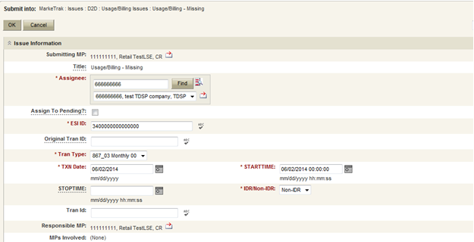
D2D Issues: Usage Billing - Missing
Submitting a Usage/Billing – Missing Issue (cont.):
TRAN TYPE:
867_03 F
867_03 Monthly 00- original
867_03 Monthly 01- cancel
867_03 Monthly 05- rebill
810_02 Monthly 00- original
810_02 Monthly 01- cancel
810_02 Monthly 05- replace
Select OK.

Slide 37
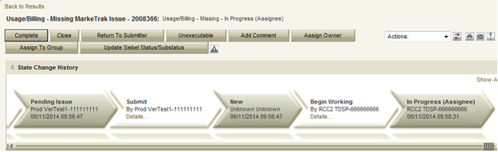
D2D Issues: Usage Billing - Missing
Submitting a Usage/Billing – Missing Issue (cont.)
  The issue enters TDSP queue in a state of New and is visible only by the Submitting CR and TDSP.
  The Submitting CR can Withdraw the issue at this point.
  The TDSP selects Begin Working and the issue is transitioned in a new state of In Progress-Assignee.
  At this point, the Submitting CR can no longer Withdraw the issue.
  TDSP reviews the issue and has the options:
    Unexecutable, which results in state Unexecutable- Pending Complete – requires comments
    Return to Submitter which requires comments and then the issue is transitioned back to the Submitter for additional information
    Complete which transitions to a state of Pending Complete. The Submitter has the option to close the issue by selecting Complete or the issue will be auto closed in 14 calendar days.

Slide 38
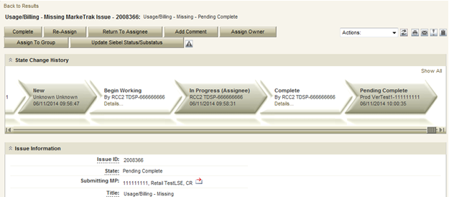
D2D Issues: Usage Billing - Missing
Submitting a Usage/Billing – Missing Issue (cont.)
  In this example the TDSP selects Complete, provides the required Tran ID of the missing transaction, and the issue is transitioned to the submitting CR in a state of Pending Complete. If the issue covers multiple service periods, information regarding those transactions should be provided in the comments.
  The Submitting CR has the option to close the issue by selecting Complete or the issue will be Auto Closed in 14 Calendar days.

Slide 39
D2D Issues: Usage Billing - Dispute
Examples of Usage/Billing Issues – Dispute:
  For use when a CR has an issue with any data found on an 867 or 810 which may pertain to one or more of the following examples:
    Consumption / Usage Data
    Bill Calculations – kW, kWh, power factor, meter multiplier
    Rate Issues – rate classifications/tariffs
    Discretionary Service Charge dispute
    Crossed Meter Situation
    Dispute of Estimated Bill
    Estimation Methodology

Slide 40
D2D Issues: Usage Billing - Dispute
Submitting a Usage/Billing – Dispute Issue:
The following fields must be populated for successful submission of Day to Day issue sub type Usage/Billing Issues: (For this example, the submitter selects the TDSP.)
  Assignee
  ESIID
  Original Tran ID (Optional except for 867_03 Final) - BGN02 of the 814_01, 814_16 or 814_24. The TDSP will see it as the BGN06 of the 814_03/814_25.
  Tran Type
  TXN Date
  Start Time - Service Period Start Date
  Dispute Category
    Priority Issue – defined as a subsequent MarkeTrak issue submitted/resubmitted due to initial MarkeTrak issue being auto closed without resolution or a follow-up MarkeTrak issue exceeding Market accepted SLA
    Consumption/Usage Issue
    Billing Calculations kWh
    Billing Calculations kW
    Billing Calculations Power Factor
    TDSP Charge Issue
    Rate Issue
    Crossed Meter Issues
    Non-Metered Issues
    Other – Comments Required
  Tran ID
  IDR/Non-IDR
Comments are highly recommended!

Slide 41
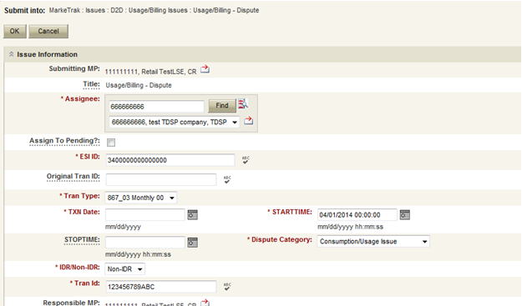
D2D Issues: Usage Billing - Dispute
Submitting a Usage/Billing – Dispute Issue (cont.):
NOTE: The Comments field is optional except when the Dispute Category is Other. Please include any additional information in this box. Stop Time = Service Period Stop Date. Although optional it is encouraged to be populated. If left blank it will be assumed that the Stop date is the date up to the most current read date. The submitting MP will be validated as the ROR for the Start Time provided on the issue to prevent users from submitting invalid issues.
Select OK.

Slide 42
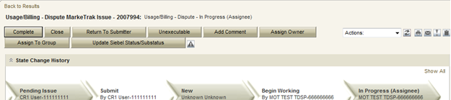
D2D Issues: Usage Billing - Dispute
Submitting a Usage/Billing – Dispute Issue (cont.):
The issue enters TDSP queue in a state of New and is visible only by the Submitting CR and TDSP.
The Submitting CR can Withdraw the issue at this point.
The TDSP selects Begin Working and the issue is transitioned in a new state of In Progress-Assignee.
At this point, the Submitting CR can no longer Withdraw the issue.
TDSP reviews the issue and has the options:
  Unexecutable, which results in state Unexecutable- Pending Complete – requires comments
  Return to Submitter which requires comments and then the issue is transitioned back to the Submitter for additional information
  Complete which transitions to a state of Pending Complete. The Submitter has the option to close the issue by selecting Complete or the issue will be auto closed in 14 calendar days.
In this example the TDSP selects Complete and the issue is transitioned to the submitting CR in a state of Pending Complete. The Submitting CR has the option to close the issue by selecting Complete or the issue will be Auto Closed in 14 Calendar days.

Slide 43
AMS LSE Interval Subtypes
AMS LSE Interval Subtypes are submitted for questions regarding AMS interval level data whereas questions regarding 867s or 810s are handled via Usage & Billing subtypes.
The Supplemental AMS Interval Data Extract is used as reference for AMS LSE Dispute subtype. The extract is posted daily to the ERCOT Market Information System (MIS) on ercot.com website.
Additional information about the extract can be found in the Supplemental AMS Interval Data Extract User Guide located on ERCOT.com.

Slide 44
AMS LSE Interval: Missing
Competitive Retailers (CRs) submit this Subtype when they discover an interval usage gap with the AMS LSE interval data from the TDSP.
Typically submitted requesting AMS data for one or more consecutive days of a service period. (Remember LSE files will have all 96 intervals completed for each day)
In order to submit this subtype, the following is required:
  The ESIID must have an AMS meter profile at ERCOT. (AMS Settlement Flag = true on Find ESI functionality)
  The CR must be the current Rep of Record for ALL usage days specified by the STARTIME and STOPTIME range.

Slide 45
AMS LSE Interval: Missing
How to submit this SubType?
From the MarkeTrak submit tree, under the D2D option:
  Select the Usage/Billing AMS LSE Interval Missing option.
  Enter the data for the required fields.

Slide 46
AMS LSE Interval: Missing
CR enters required information indicating STARTTIME and STOPTIME as formatted above for the missing period only and selects ‘OK’.

Slide 47
AMS LSE Interval: Missing
“Happy Path”
Requesting CR selects Missing under Usage/Billing AMS LSE Interval from the Submit Tree.
Requesting CR enters all required information and selects ‘OK’.
The issue is now in the state of ‘New’ with the TDSP as Responsible MP.
TDSP selects ‘Begin Working’.
The issue is now in a state of ‘In Progress (Assignee)’.

Slide 48
AMS LSE Interval: Missing
TDSP selects ‘Begin Working’ and then selects ‘Complete’ and enters optional Comments. TDSP selects ‘OK’.
NOTE: If CR is no longer ROR, SMT cannot be referenced and interval data should be attached to MarkeTrak.

Slide 49
AMS LSE Interval: Missing
“Happy Path” (cont.)
TDSP selects ‘Complete’, enters Comments (optional) and selects ‘OK’.
The issue is now in a state of ‘Pending Complete’ with the Submitting MP as the Responsible MP.
Submitting MP selects ‘Complete’ and the issue closes to ‘Complete’.

Slide 50
AMS LSE Interval: Missing
Submitting CR selects ‘Complete’ and the issue is closed to a state of ‘Complete.

Slide 51
AMS LSE Interval: Dispute
Competitive Retailers (CRs) submit this Subtype when they discover a discrepancy with the AMS LSE interval data from the TDSP.
Before submitting a Usage & Billing AMS LSE Dispute issue, the CR should allow 5 business days for transaction processing to complete.
In order to submit this subtype, the following is required:
  The ESIID must have an AMS meter profile at ERCOT.
  The usage data must be loaded in the ERCOT system and is identified by the unique identifier ‘UIDAMSINTERVAL’ from the Supplemental AMS Interval Data Extract. This code is retrieved and is a required field for this subtype.
Each issue should reflect the intervals from a single day or a consecutive period; a new issue should be created for each additional period.

Slide 52
AMS LSE Interval: Dispute
How to submit this SubType?
From the MarkeTrak submit tree, under the D2D section:
  Select the Usage/Billing AMS LSE Interval Dispute option.
  Enter the data for the required fields.

Slide 53
AMS LSE Interval: Dispute
Code retrieved from AMS Supplemental Extract for service interval in question or the last interval for the specific day or period in question. If past 30 days, enter the oldest date available
Comments are essential in efficiently and accurately processing the MT in a timely manner
STARTTIME = service period start time formatted as mm/dd/yyyy 00:00:00
STOPTIME = service period stop time (varies by TDSP)
mm/dd/yyyy 23:59:59

Slide 54
AMS LSE Interval: Dispute
“Happy Path”
Requesting CR selects Dispute under Usage/Billing AMS LSE Interval from the Submit Tree.
Requesting CR enters all required information and selects ‘OK’.
The issue is now in the state of ‘New’ with the TDSP as Responsible MP.
TDSP selects ‘Begin Working’.
The issue is now in a state of ‘In Progress (Assignee)’.

Slide 55
AMS LSE Interval: Dispute
TDSP selects ‘Begin Working’ and then selects ‘Complete’ and enters optional Comments. TDSP selects ‘OK’.

Slide 56
AMS LSE Interval: Dispute
“Happy Path” (cont.)
TDSP selects ‘Complete’, enters Comments (optional) and selects ‘OK’.
The issue is now in a state of ‘Pending Complete’ with the Submitting MP as the Responsible MP.
Submitting MP selects ‘Complete’ and the issue transitions to ‘Complete’.

Slide 57
AMS LSE Interval: Dispute
Submitting CR selects ‘Complete’ and the issue is closed to a state of ‘Complete.

Slide 58
Checkpoint Question
Which subtype should a CR submit if a customer is questioning the monthly consumption value they received on their monthly bill?
  Usage & Billing – Missing
  Usage & Billing – Dispute
  AMS LSE – Missing
  AMS LSE – Dispute
Usage & Billing – Dispute

Slide 59
Checkpoint Question
True or False
A CR should submit an AMS LSE – Dispute MarkeTrak as soon as they receive the 867_03 monthly from the TDSP.
FALSE

Slide 60
Checkpoint Question
True or False
When submitting any Usage & Billing MarkeTrak, if the STOP time is left blank it will be assumed it is the end of the 30 day period following the START time.
FALSE

Slide 61
Checkpoint Question
If a CR has submitted an 814_16 enrollment and has received an 814_05 and an 867_04, but has yet to receive the 867_03 (initial periodic), the CR should submit a ___________ MarkeTrak.
a) Missing Enrollment Transaction
b) Usage & Billing - Missing
c) AMS LSE - Missing
b) Usage & Billing - Missing
This is only after the scheduled meter read date has passed.

Slide 62

Questions

Slide 63
MarkeTrak Training
Switch Hold

Slide 64
Switch Hold
Purpose:
To ensure that the occupant responsible for the financial obligations at the premise satisfies and resolves any outstanding charges with the appropriate entities before switching to a new REP.
What it is:
According to PUCT Subst. Rule 25.126 & PUCT Subst. Rule 25.480, a Switch Hold can be placed on a premise by either a Retail Electric Provider (REP) for a Deferred Payment Plan (DPP) or by the Transmission and Distribution Service Provider (TDSP) due to Meter Tampering. The Switch Hold will remain in effect until the specified charges have been paid by the customer.
Types:
1) Deferred Payment Plan (DPP) – REP initiated
2) Tampering – TDSP initiated

Slide 65
Types of Switch Hold
Deferred Payment Plan (DPP) Switch Holds:
Initiated and removed by the REP of Record via 650_01 to TDSP.
Prevents customers from switching to another REP if they have outstanding charges with current REP of Record (ROR).
Current ROR must provide clear explanation (orally or written) to customer of the switch hold process before initiation of DPP Switch Hold.
Current ROR must receive customer’s agreement before initiation of DPP Switch Hold.
Switch Hold must be removed by ROR in a timely manner once all DPP obligations have been satisfied by the customer.

Slide 66
Types of Switch Hold
Tampering Switch Holds:
Initiated by the TDSP when Tampering is discovered at the premise.
TDSP must store evidence of Tampering discovery.
TDSP sends 814_20 to update ESIID status for Tampering.
TDSP sends Tampering charges on the 810_02 to ROR.
Switch Hold prevents customer from switching to another REP if they have outstanding Tampering charges with current ROR.
Switch Hold must be removed in a timely manner by current ROR via 650_01 once all outstanding Tampering charges are satisfied by the customer.

Slide 67
Switch Hold Removal for Purposes of a Move In
Scenario:
A Premise has a Switch Hold applied, however the customer vacates the premise. An entirely new customer tries to move in, yet encounters the Switch Hold on the Premise.
When this happens, the requesting REP cannot use a 650_01 to remove the Switch Hold, since they are not the initiators of the Switch Hold.
Instead, the requesting REP must follow the process outlined in Retail Market Guide Section 7.16.4.3 (for Tampering) or 7.17.4.3 (for DPP) associated with removal of a Switch Hold for purposes of a Move In.

Slide 68
Switch Hold Removal for Purposes of a Move In
How it works:
Using only one (1) MarkeTrak issue per ESI ID, the requesting CR must initiate the Switch Hold MarkeTrak (MT) issue type to begin the removal process.
The TDSP, current REP of Record, and requesting CR will collaborate to determine if the New Occupant is in any way associated with the Current Occupant who is subject to Switch Hold.
The requesting CR must provide supporting documentation for the New Occupant including a New Occupant Statement (NOS).
  Confirm a Switch Hold currently exists on the premise via MIS portal
  Ensure submitter is not ROR
  Documentation is valid and complete
If it is determined that the New Occupant is not associated with the Customer of Record (current occupant), the TDSP will remove any Switch Holds applied to the ESIID.
If an issue has been open for more than four (4) business hours without resolution, the TDSP will make the final decision as to whether or not the Switch Hold will remain.

Slide 69
Switch Hold Removal
What does it mean: Four (4) Business Hours?
MarkeTrak Switch Hold Removals are worked during Business Hours only (Monday-Friday, 8:00AM-5:00PM CPT)
Market Participant Timelines:
  TDSP “Initial” review: one (1) business hour
  Current REP of Record review: one and a half (1.5) business hours
  TDSP “Final” review: one and a half (1.5) business hours (or any remaining time within the four-hour period)
If issue remains unresolved at the end of a business day, the Responsible MP’s time will resume next business day at 8:00AM
  Example: REP of Record is assigned the issue at 4:00PM Friday. Business hours cease at 5:00PM Friday. Business hours resume 8:00AM Monday. REP of Record has until 8:30 AM Monday to respond, for a total of one and a half business hours as Responsible MP.

Slide 70
Switch Hold Removal Documentation
Standard Documentation Requirements
Per RMG 7.16 & 7.17, the Requesting CR must include the New Occupant Statement (RMG Appendix J2) AND one of the following:
Copy of a current signed lease;
Notarized Affidavit of Landlord (RMG Appendix J9);
Utility bill, in new occupant’s name, dated within last two months from a different Premise address;
Closing documents indicating transfer of ownership occurred subsequent to Switch Hold applied to Premise; or
Certificate of Occupancy
Ensure documentation is valid and complete prior to submitting a MarkeTrak Issue.

Slide 71
Switch Hold Removal Documentation
Standard Documentation “Best Practices”
TDSPs will review all supplied documentation for completeness. For quickest resolution, the documentation provided should include:
Current Signed Lease
  Customer name, service address, portion of lease signed by both landlord and tenant
  Dates on lease should align with Move In request
  Any expired agreements or agreement not signed by all parties will be rejected by TDSP
Utility bill
  Dated within last two months from a different Premise address and New Occupant’s name and service address should be visible
Closing Documents
  New Occupant’s name and service address should be visible
  Indicating transfer of ownership occurring after Switch Hold was applied
Affidavit of Landlord
  Notarized
  If form Appendix J9 is not used, the document must contain all data elements required within J9

Slide 72
Switch Hold Removal
Continuous Service Agreement (CSA) Documentation Requirements
For a premise where a CSA agreement is present, only the CSA form in Appendix J4/J5 is required. The New Occupant Statement does not need to accompany the CSA form, and it does not need to be notarized.
The Requesting CR must be the CSA provider, established via 814_18 CSA Add transaction.
If there is not an actual CSA, the Requesting CR must use the previously mentioned process.
  New Occupant Statement + documentation
  Example: Non-CSA vacant agreement

Slide 73
Switch Hold Removal
“Happy Path” #1 – All users agree and switch hold is removed
Requesting CR selects Switch Hold Removal from Submit Tree.
Requesting CR enters all required information, attaches all valid and necessary documentation and chooses the ‘Submit’ transition.
The issue is now in the state of ‘New (TDSP)’ with the TDSP as Responsible MP.
TDSP selects ‘Begin Working’.
The issue is now in a state of ‘In Progress (TDSP)’.

Slide 74
Switch Hold Removal
“Happy Path” #1 – All users agree and switch hold is removed (cont.)
TDSP selects ‘Send to REP of Record’.
  Enters DUNS/company name via dropdown.
The issue is now in a state of ‘New’ with the REP of Record as Responsible MP.
REP of Record selects ‘Begin Working’.
Issue is now in a state of ‘In Progress (Assignee)’.
REP of Record selects ‘Agree’.

Slide 75
Switch Hold Removal
“Happy Path” #1 – All users agree and switch hold is removed (cont.)
Issue is now in a state of ‘New (TDSP) - Final Review’ with the TDSP as Responsible MP.
TDSP selects ‘Begin Working’.
Issue is now in a state of ‘In Progress (TDSP)- Final Review’ with the TDSP as Responsible MP.
TDSP selects the ‘Switch Hold Removed’ transition.
Issue is now in a state of ‘Pending Complete’ with Requesting CR as Responsible MP.
Requesting CR selects ‘Complete’, and issue is closed.

Slide 76
Switch Hold Removal
CR enters required information and attaches file(s).

Slide 77
Switch Hold Removal
TDSP sends to REP of Record.

Slide 78
Switch Hold Removal
REP of Record DUNS is used by TDSP to assign issue.

Slide 79
Switch Hold Removal
REP of Record agrees to release switch hold.

Slide 80
Switch Hold Removal
TDSP confirms removal of switch hold.

Slide 81
Switch Hold Removal
Submitting (Requesting) CR selects ‘Complete’ and the issue is closed.

Slide 82
Alternate Resolution Paths
Step by Step walkthrough of the following paths is located after the checkpoint questions:
REP of Record disagrees; TDSP declines to remove hold
REP of Record disagrees; TDSP still removes hold.
TDSP rejects issue during first step as Responsible MP.
REP of Record does not choose “Begin Working”, exceeds time limit.
REP of Record selects ‘Begin Working’, exceeds time limit.
‘Time Limit Exceeded’ used before one and a half business hours.
Ultimately the TDSP determines if the Switch Hold will be removed.

Slide 83
Switch Hold Overview
References and General Overview of Switch Hold Process:
PUCT Rule References:
PUCT Subst. Rule 25.126, Adjustments due to Non-Compliant Meters and Meter Tampering in Areas where Customer Choice has been Introduced
PUCT Subst. Rule 25.480, Bill Payments and Adjustments
Retail Market Guide References:
7.16, Business Processes & Communications Related to Meter Tampering
  7.16.4.3, Removal of a Switch Hold for Meter Tampering for Purposes of a Move In
7.17, Business Processes & Communications Related for Switch Holds Related to Deferred Payment Plans
  7.17.3.3, Removal of a Switch Hold for Deferred Payment Plans for Purposes of a Move In

Slide 84
Checkpoint Question
How long does the REP of Record have to review the Switch Hold Removal request, once the TDSP assigns the issue to them?
  1 hour
  4 hours
  1 ½ hours
  6 Hours
  None of the Above
Answer:
C) 1 ½ hours

Slide 85
Checkpoint Question
The TDSP assigns a Switch Hold Removal MarkeTrak issue to the REP of Record on Friday, at 4:30 pm. When does the REP of Record's review period expire?
  Friday at 6:00pm
  Saturday at 9:00 am
  Sunday at 9:00 am
  Monday at 9:00 am
  None of the Above
Answer:
D) Monday at 9:00am

Slide 86
Checkpoint Question
Which of the following documents is not an “acceptable” document for Switch Hold Removal consideration?
Utility bill from a different address dated within the last two months
Notarized Affidavit of Landlord
Closing documents executed after the Switch Hold was applied
Cell phone bill
All of the above
Answer:
D) Cell phone bill

Slide 87
Questions

Slide 88
MarkeTrak Training
Inadvertent Gain/Loss (IAG) Overview

Slide 89
What is an IAG?
An Inadvertent Gain/Loss (IAG) is an unauthorized change of a customer’s
Retail Electric Provider
Commonly referred to as either an Inadvertent Gain (IAG) or Inadvertent Loss (IAL), an inadvertent situation occurs when a customer or a premise is changed to a REP that is different than their expected REP of choice.
When resolving IAG issues, the ultimate goal is to return the Customer to their REP of choice in a quick and efficient manner with minimal inconvenience to the Customer.

Slide 90
Gaining CR and Losing CR
The Gaining CR is a competitive retailer who inadvertently gains an ESI ID and is responsible for returning the customer to the previous REP of Record.
  When initiating the MarkeTrak process the Gaining CR shall submit the Inadvertent Gain subtype.
The Losing CR is a competitive retailer who was the REP of Record prior to losing an ESI ID due to an Inadvertent Gain situation.
  When initiating the MarkeTrak process the Losing CR shall submit the Inadvertent Loss subtype.

Slide 91
Reference Documents
PUCT Subst. Rule §25.495, Unauthorized Change of Retail Electric Provider
ERCOT Retail Market Guide Section 7.3, Inadvertent Gain Process
MarkeTrak User’s Guide, Section 2

Slide 92
How does an IAG occur?
An Inadvertent Gain or Loss can occur under various circumstances:
Incorrect information provided by the Customer during enrollment – service address, ESI ID, wrong apartment number.
Incorrect information entered by the REP during enrollment
Unauthorized enrollments – slamming
Variety of different enrollment processes used by REPs

Slide 93
Who does an IAG impact?
Customer
Gaining REP
ERCOT
Losing REP
TDU

Slide 94


How is the Market impacted?
Customer
  Confusion as to who is their REP
  Delayed Billing
  Possible Lights Out Situation
  Poor Customer Experience
Market
  Most used MT Subtype - represents over 49% of all MTs
  One of the longest MT issues to resolve
  It can create distrust and confusion in the Market
Cost
  Resource Commitments
  Consumption Write-offs
  IAG Fees from TDSPs

Slide 95
Questions

Slide 96
MarkeTrak Training
Customer Rescission Walkthrough

Slide 97
Right of Rescission
PUCT Subst. Rule 25.474(j) - Right of Rescission
A REP shall promptly provide the applicant with the terms of service document after the applicant has authorized the REP to provide service to the applicant and the authorization has been verified. For switch requests, the REP shall offer the applicant a right to rescind the terms of service without penalty or fee of any kind for a period of three federal business days after the applicant's receipt of the terms of service document. The provider may assume that any delivery of the terms of service document deposited first class with the United States Postal Service will be received by the applicant within three federal business days. Any REP receiving an untimely notice of rescission from the applicant shall inform the applicant that the applicant has a right to select another REP and may do so by contacting that REP. The REP shall also inform the applicant that the applicant will be responsible for charges from the REP for service provided until the applicant switches to another REP. The right of rescission is not applicable to an applicant requesting a move-in.

Slide 98
Right of Rescission
In other words …
Applicable to Switch requests only, not Move-Ins.
After receiving the Terms of Service, Customer is allowed three (3) federal business days to rescind without penalty or fees from the Gaining REP.
Ultimate goal is to return the Customer to their REP of choice quickly and efficiently with minimal inconvenience to the Customer.

Slide 99
Rescission vs. Inadvertent Switch
Strongly recommended that involved CRs share as much information as possible at the onset of issue creation to aid in resolution of Customer Rescission issue quickly and efficiently (e.g. Customer Name, Meter #, etc.)
Although Customer Rescission is part of the Inadvertent Switch ‘family’ within the MarkeTrak tool, resolution of a Customer Rescission does not follow the same criteria nor follow the same completion timeline.
If/when the customer requests rescission (within the 3 federal business day window), the ‘losing’ REP must promptly regain the Customer – no questions asked.
  The research and investigation normally pursued during resolution of an Inadvertent Switch is not utilized when resolving Customer Rescission.

Slide 100
Rescission vs. Inadvertent Switch
Handling of Fees/Charges Associated with IAG vs Rescission
(per TDSP tariff):
 | Customer Rescission | Inadvertent Gain/ Loss
Can CRs pass TDSP fees to customer? | No | Yes – TDSPs may charge Gaining CRs an IAG fee and/or pass-through charges. Gaining CRs may choose to pass these charges to the customer.
Can CRs pass kWh usage to customer? | No | Yes – because IAG reinstatement date can range from “DOL + 1” to “Date of MT submission +10”, Gaining CRs may choose to pass kWh charges (usage) to the customer.
Notes:
NEW SLIDE

Slide 101
Customer Rescission Guidelines
Only the Gaining CR may submit the rescission-based MarkeTrak
The issue must be submitted on or before the twenty-fifth (25th) calendar day following ERCOT’s established First Available Switch Date (FASD).
If a Customer Rescission issue has not been submitted within the specified timeframe above, the two CRs should work to resolve the issue through the IAG/IAL subtype.

Slide 102
Completion Timeline for Customer Rescission
Once a Customer Rescission MarkeTrak (MT) issue has been submitted, the Losing CR has two (2) business days to agree to the Customer Rescission MT issue.
Once the Transmission and/or Distribution Service Provider (TDSP) has updated the MT issue to “Ready to Receive”, the Losing CR has another two (2) business days to send a backdated 814_16, Move-In Request.

Slide 103
Rescission Walkthrough – Gaining CR
The Gaining CR selects the Submit tab.
From the Submit Tree, select Customer Rescission.
Note: The submitter should include any details (ex. customer name) in the comments section which may expedite resolution of the issue.

Slide 104
Rescission Walkthrough – Gaining CR
The following fields must be populated:
ESI ID
Original Tran ID
Comments (Recommended)

Slide 105
Rescission Walkthrough - Validations
ERCOT validates ESI ID, submission timeframe and valid originating transaction.
Upon passing validation, MarkeTrak issue is created and ERCOT updates the issue with the following information:
  Losing CR Name and Duns
  TDSP Name and Duns
  Gaining CR ROR = Y or N
  Gaining CR Start Date
  Regain Date – auto populated by ERCOT.
  (Gaining CR Start Date +1 calendar day)
MarkeTrak issue is assigned to the state of ‘New (Losing CR)’ with the Losing CR as the Responsible Party.
[Starts the 2 Business Day clock for Losing CR to Agree]
Losing CR user selects ‘Begin Working’.

Slide 106
Rescission Walkthrough – Losing CR
MarkeTrak issue is assigned to the state of ‘In Progress (Losing CR)’ with the Losing CR as the Responsible Party.
Losing CR selects ‘Send to TDSP’.
[Implies “Agreement” & ends the 2 Business Day clock]

Slide 107
Rescission Walkthrough – TDSP
Issue is in a state of ‘New (TDSP)’ with TDSP as Responsible MP.
TDSP selects ‘Begin Working’.
Issue is in a state of ‘In Progress (TDSP)’ with TDSP as Responsible MP.

Slide 108
Rescission Walkthrough - TDSP
TDSP selects ‘Ready to Receive’
[Starts the 2 Business Day clock for Losing CR to submit BDMVI]

Slide 109
Rescission Walkthrough – Losing CR
Issue is in a state of ‘New (Losing CR Submit)’ with the Losing CR as Responsible MP.
Losing CR selects ‘Begin Working’.
Issue is in a state of ‘In Progress (Submit Regaining)’ with the Losing CR as Responsible MP.

Slide 110
Rescission Walkthrough – Losing CR
Losing CR selects ‘Provide Regaining BGN02’.

Slide 111
Rescission Walkthrough – Losing CR
Losing CR populates all required information:
  Regaining Transaction Submit Date
  Regaining BGN 02

Slide 112
Rescission Walkthrough - Resolution
Issue is in a state of ‘Regaining Transaction Submitted (PC)’ with the Gaining (Submitting CR) as Responsible MP.
Once the regaining transaction (Backdated 814_16 MVI) has been successfully sent by (Losing/Original CR), Siebel will automatically:
  Check Regaining Transaction Siebel Status every 30 minutes using the BGN 02 from the new initiating transaction.
  Update the issue with the current Regaining Transaction Siebel Status.
The issue will move to a state of ‘Complete’ with the Submitting MP as the Responsible Party once the Regaining Transaction Siebel Status is Complete.
[Ends the 2 business day clock for the Losing CR]

Slide 113

Checkpoint Question #1
Who can submit a Rescission MarkeTrak?
  The Losing REP
  The Gaining REP
ANSWER
The Gaining REP – only the Gaining REP may initiate the Rescission process

Slide 114
Checkpoint Question #2
In order to efficiently process a Rescission MT, the customer name should be stated in the comments.
  True
  False
ANSWER
TRUE – providing any relevant information assists in the timely resolution of the MT

Slide 115
Checkpoint Question #3
A customer who has exercised their ‘right of rescission’ may receive fees from the Gaining REP.
  True
  False
ANSWER
FALSE – per PUC Subst. Rule 25.474(j), a customer has the right to rescind the terms of service without penalty or fee of any kind

Slide 116
Checkpoint Question #4
Once the Losing REP has agreed to the Rescission, they have _______ days to submit the BDMVI.
  10 days
  5 business days
  2 business days
  14 days
ANSWER
2 business days – once the TDSP has transitioned the MT to “Ready to Receive”

Slide 117
Questions

Slide 118
MarkeTrak Training
Inadvertent Gain (IAG) MarkeTrak Walkthrough

Slide 119
Inadvertent Gain
An inadvertent issue begins upon the discovery of an Inadvertent Gain or Move-In transaction submission.
Upon identification of an Inadvertent Gain, the CR will check the transaction status via the ERCOT MIS.
  If transaction Status is “In Review” or “Scheduled” with a ‘key date’ > 1 day and the Inadvertent CR is the submitting CR, then the CR will cancel their submitting transaction by submitting an 814_08 EDI cancel transaction.
  For “Completed” or “Scheduled” status where the ‘key date’ is the same day, or if the CR is not the submitter of the transaction, the CR will log a MarkeTrak Inadvertent issue.

Slide 120
Inadvertent Gain
CR’s will work together in a manner outlined in Section 7.2 of the Retail Market Guide (RMG) to determine appropriate resolution.
  CRs, both Losing and Gaining Reps, must investigate the matter and provide all necessary/relevant information – customer name, service address, meter number
If resolution requires a backdated move-in (BDMVI), the regain date should be Date of Loss + 1 (DOL+1) or at the latest 10 days from the date the MarkeTrak was submitted to avoid creating transaction business process exceptions at ERCOT and the TDSP.
  The Losing Rep shall submit the BDMVI 814_16 no later than 12 days after submittal of the MarkeTrak and shall be dated with the ‘proposed regain date’ as agreed in the MarkeTrak.

Slide 121
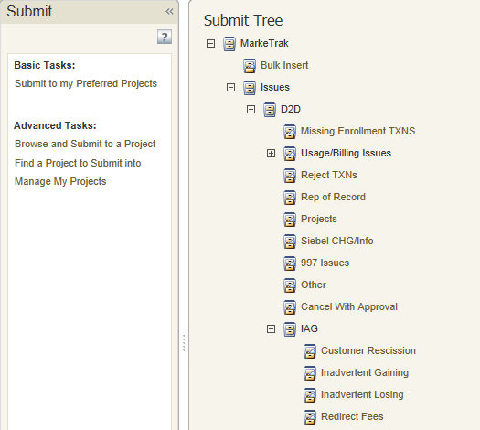
Inadvertent Gain
Submitting an Inadvertent Gain – CR Submits as the Gaining CR
From the Submit Tree, select IAG – Inadvertent Gaining

Slide 122
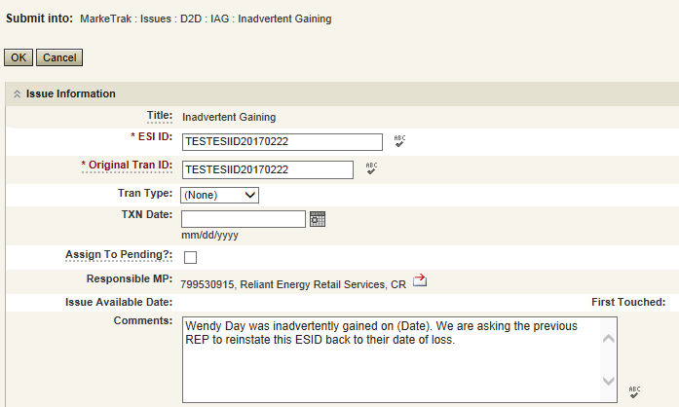
Inadvertent Gain
CR1 (Gaining/Original CR) will enter all required information.
  ESIID
  Original Tran ID – The original tran id of the other CR’s enrollment. (BGN06 of the 814_06).
  CRITICAL: The Comments field is technically optional; however, not providing the required information referenced in RMG Section 7.3.2(1) could result in a delay of issue resolution.
  Please include any additional information in this box.
        Customer Name (Always)
        Meter Number (If available)
        Any other pertinent information that will help expedite resolution

Slide 123
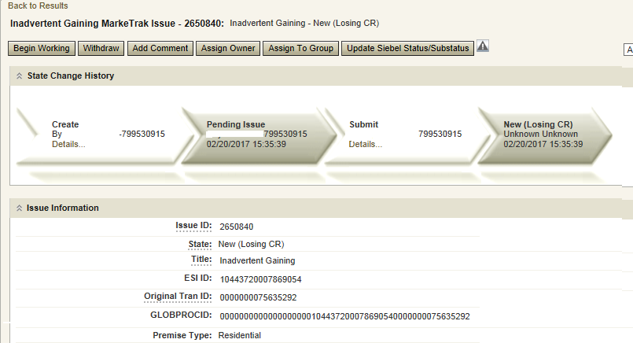
Inadvertent Gain
Select OK to create the IAG – Inadvertent Gaining MarkeTrak Issue. The issue enters the state of New (ERCOT) and is visible only by the Submitting CR and ERCOT.
The Submitting CR has the option to Withdraw the issue at this point
ERCOT will select Begin Working to provide the Gaining CR Start Date, if the Gaining CR is still the rep of record (Gaining CR ROR), assign CR2 (Gaining CR) and TDSP. ERCOT will then select “OK” to move the issue to CR2 (Gaining CR).

Slide 124
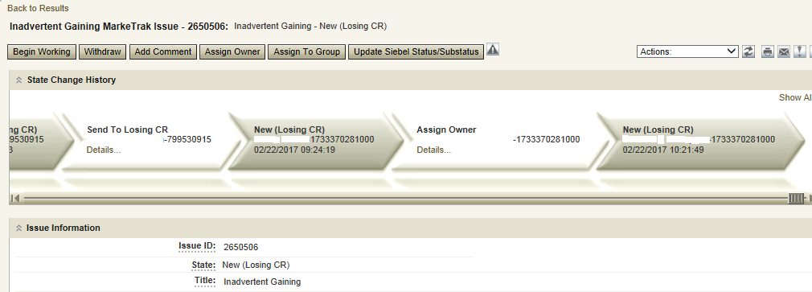
Inadvertent Gain
CR2 (Losing CR) will select Begin Working and Issue details and Investigate Market Conditions to determine the appropriate regain date.
CR2 (Losing CR) will select Begin Working and Issue details and Investigate Market Conditions to determine the appropriate regain date.

Slide 125
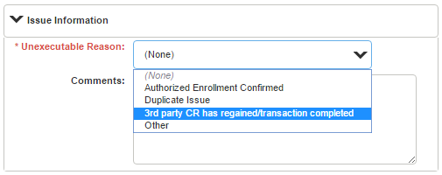
Inadvertent Gain
If CR2 (Losing/Original CR) determines that an Inadvertent Gain has NOT taken place, they have the option to select “Unexecutable” to stop the Inadvertent Gain process as outlined in Section 7.3.2.4 of the Retail Market Guide.
7.3.2.4 Valid Reject/Unexecutable Reasons
The Losing CR may reject the return of an inadvertently gained ESI ID from the Gaining CR for one of the following reasons only:
  A new transaction has completed in the market, including, but not limited to the following transactions:
    The 814_16, Move In Request; or
    The 814_01, Switch Request.
    Use “3rd Party CR has regained/transaction completed”

Slide 126
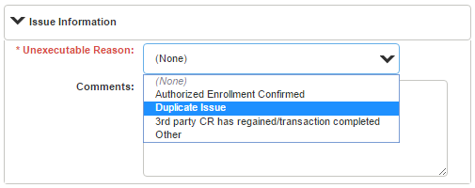
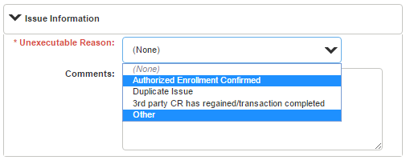
Inadvertent Gain
7.3.2.4 Valid Reject/Unexecutable Reasons
The Losing CR may reject the return of an inadvertently gained ESI ID from the Gaining CR for one of the following reasons only:
Duplicate Inadvertent Gaining issue in MarkeTrak for the same Customer on the same ESI ID.
Use “Duplicate Issue”
NOTE:
“Authorized Enrollment Confirmed”
and “Other” are not valid reasons for Losing REP to unexecute.

Slide 127
Invalid Reject Reasons
The Losing CR shall not reject the return of an inadvertently gained ESI ID due to:
Inability to contact the Customer;
Past due balances or credit history;
Customer no longer occupies the Premise in question;
Contract expiration or termination;
Pending TX SETs; or
Losing CR serving the Premise under a Continuous Service Agreement (CSA).
Located under RMG 7.3.2.5 Invalid Reject / Unexecutable Reasons

Slide 128

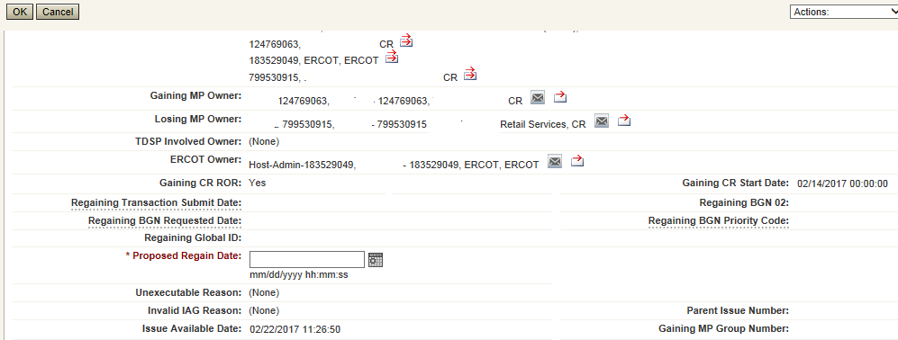
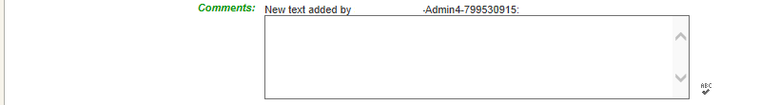
Inadvertent Gain
If CR2 (Losing/Original CR) determines they will need more information from CR1 (Gaining CR), then they will need to select Send to Gaining CR. This transition allows both CR’s to talk back and forth while transitioning the issue back and forth before a resolution is made.
If CR2 (Losing/Original CR) determines that an Inadvertent Gain has taken place, they will select Send to TDSP, enter the proposed regain date, add comments and select “OK” to move the issue to the TDSP. A validation will occur on the Proposed Regain Date: Validate that the date is less than “Submit Date” + 10 days. If not the following error message will be displayed “Proposed Regain Date is greater than 10 Calendar days from the submittal of MarkeTrak Issue, please update with valid Proposed Regain date.”

Slide 129
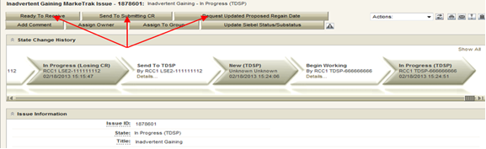
Inadvertent Gain
The TDSP will select Begin Working, investigate the issue details, then select one of the following:
Ready to Receive – The TDSP would select this transition to send the issue back to CR1 (Losing/Original CR). It is extremely important that CR1 (Losing/Original CR) wait for the TDSP to select Ready to Receive indicating TDSP’s systems have been prepared to receive the Original MP’s transaction before the EDI is actually sent. If not, the EDI will be rejected at the TDSP.
Send To Submitting CR – The TDSP would select this transition if they needed further information from CR1 (Losing/Original CR).
Request Updated Proposed Regain Date – The TDSP would select this transition if they do not agree with the proposed regain date that was provided. They would suggest a new date and send the issue back to CR1 (Losing/Original CR).

Slide 130

Inadvertent Gain
CR2 (Losing/Original CR) will select Begin Working then select Provide Regaining BGN 02. CR2 (Losing/Original CR) will provide the Regaining BGN02 and then select “OK”. When the regaining transactions process into ERCOT’s registration system, the Regaining Transaction Submit Date, Regaining BGN Requested Date and Regaining BGN Priority Code will be auto-populated on the MarkeTrak issue.
All parties should continue to monitor MIS and internal systems for the successful delivery and completion of the EDI transaction being sent by CR1 (Losing/Original CR) to the Market to regain a premise and resolve the associated Inadvertent Gain MarkeTrak issue.
Once the regaining transaction has been successfully sent to the Market by CR2 (Losing/Original CR), Siebel will update the status automatically.

Slide 131
Key Points to Remember
Provide as much information when opening Inadvertent Gain/Loss MarkeTrak in order to help facilitate quick resolution to the issue.
Suggested Information includes:
Customer Name (Always)
Meter Number (If available)
Any other pertinent information you may have that is crucial to help resolve issue.
Regain date should be:
Date of Loss (DOL) + 1
Date of Loss (DOL) less than or equal to 10 days from date MT was submitted when gaining on a prospective basis.

Slide 132
Losing REP VALID Reject / Unexecutable Reasons
RMG 7.3.2.4 Valid Reject / Unexecutable Reasons
The Losing CR may reject the return of an inadvertently gained ESI ID from the Gaining CR for one of the following reasons only:
  A new transaction has completed in the market, including, but not limited to the following transactions:
The 814_16, Move In Request; or
The 814_01, Switch Request.
Duplicate Inadvertent Gaining issue in MarkeTrak for the same Customer on the same ESI ID.

Slide 133
Gaining REP Valid Reject / Unexecutable Reasons
RMG 7.3.2.4 Valid Reject / Unexecutable Reasons
The Gaining CR may reject returning an inadvertently gained ESI ID to the Losing CR for one of the following reasons only:
A new transaction has completed in the market, including, but not limited to the following transactions:
The 814_16 transaction; or
The 814_01 transaction.
Duplicate Inadvertent Losing issue in MarkeTrak for the same Customer on the same ESI ID;
Gaining CR has confirmed with the Customer that the Customer’s CR of choice is the Gaining CR:
Gaining CR has a valid enrollment with the same Customer and provides the Customer name, service address and meter number (if available) in the comments section of the MarkeTrak issue.
Customer has successfully completed an enrollment regarding the same ESI ID and the Gaining CR has the most recent effective date; or
In cases of Customer rescission, Inadvertent Losing MarkeTrak issue is rejected/unexecuted and a Rescission MarkeTrak issue is created

Slide 134
INVALID Reject Reasons
RMG 7.3.2.5 Invalid Reject / Unexecutable Reasons
The Losing CR SHALL NOT reject the return of an inadvertently gained ESI ID due to:
Inability to contact the Customer;
Past due balances or credit history;
Customer no longer occupies the Premise in question;
Contract expiration or termination;
Pending TX SETs; or
Losing CR serving the Premise under a Continuous Service Agreement (CSA).

Slide 135
Checkpoint Question #1
If a Losing CR receives an IAG MT and their customer does not occupy the premise, the Losing CR should Unexecute the IAG.
  True
  False
ANSWER
FALSE – this is not a valid reject reason, the Losing CR should regain the ESI ID and execute the Current Occupant process

Slide 136
Checkpoint Question #2
If a Losing CR has agreed to regain an ESI ID yet their customer at the time of the IAG no longer occupies the premise, the Losing CR may propose the following regain date:
  DOL + 1
  Date of MT submittal + 10
  Either
ANSWER
Either is applicable and is dependent upon the Losing CR’s business practices

Slide 137
Checkpoint Question #3
A back dated MVI (BDMVI) for an IAG must be submitted within _____ days.
  2 days of “ready to receive” status
  Date of MT submittal + 10
  12 days of MT submittal
  21 days
ANSWER
Per the RMG 7.3.2.3.1 Reinstatement Date, the Losing REP shall submit the BDMVI no later than 12 days after submittal of the MarkeTrak.

Slide 138
Checkpoint Question #4
A customer enrolled for service at the wrong apartment number. Their REP of choice should issue a MVO on the incorrect address and issue a MVI on the correct address.
  True
  False
ANSWER
Generally speaking, FALSE, issuing a MVO on an active ESI will create a lights out situation at the incorrect address. An Inadvertent Gain MT should be submitted to resolve the incorrect address.

Slide 139
Questions

Slide 140
MarkeTrak Training
Common IAG Issues,
Best Practices, & Quick Tips

Slide 141
MVO vs IAG
Issue:
MVO’s are incorrectly being submitted for IAG situations
Solution:
CR’s MUST NOT issue MVOs for active ESI IDs when IAG situations occur and/or while the MarkeTrak IAG/IAL process is in progress.
Best Practices:
Ask probing questions to ensure proper customer action is taken. (i.e. “Do you currently live here?”; “Was the original address provided incorrect?”)
For an incorrect address, review ERCOT’s MIS to see if the MVI resulted in an 814_06 Loss Transaction being sent to a Losing REP. If so, issue an IAG MT.
Transaction Flow for Inadvertent Gain situation
            814_01 CR to ERCOT
            814_03 ERCOT to TDSP
            814_04 TDSP to ERCOT
            814_05 ERCOT to CR
            814_06 ERCOT to Losing CR
            867_04 TDSP to CR
            867_03F TDSP to Losing CR

Slide 142
3rd Party Transactions
Issue:
3rd party transaction has occurred, nullifying the IAG MarkeTrak therefore causing the Gaining CR to be left with charges they may not be able to recover.
Solution:
Utilize the applicable market approved process to regain a lost ESI ID via MarkeTrak. Educate the customer as to what the process entails and set proper expectations with the customer.
Best Practices:
Identify IAGs in progress for ESI IDs by:
Identifying IAGs on daily basis utilizing ERCOT MarkeTrak reporting or notification
Flagging within your own system the ESI IDs that have been IAG/IAL to ensure subsequent transactions are not submitted to the market until the IAG is completed.
Timely resolution of IAG/IAL MarkeTraks

Slide 143
Escalation for resolution of IAGs
Issue:
MTs and/or Escalated MTs are not receiving responses or being completed in a timely manner
Solution:
Market participants should maintain “rolodex” contacts and work escalations on a daily basis.
Best Practice:
Designate one of the escalation contacts as a departmental mailbox instead of an individual
Escalation Path Recommendations :
    First escalation: email via MarkeTrak to the assigned agent working the issue.
    Second escalation: email via MarkeTrak to primary and secondary contact in Rolodex.
    Third Escalation: include REP Relations/ERCOT Account Manager
    Allow 3-5 business days between escalations.

Slide 144
Expected Level of Performance
Issue:
Untimely resolution of IAG issues
Solution:
Adoption of timelines stated in Retail Market Guide
Best Practice:
REPs to develop internal SLAs to address MTs aligning with market’s expected level of performance
MT Submission DAY 0
Auto generated email sent if remains in “New” state for 3 days
Responses thereafter no longer than 7 days
BDMVI to be sent no later than 12 days from MT submission
Initial Response Due no later than 10 days
Complete resolution 21 days
RMG Section 7.3 Inadvertent Gain Process

Slide 145
No Current Occupant
Issue:
Losing REP responds to an IAG indicating:
“their customer no longer occupies the premise”
“no longer under contract”
“cannot reach the customer”
“Customer no longer wants us as REP of Record”
and attempts to ‘unexecute’ the IAG MT issue.
Solution:
These are NOT valid reasons for unexecuting MT (RMG 7.3.2.5 Invalid Reject/Unexecutable Reasons)
Best Practice:
Losing REP must regain ESI ID and initiate the Current Occupant process
          Reference: PUCT Subst. R. 25.489(i)

Slide 146
Switch Hold on IAG
Issue:
A switch hold is active on account which has been identified as having an IAG
Solution:
When IAG is submitted and accepted, the switch hold should be removed by the Gaining REP in order prevent BDMVI from being rejected and any delay in completing the MarkeTrak
Best Practice:
When working IAL/IAG issues identify if your ESI ID currently has an active Switch Hold and remove as needed
RMG Section 7.3.2.3 Resolution of Inadvertent Gains

Slide 147
Self-Service Portals (online enrollment/Multi-Family Portals)
Issue:
Customers use Self-Service portals to initiate MVI’s, Transfers of Service or MVOs
Solution:
Establish safeguards ensuring that customers who may have inadvertently selected an incorrect address do not cause a lights out situation.
Best Practice:
Limited functionality for transfers of service within XX amount of days.
Redirect the customer to contact call center in move out situations
Display FAQ’s regarding Inadvertent Switches

Slide 148
Linking IAL Issues with Customer Rescission
Issue:
Losing REP issues IAL MT prior to the Gaining REP being able to issue Customer Rescission MT
Solution:
Gaining REP should create Customer Rescission MT linking it to the Losing REP’s IAL MT.
Best Practice:
Rescission MarkeTrak should be created prior to executing the Losing REP’s IAL
Linking the MT’s together allows for quicker resolution and tracking
Unexecute Losing REP’s IAL MT as a duplicate issue.

Slide 149
Questions

Slide 150
MarkeTrak Training
IAG / IAL Reporting

Slide 151
Monthly IAG/IAL Reporting
What information is reported?
Monthly IAG/IAL Statistics
Top 10 Monthly – IAG/IAL
Top 10 – 12 Month Average IAG/IAL
  % of the aggregated totals for the last 12 months
Explanation of the IAG/IAL Stats
Top REPs – 12 Month Average Rescission
% of the aggregated totals for the last 12 months
Explanation of Rescission Stats
18 Month Running Market Totals

Slide 152
Monthly IAG / IAL Statistics
Total IAG+IAL % of Total Enrollments: 1.40%
IAG/IAL % Greater Than 1% of Enrollments
Total IAG+IAL Count: 3,547
IAG/IAL % Less Than 1% of Enrollments
Total IAG+IAL Count: 1,806
Retail Electric Provider Counts
 | Percent of Enrollments Resulting in IAG/IAL
Enrollment Total | .00% to .25% | .26% to .50% | .51% to .75% | .76% to 1.00%
<= 500 | 1 | 1 | 3 | 2
> 500 and <= 2500 | 4 | 4 | 6 | 3
> 2500 | 2 | 3 | 4 | 8
The above chart shows a count of REPs whose IAG/IAL percentage of their total enrollments is below 1%.
    Blue row shows counts of REPs that have less than 500 total enrollments by their % ranges
    Orange row shows counts of REPs that have between 500 and 2500 total enrollments by their % ranges
    Purple row shows counts of REPs that have greater than 2500 total enrollments by their % ranges

Slide 153
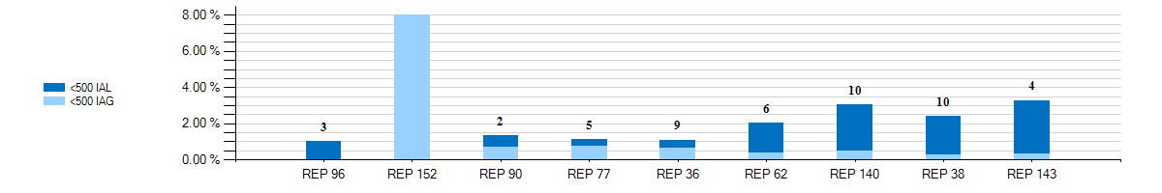
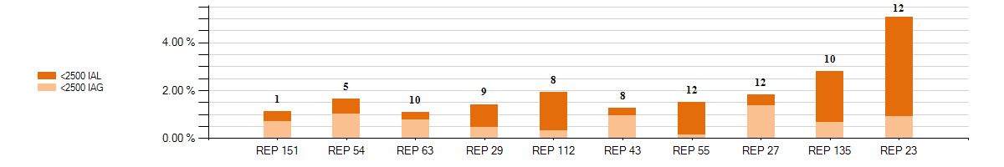
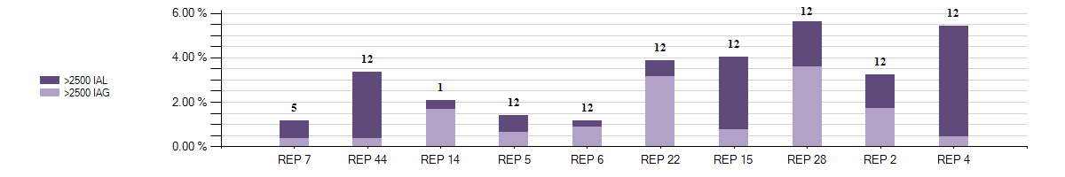
Monthly Top 10 – IAG / IAL Statistics
Top 10 – Monthly– IAG / IAL % Greater Than 1% of Enrollments With Number of Months Greater Than 1%
2
Retail Market Subcommittee

Slide 154
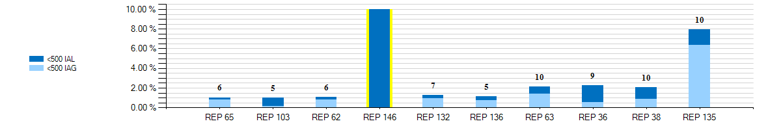
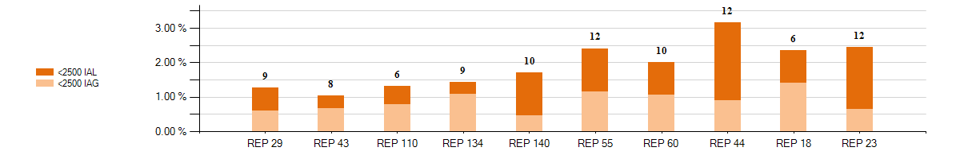
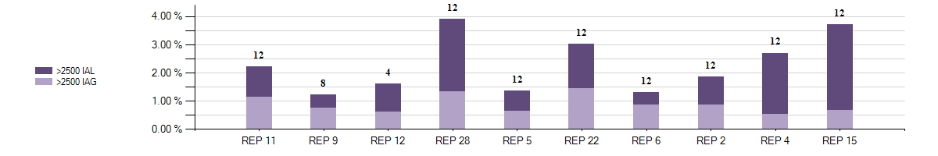
12 Month Average – IAG / IAL Statistics
Top 10 - 12 Month Average IAG / IAL % Greater Than 1% of Enrollments With Number of Months Greater Than 1%

Slide 155
Explanation of IAG / IAL Slides Data
Slide 198 charts show the top 10 REPs whose IAG/IAL percentage of their total enrollments is above 1%.
  The blue chart shows enrollment totals of less than 500 for the month being reported
  The orange chart shows enrollment totals between 500 and 2500 for the month being reported
  The purple charts show enrollment totals of over 2500 for the month being reported
  REPs with the lowest AG/IAL totals start on the left, and move to the highest counts on the right
Slide 199 charts show the top 10 REPs whose 12 month average IAG/IAL percentage of their total enrollments is above 1%.
  The blue chart shows enrollment total averages of less than 500 for the month being reported
  The orange chart shows enrollment total averages between 500 and 2500 for the month being reported
  The purple charts show enrollment total averages of over 2500 for the month being reported
  REPs with the lowest IAG/IAL averages start on the left, and move to the highest counts on the right
  Number labels represent the number of months the REP has been over 1% during the 12 month period

Slide 156
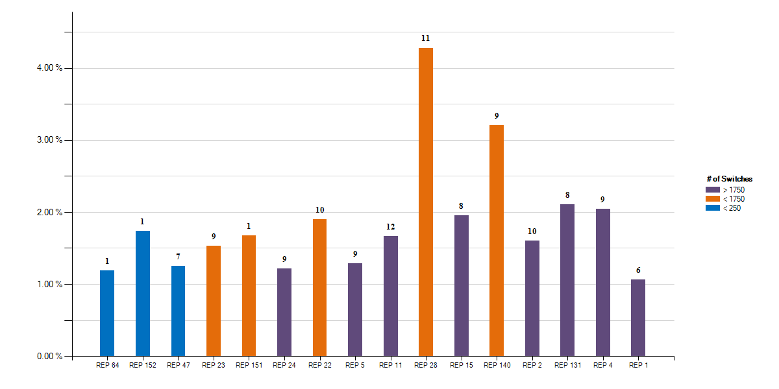
12 Month Average – Rescission Statistics
Top - 12 Month Average Rescission % Greater Than 1% of Switches With number of months Greater Than 1%

Slide 157
Explanation of Rescission Slide Data
NOTE:
A 10% chart range limit has been set. REPs data points that exceed 10% will be bordered in yellow. Please see the spreadsheet for actual percentages of these REPs.
Slide 201 charts show the top REPs whose 12 month average Rescission percentage of their total Switches is above 1%.
  The blue shades show switch totals of less than 250 for the month being reported
  The orange shades show switch totals between 250 and 1750 for the month being reported
  The purple shades show switch totals of over 1750 for the month being reported
  The REPs with the lowest count of rescission totals start on the left, and move to the highest counts on the right
  Number labels represent the number of months the REP has been over 1% during the 12 month period

Slide 158
18 Month Running Market Totals
 | Enrollments |  |  | IAG, IAL, Rescission |  |  |  |  | Days to Resolution
Month | SWI | MVI | Total | IAG | IAL | Rescission | IAG,IAL,Res Total | Overall % | IAG | IAL | Rescission
2019-07 | 142,418 | 288,116 | 430,534 | 2,559 | 2,903 | 587 | 6,049 | 1.40% | 15 | 17 | 11
2019-08 | 146,534 | 278,737 | 425,271 | 2,437 | 2,398 | 692 | 5,527 | 1.30% | 14 | 17 | 12
2019-09 | 104,974 | 257,060 | 362,034 | 2,071 | 2,143 | 453 | 4,667 | 1.29% | 14 | 16 | 11
2019-10 | 97,443 | 259,662 | 357,105 | 2,050 | 2,283 | 454 | 4,787 | 1.34% | 13 | 17 | 13
2019-11 | 69,866 | 210,793 | 280,659 | 1,834 | 2,129 | 397 | 4,360 | 1.55% | 15 | 18 | 14
2019-12 | 74,363 | 210,921 | 285,284 | 1,841 | 1,980 | 394 | 4,215 | 1.48% | 16 | 19 | 14
2020-01 | 78,720 | 227,645 | 306,365 | 1,980 | 2,165 | 531 | 4,676 | 1.53% | 13 | 16 | 11
2020-02 | 74,361 | 213,951 | 288,312 | 1,975 | 2,025 | 563 | 4,563 | 1.58% | 12 | 15 | 11
2020-03 | 88,857 | 217,657 | 306,514 | 1,707 | 1,779 | 575 | 4,061 | 1.32% | 12 | 14 | 10
2020-04 | 82,551 | 191,679 | 274,230 | 1,494 | 1,438 | 245 | 3,177 | 1.16% | 10 | 12 | 8
2020-05 | 99,776 | 208,903 | 308,679 | 1,549 | 1,358 | 335 | 3,242 | 1.05% | 10 | 13 | 8
2020-06 | 146,804 | 241,696 | 388,500 | 1,935 | 1,922 | 392 | 4,249 | 1.09% | 11 | 13 | 9
2020-07 | 109,354 | 267,239 | 376,593 | 1,962 | 2,151 | 600 | 4,713 | 1.25% | 11 | 13 | 9
2020-08 | 123,368 | 253,886 | 377,254 | 1,737 | 2,207 | 457 | 4,401 | 1.17% | 12 | 14 | 9
2020-09 | 81,951 | 239,448 | 321,399 | 1,571 | 2,331 | 392 | 4,294 | 1.34% | 11 | 13 | 7
2020-10 | 98,008 | 244,865 | 342,873 | 1,699 | 2,323 | 343 | 4,365 | 1.27% | 11 | 13 | 7
2020-11 | 144,773 | 215,114 | 359,887 | 1,457 | 1,934 | 288 | 3,679 | 1.02% | 13 | 16 | 11
2020-12 | 118,401 | 232,338 | 350,739 | 1,432 | 2,514 | 369 | 4,315 | 1.23% | 11 | 14 | 8

Slide 159
How can we drive efficiency? Reporting
Reporting to measure success … New format!!
Impact by REP
% of IAG/IALs to total enrollments by REP
Each REP is assigned a REP # - this # won’t change
Enrollments are MVIs+SWIs for IAG/IALs
For Rescissions, enrollments are SWIs only
IAG/IAL totals & % are calculated using the counts of the acknowledged Inadvertent Gaining REP only for both IAG & IAL issues.
If the Gaining REP in a submitted IAL issue does not agree to return the ESI to the Losing REP, that issue will not be counted
The Losing REP is not represented in any of the totals or % in any data
Two month lag in reporting to allow for IAG/IALs to be tied to enrollment transaction
MVI sent in November that resulted in an IAG MT submitted in December, will be reported on the % IAG/IAL total for November

Slide 160
Market Performance - Volumes
Overall % Change in IAS volume per enrollment:
2015 to 2016 = -6.62%
2016 to 2017 = -7.09%
2017 to 2018 = 5.38%
2018 to 2019 = 10.59%
2019 to 2020 = -17.7%

Slide 161
Market Performance - % of enrollments
 | Enrollments |  |  | IAG, IAL, Rescission
Year | SWI | MVI | Total | IAG | IAL | Rescission | IAG,IAL,Res Total | Overall %
2015 | 901,409 | 2,593,096 | 3,494,505 | 22,337 | 18,861 | 11,574 | 52,772 | 1.51%
2016 | 864,357 | 2,647,635 | 3,511,992 | 22,843 | 16,555 | 10,210 | 49,608 | 1.41%
2017 | 1,001,416 | 2,765,274 | 3,766,690 | 21,807 | 18,017 | 9,036 | 48,860 | 1.30%
2018 | 1,214,662 | 2,836,682 | 4,051,344 | 22,979 | 22,680 | 9,668 | 55,327 | 1.37%
2019 | 1,322,647 | 2,944,372 | 4,267,019 | 26,655 | 30,446 | 7,340 | 64,441 | 1.51%
2020 | 1,246,924 | 2,754,421 | 4,001,345 | 20,498 | 24,147 | 5,090 | 49,735 | 1.24%

Slide 162
Market Performance – Resolution Days
Valid IAG/IAL/RESC Issues by Close Date

Slide 163
Inadvertent Gain Process Timeline
TDTMS analyzed the results of over 44,000 IAGs/IALs from July 2019 to July 2020, breaking down time required for each transition to provide insight into opportunities for efficiency…

Slide 164
Inadvertent Gain Process Timeline – Data Analysis
Summary of the TDTMS analysis…
Over 50% of MTs are submitted within 7 days of the originating transaction
~50% of MTs are acknowledged same day they are submitted
94% of completed MTs – CRs reach an agreement within 7 days once opened
Appears some REPs have ‘hand-offs’ in sending BDMVIs
90% of IAGs are resolved in 21 days
80% of IALs are resolved in 21 days
CALL TO ACTION – REPs are encouraged to review their performance to identify any opportunities to streamline their process
Posted to main TDTMS meeting page are IAL Analysis 20201116 and IAG Analysis 20201116 providing the performance of each REP (listed by respective REP#)

Slide 165


Market Challenge
Together we can make it a …

Slide 166
Checkpoint Question #1
An Inadvertent Loss MT submitted by the Losing REP will count toward which REP’s % total?
  The Losing REP
  The Gaining REP
ANSWER
The Gaining REP – valid IAG & IAL MTs will only count toward the Gaining REP’s total

Slide 167
Checkpoint Question #2
The assigned REP’s # on the IAG report will change each month.
  True
  False
ANSWER
FALSE – Assigned REP #s will remain consistent for the market reporting

Slide 168
Checkpoint Question #3
Driving down the number IAGs / IALs / Rescissions in the market will result in which of the following:
  Fewer customer complaints
  Improved customer experience
  Addressing customer issues faster
  Fewer back-off resources
  All of the above
ANSWER
All of the above – If all REPs work to drive efficiencies in their processes, the market will benefit

Slide 169
Questions

Slide 170
MarkeTrak Training
Siebel Change

Slide 171
Siebel Change
Siebel is the ERCOT Registration System of Record that maintains ESI ID activity.
A Siebel change is used to correct order status for an ESI ID’s past activity.
CR or TDSP can submit this subtype.
TXSET transactions cannot be utilized for Siebel system changes.
Upon completion, a Siebel Change will align ERCOT’s Siebel system with the impacted Market Participant’s system.
The following fields are required to initiate a Siebel Change issue:
- Assignee
- ESI ID
- Original TranID
- Comments

Slide 172
Examples of Siebel Change/Info
Changing Service Order Status
  For out-of-sync scenarios when a transaction’s status is different on ERCOT MIS from the Market Participant’s systems.
  To inquire why a transaction was cancelled.
  To inquire why Siebel status is different than the status of the transaction(s) submitted by the TDSP.
  When changing Service Order Status from “Cancel” to “Complete” or vice versa.
Changing Start Time Discrepancies
  To inquire why an ESI ID is not in ERCOT’s system.
  When changing a start time of a Siebel service order.

Slide 173
MarkeTrak Training
Data Extract Variances (DEVs)

Slide 174
Data Extract Variance (DEV) Overview
Data Extract Variances (DEVs) are used to correct a “Service History Row” on the SCR727 ESI ID Service History & Usage Extract or ESI ID characteristics when corrections cannot be resolved with a TXSET transaction.
Two types of DEVs can be used when a discrepancy is identified:
  DEV LSE:
    Used to correct the MP's StartTime and/or StopTime for REP of Record (ROR) synchronization.
  DEV Non-LSE:
    Non-LSE DEVs are used to synchronize ESI ID characteristics, existence and/or usage data.

Slide 175
Checkpoint Question
Today is October 1st, what MarkeTrak subtype is used to correct service history rows for a REP of Record serving the ESI ID from August 1st – August 30th?
  Siebel Change
  DEV Non-LSE
  Inadvertent Gain
  DEV LSE
D) DEV LSE

Slide 176
Checkpoint Question
Today is October 1st, what MarkeTrak subtype is used to correct service history rows for a REP of Record serving the ESI ID from September 15th to today?
  Siebel Change
  DEV Non-LSE
  Inadvertent Gain
  DEV LSE
A) Siebel Change

Slide 177
MarkeTrak Training
Bulk Insert Process

Slide 178
Bulk Insert: Overview
MarkeTrak Bulk Insert functionality…
Allows for automated method of submitting multiple MarkeTrak issues of the same subtype
Uses a .CSV file containing data for each issue and is uploaded via the Bulk Insert workflow
Templates are available on ERCOT.com for each subtype’s .CSV file format. These contain the defined required field ordering for the specific issue type.

Slide 179
Bulk Insert: Validations
Two levels of validations are performed on this MT Subtype:
  Overall file format level validation is performed upon submission
  Business level validations on each row of data within .CSV file
    All validations will default to “off” unless otherwise flagged
    Any “blank” validation flag assumes validation is turned “off”
    If populated with “1” in the appropriate field, validation is “on”

Slide 180
Bulk Insert: File Format Validations
Performed on .CSV file by clicking “Attach and Validate”.
  Determine if correct # of columns were uploaded
  Comments will indicate # of rows that successfully uploaded (with correct # of columns) and # of rows not uploaded from .CSV file

Slide 181
Bulk Insert: Business Level Validations
Performed on required fields of template
Report posted to destination of choice: MarkeTrak attachment or MIS
Report includes the following five additional columns added at the end of each row, representing the following data:
  Success or Fail: “success” indicates successfully submitted via Bulk Insert and “fail” indicates issue was not submitted
  Error Code: if an issue fails, a code will populate in this field
  Error Message: field contains error message why the issue failed to submit
  Date/Time Stamp: contains date and time stamp of when the issue was submitted
  Issue ID: MarkeTrak issue ID for successfully submitted issues
Allow adequate time for processing individual issues. Average processing time is a few seconds per row.

Slide 182
Bulk Insert: .CSV File Validations
Validation | Populate “1” | Populate “0”
ESI ID Duplicate Check - validates ESID | Will not submit issue if duplicate issue exists containing the ESI ID for which submitter has access | Duplicate check overridden, issue will submit provided criteria is met
Global ID Duplicate Check – validates ESID and original Transaction ID | Will not submit issue if a duplicate issue is located in MarkeTrak system containing the ESI ID and original transaction for which submitter has access | Duplicate check overridden, issue will submit provided criteria is met
ESI ID Validation- must be enabled for Premise Type to return | Submit for validation of ESI ID against ERCOT registration system | Submit regardless if ESI ID is within ERCOT registration system
Evaluation Window Check – Global ID Validation must be enabled | Enables TRAN Type/Evaluation rules be applied for Cancel w/Approval issues | Ignores Evaluation rule and submits issue regardless of violation
Global ID Validation | Enables validation of Global ID against ERCOT registration system | Ignores validation of Global ID with ERCOT registration system
If Validation field is left blank, a “0” will automatically default and the check will not be performed.

Slide 183
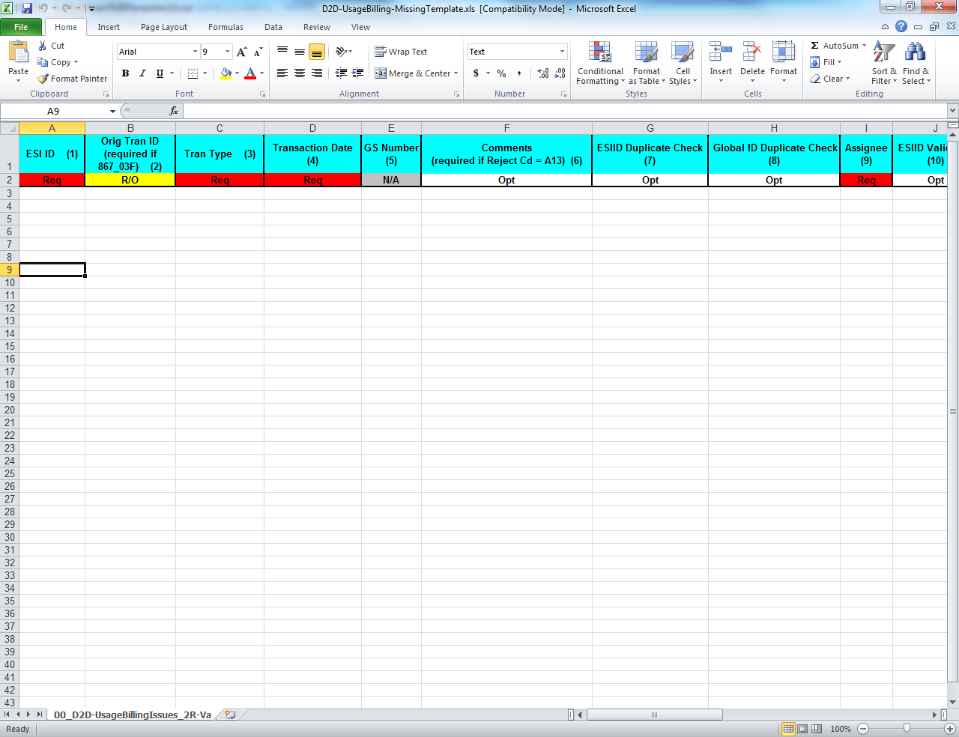
Bulk Insert: .CSV File Template
  Bulk Insert templates for every applicable subtype are available on the MarkeTrak Information Page. Below is a sample of the template for the Usage/Billing Missing subtype:
The definition of the data fields is as follows:
  Required (Req)
  Optional (Opt)
  Not Applicable (N/A)
  Required or Optional (R/O)
  Required or Not Applicable (R/NA)
  Optional or Not Applicable (O/NA)
  DateTime format = ccyy-mm-dd Thh:mm:ss eg: 2019-11-15T13:20:57
  Date format = ccyy-mm-dd eg: 2015-11-15

Slide 184
Bulk Insert: Tips & Tricks
Tip 1 – One template, one subtype
  Only submit multiple issues via bulk insert for the same subtype
Tip 2 – Request all validations occur
  Select all the validations to ensure data is valid and does not contain duplicates.
Tip 3 – Caution when copying ESI IDs
  Use caution when copying ESI IDs and pasting into the Excel Spreadsheet Bulk Insert Template.
  A normal copy and paste can result in the 17 digit ESI ID being automatically formatted by Excel in Scientific Notation Format (example 1.04437E+16).
  Changing the format of the cell in the spreadsheet will result in the last two digits of the 17 digit ESI ID to change to 00. This will cause the MarkeTrak issue to be created using the wrong ESI ID.

Slide 185
Bulk Insert: Tips & Tricks – cont.
Solution for accurate ESI ID format:
Open the Excel Spreadsheet Bulk Insert Template and Right Click in ESI ID cells.
Select Format Cells and choose Text from the list.
Copy ESI ID from source document and right click in the ESI ID cell and choose Paste Special and then choose Text.
This will paste the 17 digit ESI ID into the spreadsheet in text format and avoid Excel changing the ESI ID format.
Tip 4 – Avoid commas in comments
  Avoid commas (,) in any comment on the MarkeTrak issue via Bulk Insert. As a CSV (Comma Separated Value) file, any comma in a comment field will be recognized as a delimiter and misalign the column count causing the file to fail.

Slide 186

Bulk Insert: Tips & Tricks
Tip 5 – Correct format on dates and times
  ensure date/time field has correct format and populates the field in the T-format. If not formatted correctly, bulk insert file will fail validation.
Correct format on dates and times
Tip 6 – Ensure all rows are accounted for
  Before submission of the bulk insert CSV file the user should ensure all rows are accounted for in the file template to successfully pass validation for submission of the file.
Tip 7 – Delete the header row
  Once all data has been entered into required fields on the bulk insert template, the header row should be deleted before saving the file in the CSV format.
Tip 8 – Checking validation errors
  If you receive a validation error, go to notepad and open your CSV file to determine where the error has occurred and correct it. Once the error is corrected save the file with a new name. If you do not save with a new name your corrections will not be saved to the corrected file.
.

Slide 187
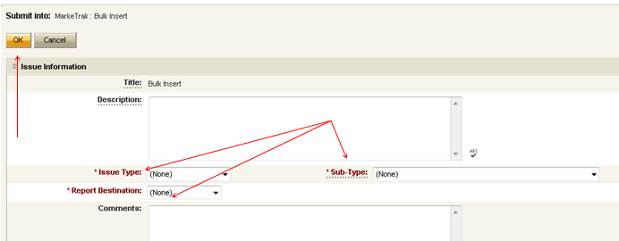
Bulk Insert: Submit
Submitting a Bulk Insert Issue:
  Following fields must be populated for successful submission of Bulk Insert:
    Issue Type
    Sub-Type
    Report Destination
  Submitter selects OK

Slide 188
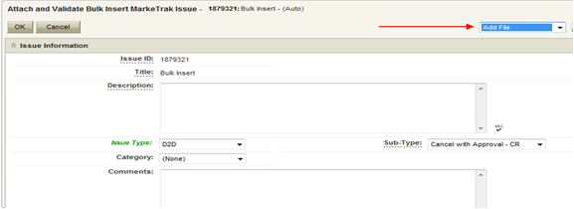
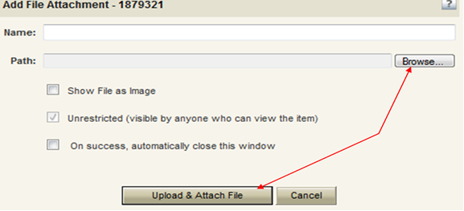
Bulk Insert: Submit (cont.)
From the Actions dropdown, select Add File
Select Browse, locate the CSV file, and press Upload & Attach File

Slide 189
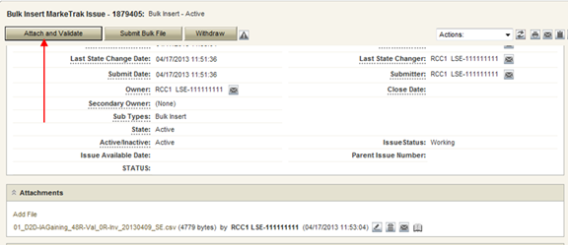
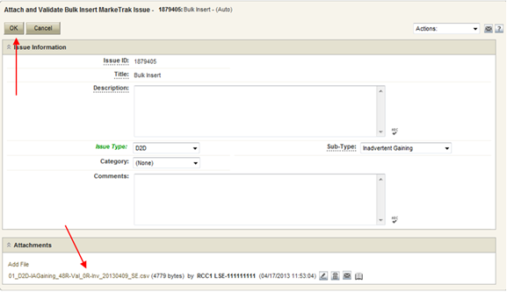
Bulk Insert: Submit (cont.)
Select Attach and Validate
Once the file has been attached select OK to validate the format of the CSV file

Slide 190
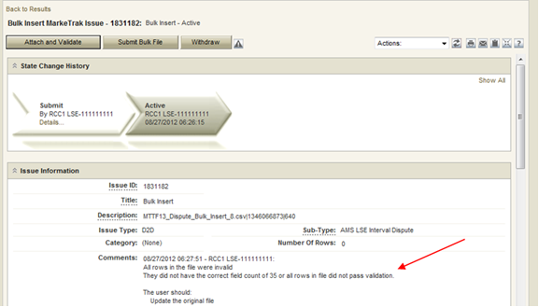
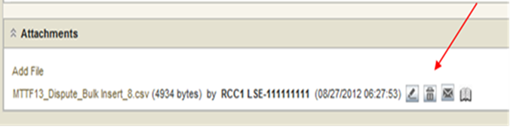
Bulk Insert: Submit (cont.)
Validation will be performed on the uploaded file
  File failure possibilities:
    incorrect number of columns
    formatted incorrectly
  Comments section to display failure message
  Failures must be corrected
  Once corrected, original file must be deleted before it can be reattached
    To delete the file, select trash can icon next to file name
    Select ‘delete file’

Slide 191
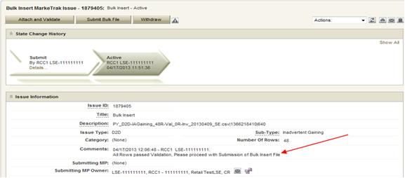
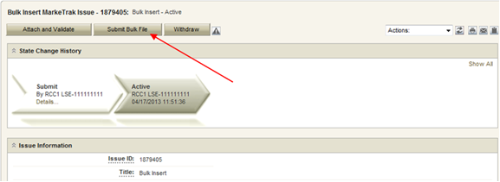
Bulk Insert: Submit (cont.)
If the upload is successful, a message indicating “All rows passed validation” will appear
Select ‘Submit Bulk File’ to create individual issues

Slide 192
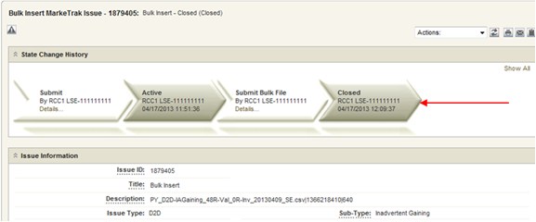
Bulk Insert: Submit (cont.)
After submitting the issue it will automatically close the Bulk Insert issue
Once submitted, Bulk Insert MarkeTrak Number becomes the “parent” and will be populated on each individual MarkeTrak issue (which are the “children”) created by the Bulk Insert

Slide 193
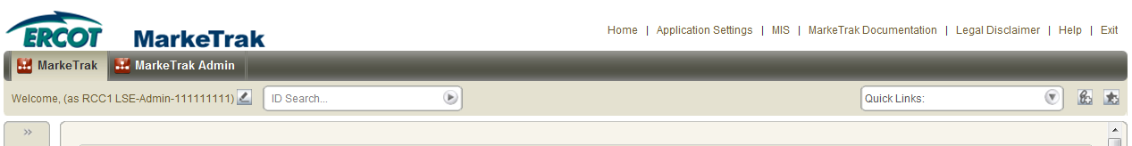
Bulk Insert: Report Destination Options
User chooses report destination as either:
file attached to the MarkeTrak issue
posted to reports section on MIS
  user to download the file via MIS
  access to MIS can be selected at top of the MarkeTrak GUI screen

Slide 194
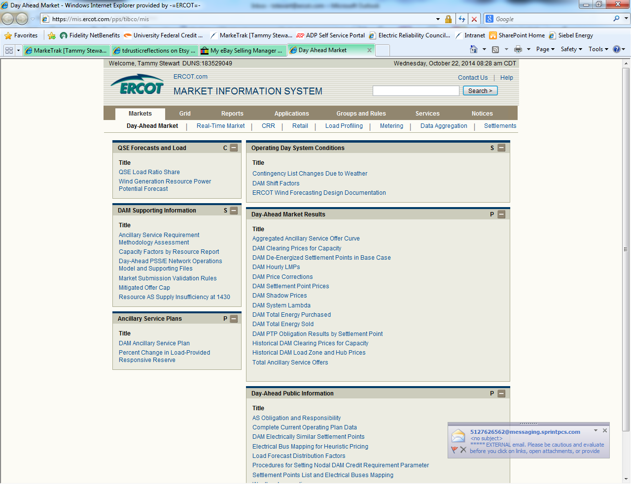
Bulk Insert: Report Destination
From within MIS, select the Retail link to access the reports

Slide 195
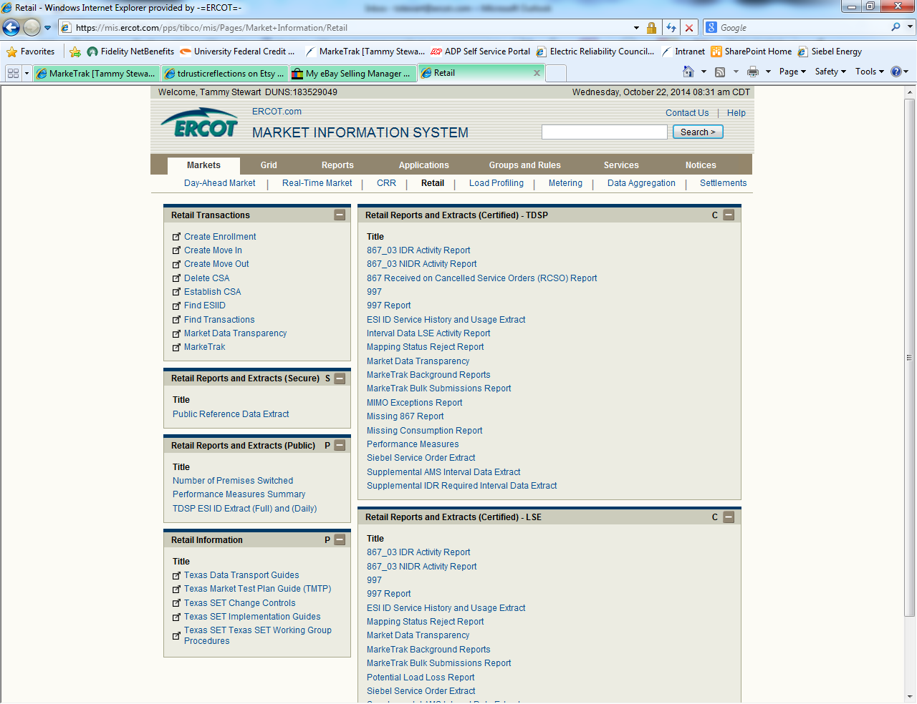
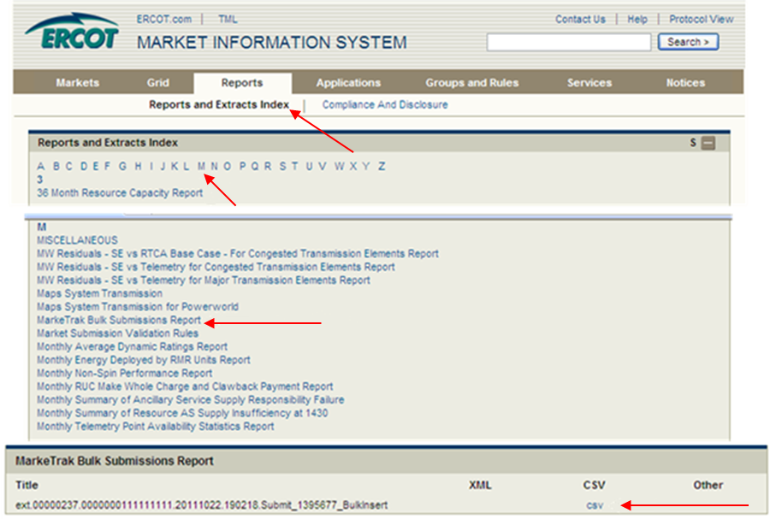
Bulk Insert: Report Destination
Select the MarkeTrak Bulk Submissions Report link to access the .csv file

Slide 196
Checkpoint Question
In what format should your Bulk Insert file be saved, prior to uploading into MarkeTrak?
  *.pdf
  *.txt
  *.csv
  *.xlsx
c) *.csv

Slide 197
Checkpoint Question
True or False:
Bulk Insert templates for every applicable subtype are available on the MarkeTrak Information Page.
True

Slide 198
MarkeTrak Training
Additional D2D Subtypes

Slide 199
Additional Day to Day Subtypes - summary
Below is a summary of additional subtypes utilized for specific purposes:
Issue Subtype | Purpose | Submitter
Cancel w/ Approval | Manually cancelling an initiating transaction – MVI, MVO, or Switch Used by CR or TDSP when experiencing system issues CR requesting cancellation of a past-dated ‘scheduled’ transaction | CR or TDSP
997s | Verify if a 997 was sent or received | CR or TDSP
Projects | Project related requests, i.e. Meter Cycle change request | CR or TDSP
ERCOT Initiated | Used when exceptions are in ERCOT’s system (i.e. conflicting metering dates, etc.) | ERCOT
Safety Net Order | Request for follow up EDI transaction after CR submittal of safety net | TDSP

Slide 200
Additional Day to Day Subtypes – summary – cont.
Below is a summary of additional subtypes utilized for specific purposes:
Issue Subtype | Purpose | Submitter
Move Out w/ Meter Removal | TDSP notification of meter removal if 650_04 is not sent Follow up request for MVO transaction upon 650_04 notification | TDSP
Redirect Fees | When an IAG results in a lights out situation, allows Losing CR to submit within 3 days of receiving 810_02 for recovery of any discretionary fees from Gaining REP | Losing CR
Market Rule | Flexible for operationalizing PUCT rulemaking, i.e. COVID ERP Program, AMS Opt-Out customer requests | TDSP or CR
Reject Transactions | CR or TDSP questions rejected transaction, i.e. invalid EDI, NFI, Dups | CR or TDSP

Slide 201
Additional Day to Day Subtypes – summary – cont.
Below is a summary of additional subtypes utilized for specific purposes:
Issue Subtype | Purpose | Submitter
REP of Record | CR questions who ERCOT or TDSP show as ROR – i.e. used in Mass Transition process | CR or TDSP
Service Order – 650 Issues | Inquiries related to service orders – missing 650_02 responses or rejects of 650_01 | CR or TDSP
Premise Type | Out of sync conditions for premise types requesting TDSP to submit 814_20 to update premise type | CR
Service Address | CR requests TDSP to submit 814_20 to update a service address for an ESI | CR

Slide 202
MarkeTrak Training
‘Other’ Issues

Slide 203
D2D Issues: Other
Examples of Other Issues but not limited to:
  Questions pertaining to discrepancy between sum of AMS Interval data and the 867 consumption value
  Questions pertaining to Siebel Reports
  Questions pertaining to request for filenames
  Questions pertaining to 997 reports
  Questions pertaining to CSAs
  Questions pertaining to missing information on non-required EDI fields
  Request for reprocessing of transactions
  Questions pertaining to Texas SET Transaction Issues
  Questions pertaining to MIS Portal
A CR or a TDSP can submit this subtype
Required Fields on Submit:
  Assignee

Slide 204
MarkeTrak Training
Background Reporting

Slide 205
MarkeTrak Background Reporting
MarkeTrak Background Reports provide the following functionality:
  Allow users to run a report and work in the GUI at the same time
  Allow users to search multiple inputs, for example:
    Multiple Issue IDs
    Multiple ESI IDs
  Allow users to access archived information that is not available in GUI reports
  API users have the ability to execute and retrieve background reports

Slide 206
MarkeTrak Background Reporting
Available Background Reports
Report Name | Report Description
Average Days Open | Report to Provide average days open by subtype for the time frame specified.
Count of Active and Inactive Issues | Report to provide a count of Active and Inactive issues for the time frame specified.
Count of Issues Resolved Outside Benchmark | Returns a count of issues closed outside of the specified benchmark number of days for a particular time frame.
Count of Issues Resolved Within Benchmark | Returns a count of issues resolved within the specified benchmark number of days for a particular time frame.
Count of Issues in State | Report to provide the total number of issues in each state for the selected subtype(s) for the time frame specified.
Count of Issues by Sub-Type by Submit MP DUNS | Report to provide the count of issues by sub-type for a given submitting MP DUNS for the sub-type(s) selected.
Count of Issues by Submitting MP DUNS | Report to provide the total number of issues identifying the submitting MP type of CR or TDSP.
Count of Issues by Sub-Type | Report to provide the total number of issues submitted for the selected sub-type(s).

Slide 207
MarkeTrak Background Reporting
Available Background Reports
Report Name | Report Description
Details for Issues Resolved Outside of Benchmark | Returns details for issues closed outside of the selected benchmark number of days within the time frame specified.
Issue Details by ESIID | Issue Details for a select group of ESIIDs for the subtype(s) selected.
Issue Details by Issue ID | Issue Details for a select group of Issue IDs for the subtype(s) selected.
Time in State | Report to provide the days an issue spent in each distinct state both the first time it moves into the state as well as the last time if applicable.
Total No. Closed | Report to provide a count by subtype of all issues closed within the specified time frame.
Issues Open Outside Benchmark | Report to Provide the active issues that have been open outside of the selected benchmark number of days.
Issue Transition Details | Report to Provide by subtype the issue transition details. This report will also help with tracking the transition details for the Meter Tampering Switch Hold Issues.

Slide 208
MarkeTrak Training

Slide 209
MarkeTrak Training
Survey

Slide 210
MarkeTrak Training
Jeopardy

