Slide 1
ERCOT Frequency Control Report
February 2021
ERCOT
Operations Planning
PDCWG | March 10th, 2021

Slide 2
Summary of February 2021
CPS1: 155.58%
Current CPS1 12-Month Rolling Average: 169.53%
52 BAAL Exceedance(s)
8 hourly CPS1 score below 100%
BAAL-003 Events have updated through 2019
2019 BAAL-003 FRM Performance: -811.14
2021 RMS1 Statistics
Mean: 16.91 mHz
Min: 12.01 mHz
Max: 60.59 mHz
Energy Statistics
Total Energy: 28,982,244 MWh
Wind Energy: 5,999,684 MWh
Percent Energy from Wind: 20.70%
Solar Energy: 660,966 MWh
Percent Energy from Solar: 2.28%
Minimum System Inertia
Mean: 210,940 MW*s
Max: 330,433 MW*s on Feb 14th
Min: 14,1033 MW*s on Feb 4th
Notes:
2018 BAAL-003 FRM Performance: -843.17

Slide 3
Frequency Control
CPS1, BAAL, & RMS1

Slide 4
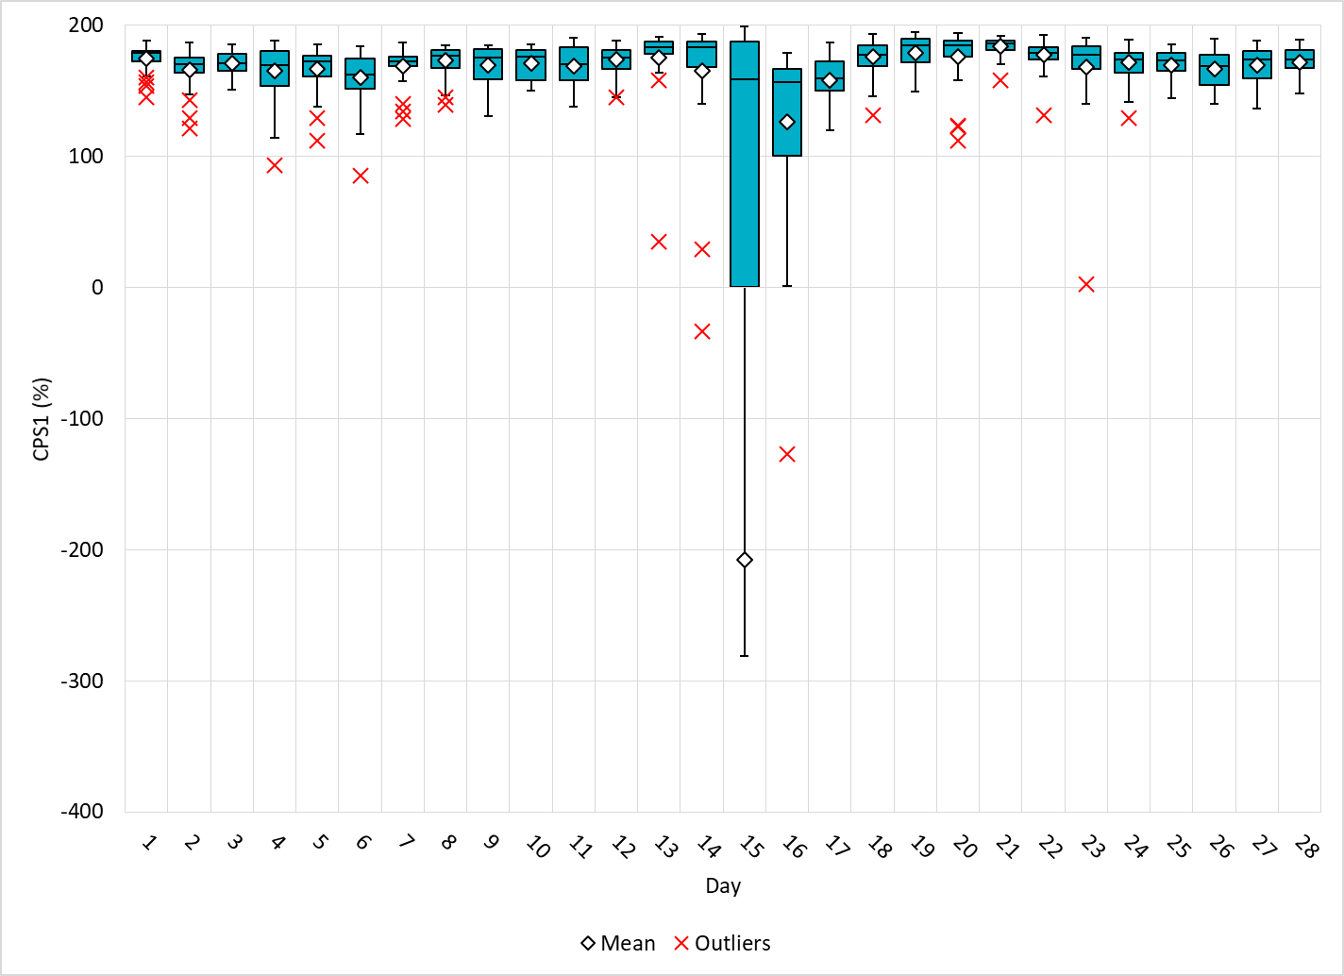
Hourly CPS1 by Day
Feb-21 CPS1 (%): 155.58
Notes:
93.04% @ 02/04/2021 13:00
Expected Generation Deviation
Expected gen dev remained negative for most of the hour. The largest expected gen dev was -1903 MW @ 13:07 mostly due to wind and solar.
A thermal unit experienced significant deviation from basepoint due to unit testing.
IRR Ramps
Wind generation consistently ramped down throughout the hour from 16755 MW to 13330 MW (3425 MW). The largest down ramp observed was -405 MW/5 Min.
Solar ramped down from 4027 MW to 3771 MW (256 MW) between 13:25 and 13:30.
Regulation: Regulation up exhausted during the period of negative expected gen. dev.
Manual SCED reset
SCED was run manually multiple times.
2. 85.00% @ 02/06/2021 17:00
Expected Generation Deviation
Expected gen dev remained negative for most of the hour. The largest expected gen dev was -2828 MW @ 17:48, mostly due to wind and solar.
IRR Ramps
Wind generation consistently ramped down throughout the hour from 10362 MW to 6216 MW (4146 MW). The largest down ramp was -445 MW/5 Min. Coincides with the solar ramp down.
Regulation: Regulation up exhausted during the period of negative expected gen. dev.
Manual SCED reset
SCED was manually run at 17:47
3. 35.05% @ 02/13/2021 08:00
Unit Derates/Trip
Several conventional resources were derated during this hour and a resource tripped @8:36.
Expected Generation Deviation
The Expected gen dev was negative throughout the hour. The largest expected generation dev was -1369 MW @ 8:44, mostly due to unit derates and wind ramp down.
IRR Ramps
Wind generation was on down ramp during later half of the hour. The largest down ramp of 125 MW/5 Min between 8:35 and 8:40 coincides with the unit trip.
Other
Manual offset of 300 MW was applied @ 08:40 and 450 MW @ 08:42. A total of 724.96 MW of RRS was deployed @ 08:36
4. 2.36% @ 2/23/2021 23:00 (high freq)
Expected Generation Deviation
The Expected gen dev from wind generation is positive throughout the hour. The largest expected gen dev was +591 MW @ 23:23.
Several wind resources were deviating from the basepoints
Regulation: Regulation down exhausted during the period of positive expected gen dev.
Manual SCED reset
SCED was run manually multiple times.

Slide 5
BAAL Exceedances & Violations
There was 52 BAAL exceedance(s) in Feb
Notes:
Occurred on 02/13/2021 (5) and 2/15 – 2/16 (47)

Slide 6
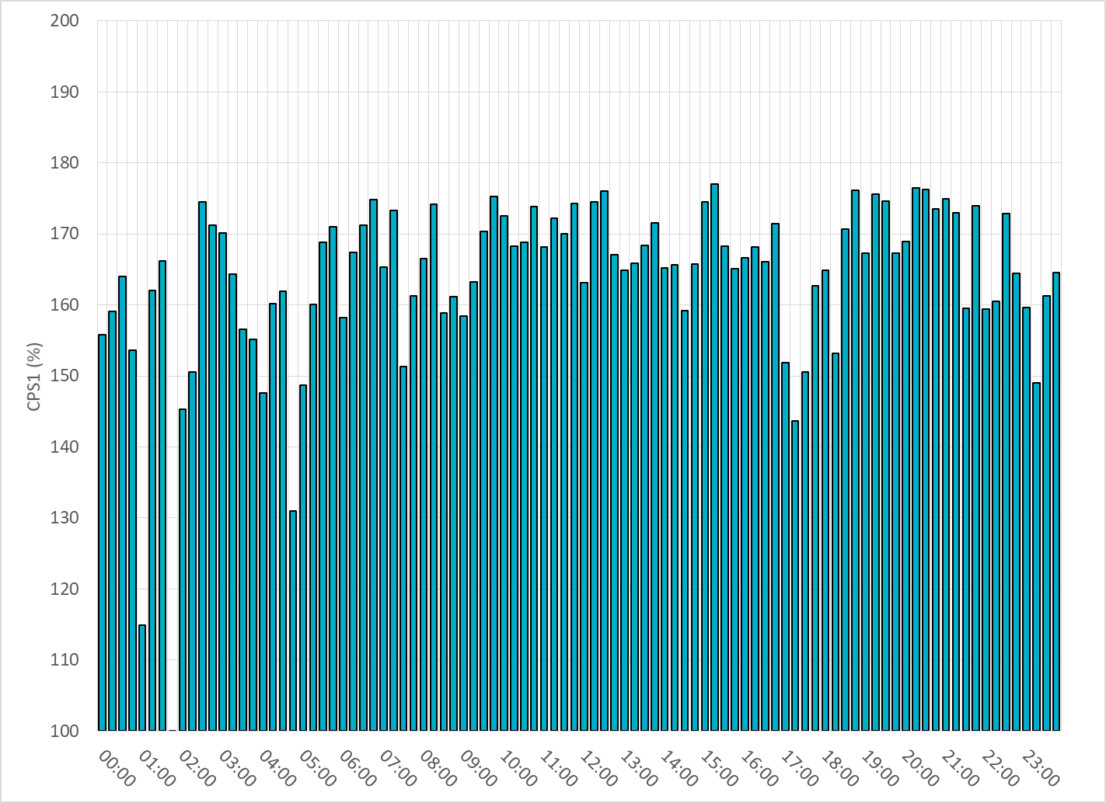
15-Minute Average CPS1%
Feb-21 CPS1 (%): 155.58

Slide 7
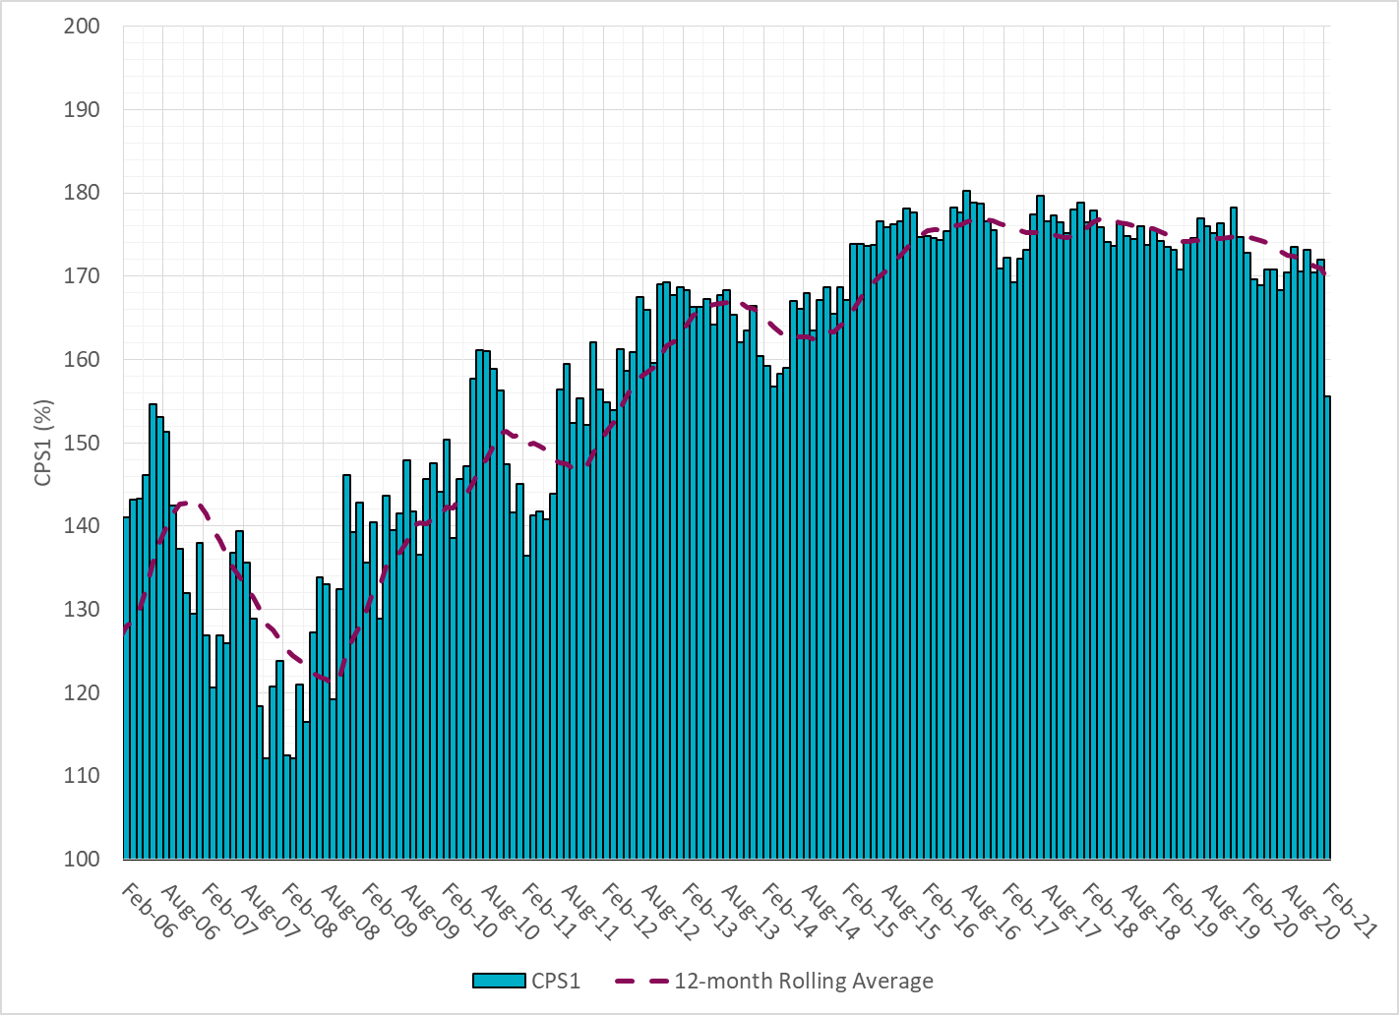
12-Month Rolling Average CPS1
Current 12-Month Rolling Average: 169.53%

Slide 8
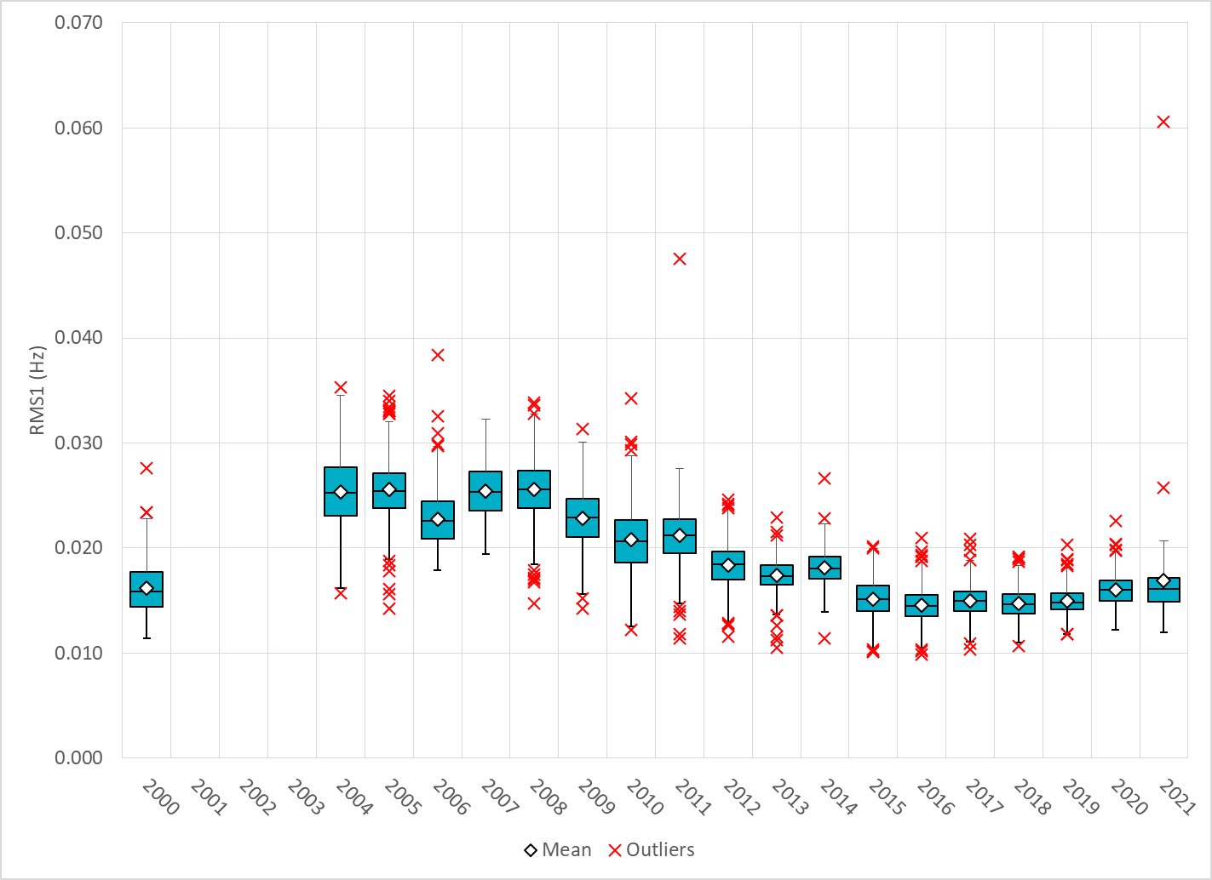
Daily RMS1 of ERCOT Frequency by Year
Notes:
Mean: 16.91 mHz
Min: 12.01 mHz
Max: 60.59 mHz

Slide 9
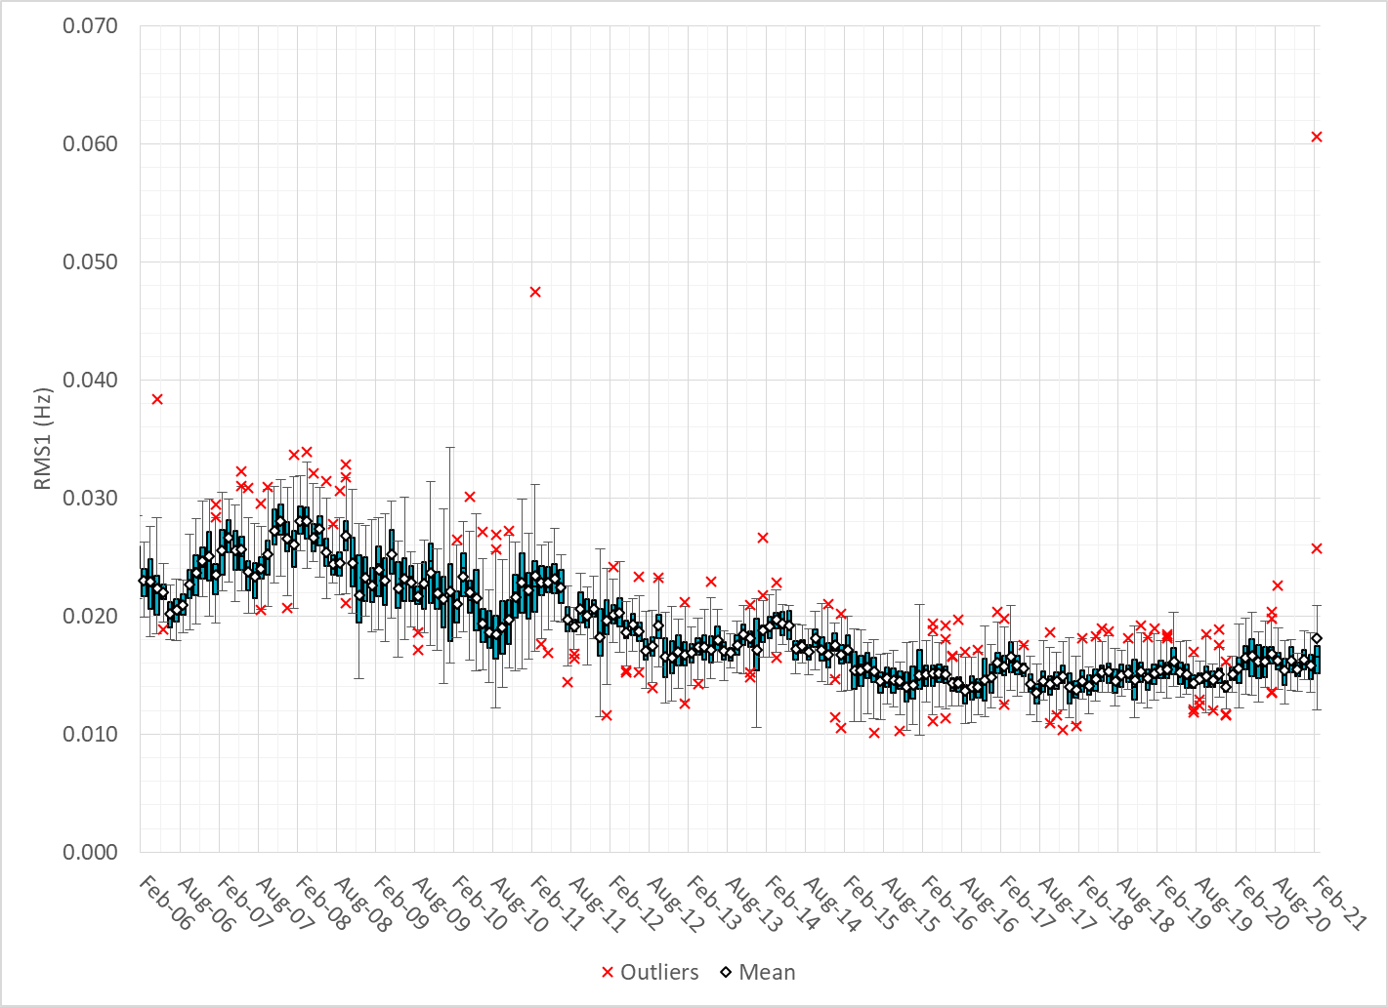
Daily RMS1 of ERCOT Frequency by Month

Slide 10
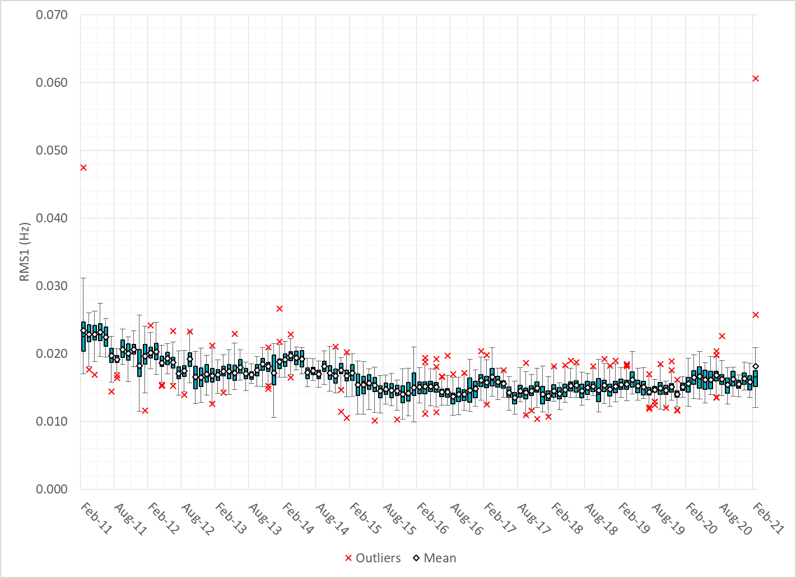
Daily RMS1 of ERCOT Frequency by Month

Slide 11
Frequency Profile Comparison

Slide 12
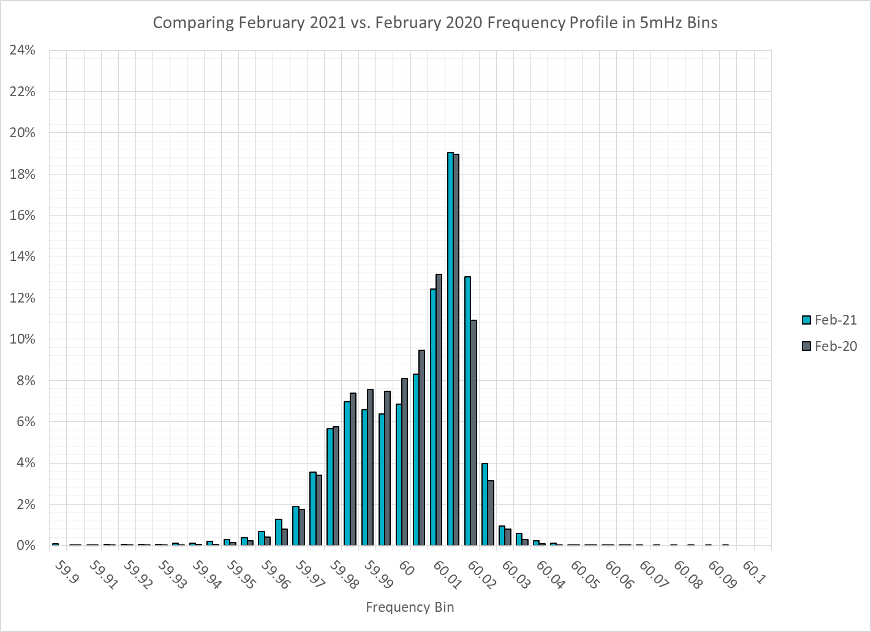
Frequency Profile Comparison

Slide 13
Frequency Profile Comparison

Slide 14
Time Error Correction

Slide 15
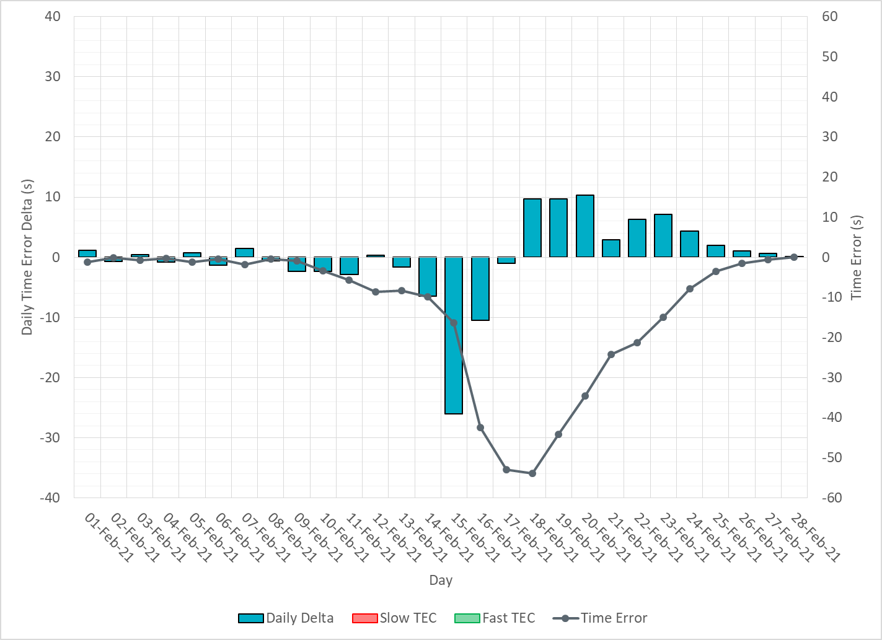
ERCOT Daily Time Error

Slide 16
Time Error Corrections Log Summary
There have been no time error corrections since December 2016

Slide 17
BAL-003 Performance

Slide 18
Op. Year 2019 BAL-003 Selected Events – Update
Notes:
BAL-003

Slide 19
Op. Year 2019 BAL-003 FRM Performance - Update
Notes:
OP2018: FRO = -381.0, FRM_median = -843.17, FRM_average = -959.7
OP2019: FRO = -381.0, FRM_median = -811.14, FRM_average = -892.5
OP2020: FRO = -425.0,

Slide 20
ERCOT Energy Statistics

Slide 21
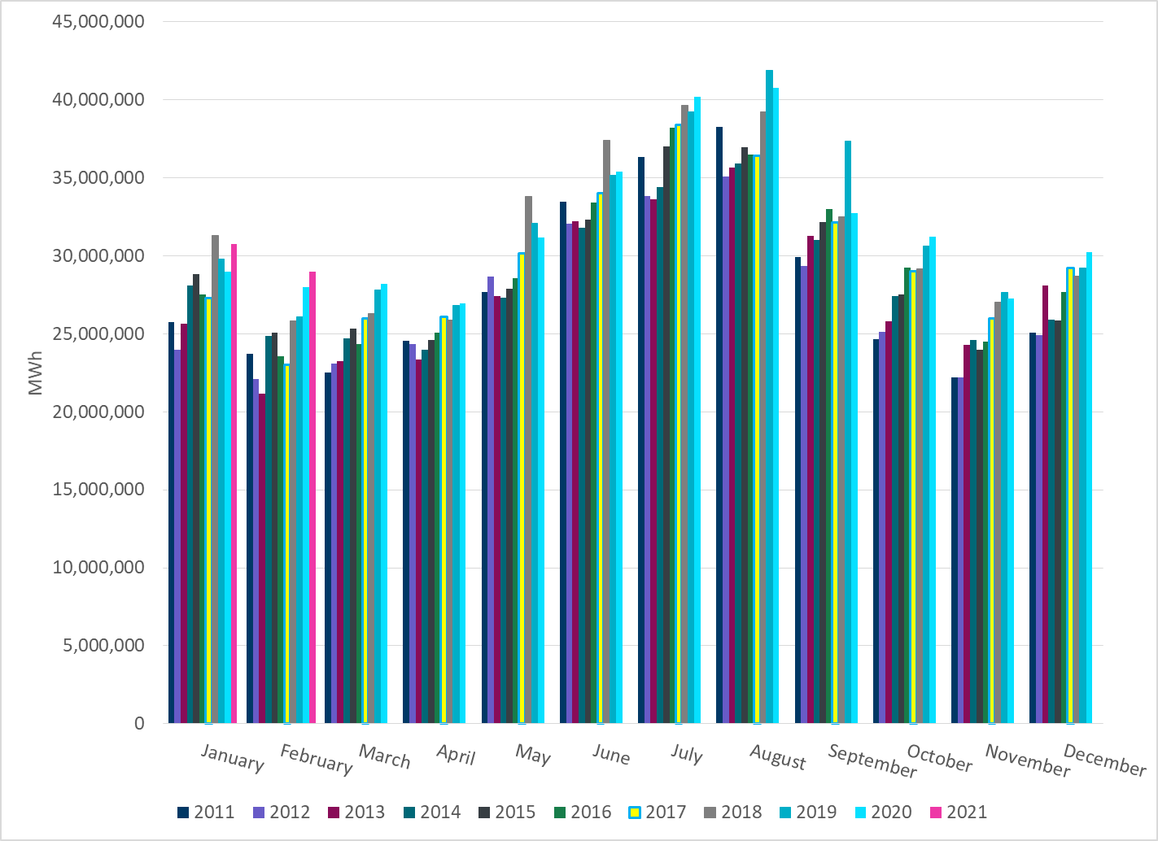
Total Energy
Notes:
28,982,244 MWh

Slide 22
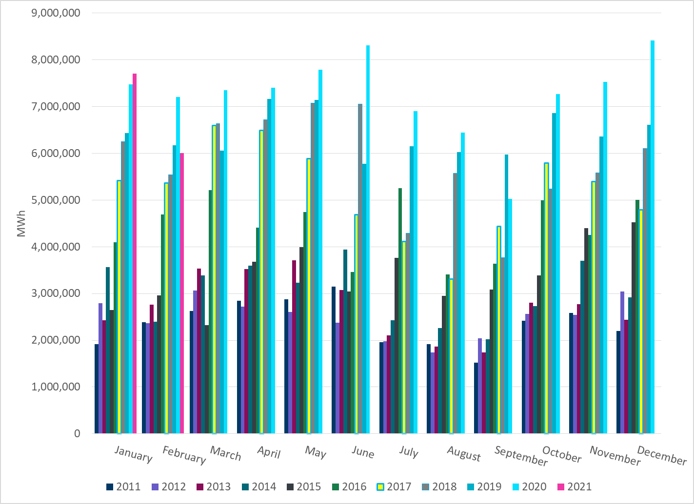
Total Energy from Wind Generation
Notes:
5,999,684 MWh

Slide 23
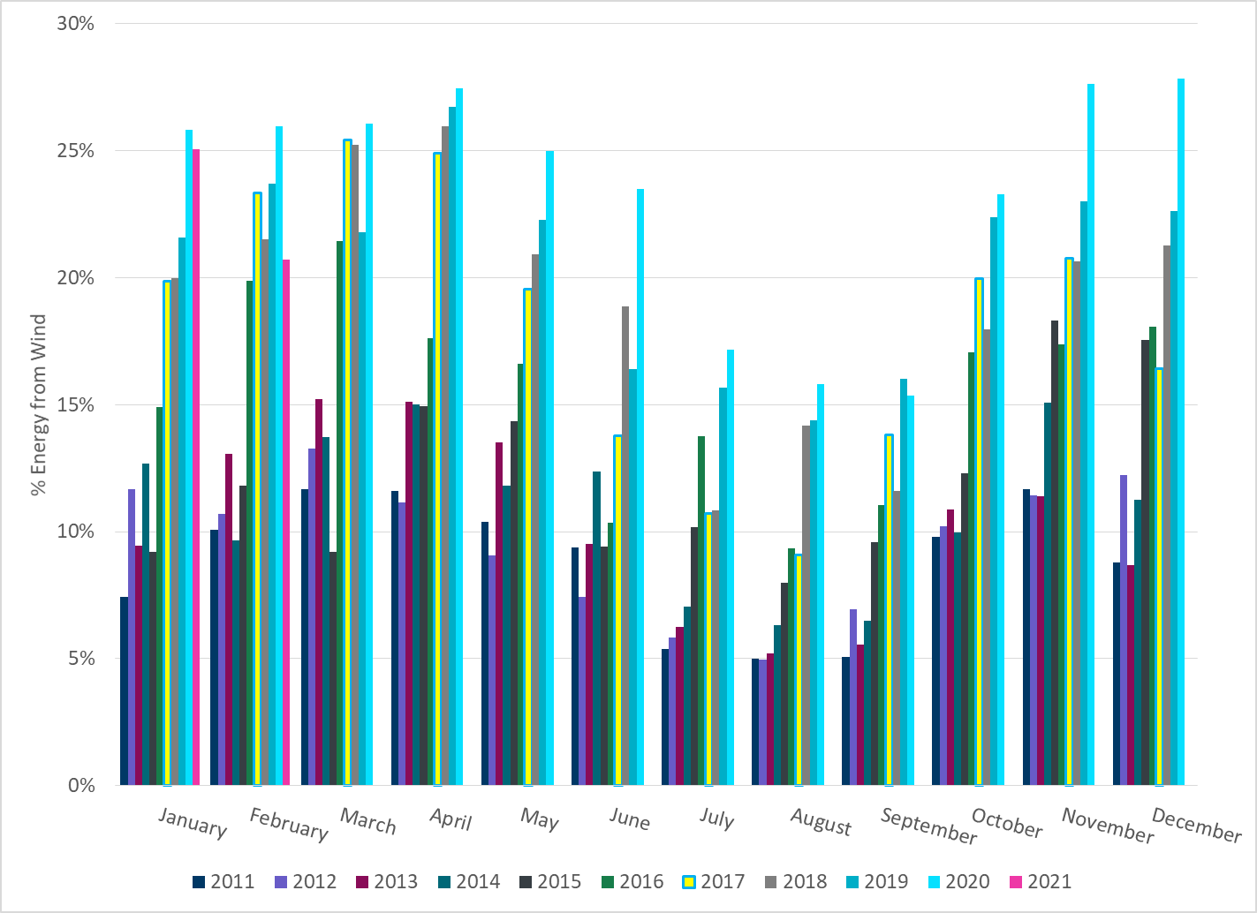
% Energy from Wind Generation
Notes:
20.70% %

Slide 24
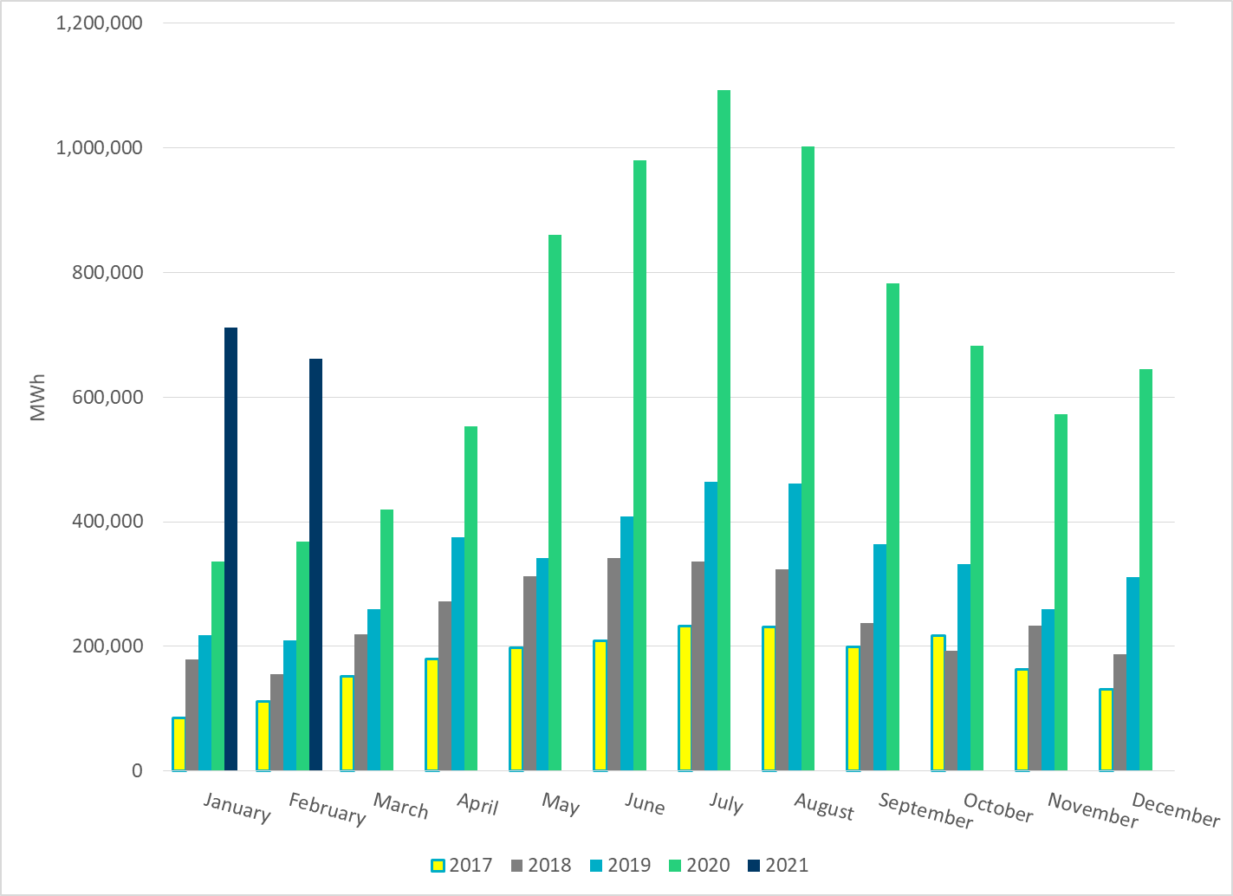
Total Energy From Solar Generation
Notes:
660,966 MWh

Slide 25
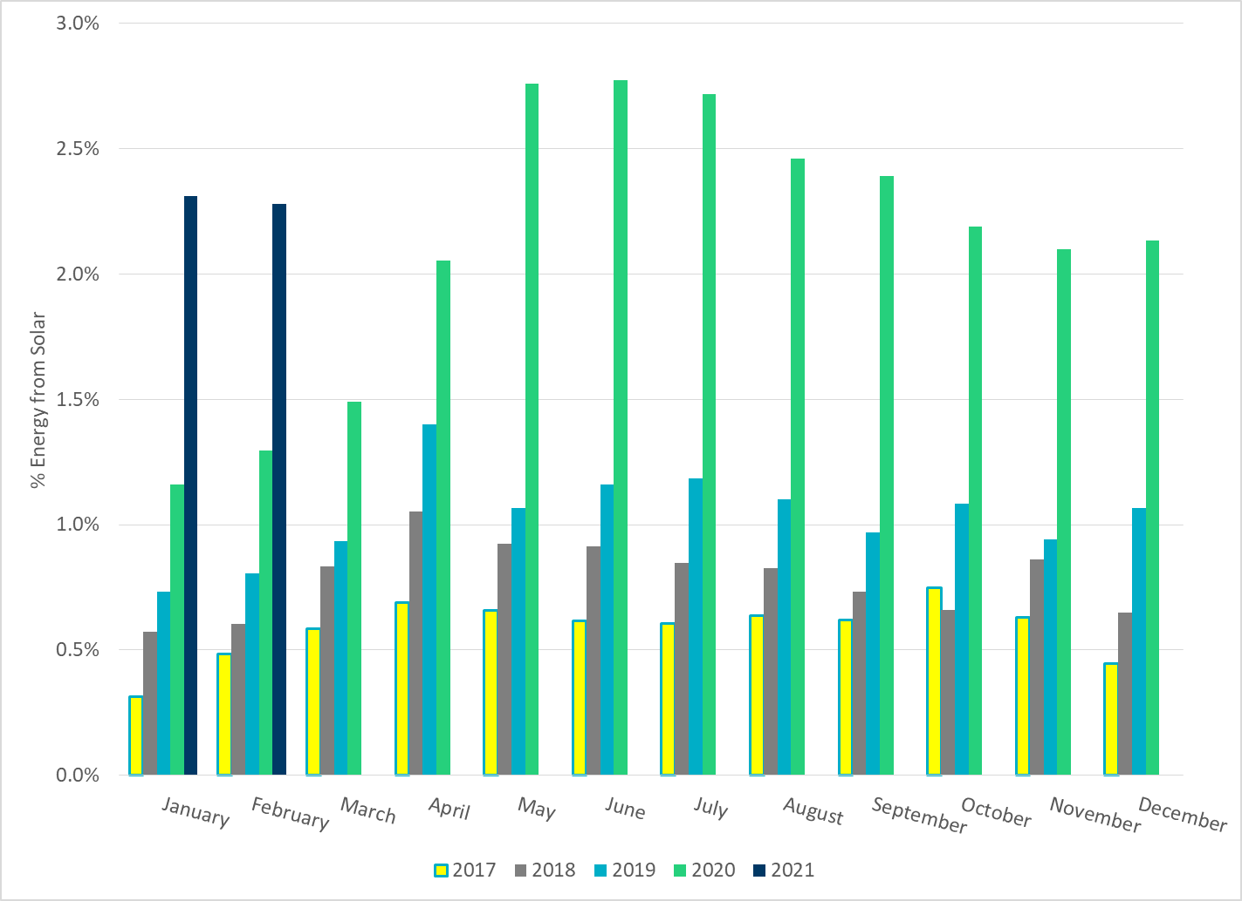
% Energy from Solar Generation
Notes:
2.28%

Slide 26
ERCOT System Inertia

Slide 27
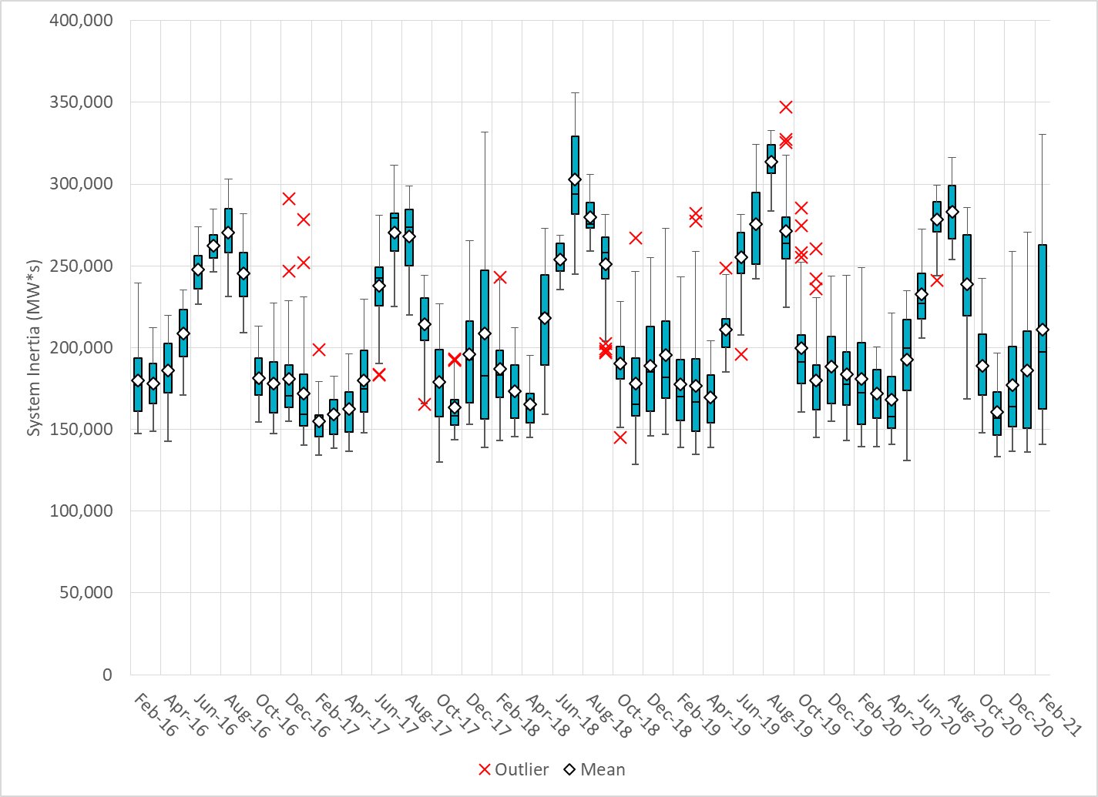
Daily Minimum System Inertia
Notes:
Minimum Inertia = 136,033 MW*s on 1/30/2021
Previous Minimum was 128,759 MW*s on 11/3/2018.
Data:
Mean: 210,940 MW*s
Max: 330,433 MW*s on Feb 14th
Min: 14,1033 MW*s on Feb 4th

Slide 28
Questions?
Thank you!

