Slide 1
ERCOT Frequency Events
February 2021
ERCOT
Operations Planning
PDCWG | March 10th, 2021

Slide 2
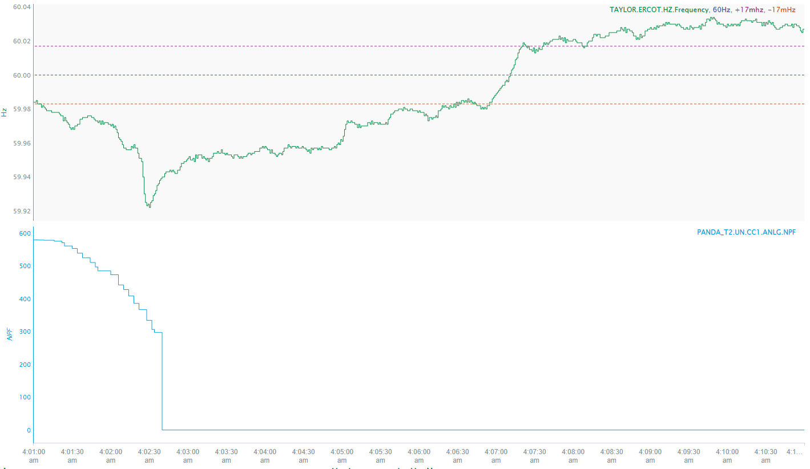
2/13/2021 04:02:23 (Non-FME)
Notes:
Unit had a runback from 576MW to 298 MW MW tripped offline while carrying 298 MW
Starting Frequency: 59.958 Hz
Minimum Frequency: 59.922 Hz
A-C Time: 7 seconds
Recovery Time (back to deadband): 4 minutes and 32 seconds
RRS Deployed: 0 MW
Trip Reason: Loss of gas pressure
Contextual Information: A total 311 MW of regulation up requested during the event
No Selection Reason: Not a clean trip and the frequency is not stable prior to the start of the event.

Slide 3
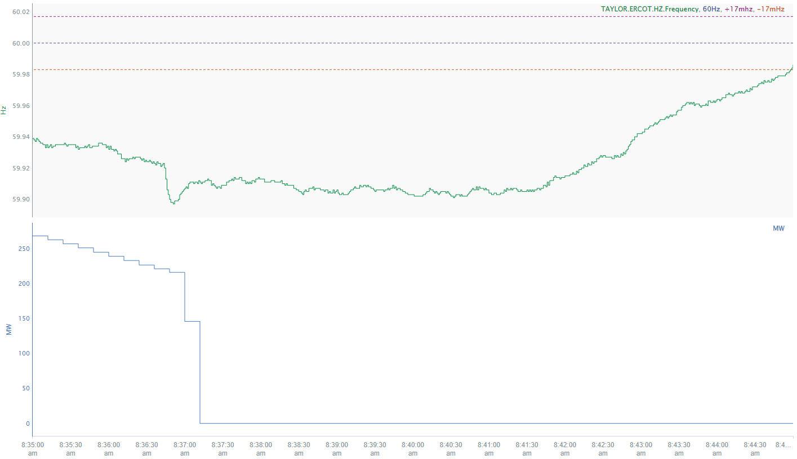
2/13/2021 8:36:43 (Non-FME)
Notes:
Unit tripped offline carrying 221 MW
Starting Frequency: 59.923 Hz
Minimum Frequency: 59.897 Hz
A-C Time: 8 seconds
Recovery Time (back to deadband): 8 minutes and 15 seconds
RRS Deployed: 724.96 MW
Trip Reason: Steam injector froze and caused a low vacuum trip
Contextual Information: 272 MW of regulation up was being requested prior to the event and all regulation up was exhausted during the event. A 300 MW Manual SCED reset at 8:40 and another 450 MW
No Selection Reason: Pre-perturbation frequency is low and not stable and MW loss is too small.

Slide 4
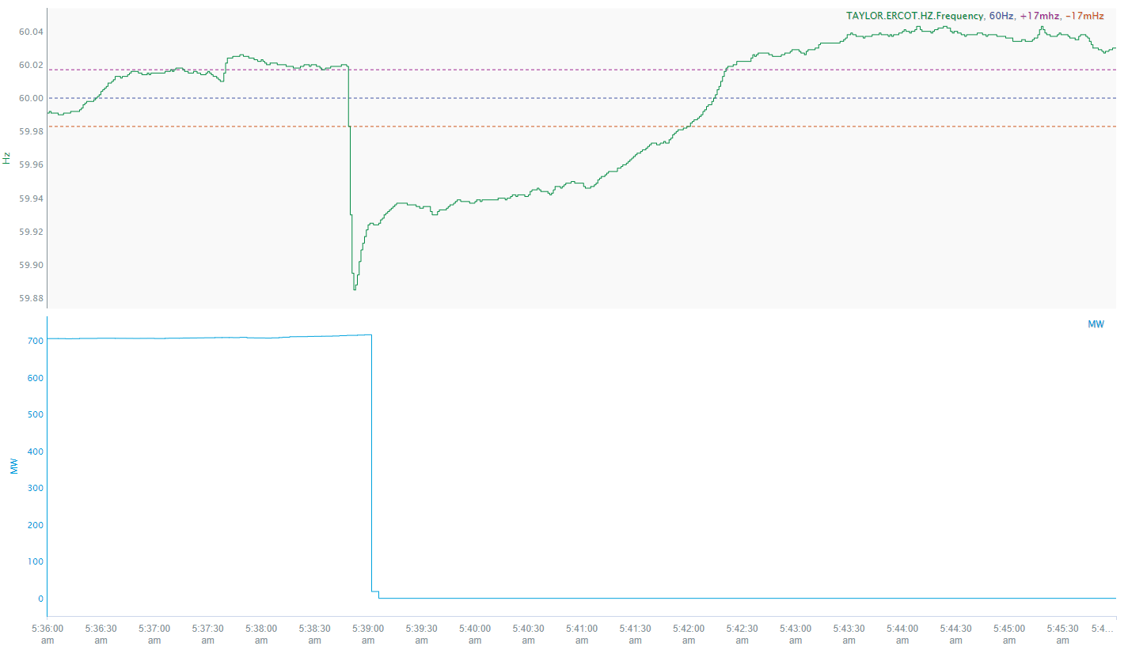
2/22/2021 5:38:48 (FME)
Notes:
Unit tripped offline carrying around 714 MW.
Starting Frequency: 60.019Hz
Minimum Frequency: 59.885 Hz
A-C Time: 9 seconds
Recovery Time(back to deadband): 3 minutes and 12 seconds
RRS Deployed: 337.75 MW
Trip Reason: No information available.
Contextual Information: A total of 405 MW of regulation up requested during the event. 238 MW of regulation down was requested prior to the event.

Slide 5
Questions?
Thank you!

