Slide 1
Credit Exposure Update
Spoorthy Papudesi
Credit Work Group
ERCOT Public
February 17, 2021

Slide 2
Monthly Highlights Dec 2020- Jan 2021
Market-wide average TPE decreased from $ 433.07 million to $ 362.8 million
TPE decreased mainly due to higher Real-Time and Day-Ahead Settlement Point prices in November driving TPE in December higher
Discretionary Collateral is defined as Secured Collateral in excess of TPE,CRR Locked ACL and DAM Exposure
Average Discretionary Collateral increased from $ 1,241.2 million to $1,378.5 million
The increase in Discretionary Collateral is largely due to decrease in TPE and CRR Locked ACL.
Number of active Counter-Parties increased by 2
No unusual collateral call activity

Slide 3
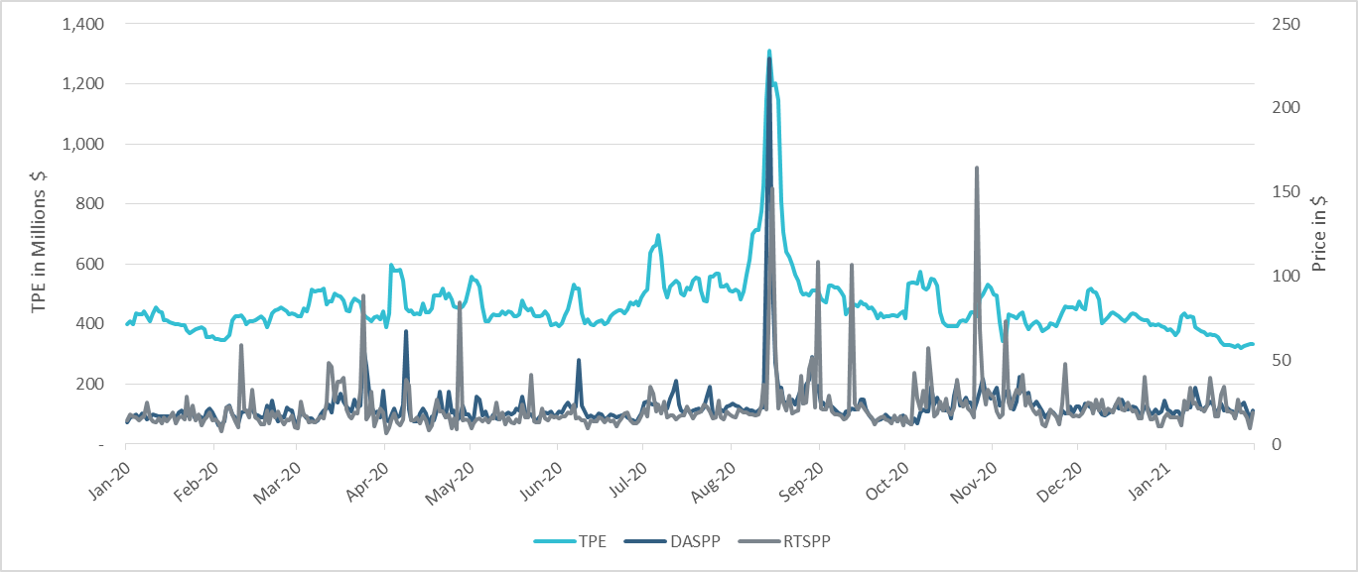
TPE/Real-Time & Day-Ahead Daily Average Settlement Point Prices for HB_NORTH Jan 2020- Jan 2021

Slide 4
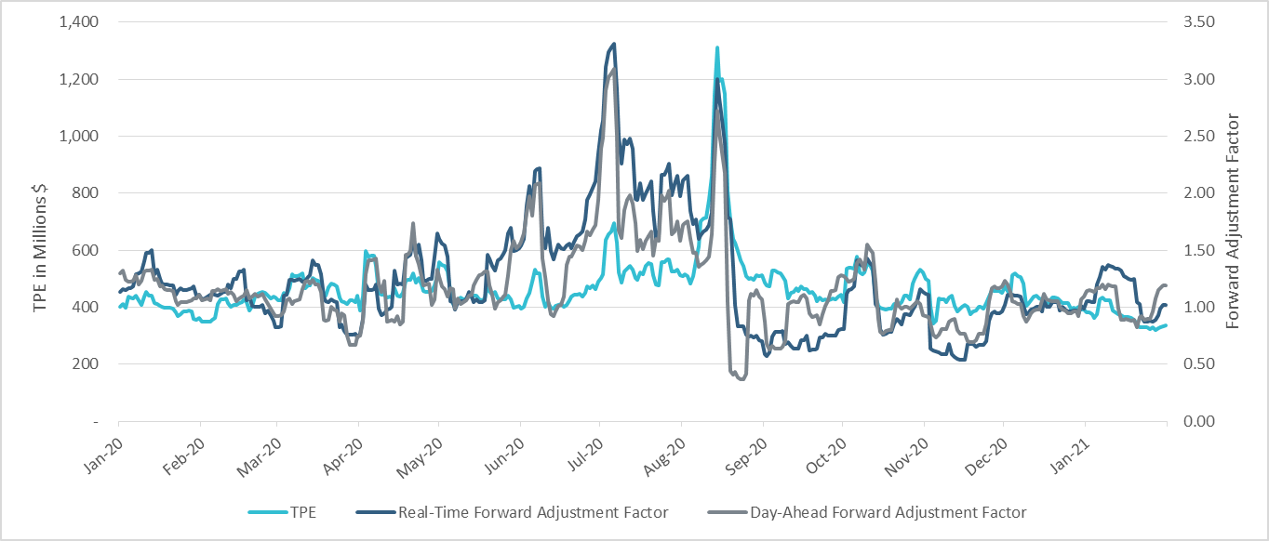
TPE and Forward Adjustment Factors Jan 2020- Jan 2021

Slide 5
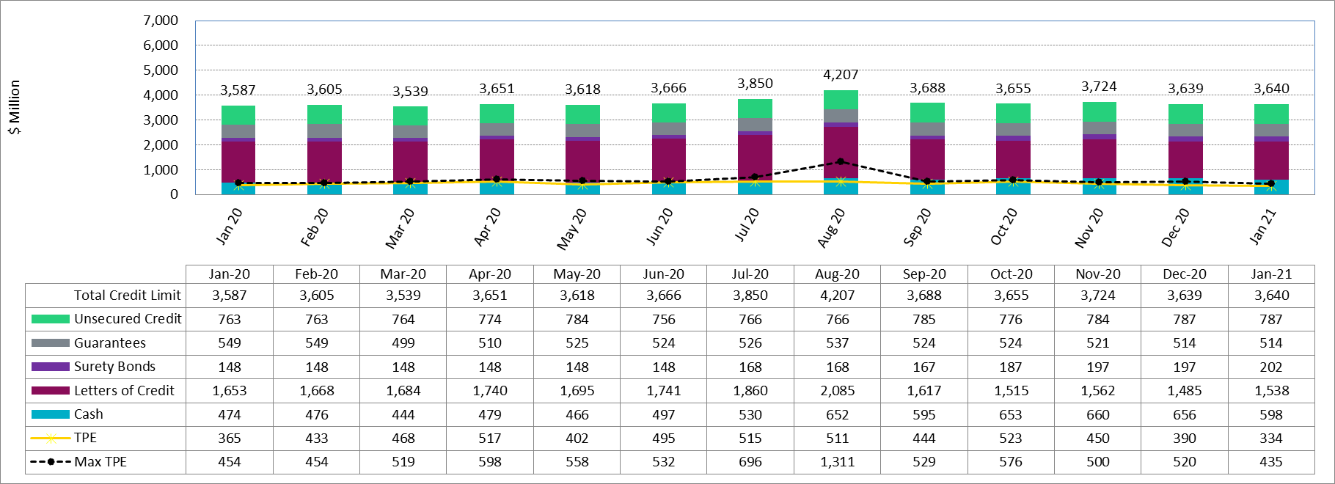
Available Credit by Type Compared to Total Potential Exposure (TPE)
* Numbers are as of month-end except for Max TPE

Slide 6
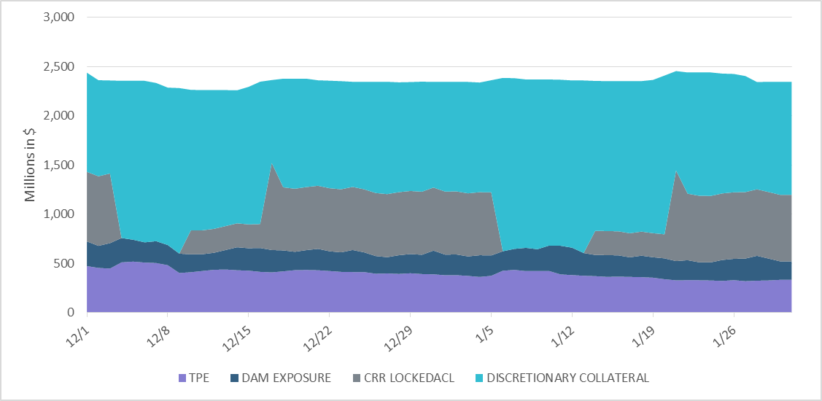
Discretionary Collateral Dec 2020- Jan 2021
At a Counter-Party level, no unusual changes were noted
Note: Discretionary collateral doesn’t include Unsecured Credit Limit or parent guarantees

Slide 7
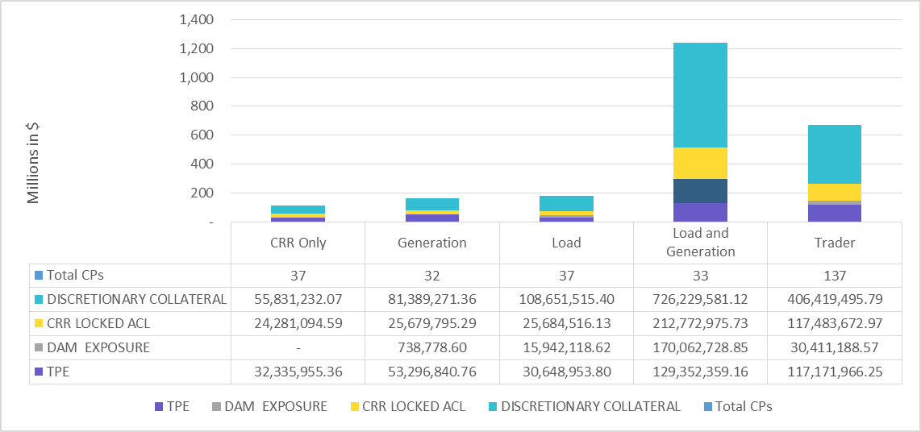
TPE and Discretionary Collateral by Market Segment- Jan 2021
Load and Generation entities accounted for the largest portion of discretionary collateral

Slide 8
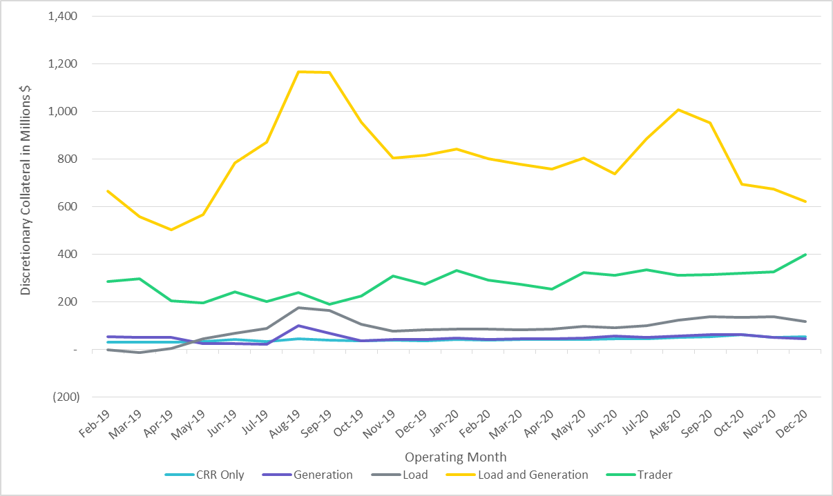
Discretionary Collateral by Market Segment Feb 2019- Dec 2020

Slide 9
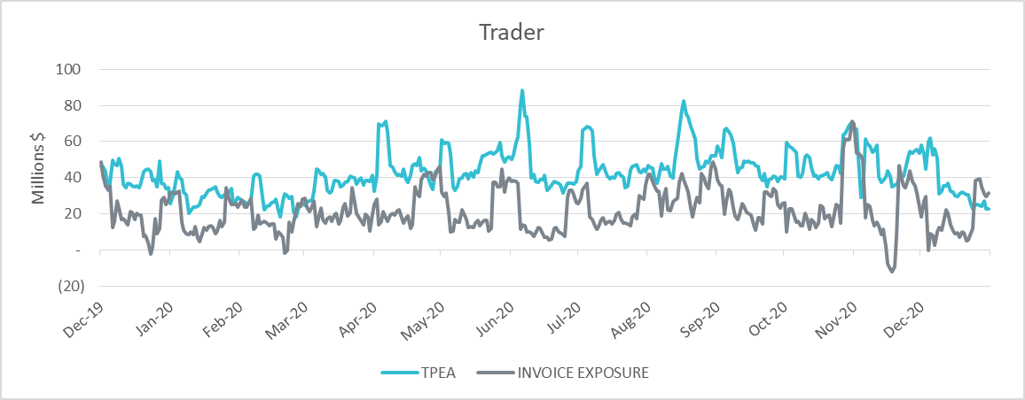
TPE Coverage of Settlements Dec 2019 - Dec 2020
TPEA generally exceeds actual/invoice exposure

Slide 10
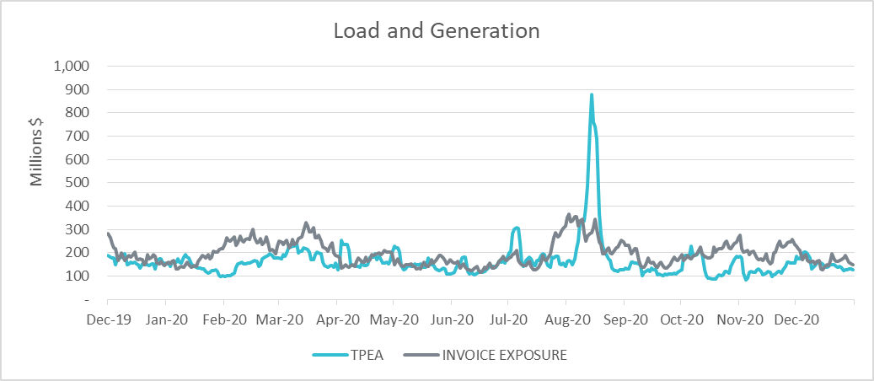
TPE Coverage of Settlements Dec 2019 - Dec 2020
Actual/invoice exposure slightly higher than TPEA except during summer peak and fall

Slide 11
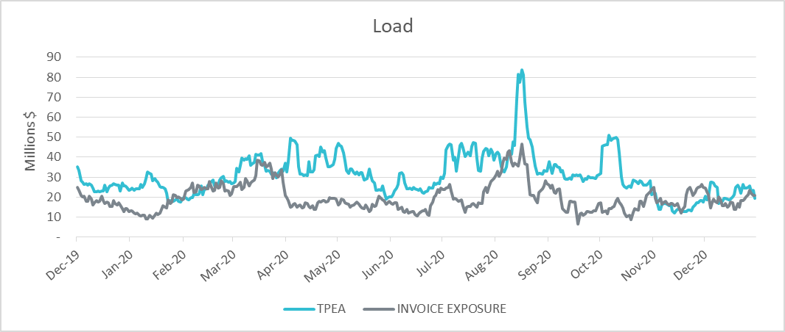
TPE Coverage of Settlements Dec 2019 - Dec 2020
TPEA closely approximates actual/invoice exposure

Slide 12
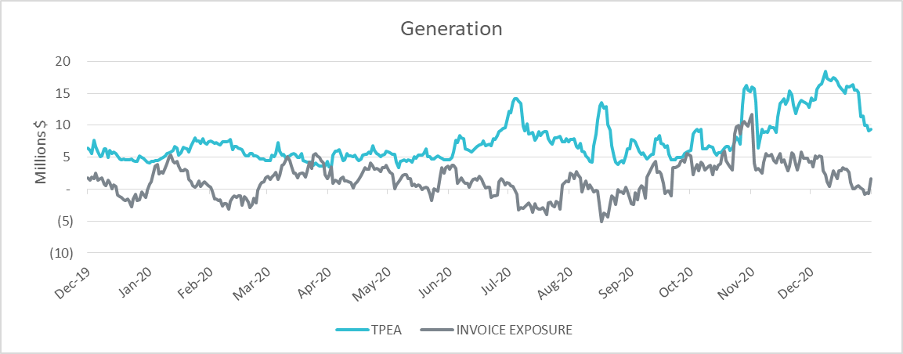
TPE Coverage of Settlements Dec 2019 - Dec 2020
TPEA generally exceeds actual/invoice exposure

Slide 13
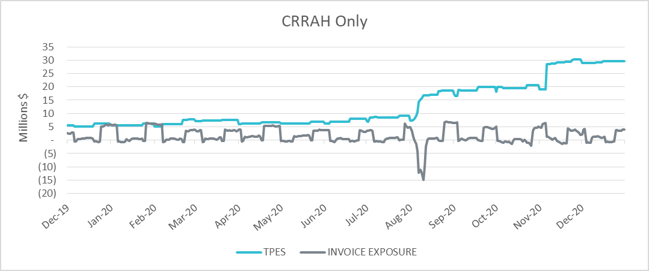
TPE Coverage of Settlements Dec 2019 - Dec 2020
TPES mostly exceeds actual/invoice exposure

Slide 14
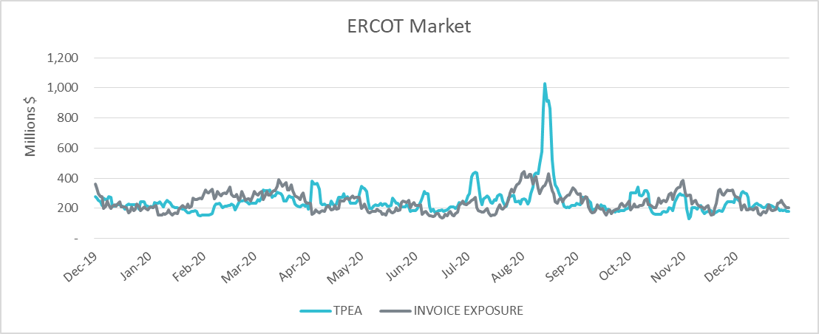
TPE Coverage of Settlements Dec 2019 - Dec 2020
TPEA closely approximates actual/invoice exposure during winter and shoulder months

Slide 15
Appendix

Slide 16
Summary of Distribution by Market Segment
Note: Excess collateral doesn’t include Unsecured Credit Limit and is defined as Collateral in excess of TPE

Slide 17
Summary of Distribution by Rating Group

Slide 18
Distribution of TPE by Rating and Category
Rating Group | CRR Only | Generation Only | Load Only | Load and Generation | Trader | Total TPE | Percent TPE
AAA | 0 | 0 | 0 | 0 | 0 | 0 | 0.00%
AA- to AA+ | 166,161 | 0 | 254,965 | 12,098,150 | 710,597 | 13,229,874 | 3.65%
A- to A+ | 0 | 13,507 | 8,586,350 | 26,511,581 | 1,592,603 | 36,704,043 | 10.12%
BBB- to BBB+ | 2,536,712 | 47,722,215 | 6,196,743 | 35,222,356 | 24,060,823 | 115,738,848 | 31.90%
Investment Grade | 2,702,873 | 47,735,722 | 15,038,059 | 73,832,088 | 26,364,023 | 165,672,765 | 45.66%
BB- to BB+ | 0 | 0 | 0 | 23,474,470 | 33,913,164 | 57,387,634 | 15.82%
B- to B+ | 0 | 0 | 0 | 4,937,778 | 5,693,965 | 10,631,743 | 2.93%
CCC+ and below | 0 | 0 | 0 | 0 | 0 | 0 | 0.00%
Not Rated | 29,633,082 | 5,561,118 | 15,610,895 | 27,108,023 | 51,200,815 | 129,113,934 | 35.59%
Non-Investment Grade | 29,633,082 | 5,561,118 | 15,610,895 | 55,520,271 | 90,807,944 | 197,133,311 | 54.34%
Total TPE | 32,335,955 | 53,296,841 | 30,648,954 | 129,352,359 | 117,171,966 | 362,806,075 | 100.00%
Percent TPE | 8.91% | 14.69% | 8.45% | 35.65% | 32.30% | 100.00%

Slide 19
Distribution of Excess Collateral by Rating and Category
Rating Group | CRR Only | Generation Only | Load Only | Load and Generation | Trader | Excess Collateral | Percent Excess Collateral
AAA | 0 | 0 | 0 | 0 | 0 | 0 | 0.00%
AA- to AA+ | 7,336,324 | 0 | 893,468 | 38,707,997 | 3,289,447 | 50,227,236 | 2.00%
A- to A+ | 116,644 | 4,310,832 | 105,422,344 | 466,878,245 | 71,351,233 | 648,079,298 | 25.77%
BBB- to BBB+ | 18,777,946 | 115,712,841 | 57,024,105 | 403,314,522 | 218,726,600 | 813,556,014 | 32.35%
Investment Grade | 26,230,915 | 120,023,673 | 163,339,917 | 908,900,764 | 293,367,280 | 1,511,862,548 | 60.11%
BB- to BB+ | 0 | 0 | 0 | 213,095,053 | 26,701,717 | 239,796,770 | 9.53%
B- to B+ | 0 | 0 | 0 | 27,761,361 | 2,696,360 | 30,457,721 | 1.21%
CCC+ and below | 0 | 0 | 0 | 0 | 0 | 0 | 0.00%
Not Rated | 56,921,912 | 8,284,173 | 64,861,679 | 176,307,189 | 426,703,226 | 733,078,178 | 29.15%
Non-Investment Grade | 56,921,912 | 8,284,173 | 64,861,679 | 417,163,603 | 456,101,303 | 1,003,332,669 | 39.89%
Total Excess Collateral | 83,152,827 | 128,307,845 | 228,201,596 | 1,326,064,367 | 749,468,582 | 2,515,195,217 | 100.00%
Percent Excess Collateral | 3.31% | 5.10% | 9.07% | 52.72% | 29.80% | 100.00%
Note: Excess collateral doesn’t include Unsecured Credit Limit

Slide 20
TPE Coverage of Settlements
TPEA covers Settlement/Invoice exposure and estimated Real-Time and Day- Ahead completed but not settled activity (RTLCNS and UDAA)
The analysis was performed for the period, Dec 2019 - Dec 2020
Only Settlement invoices due to ERCOT are considered in the calculation
M1 values as of May 28, 2020 were used for the period Jul 2019 - May 2020 and M1 values effective as of each day were used since Jun 2020
Example
For business date 2/1/2020, if a Counter-Party has M1 value of 20, then all the charge invoices till 2/21/2020 including RTLCNS and UDAA as of 2/1/2020 is summed up to arrive at “Invoice Exposure”

Slide 21
Questions

