Slide 1
PDCWG Report to ROS
Chair: Chad Mulholland, NRG
Vice Chair: Jimmy Jackson, CPS
ROS
March 4th, 2021

Slide 2
Report Overview & Notes
Report Overview
Meeting Minutes
BAL-001-TRE-2 FMEs & IMFR
4 FMEs in the month of January
Frequency Control Report

Slide 3
Meeting Minutes
PDCWG Meeting 01/13/2021
Update on BAL-001-TRE, SAR 12
OBDRR25 – ERCOT RFP status update
ERCOT Reports

Slide 4
Frequency Measurable Events Performance

Slide 5
Frequency Measurable Events
There were 4 FMEs in January
1/3/2021 11:34:14
Loss of 776 MW
Interconnection Frequency Response: 1094 MW/0.1 Hz
5 of 45 Evaluated Generation Resources had less than 75% of their expected Initial Primary Frequency Response.
7 of 45 Evaluated Generation Resources had less than 75% of their expected Sustained Primary Frequency Response.
1/6/2021 18:20:35
Loss of load of 774 MW
Interconnection Frequency Response: 956 MW/0.1 Hz
10 of 45 Evaluated Generation Resources had less than 75% of their expected Initial Primary Frequency Response.
9 of 45 Evaluated Generation Resources had less than 75% of their expected Sustained Primary Frequency Response.

Slide 6
Frequency Measurable Events
1/11/2021 13:03:26
Loss of 757 MW
Interconnection Frequency Response: 1147 MW/0.1 Hz
5 of 52 Evaluated Generation Resources had less than 75% of their expected Initial Primary Frequency Response.
5 of 52 Evaluated Generation Resources had less than 75% of their expected Sustained Primary Frequency Response.
1/28/2021 14:21:20
Loss of load of 718 MW
Interconnection Frequency Response: 1197 MW/0.1 Hz
9 of 53 Evaluated Generation Resources had less than 75% of their expected Initial Primary Frequency Response.
8 of 53 Evaluated Generation Resources had less than 75% of their expected Sustained Primary Frequency Response.

Slide 7
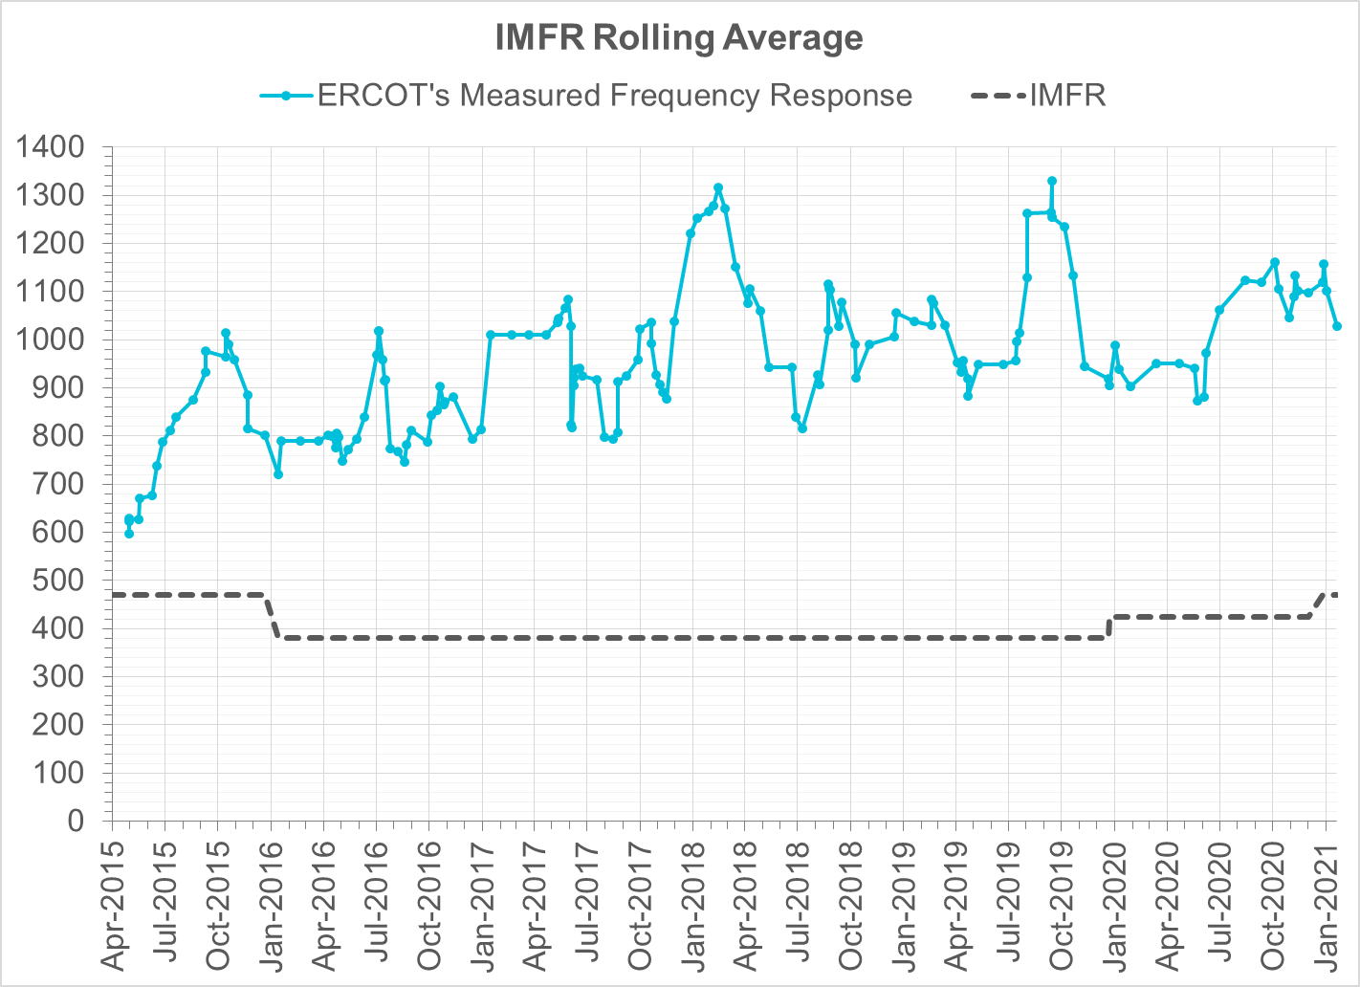
Interconnection Minimum Frequency Response (IMFR) Performance
IMFR Performance currently 1027.82 MW/0.1Hz
Frequency Response Obligation (FRO): 471 MW/0.1 Hz

Slide 8
Frequency Control Report
January 2021

Slide 9
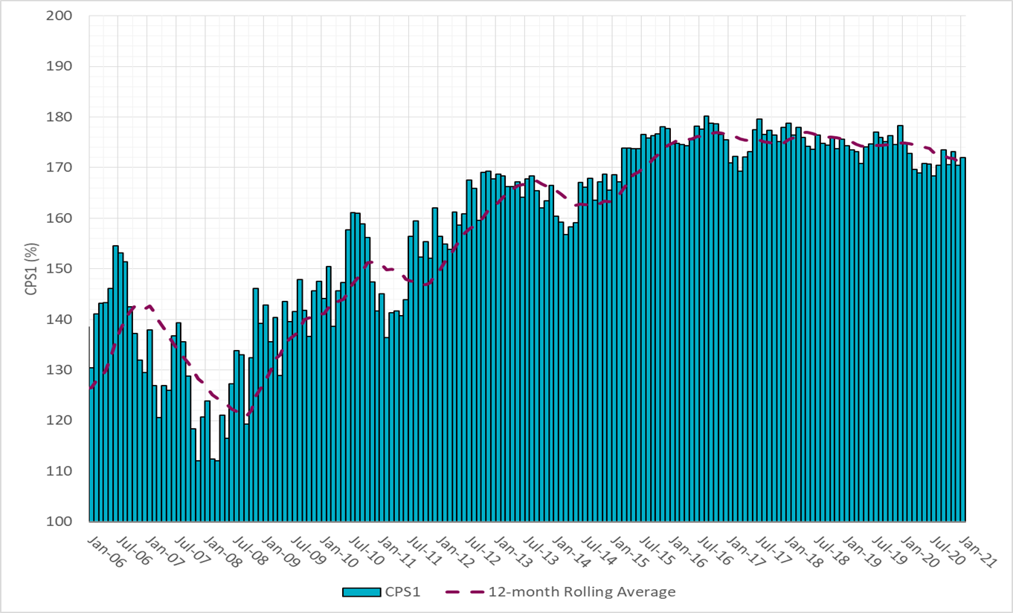
CPS1 Performance

Slide 10
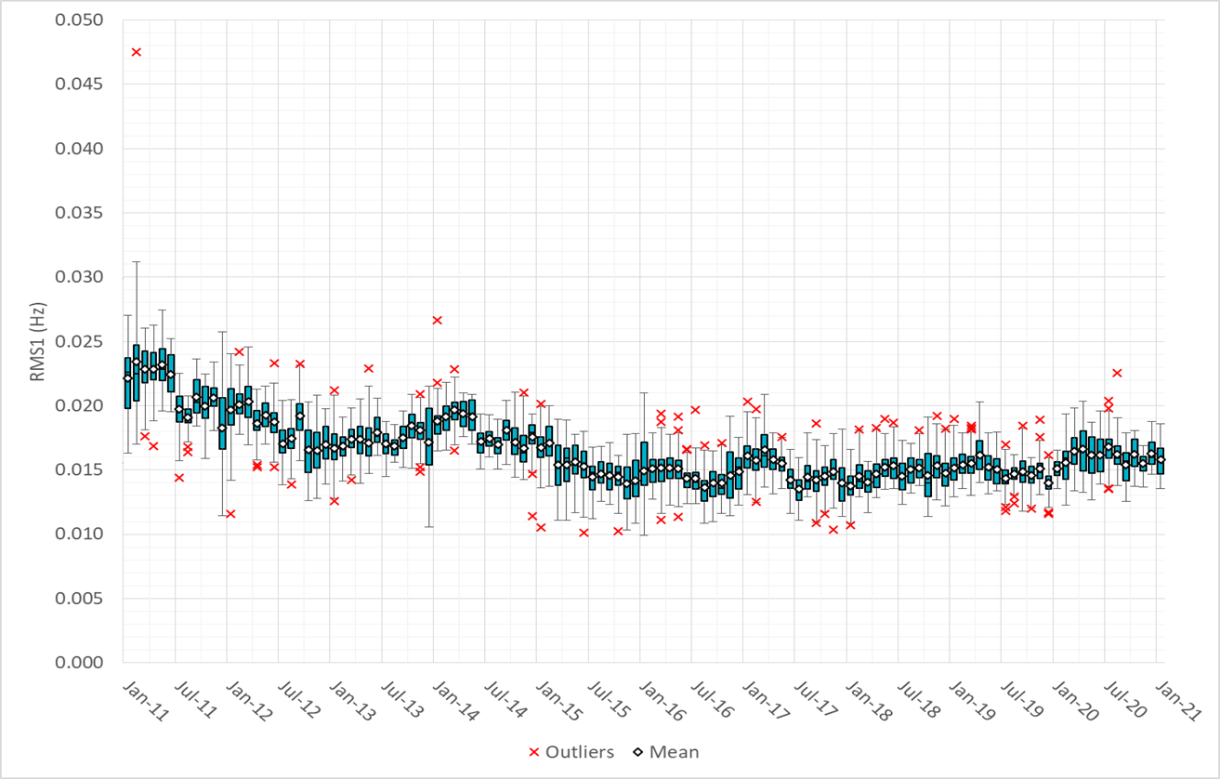
RMS1 Performance of ERCOT Frequency

Slide 11
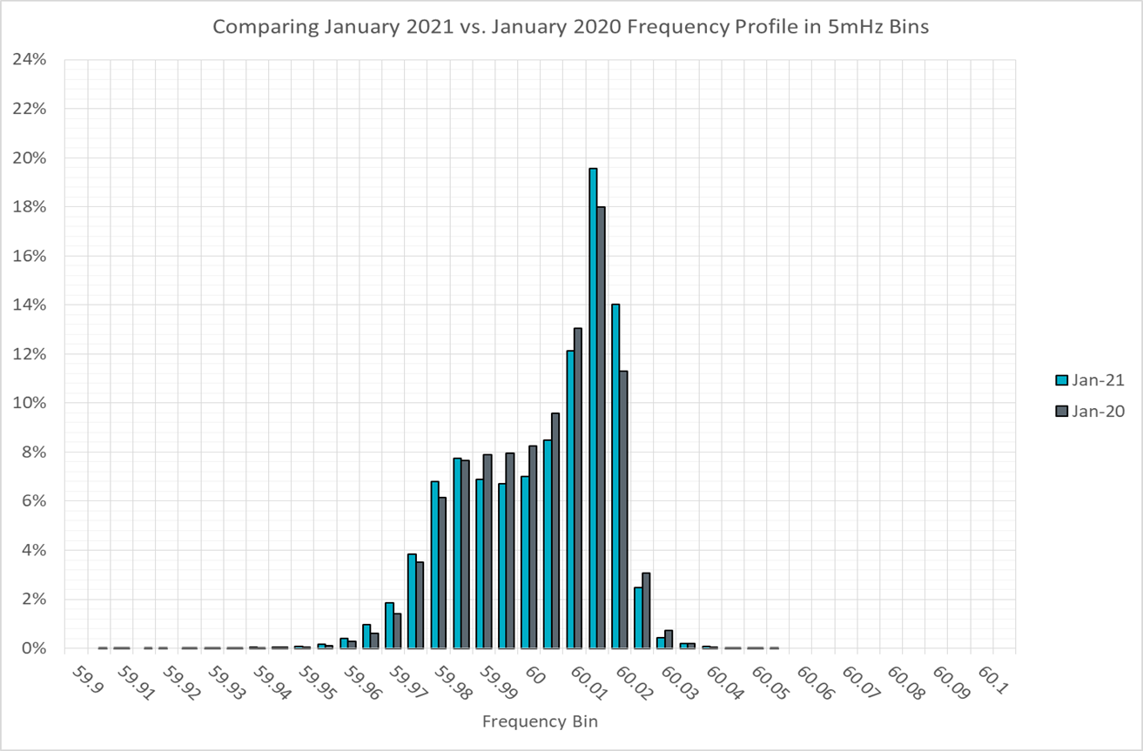
Frequency Profile Analysis

Slide 12
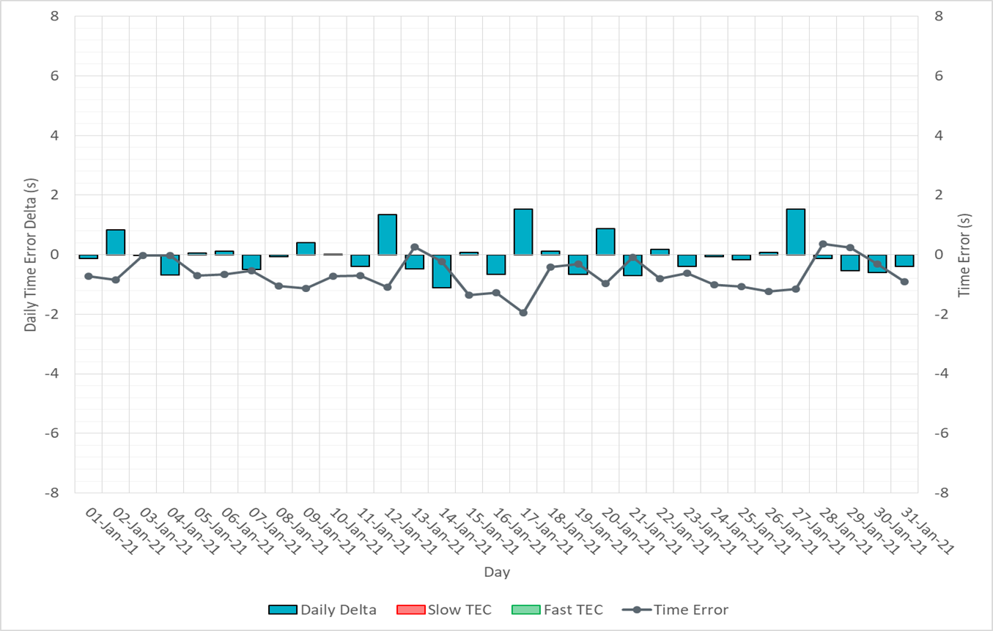
Time Error Corrections

Slide 13
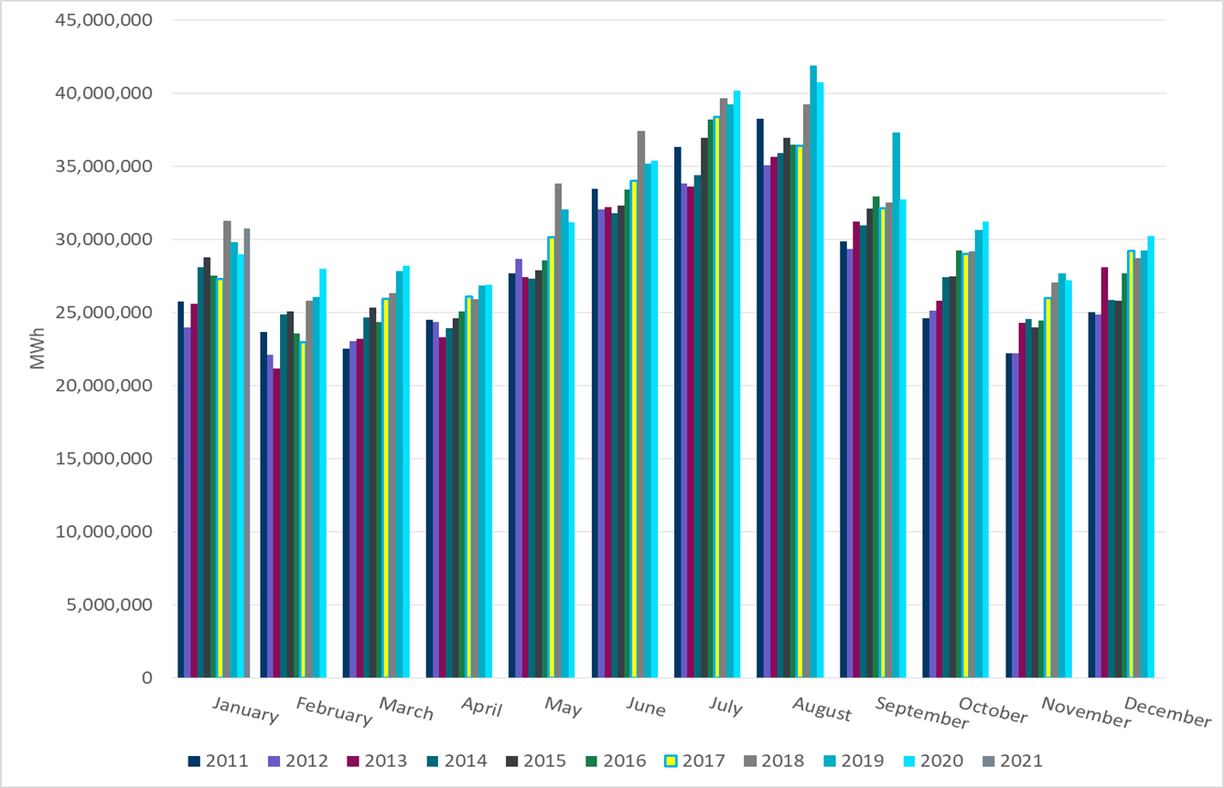
ERCOT Total Energy
Notes:
31,210,036 MWh

Slide 14
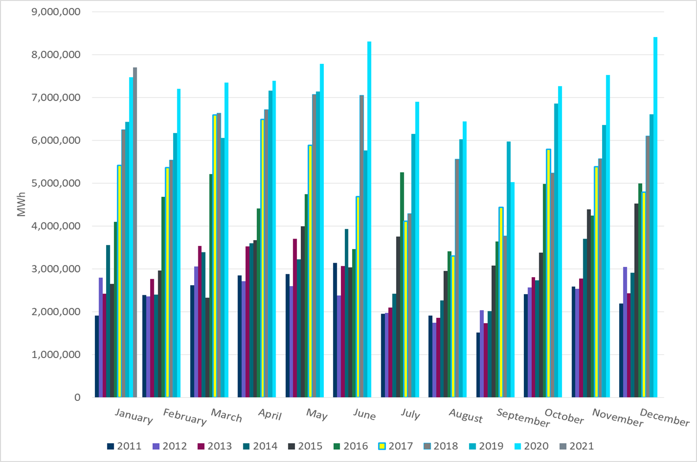
ERCOT Total Energy from Wind Generation
Notes:
7,264,919 MWh

Slide 15
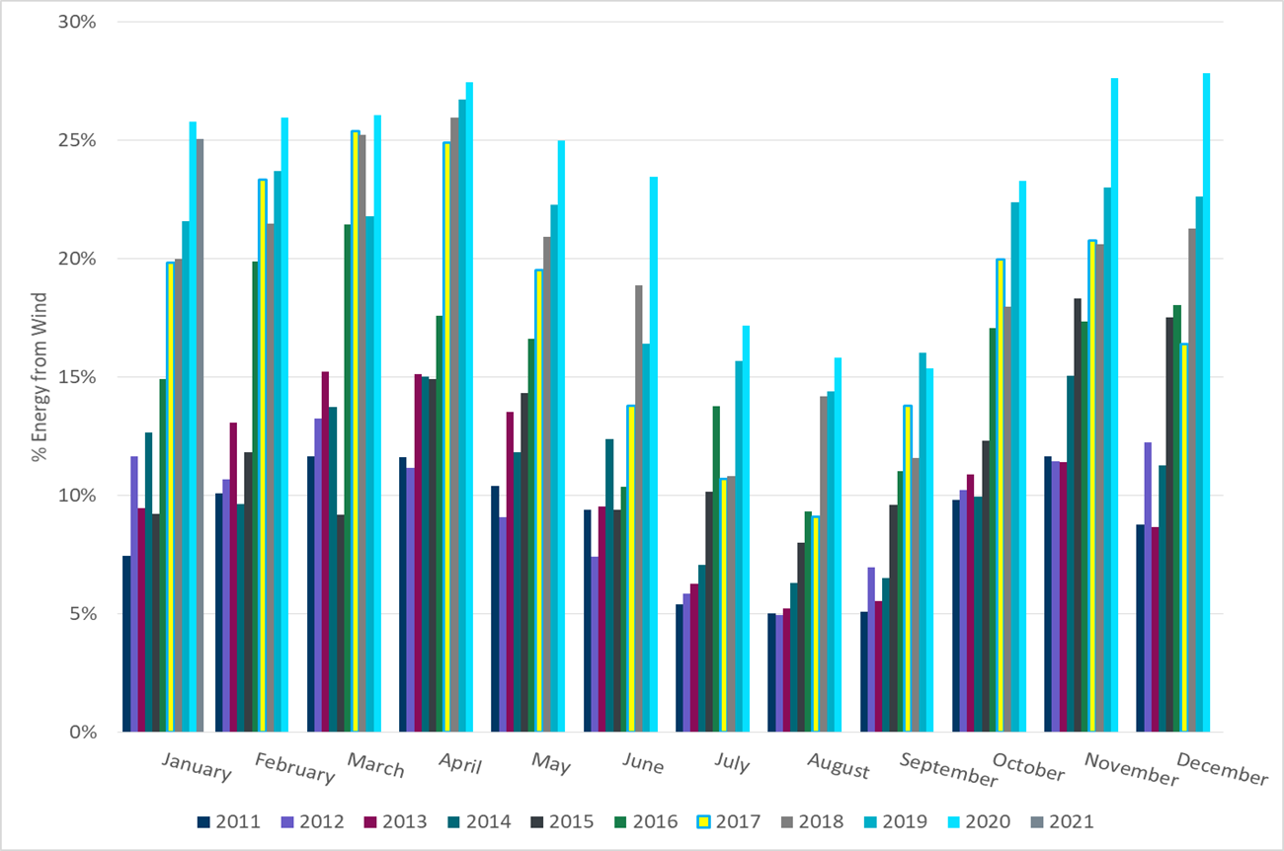
ERCOT % Energy from Wind Generation
Notes:
23.28%

Slide 16
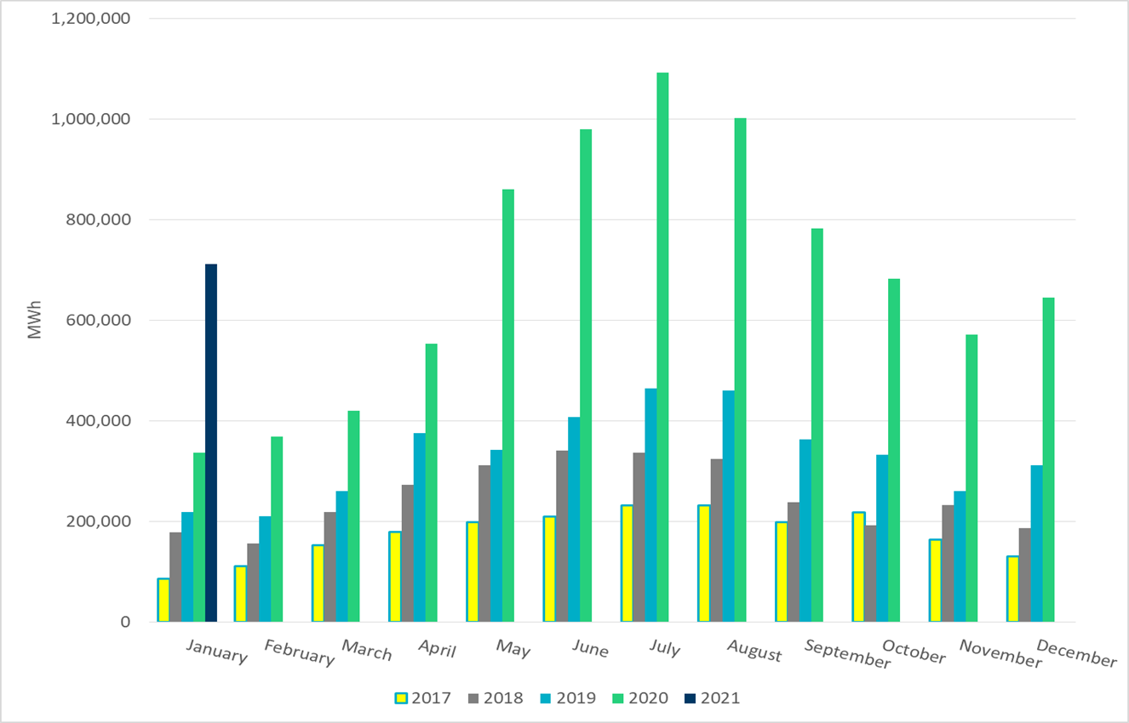
ERCOT Total Energy from Solar Generation
Notes:
682,932 MWh

Slide 17
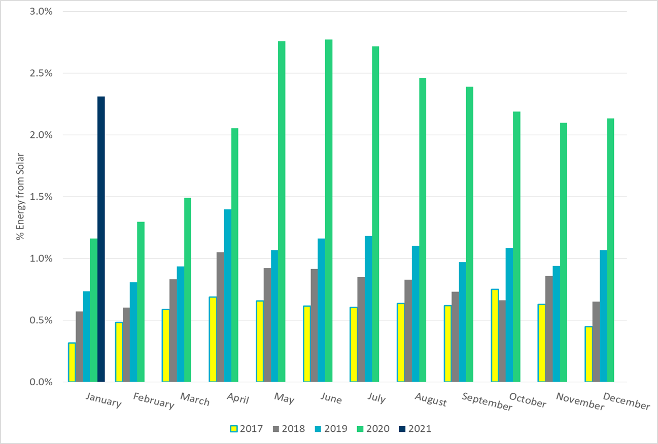
ERCOT % Energy from Solar Generation
Notes:
2.19%

Slide 18
Questions?

