Slide 1
Mass Transition Timeline & Process Review
Jim Lee
RMS Chair

Slide 2
Timeline for Initiation of a Mass Transition

Slide 3
Mass Transition Timeline
“Mass Transition Date”
Day 2
Day 3 / Day 4 / Day 5
“Notification Date”
Day 0
Day 1
ERCOT provides notice of Mass Transition event to impacted CRs, TDSPs, and PUCT
Notice before 3pm CT: Proj. Coord. call held by 5pm.
Notice after 3pm CT: Proj. Coord. call held next morning.
Project Coordination
Call 1
Project Coordination
Call 2
Project Coordination
Call 3
Where applicable, TDSPs will send 867_04 and/or 867_03F for SWI/MVI/Drop to POLR transactions completed
ERCOT begins Customer outreach to inform of POLR event (postcard/email/phone/text)
ERCOT forwards any ‘competitive’ 814_03
SWI or MVI to TDSP
ERCOT sends 814_03 “TS” Drop to POLR transactions to TDSPs with an effective date of two calendar days out (“Mass Transition Date”)
ERCOT forwards any ‘competitive’ 814_03
SWI or MVI to TDSP
TDSP executes
‘competitive’ 814_03
SWI or MVI if rec’d by 7pm CPT
Once a default is confirmed, ERCOT provides impacted TDSPs with the Defaulting CR DUNS to prepare systems for a Mass Transition event
TDSP schedules Drop to POLR as requested by ERCOT
Beginning 7:01pm CPT, TDSPs execute the remaining population of Drop to POLR transactions (if SWI/MVI hasn’t been already executed by TDSP or Cancelled by ERCOT)
TDSP executes SWI or MVI in lieu of scheduled Drop to POLR; ERCOT sends Cancel for Drop to POLR
Default CR provides CBCI file to ERCOT
IMPORTANT NOTE:
Per PUCT Subst. R 25.43, if a Mass Transition Drop to POLR’s Effective Date falls on a Sunday or Holiday, non-AMS Operational Day rules and non-Business day rules shall apply. Meaning, no competitive 814_01 Switch or 814_16 Move-In will be scheduled for the same Effective Date, thereby only the Drop to POLR will effectuate.

Slide 4
Mass Transition with Sunday Effective Date
In reference to the note above, PUCT Subst. Rule 25.43 states that a Mass Transition event must complete within 2 calendar days. Meaning, a Mass Transition event can fall on a Sunday or Holiday. Therefore, if a Mass Transition event effectuates on a Sunday or Holiday, the Mass Transition switch will be completed by the TDSP in accordance with PUCT Subst. R. 25.43.
For any Standard or Self-Selected Switch (aka competitive switches) or Move-In requesting a Sunday or Holiday (non-AMS Operational Day and non-Business Day), TDSP will schedule the switch for the next AMS Operational Day in accordance with the TDSP Tariff for Standard and Self-Selected Switch.
References to the TDSP Tariff and the Retail Market Guide, Appendix D3, TDSP’s Discretionary Service Timeline Matrix are provided on the following two slides.
IMPORTANT NOTE:
Per PUCT Subst. R 25.43, if a Mass Transition Drop to POLR’s Effective Date falls on a Sunday or Holiday, non-AMS Operational Day rules and non-Business day rules shall apply. Meaning, no competitive 814_01 Switch or 814_16 Move-In will be scheduled for the same Effective Date, thereby only the Drop to POLR will effectuate.

Slide 5
TDSP Tariff for Electric Delivery Service – 6.1.2
Meter Reading for the Purpose of a Standard Switch
This service reads Retail Customer’s Meter for the purpose of switching Retail Customer’s account to a different Competitive Retailer when Retail Customer has not requested a self-selected switch. The service is performed in accordance with Section 4.3.4, CHANGING OF DESIGNATED COMPETITIVE RETAILER.
Company shall complete performance of the service using an Actual Meter Reading to allow completion of the switch on the First Available Switch Date (FASD) received from the Registration Agent, provided: (1) Company receives the order by 7:00 PM CPT on an AMS Operational Day; and (2) the FASD is an AMS Operational Day. The FASD is day zero unless otherwise specified by the Registration Agent.
Company may treat an order received after 7:00 PM CPT on an AMS Operational Day, or on a day that is not an AMS Operational Day, as received on the next AMS Operational Day.
Company may use an Estimated Meter Reading to complete performance of the service if conditions preclude execution of an Actual Meter Reading.
Meter Reading for the Purpose of a Self-Selected Switch
This service reads Retail Customer’s Meter on a date other than the Scheduled Meter Reading Date for the purpose of switching Retail Customer’s account to a different Competitive Retailer on a date certain. The service is performed in accordance with Section 4.3.4, CHANGING OF DESIGNATED COMPETITIVE RETAILER. A charge applies only when Company uses an Actual Meter Reading to perform the service.
Company shall complete performance of the service on the requested date provided: (1) Company receives the order by 7:00 PM CPT on the requested date; and (2) the requested date is an AMS Operational Day.
Company may treat an order received after 7:00 PM CPT on an AMS Operational Day, or on a day that is not an AMS Operational Day, as received on the next AMS Operational Day. If the requested date is not an AMS Operational Day, Company shall complete performance of the service by the first AMS Operational Day following the requested date.
Company may use an Estimated Meter Reading to complete performance of the service if conditions preclude execution of an Actual Meter Reading.
Meter Reading for the Purpose of a Mass Transition
This service provides a Meter Reading for each affected Retail Customer for the purpose of a mass transition of the Retail Customers pursuant to 16 TAC §25.43. Company shall charge the exiting Competitive Retailer for performance of the service.

Slide 6
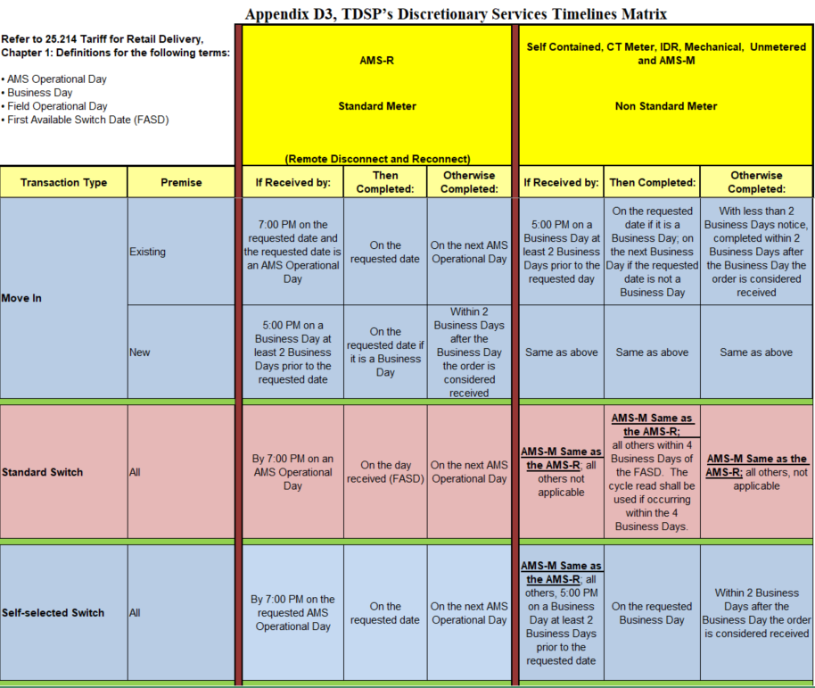
Retail Market Guide, Appendix D3

Slide 7
Market Communications

Slide 8
Customer Communications (pre-transition)
PUCT Subst. Rule §25.43(t) - Notice of transition to POLR service to customers
When a customer is moved to POLR service, the customer shall be provided notice of the transition by ERCOT, the REP transitioning the customer, and the POLR provider.
The ERCOT notice shall be provided within two days of the time ERCOT and the transitioning REP know that the customer shall be transitioned and customer contact information is available. If ERCOT cannot provide notice to customers within two days, it shall provide notice as soon as practicable.
(1) ERCOT notice methods shall include a post-card, containing the official commission seal with language and format approved by the commission. ERCOT shall notify transitioned customers with an automated phone-call and email to the extent the information to contact the customer is available pursuant to subsection (p)(6) of this section. ERCOT shall study the effectiveness of the notice methods used and report the results to the commission.

Slide 9
ERCOT Market Communications
PUCT Subst. Rule §25.43(u) – Market Notice of Transition to POLR Service
ERCOT shall notify all affected Market Participants and the Retail Market Subcommittee (RMS) email listserv of a mass transition event within the same day of an initial mass-transition call after the call has taken place. The notification shall include the exiting REP’s name, total number of ESI IDs, and estimated load.

Slide 10
Questions?

