Slide 1
ERCOT Frequency Control Report
January 2021
ERCOT
Operations Planning
PDCWG | February 12th, 2021

Slide 2
Summary of December 2020
CPS1: 172.03%
Current CPS1 12-Month Rolling Average: 170.97%
1 BAAL Exceedance(s)
0 hourly CPS1 score below 100%
BAAL-003 Events have updated through 2019
2019 BAAL-003 FRM Performance: -811.14
2021 RMS1 Statistics
Mean: 15.82 mHz
Min: 13.56 mHz
Max: 18.6 mHz
Energy Statistics
Total Energy: 30,759437 MWh
Wind Energy: 7,706899 MWh
Percent Energy from Wind: 25.06%
Solar Energy: 711282 MWh
Percent Energy from Solar: 2.31%
Minimum System Inertia
Mean: 185886
Max: 270782 on Jan 11th
Min: 136,033 on Jan 30th
Notes:
2018 BAAL-003 FRM Performance: -843.17

Slide 3
Frequency Control
CPS1, BAAL, & RMS1

Slide 4
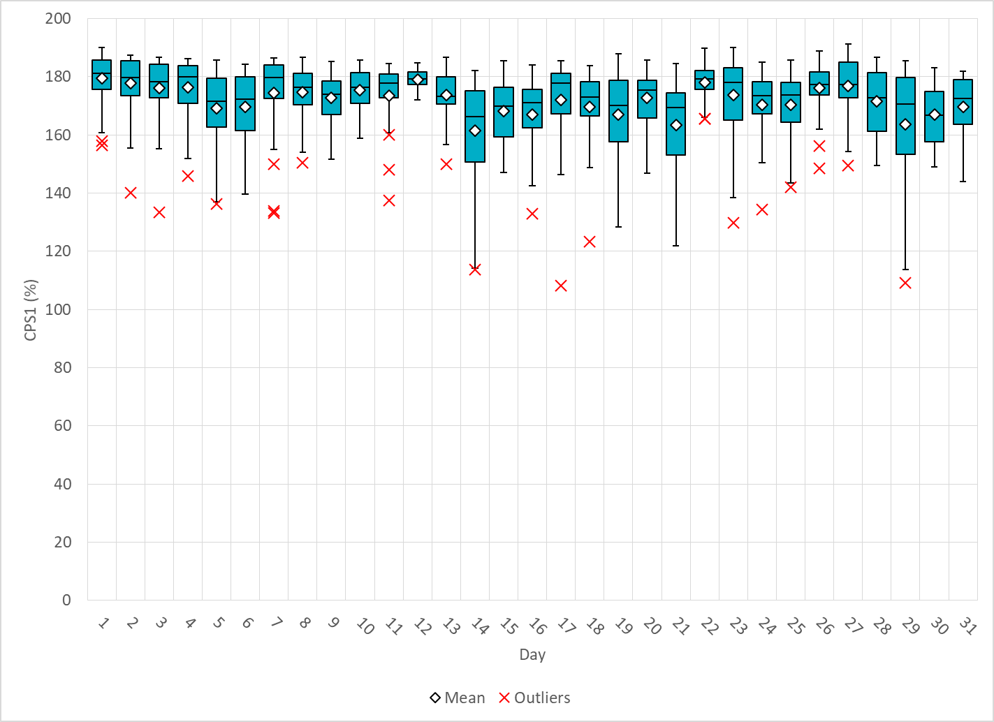
Hourly CPS1 by Day

Slide 5
BAAL Exceedances & Violations
There was 1 BAAL exceedance(s) in Jan
Notes:
Occurred on 01/03/2021

Slide 6
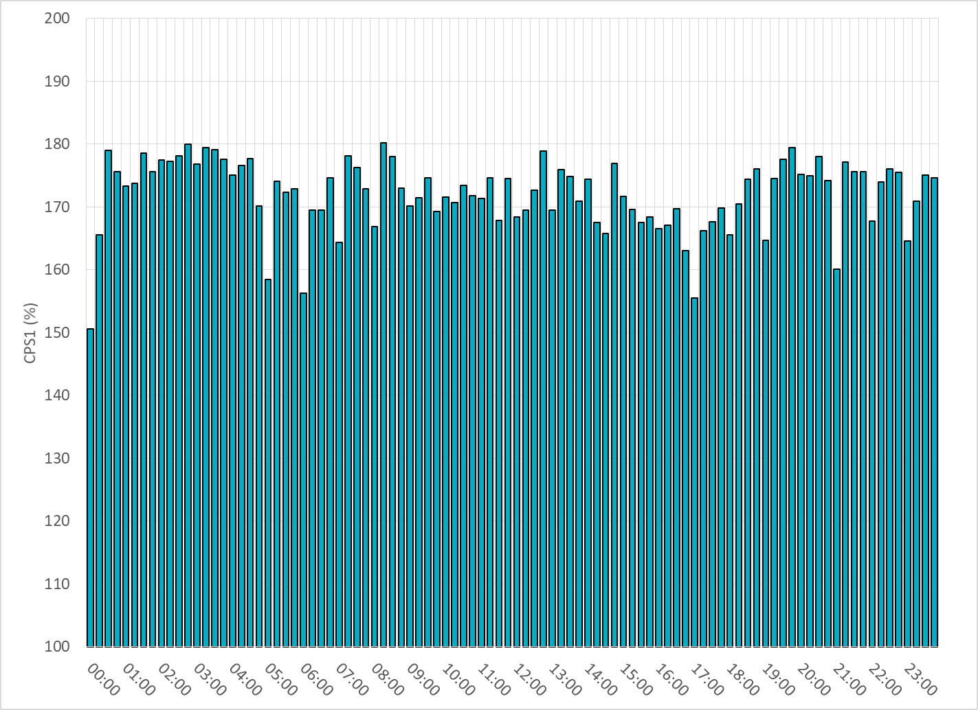
15-Minute Average CPS1%
Jan-21 CPS1 (%): 172.03

Slide 7
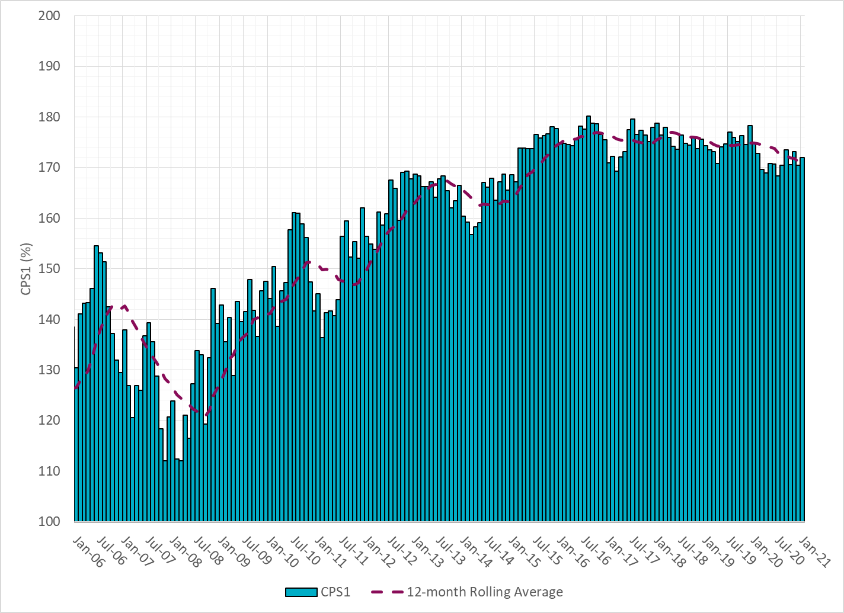
12-Month Rolling Average CPS1
Current 12-Month Rolling Average: 170.97%

Slide 8
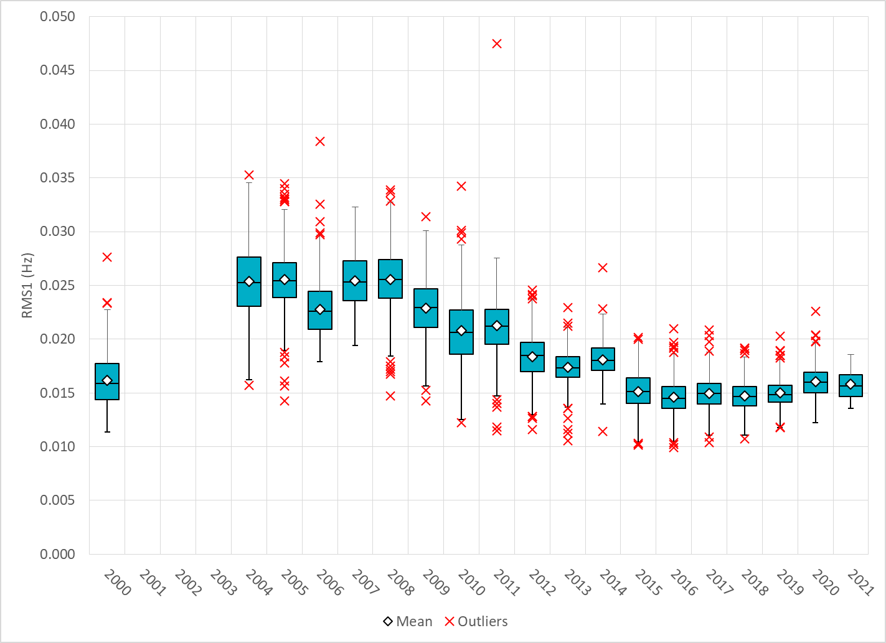
Daily RMS1 of ERCOT Frequency by Year
Notes:
Mean: 15.82 mHz
Min: 13.56 mHz
Max: 18.6 mHz

Slide 9
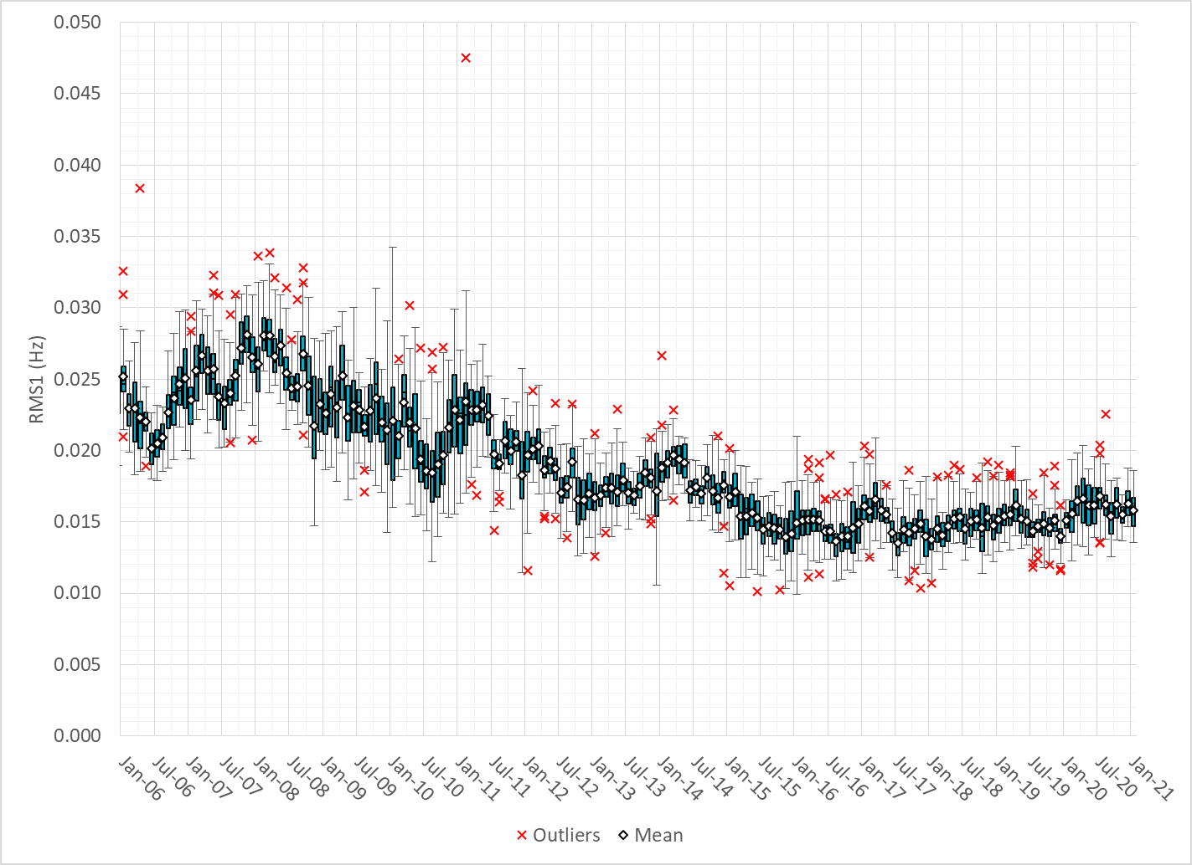
Daily RMS1 of ERCOT Frequency by Month

Slide 10
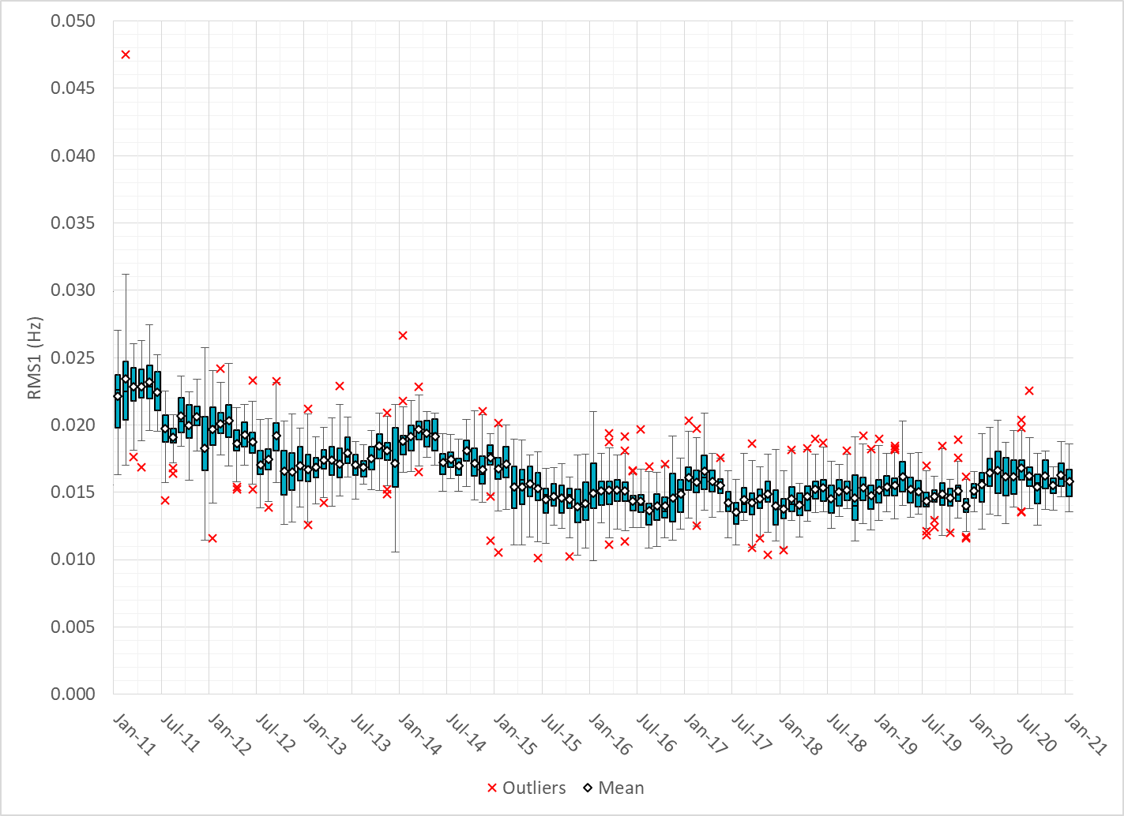
Daily RMS1 of ERCOT Frequency by Month

Slide 11
Frequency Profile Comparison

Slide 12
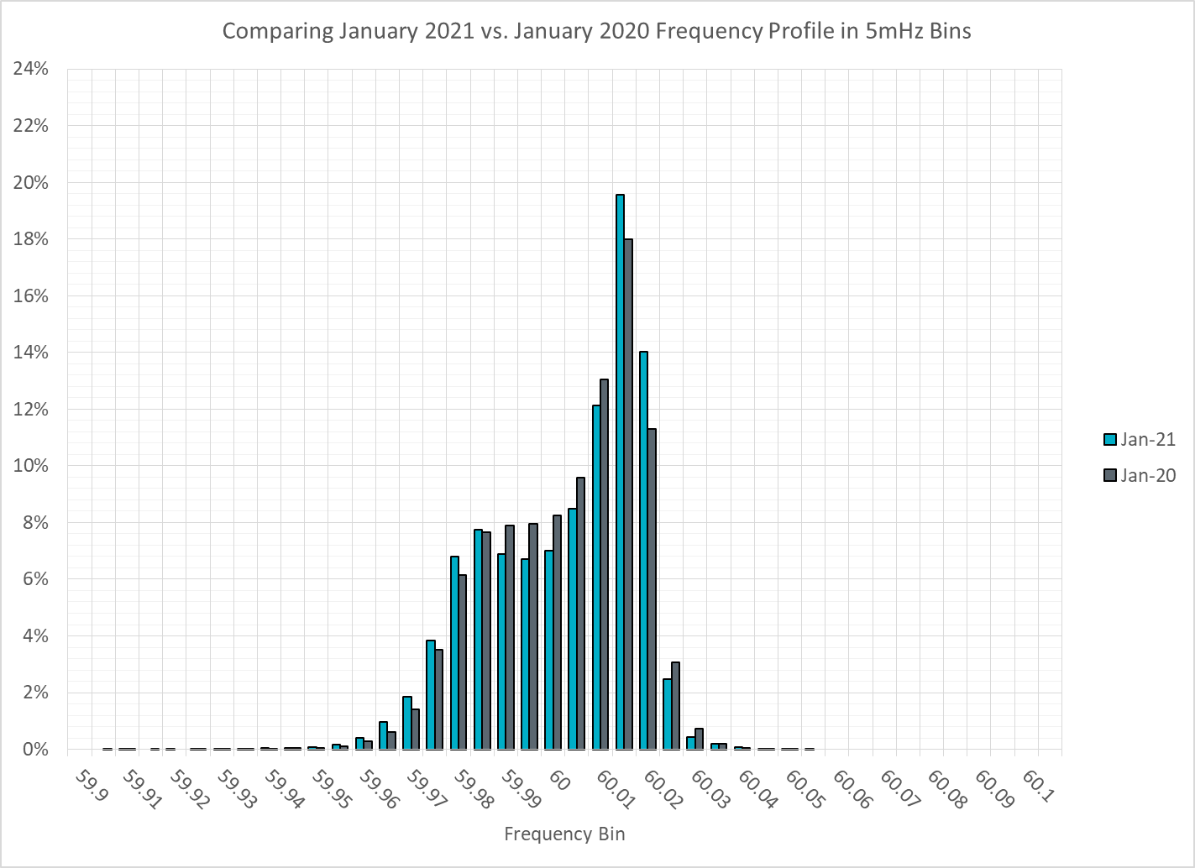
Frequency Profile Comparison

Slide 13
Frequency Profile Comparison

Slide 14
Time Error Correction

Slide 15
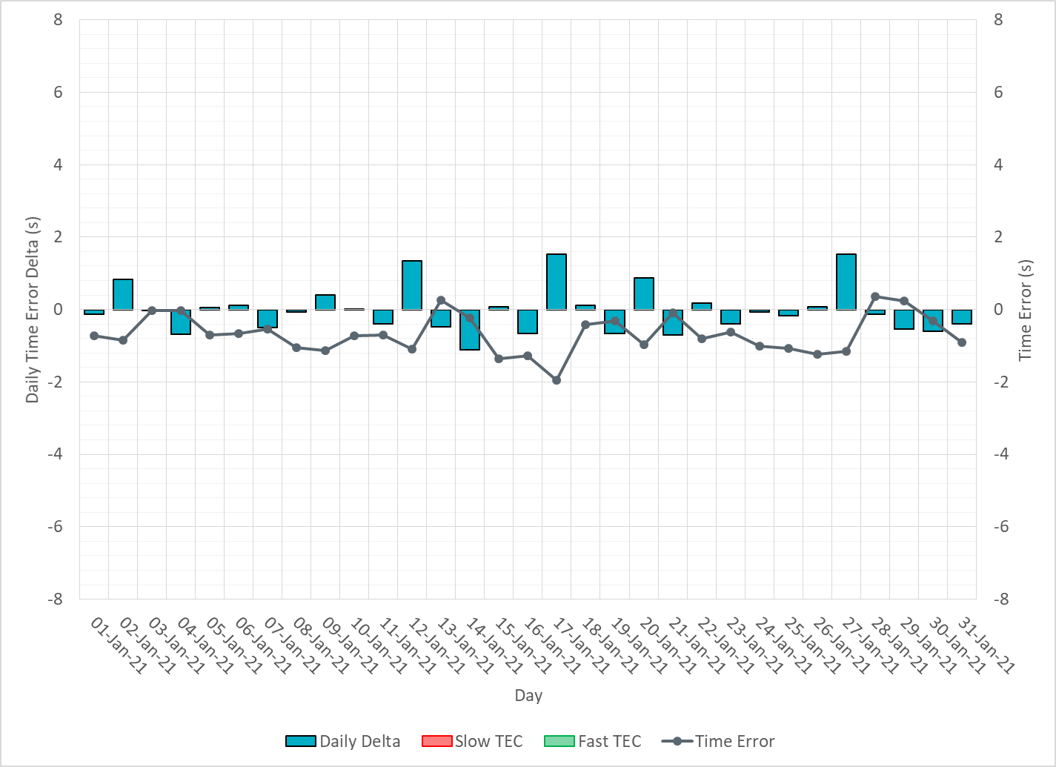
ERCOT Daily Time Error

Slide 16
Time Error Corrections Log Summary
There have been no time error corrections since December 2016

Slide 17
BAL-003 Performance

Slide 18
Op. Year 2019 BAL-003 Selected Events – Update
Notes:
BAL-003

Slide 19
Op. Year 2019 BAL-003 FRM Performance - Update
Notes:
OP2018: FRO = -381.0, FRM_median = -843.17, FRM_average = -959.7
OP2019: FRO = -381.0, FRM_median = -811.14, FRM_average = -892.5
OP2020: FRO = -425.0,

Slide 20
ERCOT Energy Statistics

Slide 21
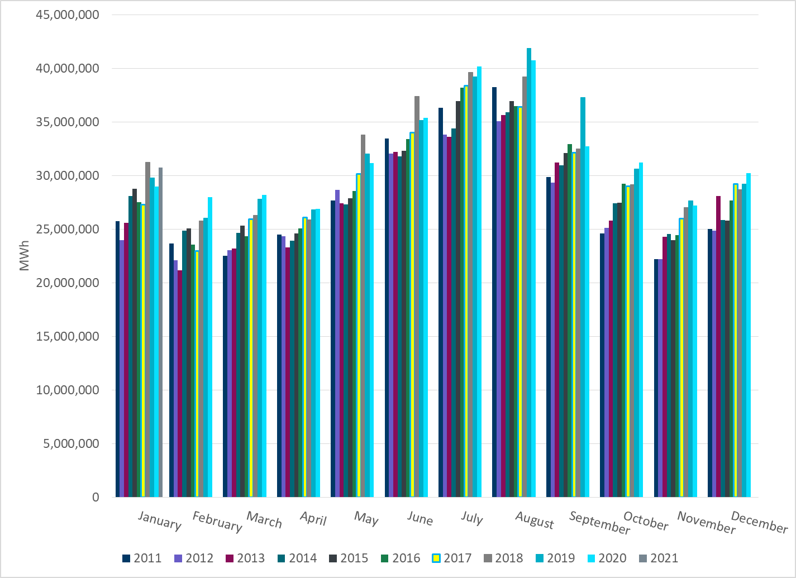
Total Energy
Notes:
30,759437 MWh

Slide 22
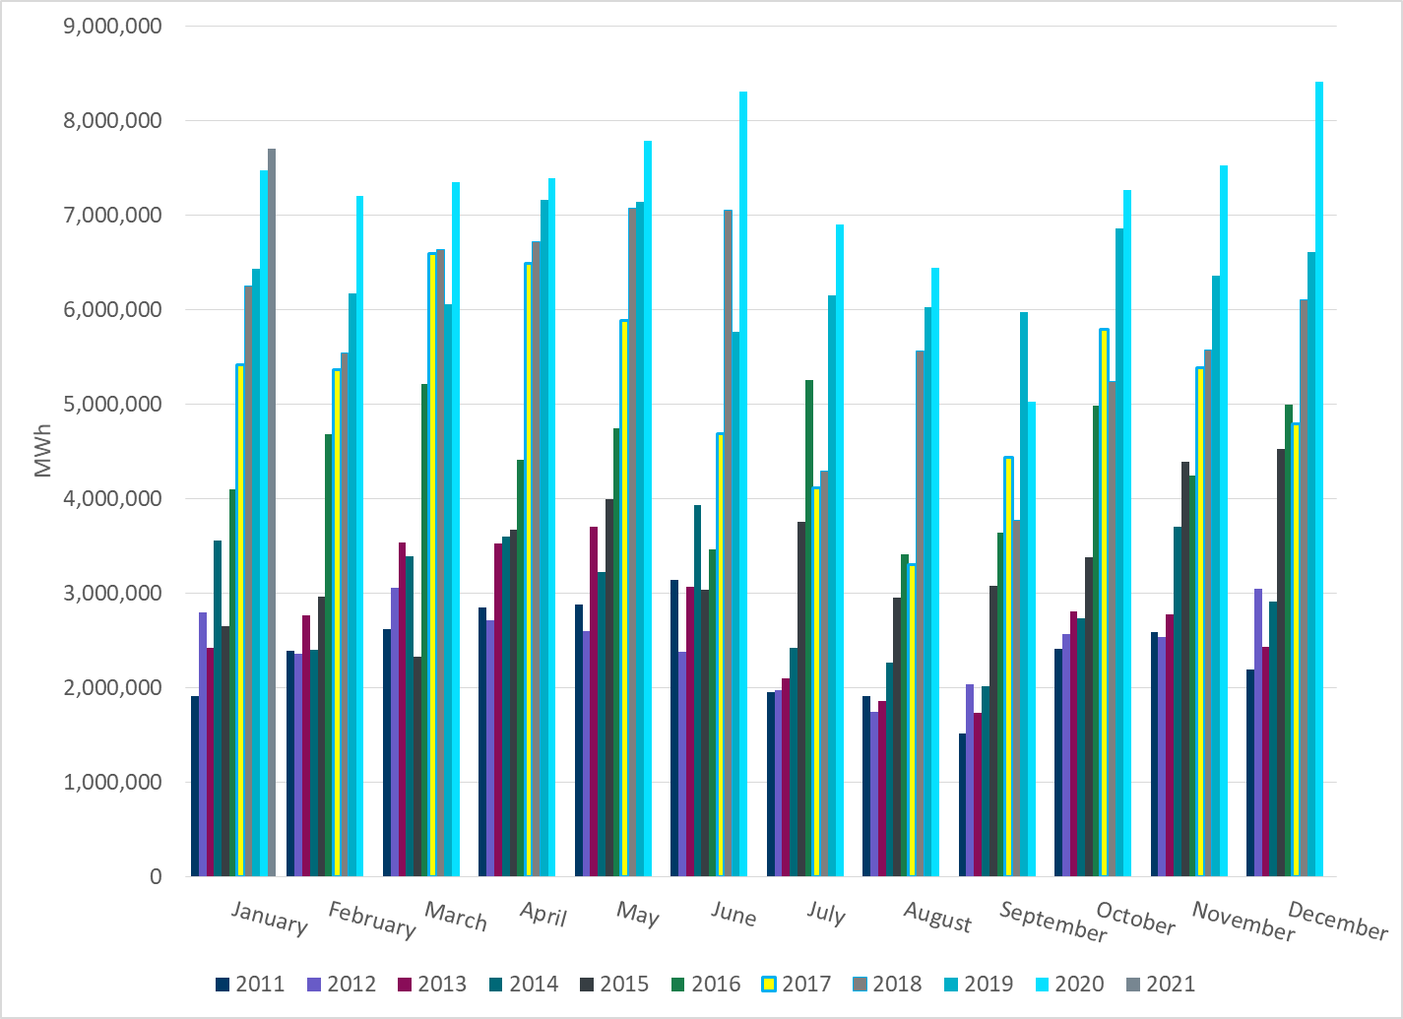
Total Energy from Wind Generation
Notes:
7,706899 MWh

Slide 23
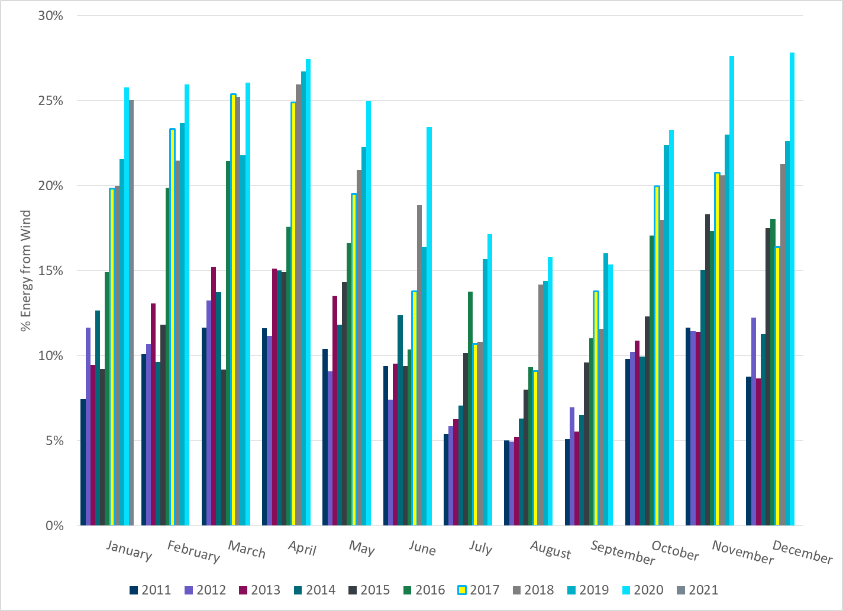
% Energy from Wind Generation
Notes:
25.06%

Slide 24
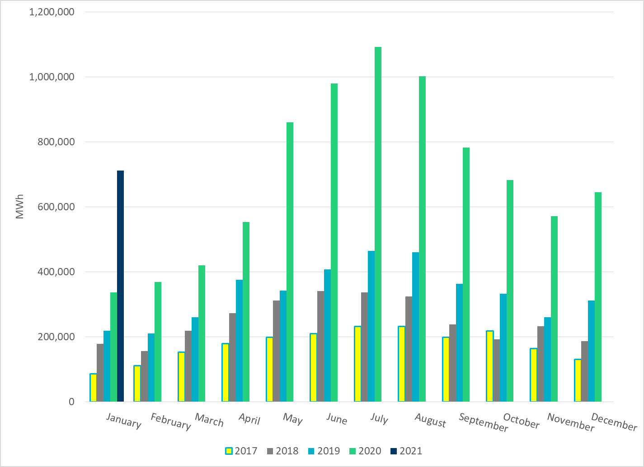
Total Energy From Solar Generation
Notes:
711282 MWh

Slide 25
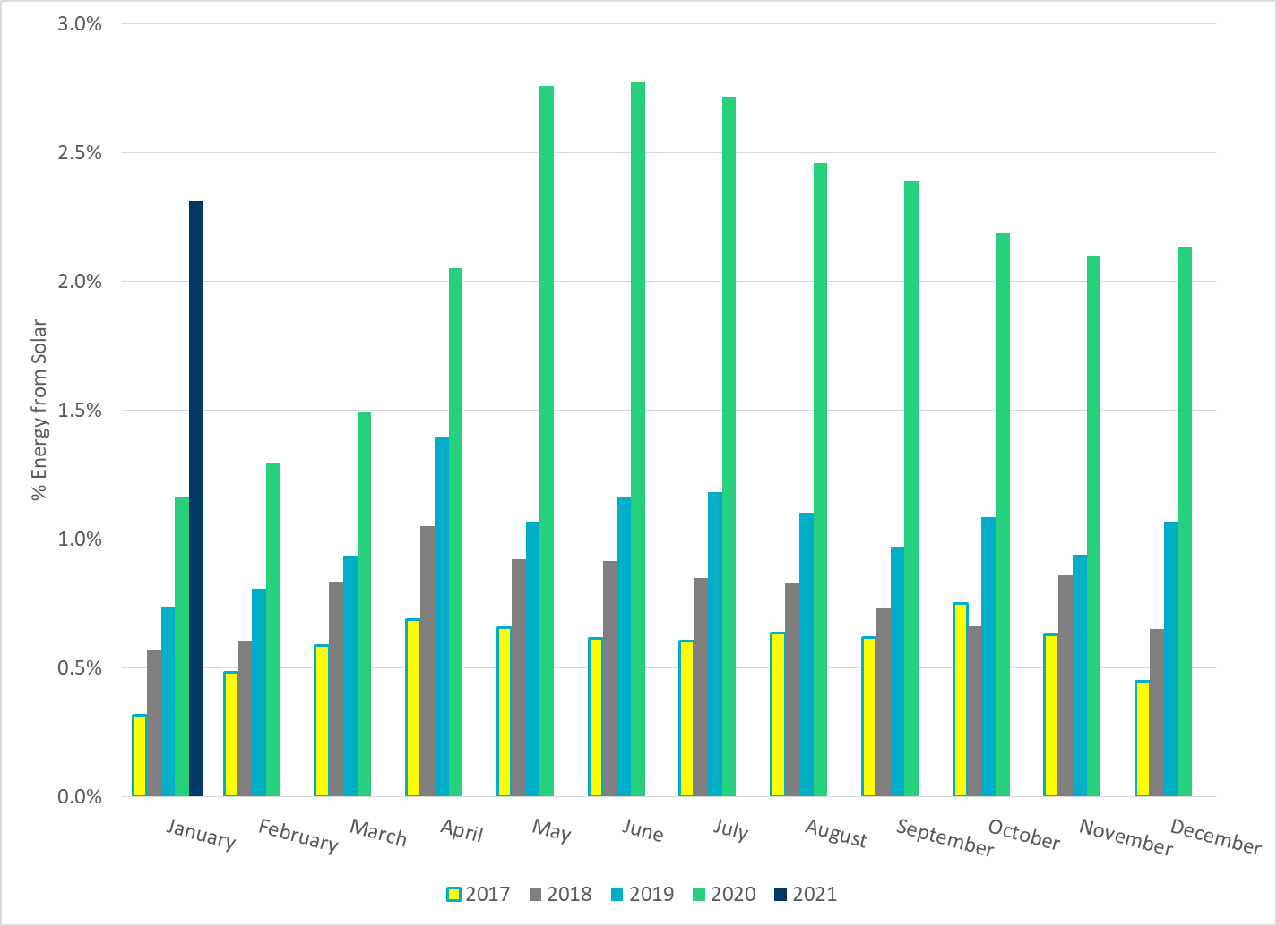
% Energy from Solar Generation
Notes:
2.31%

Slide 26
ERCOT System Inertia

Slide 27
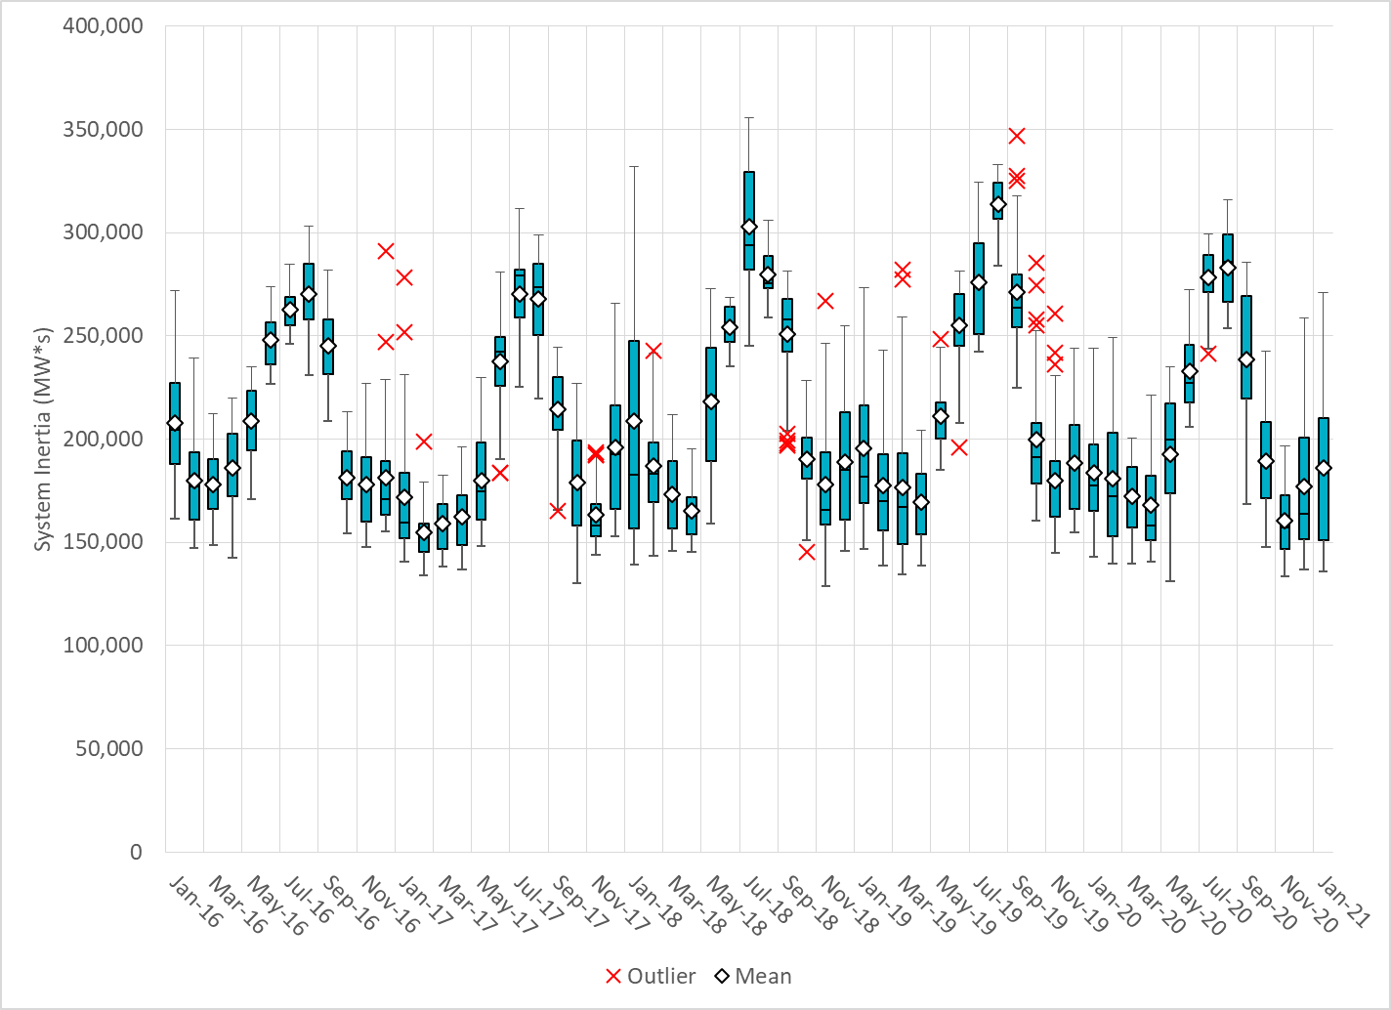
Daily Minimum System Inertia
Notes:
Minimum Inertia = 136,033 MW*s on 1/30/2021
Previous Minimum was 128,759 MW*s on 11/3/2018.
Data:
Mean: 185886
Max: 270782 on Jan 11th
Min: 136,033 on Jan 30th

Slide 28
Questions?
Thank you!

