Slide 1
ERCOT Frequency Events
January 2021
ERCOT
Operations Planning
PDCWG | February 12th, 2021

Slide 2
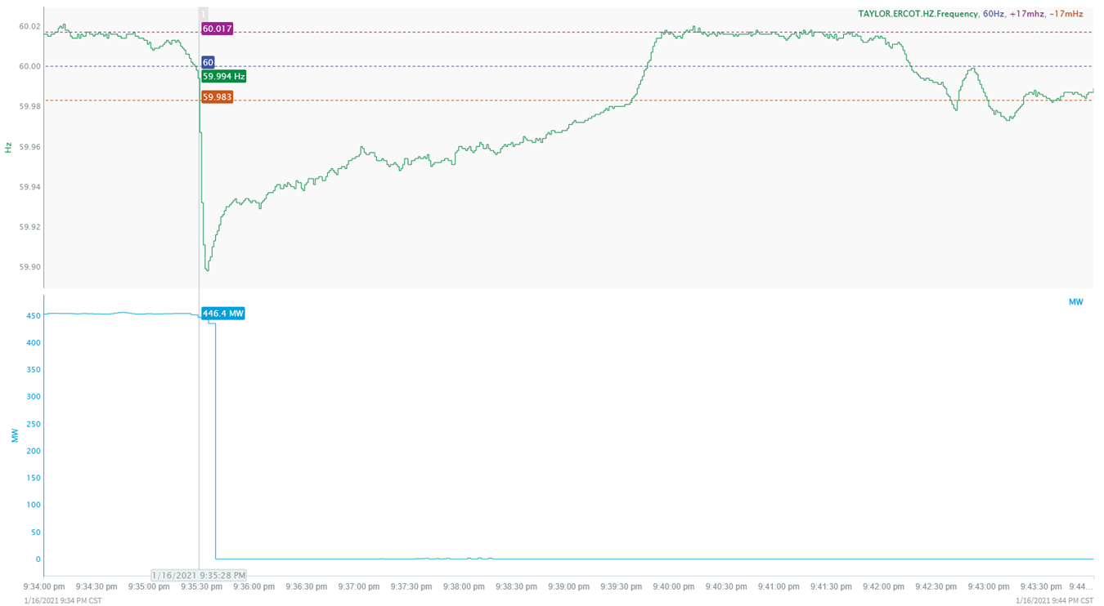
1/16/2021 21:35:28 (Non-FME)
Notes:
Unit tripped offline while carrying 453 MW
Starting Frequency: 59.994 Hz
Minimum Frequency: 59.8980 Hz
A-C Time: 5 seconds
Recovery Time (back to deadband): 4 minutes and 17 seconds
RRS Deployed: 568 MW
Trip Reason: Unit was performing valve testing and valves went completely closed.
Contextual Information: 19 MW of regulation down requested at the time of the event. Total of 148 MW of regulation up was deployed during the event
No Selection Reason: MW loss was less than 550 MW and the frequency is not stable prior to the start of the event.

Slide 3
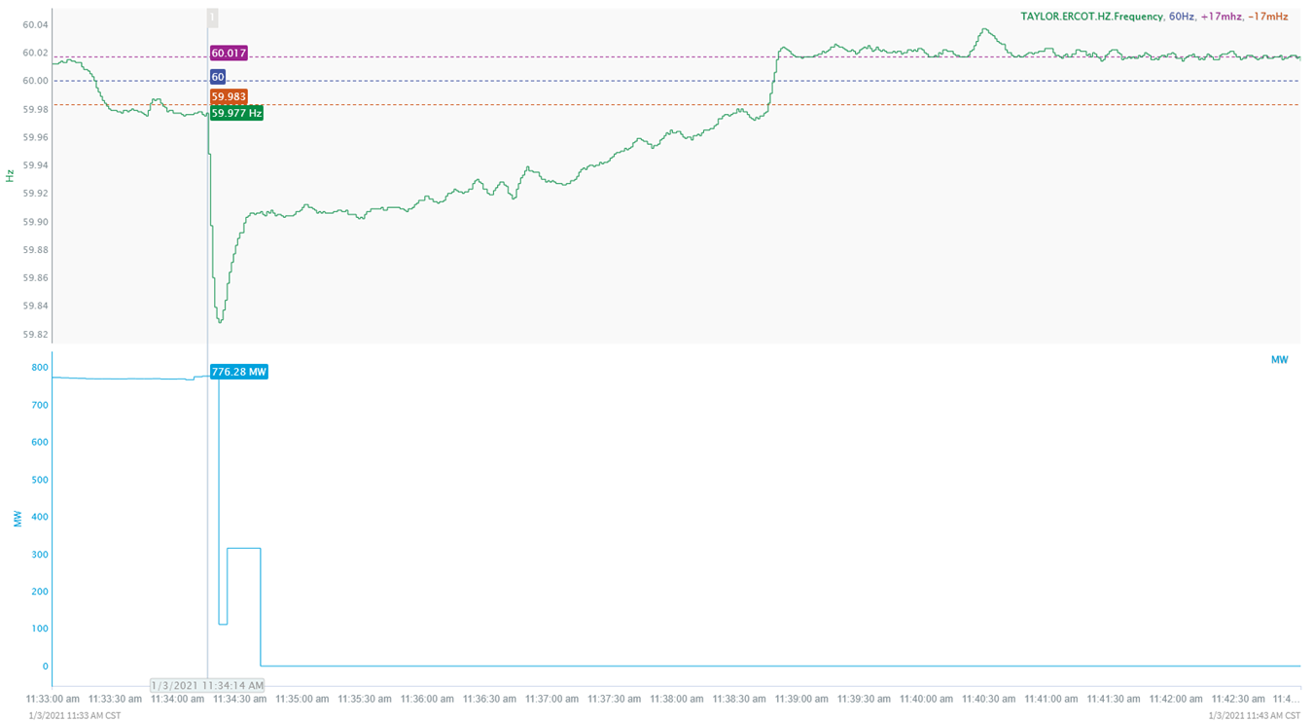
1/3/2021 11:34:14 (FME)
Notes:
Unit tripped offline carrying around 776 MW.
Starting Frequency: 59.977 Hz
Minimum Frequency: 59.828 Hz
A-C Time: 6 seconds
Recovery Time(back to deadband): 4 minutes and 30 seconds
RRS Deployed: 998.75 MW
Trip Reason: Trip caused by loss of 1 alpha bus
Contextual Information: 135 MW of regulation down requested at the time of the event. Total of 300 MW of regulation up was deployed during the event and 300 MW offset was applied after the event

Slide 4
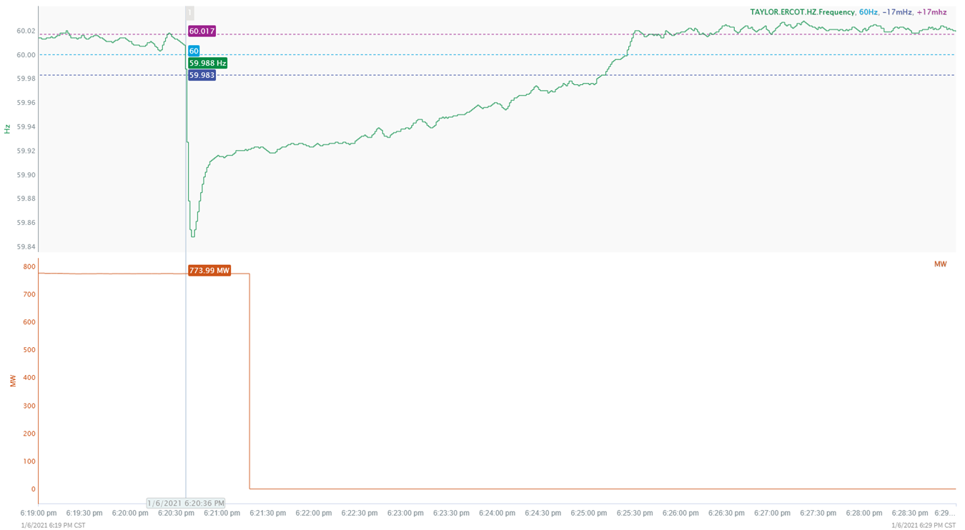
1/6/2021 18:20:35 (FME)
Notes:
Unit tripped offline carrying 774 MW
Starting Frequency: 59.988 Hz
Minimum Frequency: 59.848 Hz
A-C Time: 5 seconds
Recovery Time (back to deadband): 4 minutes and 32 seconds
RRS Deployed: 795.59 MW
Trip Reason: Water wall issues tripped the unit
Contextual Information: 241 MW of regulation down was being requested at the time of the event. Total of 350 MW of regulation up was deployed during the event.

Slide 5
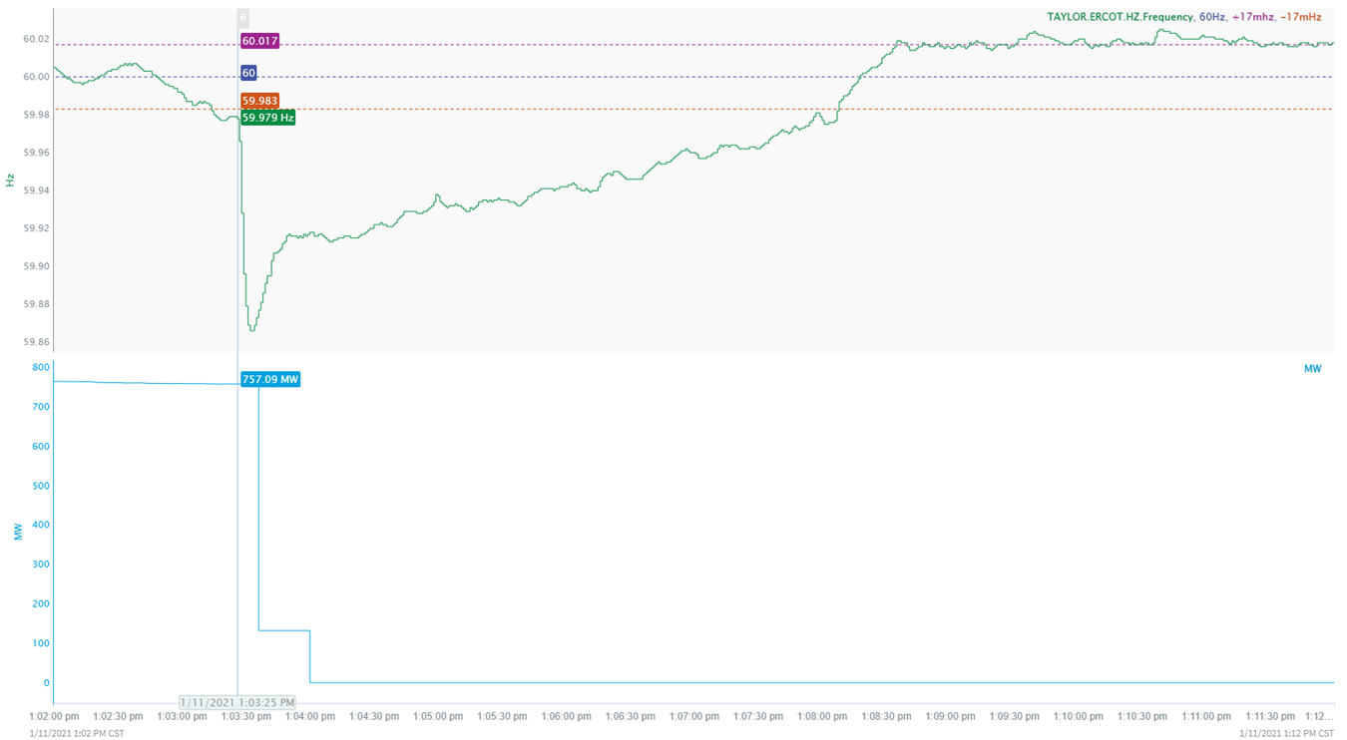
1/11/2021 13:03:26 (FME)
Notes:
Unit tripped offline while carrying 757 MW
Starting Frequency: 59.979 Hz
Minimum Frequency: 59.866 Hz
A-C Time: 7 seconds
Recovery Time (back to deadband): 4 minutes and 43 seconds
RRS Deployed: 756.34 MW
Trip Reason: Loss of power to all forced draft fans
Contextual Information: 60 MW of regulation down was being requested at the time of the event. Total of 255 MW of regulation up was deployed during the event

Slide 6
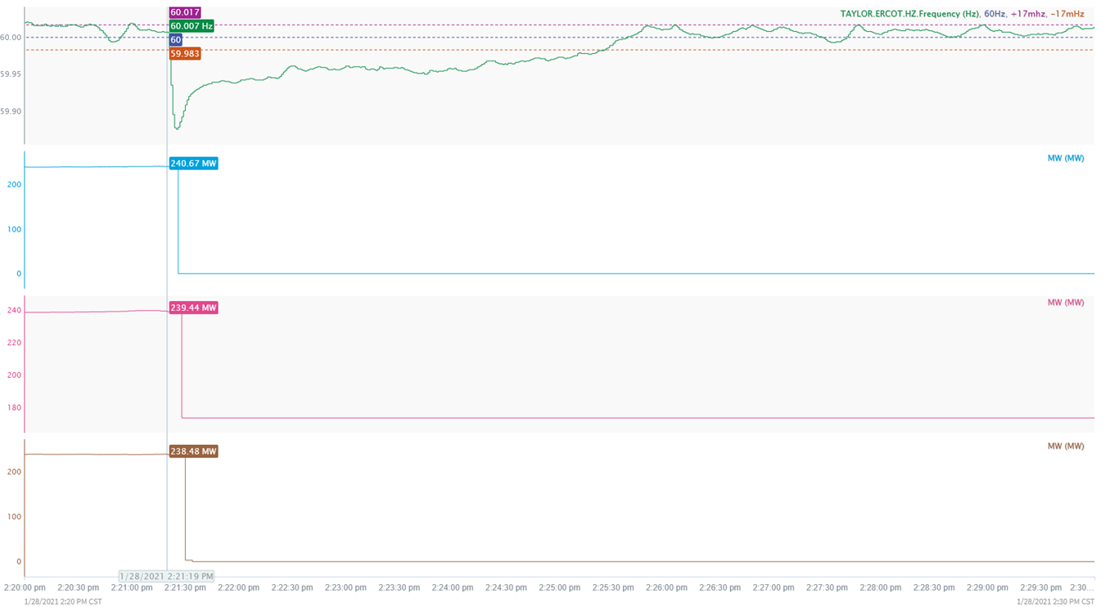
1/28/2021 14:21:20 (FME)
Notes:
Three combined cycles tripped offline for a combined loss of 718 MW
Starting Frequency: 60.007 Hz
Minimum Frequency: 59.875 Hz
A-C Time: 6 seconds
Recovery Time (back to deadband.): 4 minutes and 6 seconds
RRS Deployed: 655.8 MW
Trip Reason: No information available.
Contextual Information: 275 MW of regulation down was being requested at the time of the event. Total of 275 MW of regulation up was deployed during the event

Slide 7
Questions?
Thank you!

