Slide 1
Resource Integration & On-going Operations - Resources Services
(RIOO-RS)
Project Update
09 Dec 2020

Slide 2
RIOO- RS is live
All updates required to be submitted in RIOO-RS starting 11/13
  RARFs for updates to Resource Registration data will no longer be accepted.
  Exceptions may be granted in certain cases.
New Resources, SODGs, or Load Resources will continue to use the RARF spreadsheet and submit as a Service Request through the MIS
The RIOO Create phase effort has been initiated – this will allow new generators to submit their data via the on-line application

Slide 3
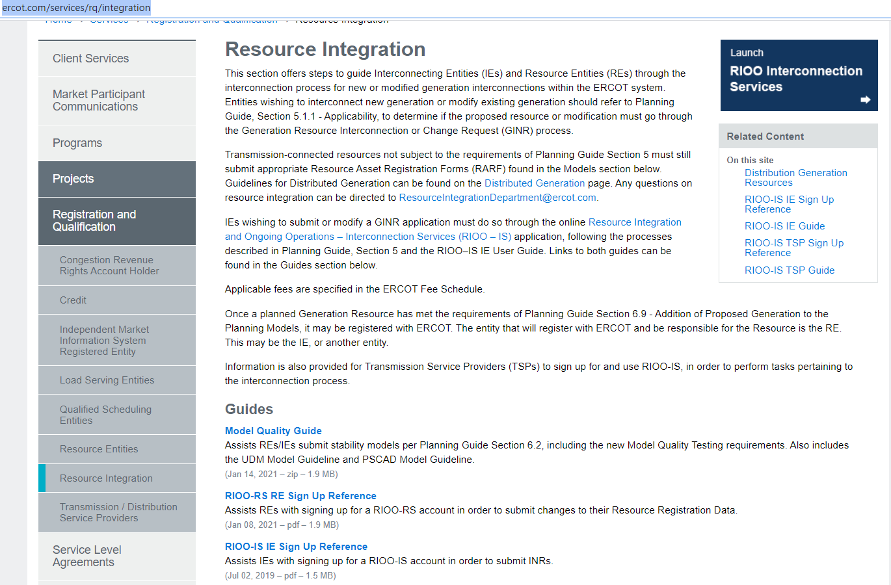
RIOO- RS is live – how do I get access?
The RIOO-RS sign-up reference is available here: http://www.ercot.com/services/rq/integration

Slide 4
How to get access - Checklist
The user:
  Gets the role “RIOORS_M_OPERATOR” from his/her USA
  Gets an email
    Clicks on “Verify my account” button
  Types in URL for the system
    Clicks “Don’t remember your password” button
  Gets a change password email
    Clicks on change my password button
  Changes his/her password
  Types in URL for the system, sign with user-id / password
  Setups authentication
    Scans code or enter mobile phone for SMS
    Saves Recovery code
    Confirms authorization method
    (Google Authenticator/ Auth0 guardian/SMS)
  Get an email
  Click on verify my account button
  Access the RIOO-RS, sign with user-id / password

Slide 5
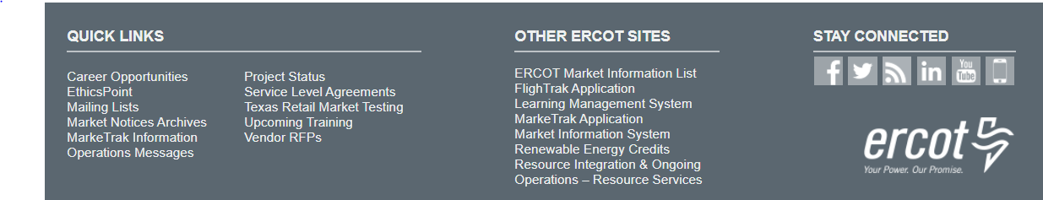
RIOO- RS is live – now what?
What is the link to RIOO-RS?
  The link for RIOO-RS is located on ercot.com and is: https://sa.ercot.com/rioo-rs/
Does RIOO-RS use a digital certificate?
  No.
What role do I need and how do I get it?
  Your company USA should provide the RIOO_M_Operator in order to gain access to RIOO-RS.

Slide 6
RIOO-RS is live – now what?
What changes can I make?
  The system can accept most updates with the exception combined cycle configurations update, this capability will be available with the next release.
Why do I have errors on things I did not change?
  May have errors on first Change Request in the system
  Caused by update validation rules and migrated data
How can I just view the resource data?
  For now, viewing is done via initiating a Change Request
What do I do if I can’t see my resources?
  Check with your USA, ensure RIOO_M_Operator role has been added to desired DUNS
  Still can’t see? Send info to RIOO-HELP@ercot.com
    Email used for accessing RIOO-RS
    DUNS number of missing resource
    We can also set up a WebEx to trouble-shoot the issue

Slide 7
RIOO-RS is live – now what?
I see some of my Resources but not all of them, why?
  MPIM is case sensitive; if an email address was entered using different letter case combinations, only some resources may be visible. Send the email address associated with your account and the DUNs numbers for the resources that need to be seen to: RIOO-Help@ercot.com
I’m getting a weird error?
  Please send a screen shot
Can Dynamic Model files be submitted via RIOO?
  Yes, RIOO has a section that accepts attachments.
  I have not been able to set up access, what do I do?
  Can’t access the system: Contact the Help Desk
  Questions: RIOO-HELP@ercot.com
  We can also set up a WebEx to trouble-shoot the issue

Slide 8
Reminders
System updates will continue
  Usually Friday 10 am deployments
Need TSP input

Slide 9
Discussion
or
Questions

