Slide 1
Resource Integration Topics
Jay Teixeira
ERCOT
Resource Integration Working Group
February 10, 2021

Slide 2
Quarterly Stability Assessment (QSA)
Planning Guide 5.9
Next Deadline for QSA
If a GINR is not included in QSA, its Initial Synchronization date will be automatically delayed to the next quarter
All-Inclusive Generation Resource Initial Synchronization Date | Last Day for an IE to meet prerequisites as listed in paragraph (4) below | Completion of Quarterly Stability Assessment
Upcoming January, February, March | Prior August 1 | End of October
Upcoming April, May, June | Prior November 1 | End of January
Upcoming July, August, September | Prior February 1 | End of April
Upcoming October, November, December | Prior May 1 | End of July

Slide 3
Quarterly Stability Assessment (QSA)
Planning Guide 5.9, Quarterly Stability Assessment
Issue’s seen in previous QSA’s
  10 day comment period for FIS
    Needs to be complete before QSA deadline
    TSPs need to plan for it
  Dynamic Model Review
    Dependent on FIS Stability study
    Need to meet PG 6.9 15 to 30 days prior to QSA deadline
PSSE Model Quality Test Required
TSAT Model Required – If PSSE model is UDM, then TSAT model should be UDM.

Slide 4
GINR Time Line (Fastest)

Slide 5
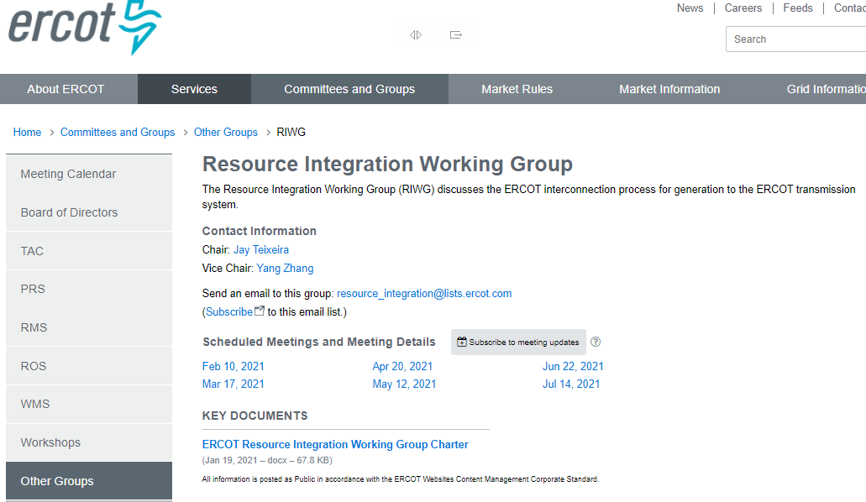
Resource Integration Working Group Created

Slide 6
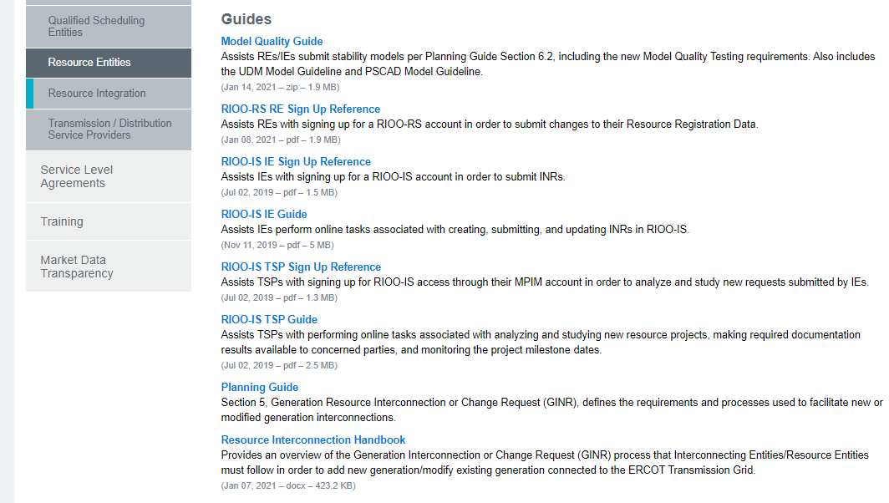
New Resource Interconnection Handbook posted
Also note, sign up guide for RIOO-RS posted

Slide 7
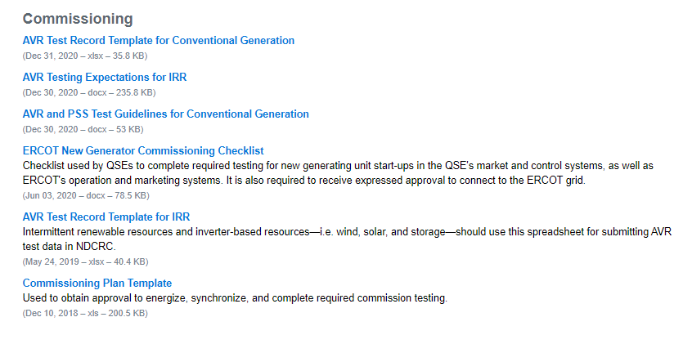
AVR documents posted

Slide 8
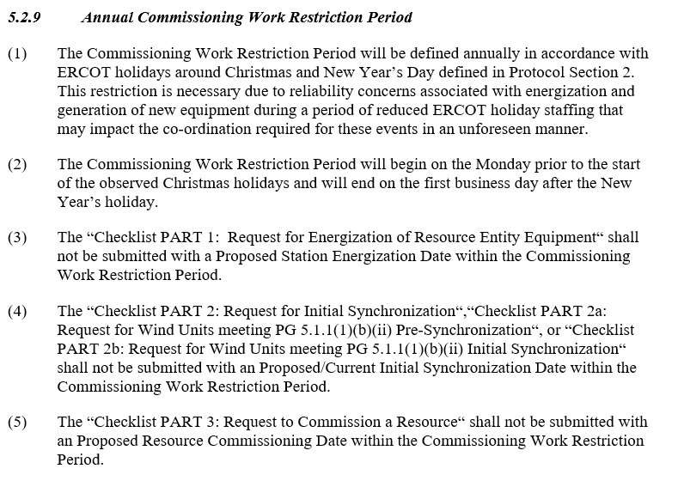
Annual Commissioning Work Restriction Period Proposal

Slide 9
Self-Limiting Facilities and DC-Coupled Resources in the INR Process
NPRR1026, PGRR081, NPRR1029 and RRGRR023 related to Self-Limiting Facilities and DC-Coupled Resources approved by BOD on 12/8/2020. Implementation to take 7 to 10 months.
RIOO-IS currently does not have capability to explicitly capture Self-Limiting Facilities or DC-Coupled Resources and their MW limits during the interconnection process.
Until approval and implementation of NPRR1026, in which RIOO-IS and other ERCOT systems should be modified to allow Self-Limiting Facilities and DC-Coupled Resources, ERCOT will use an manual process to allow interconnection requests to be submitted. This is a workaround.
Any interconnection request using the manual process will not be able to proceed further than the QSA until the implementation and system modifications necessary for all systems are complete.

Slide 10
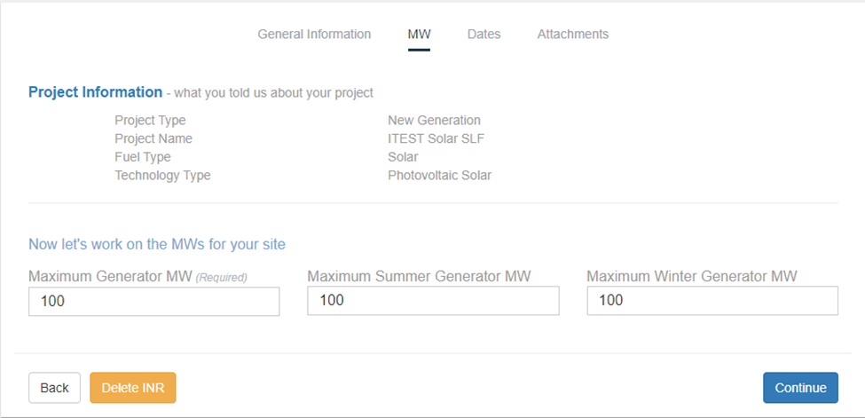
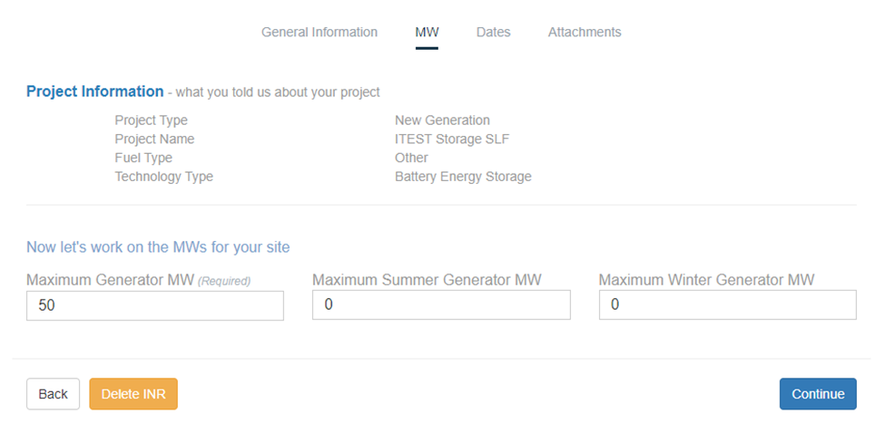
Proposal to Request a Self-Limiting Facility in RIOO-IS
Similar to repowers, a standard naming convention will be used for proposed Self-Limiting Facilities: [Common Name][space][“Solar” or “Storage”][space][“SLF” or “DCC”]
For Self-Limiting Facilities and DC Coupled Resources, whose total MW rating is equal to the rating of the non-battery resource (e.g. PVGR, WGR, etc.):
  The non-battery resource’s ratings in RIOO will be its true Maximum MW and Maximum Summer/Winter MW.
  The battery’s Maximum MW in RIOO will be its true rating, while Maximum Summer/Winter MW set to 0.

Slide 11
Proposal to Request a Self-Limiting Facility in RIOO-IS
For Self-Limiting Facilities whose MW rating is higher than the rating of the non-battery resource:
  The non-battery resource’s ratings in RIOO will be its true Maximum MW and Maximum Summer/Winter MW.
  The battery’s Maximum MW in RIOO will be its true capacity, while Maximum Summer/Winter MW will be non-zero to reflect the MW needed to meet the intended Self-Limit.
AC-Coupled resources will be considered Self-Limiting Facilities for RIOO-IS purposes.
GIS Report logic that handles re-powers (looks for “repower” in project name”) will be modified to look for the “SLF” and “DCC” keywords to capture the MW limit.

Slide 12
AVR Test for DGR
Meeting was held for February 2, 2021. Language was agreed upon and accepted. Document will be posted to http://www.ercot.com/services/rq/integration

Slide 13
Active PGRR’s
PGRR086 and RRGRR027, submitted by Enel Green Power North America on September 18, 2020, Clarify Models Required to Proceed with an FIS. TAC recommended approval on January 27, 2021.
RRGRR028, submitted by John Karlik on behalf of the SPWG on December 23, 2020, Transformer Impedance Clarifications. First review by ROS on February 4, 2021. Awaiting Impact Analysis by ERCOT.

Slide 14
Other contact information
ResourceIntegrationDepartment@ercot.com is distribution list for Resource Integration department
Mailing List
  RESOURCE_INTEGRATION@LISTS.ERCOT.COM

Slide 15

Questions?
Thank you!

