Slide 1
Curtailment Test for IRR Units
Alex Al-Homsi
(contact : Anas.Al-Homsi@ercot.com)
Feb 10, 2020

Slide 2
Curtailment Overview
Per protocol requirement 6.5.7.4 and 6.6.5.4, IRR units should follow SCED Base Point once curtailed (i.e., SBBH (SCED Base Point Below HDL) flag is set).
  ERCOT evaluates the curtailment performance in the monthly GREDP report and identifies compliance issues if they exist.
  In real-time operation, operators may request to disconnect an IRR unit if a deviation from its BP may threaten the grid reliability (Transmission and Security Operating Procedure)
Curtailment Test started in Oct. is a mandatary requirement for all new IRR units planned to be connected to the ERCOT grid.
  The objective of the curtailment test is to evaluate whether an IRR unit can follow SCED BP while validating telemetry data during the period of curtailment test.

Slide 3
Curtailment Procedure (1 unit)
Step#0: Following approval to conduct the below Curtailment Self-Test, set RST to “ONTEST” (RST=8) for the unit.
Step#1: Set Curtailment Flag to True (SBBH=True) and BP = 0 for the unit
This sends a curtailment to 0 MW to the unit
The unit should respond to the curtailment and the output is expected to be equal to zero MW.
Maintain the curtailment for 15 mins.
    Note that for this 15 min. period ERCOT will observe how the combined unit’s MW & HSL
    HSL is expected to continue reflecting the available capacity of the unit. HSL shouldn’t have sudden drops and it shouldn’t drop to zero. HSL should have similar pattern of the wind speed and should maintain a smooth transition.
    The turbines availability (NTON, NTOF & NTUN) are expected to have no change.
    The unit should ramp down to the new base point within 5 min. and follow its NDRR.
Step#2: Following the completion of the above 15 min., set Curtailment Flag to False (SBBH=False) for the unit.
    This releases the unit from curtailment.
    Note that ERCOT will observe the 10 min. period following the curtailment release to see how the unit’s MW, HSL, NTON, NTOF, NTUN are telemetered.
    The unit output should ramp up to follow its HSL.
    The unit ramping up rate shouldn’t exceed the NURR.
    HSL is expected to continue reflecting the available capacity of the unit. HSL shouldn’t have sudden drops and it shouldn’t drop to zero. HSL should have similar pattern of the wind speed and should maintain a smooth transition.
Step#3: Following the completion of the above test, set RST to “ON” (RST=3) for the unit and follow SCED curtailment instructions.
Step#4: Provide ERCOT with the date and time of the Curtailment Self-Test.

Slide 4
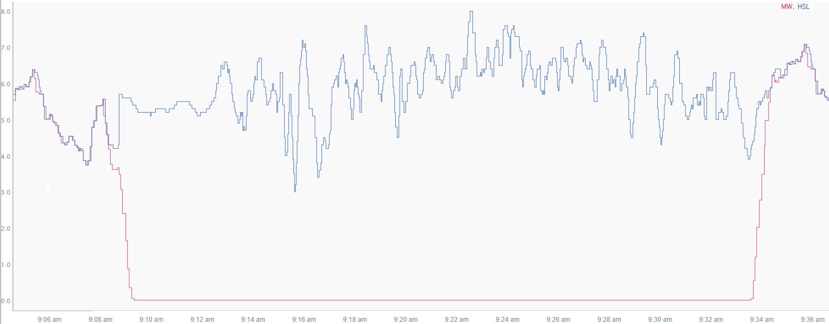
Expected Response (1 unit)
  HSL reflects the current net output capability of the unit. There are no sudden/step changes during the test.
  The unit ramped down following its NDRR to 0 MW
  The unit ramped up following its NURR to reach its HSL after released by curtailment
A IRR unit should not ramp up at a rate more than 20% of its registered capacity per minute when released from curtailment

Slide 5
Curtailment Procedure (3 units in IRR group)
Step#0: Following approval to conduct the below Curtailment Self-Test, set RST to “ONTEST” (RST=8) for the all units in the IRR Group that are on-line during the test.
Step#1: Set Curtailment Flag to True (SBBH=True) and BP = 0 for unit1
The IRR Group should respond to the curtailment and the group output is expected to be equal to the group output (prior to Step #1) minus unit1 MW (prior to Step #1)
Maintain the curtailment for 15 mins.
    Note that for this 15 min. period ERCOT will observe how the combined unit’s MW & HSL
    HSL is expected to continue reflecting the available capacity of the group. HSL shouldn’t have sudden drops and it shouldn’t drop to zero. HSL should have similar pattern of the wind speed and should maintain a smooth transition.
    The turbines availability (NTON, NTOF & NTUN) are expected to have no change.
    The units should ramp down to the new base point within 5 min. and follow its NDRR.
Step#2: Set Curtailment Flag to True (SBBH=True) and BP = 0 for unit2
The IRR Group should respond to the curtailment and the group output is expected to be equal to the group output (prior to Step #2) minus unit2 MW (prior to Step #2)
Maintain the curtailment for 15 mins.
    Note that for this 15 min. period ERCOT will observe how the combined unit’s MW & HSL
    HSL is expected to continue reflecting the available capacity of the group. HSL shouldn’t have sudden drops and it shouldn’t drop to zero. HSL should have similar pattern of the wind speed and should maintain a smooth transition.
    The turbines availability (NTON, NTOF & NTUN) are expected to have no change.
    The units should ramp down to the new base point within 5 min. and follow its NDRR.
Step#3: Set Curtailment Flag to True (SBBH=True) and BP = 0 for unit3
The IRR Group should respond to the curtailment and the group output is expected to be equal to zero MW.
Maintain the curtailment for 15 mins.
    Note that for this 15 min. period ERCOT will observe how the combined unit’s MW & HSL
    HSL is expected to continue reflecting the available capacity of the group. HSL shouldn’t have sudden drops and it shouldn’t drop to zero. HSL should have similar pattern of the wind speed and should maintain a smooth transition.
    The turbines availability (NTON, NTOF & NTUN) are expected to have no change.
    The units should ramp down to the new base point within 5 min. and follow its NDRR.
Step#4: Following the completion of the above 45 min., set Curtailment Flag to False (SBBH=False) for all units in the IRR Group.
    This releases the units from curtailment.
    Note that ERCOT will observe the 10 min. period following the curtailment release to see how the unit’s MW, HSL, NTON, NTOF, NTUN are telemetered.
    The group output should ramp up to follow its HSL.
    The units ramping up rate shouldn’t exceed the NURR.
    HSL is expected to continue reflecting the available capacity of the group. HSL shouldn’t have sudden drops and it shouldn’t drop to zero. HSL should have similar pattern of the wind speed and should maintain a smooth transition.
Step#5: Following the completion of the above test, set RST to “ON” (RST=3) for the all units and follow SCED curtailment instructions.
Step#6: Provide ERCOT with the date and time of the Curtailment Self-Test.

Slide 6
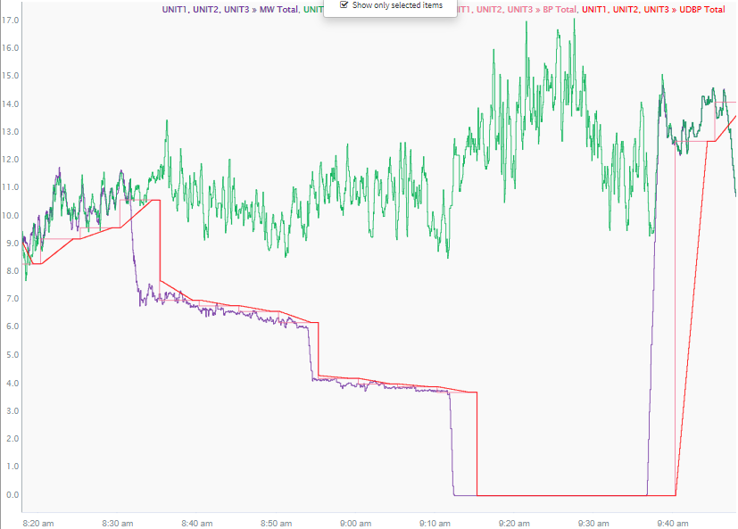
Expected Response (3 units in IRR group)
  HSL reflects the current net output capability of the facility. There are no sudden changes during the test. HSL had similar wind speed pattern.
  The group ramped down following its NDRR to a new base point equal to the group output – (unit 1 output)
  The group ramped up following its NURR to reach its HSL
  The group ramped down following its NDRR to a new base point equal to the group output – (unit 1 & unit 2 output)
  The group ramped down following its NDRR to 0 MW

Slide 7
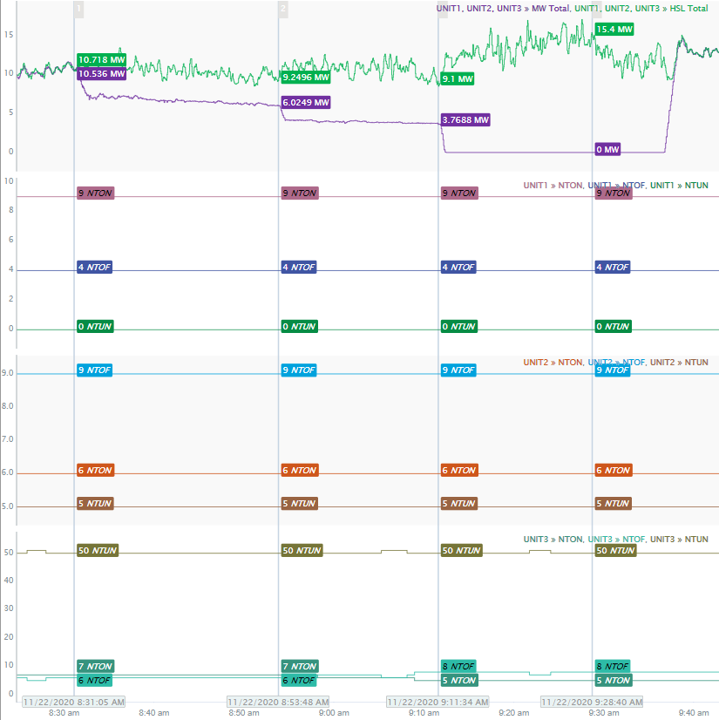
Turbine/Inverter Availability
  The number of available turbine/inverters didn’t change dramatically during the test for all the units

Slide 8
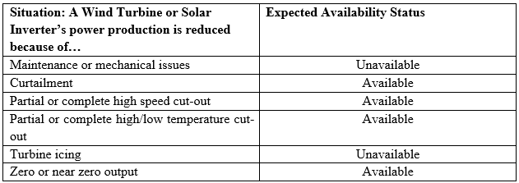
Turbine/Inverter Availability
NTON
  Number of wind turbines/solar inverters Available
NTOF
  Number of wind turbines/solar inverters Unavailable (“out of service and not available for operation, independent of MW production”)
NTUN
  Number of wind turbines/solar inverters Unknown (“not able to communicate and whose status is unknown”)

Slide 9
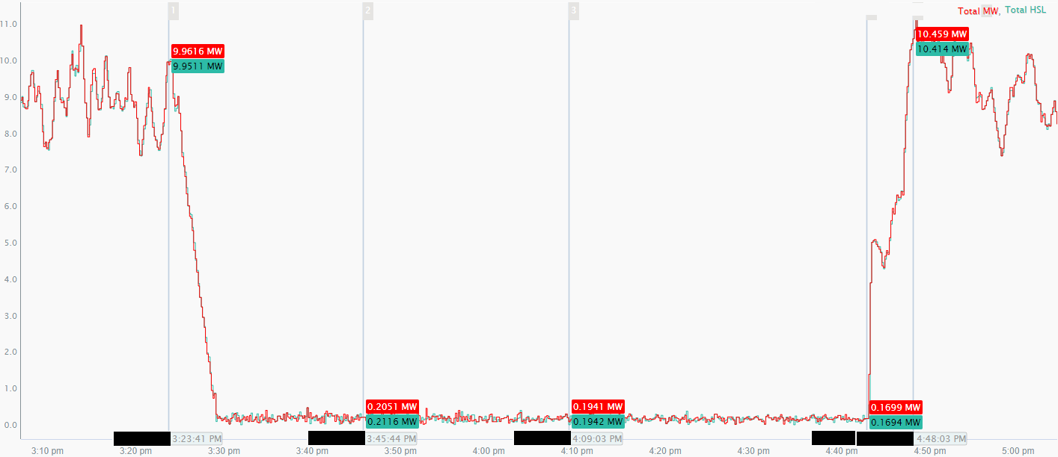
Curtailment Test for an IRR group (2 units)
  Both Units MW curtailed to zero.
  HSL followed MW and BP and dropped to zero.
  Ramping up in two stages
  Ramping up didn’t match NURR telemetry
  MW Oscillations when curtailed to zero MW

Slide 10
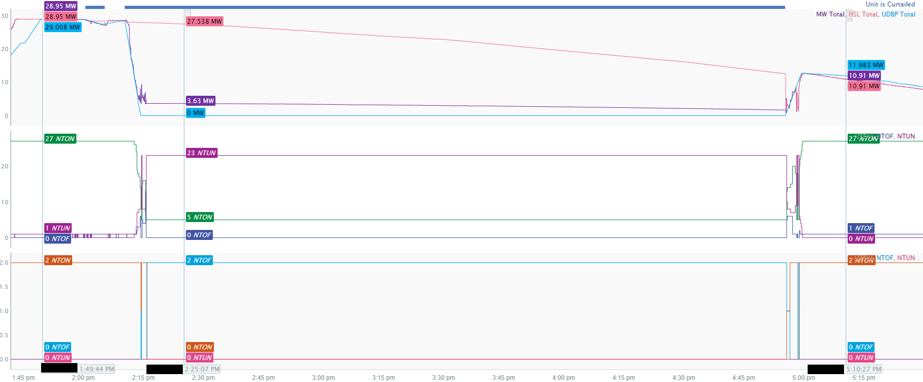
Curtailment Test for an IRR group (2 units)
  HSL dropped to zero when the curtailment was lifted.
  1.63MW output when curtailed to zero MW
  Unit 1 available telemetry switched to NTUN under curtailment
  Unit 2 available telemetry switched to NTOF under curtailment

