Slide 1
GINR Analysis
February 2021 SAWG Meeting
Dan Mantena – Resource Adequacy

Slide 2
Three topics for discussion
Reviewing summer 2020 planned project forecasts in CDR/SARA reports
Analyzing the COD delays to planned projects listed in the summer 2020 SARA report (impact on summer 2020, issues with trying to forecast delays)
Notable ERCOT queue trends during 2020

Slide 3
Key takeaways
Reviewing summer 2020 planned project forecasts in CDR/SARA reports
background: planned project forecasts in CDR and SARA reports are based on developer information at the time of report creation (summer 2020 SARA was created in late April 2020)
Retrospective analysis of the forecast indicated discrepancies between the projected COD (provided by developers) and commercial operations approval for several projects.
Regarding project delays and project cancelations for the summer 2020 season, the former occurred more frequently in short forecast time horizons (Final Summer 2020 SARA) and the latter more often in long forecast time horizons (May 2015 CDR).
COD delays to planned projects listed in the summer 2020 SARA report
37% of planned project capacity did not reach commercial operations before or during summer 2020

Slide 4
Key takeaways (continued)
Notable queue trends during 2020
Solar project CODs trends and highlighting the recent Investment Tax Credit (ITC) extension
Cancelation trends in the queue since August 2018
Siting of new solar projects away from the West CDR zone

Slide 5
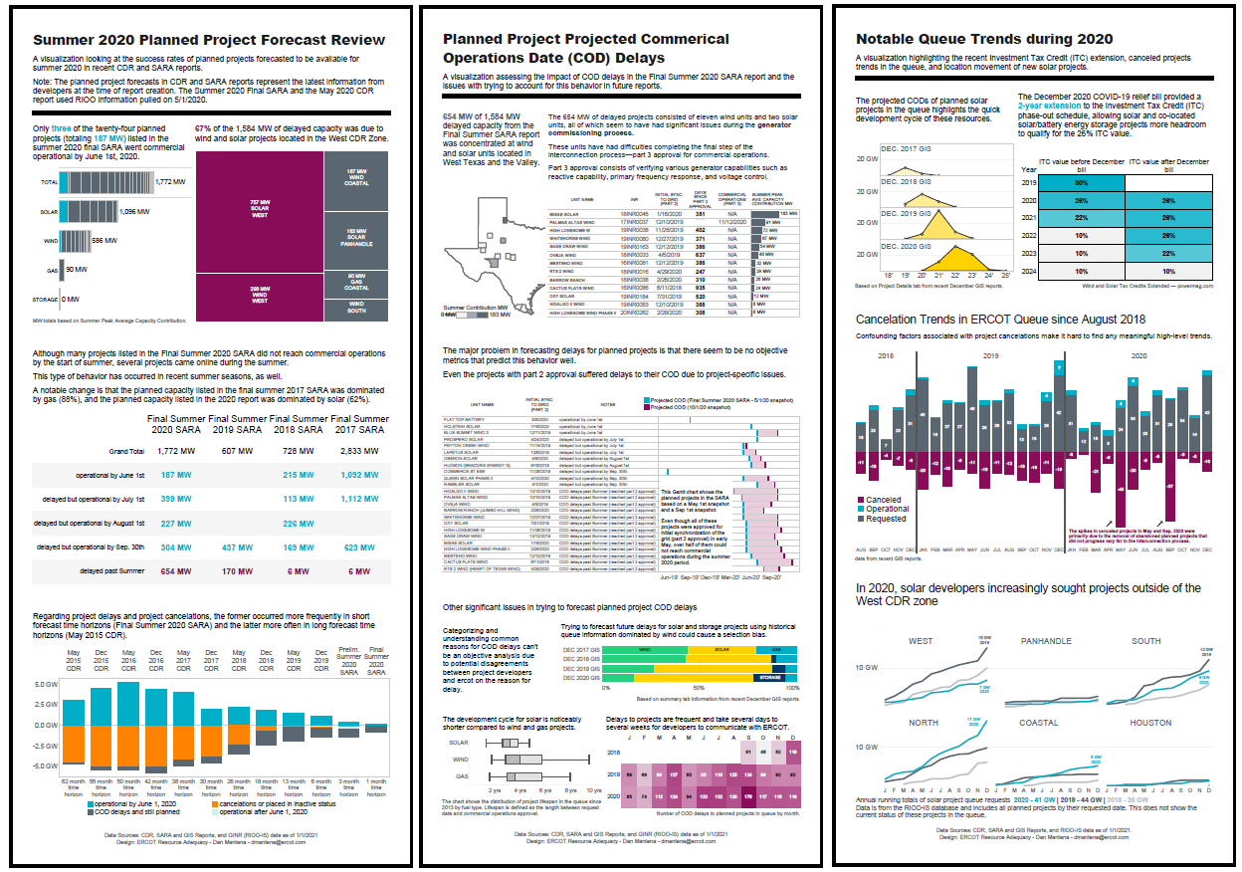
Analysis found in the GINR Analysis PDF (Feb 2021 SAWG) file on the meeting page

Slide 6
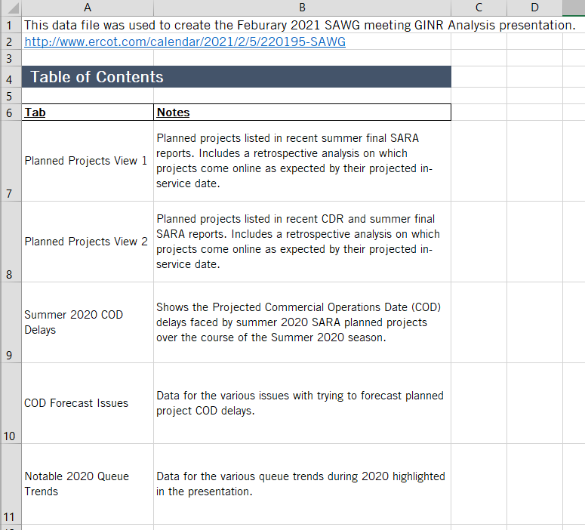
The GINR Analysis Data (Feb 2021 SAWG) Excel file on the SAWG meeting page contains the data used in the analysis (at a project level of detail).

Slide 7
Potential next steps
Include the latest COD delays data in the Resource Adequacy reports? (GIS or Resource Capacity Trends)
Develop summary statistics to highlight the success rate of planned projects reaching commercial operations.
Change the problem scope?
Explore the factors that promote project development with minimal COD delays.
If you have any questions on this analysis or requests for additional research, here is my contact info:
Dan Mantena, dan.mantena@ercot.com

