Slide 1
Market Credit Working Group update to the Wholesale Market Subcommittee
Brenden Sager, Austin Energy, Chair
Seth Cochran, Direct Energy, Vice Chair
03 February 2021

Slide 2
MCWG update to WMS
General Update
20 Jan 2021 Joint MCWG/CWG WEBEX Meeting
8 NPRRs reviewed for their credit impacts No Credit impacts
Review NPRRs for Credit Implications (vote)
1024 - Determination of Significance with Respect to Price Corrections
1040 - Compliance Metrics for Ancillary Service Supply Responsibility
1044 - Enhancement of SSR Mitigation Requirement
1045 - Transmission Operator Definition and Designation
1053 - BESTF-9 Exemption from Ancillary Service Supply Compliance Requirements for Energy Storage Resources Affected by EEA Level 3 Charging Suspensions
1054 - Removal of Oklaunion Exemption Language
1057 - Modification to Real-Time Hub Price Formulas for Fully De-Energized Hubs
1059 - Ability for MOUs and ECs to Send Non-BUSIDRRQ Interval Data

Slide 3
MCWG update to WMS
Review 2021 CWG/MCWG Leadership
MCWG Chair Brenden Sager and VC Seth Cochran
CWG Chair Loretto Martin and VC James Spalding
Discuss 2021 Goals (approved)
Review the ongoing impact on market participant credit exposure and collateral requirements resulting from the incorporation of a forward price curve-based methodology
Clarify the market’s risk tolerance/appetite level and provide regular updates on credit exposure to the ERCOT Board
Evaluate and quantify potential market risk under current credit rules and examine a framework for reviewing rules in flight
Effectively communicate credit risk to the market
Examine current Protocol language to determine how effective current calculations capture actual credit risk
Another goal added to the list. Review the proposed credit assessment methodology and provide guidance to ERCOT to ensure accuracy in assessing risk

Slide 4
MCWG update to WMS
Review and Discussion of Credit Work Group Charter (approved)
Approved with minor revisions (including ERCOT contacts)
Document covers
Purpose and Authority
Reporting relationships within ERCOT
Specific Functions and Conduct of meetings

Slide 5
MCWG update to WMS
Review August 2020 DAM/CRR Credit Exposure
Hurricane Hanna impacted South Texas and the Rio Grande Valley on July 25, 2020
Outages of two AEP transmission lines in the area of Edinburg caused a significant amount of congestion through August 10, 2020 when the lines were returned to service
South Load Zone prices were significantly higher in both DAM and RTM
Significant increases in collateral requirements were observed as a result of the congestion
The higher collateral requirements were exacerbated by higher DFAFs in mid-August
DALE (i.e. 7-day average of prior DAM activity) is multiplied by DFAF to capture changes in forward market expectations for QSEs
Works well when congestion is minimal
CRR settlements are not projected forward using DFAF
CRR credits/charges netted only for days that are unbilled or invoiced
In instances where DALE*DFAF increases substantially due to congestion, there is not a corresponding projected offset at the Counter-party level for CRRAH activities, particularly for CRRAH with a book heavy with Options
Result is dramatic over-collateralization of Counter-Party, particularly when the CP, QSE, and CRRAH are the same legal entity
The entity can be owed millions by ERCOT, yet the TPEA calculations show the CP to be a significant credit risk to ERCOT, whereas the risk of default is in the opposite direction

Slide 6
MCWG update to WMS
Review August 2020 DAM/CRR Credit Exposure
ERCOT staff do analysis and backcasting to measure the effects of the proposed changes
Potential unforeseen events difficult to forecast
If you have only a CRR position, how would this affect DA/RT positions?
Potential issues with the CFTC exemptions which will have to be reviewed by ERCOT staff
FERC order 719 implications, ERCOT legal to review
Looking to get CFTC regulatory review from ERCOT as a priority

Slide 7
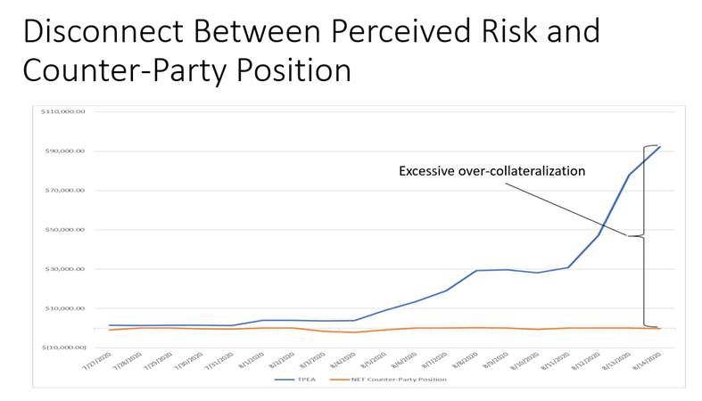
MCWG update to WMS
Potential August 2020 DAM/CRR Credit Risk Misalignment

Slide 8
MCWG update to WMS
Discuss Credit Scoring Model
CWG/MCWG reviewed recalibrated versions of credit scoring models used by ERCOT and MISO.
Test models were recalibrated using on 2018 and 2019 ERCOT Counter-Party financial data
Calibration was done by optimizing the R^2s between model results and agency ratings (where available)
There appeared to be more support for the MISO-derived model based on better explanatory power
Two sub-models: for public power and non-public power Entities
Finalize model, ratios and weightings
Incorporate results in an OBD
Goal is to make sure it’s transparent
Scrubbed from a credit perspective as to how it makes sense
Implementation timeline is unknown
Adding a thorough review of yet to be implemented credit scoring model
Will do staff impact analysis

Slide 9
MCWG update to WMS
ERCOT Updates
Market-wide average TPE increased from $ 416.58 million to $ 433.07 million
TPE increased mainly due to higher Forward Adjustment Factors in December compared to November
Discretionary Collateral is defined as Secured Collateral in excess of TPE,CRR Locked ACL and DAM Exposure
Average Discretionary Collateral slightly increased from $ 1,239.7 million to $1,241.2 million
The increase in Discretionary Collateral is largely due to decrease in CRR Locked ACL.
Number of active Counter-Parties increased by 3
No unusual collateral call activity

Slide 10
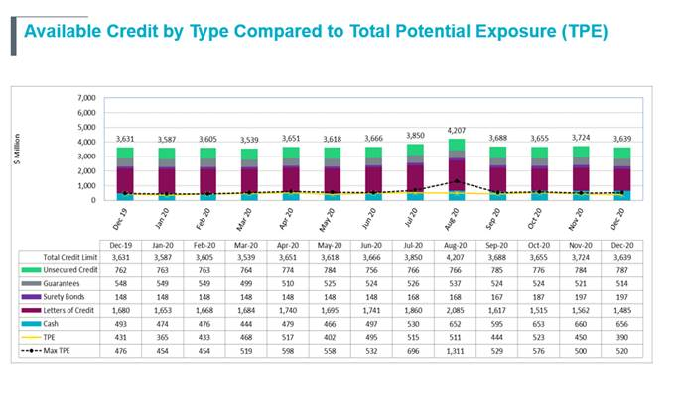

Slide 11
MCWG update to WMS
New Business
Changes amount of CP’s Available Credit Limit locked for CRR Auctions during duration of auction to cap at pre-auction screening amount
Market Notice on May 12
Go Live on June 11 for CRR (will reflect in CMM (credit reports) on June 12
Lock credit during the pre-screen auction amount (lowest of the CRR lock limit)

