Slide 1
PDCWG Report to ROS
Chair: Chad Mulholland, NRG
Vice Chair: Jimmy Jackson, CPS
ROS
February 4th, 2021

Slide 2
Report Overview & Notes
Report Overview
Meeting Minutes
BAL-001-TRE-2 FMEs & IMFR
4 FMEs in the month of November
1 FME in the month of December
Frequency Control Report

Slide 3
Meeting Minutes
PDCWG Meeting 01/13/2021
ERCOT study proposal for RRS limits – Status report
Annual ERCOT Inertia analysis report
Update on BAL-001-TRE, SAR 12
ERCOT Reports

Slide 4
Frequency Measurable Events Performance

Slide 5
Frequency Measurable Events
There were 4 FMEs in November
11/7/2020 18:05:14
Loss of 474 MW
Interconnection Frequency Response: 729 MW/0.1 Hz
6 of 34 Evaluated Generation Resources had less than 75% of their expected Initial Primary Frequency Response.
5 of 34 Evaluated Generation Resources had less than 75% of their expected Sustained Primary Frequency Response.
11/15/2020 10:47:36
Loss of load of 579 MW
Interconnection Frequency Response: 1485 MW/0.1 Hz
79 of 209 Evaluated Generation Resources had less than 75% of their expected Initial Primary Frequency Response.
64 of 209 Evaluated Generation Resources had less than 75% of their expected Sustained Primary Frequency Response.

Slide 6
Frequency Measurable Events
11/16/2020 09:51:37
Loss of 1034 MW
Interconnection Frequency Response: 1641 MW/0.1 Hz
3 of 37 Evaluated Generation Resources had less than 75% of their expected Initial Primary Frequency Response.
4 of 37 Evaluated Generation Resources had less than 75% of their expected Sustained Primary Frequency Response.
11/21/2020 00:20:06
Loss of load of 734 MW
Interconnection Frequency Response: 789 MW/0.1 Hz
7 of 33 Evaluated Generation Resources had less than 75% of their expected Initial Primary Frequency Response.
7 of 33 Evaluated Generation Resources had less than 75% of their expected Sustained Primary Frequency Response.

Slide 7
Frequency Measurable Events
There was 1 FME in December
12/10/2020 14:34:32
Loss of 571 MW
Interconnection Frequency Response: 984 MW/0.1 Hz
22 of 64 Evaluated Generation Resources had less than 75% of their expected Initial Primary Frequency Response.
21 of 64 Evaluated Generation Resources had less than 75% of their expected Sustained Primary Frequency Response.

Slide 8
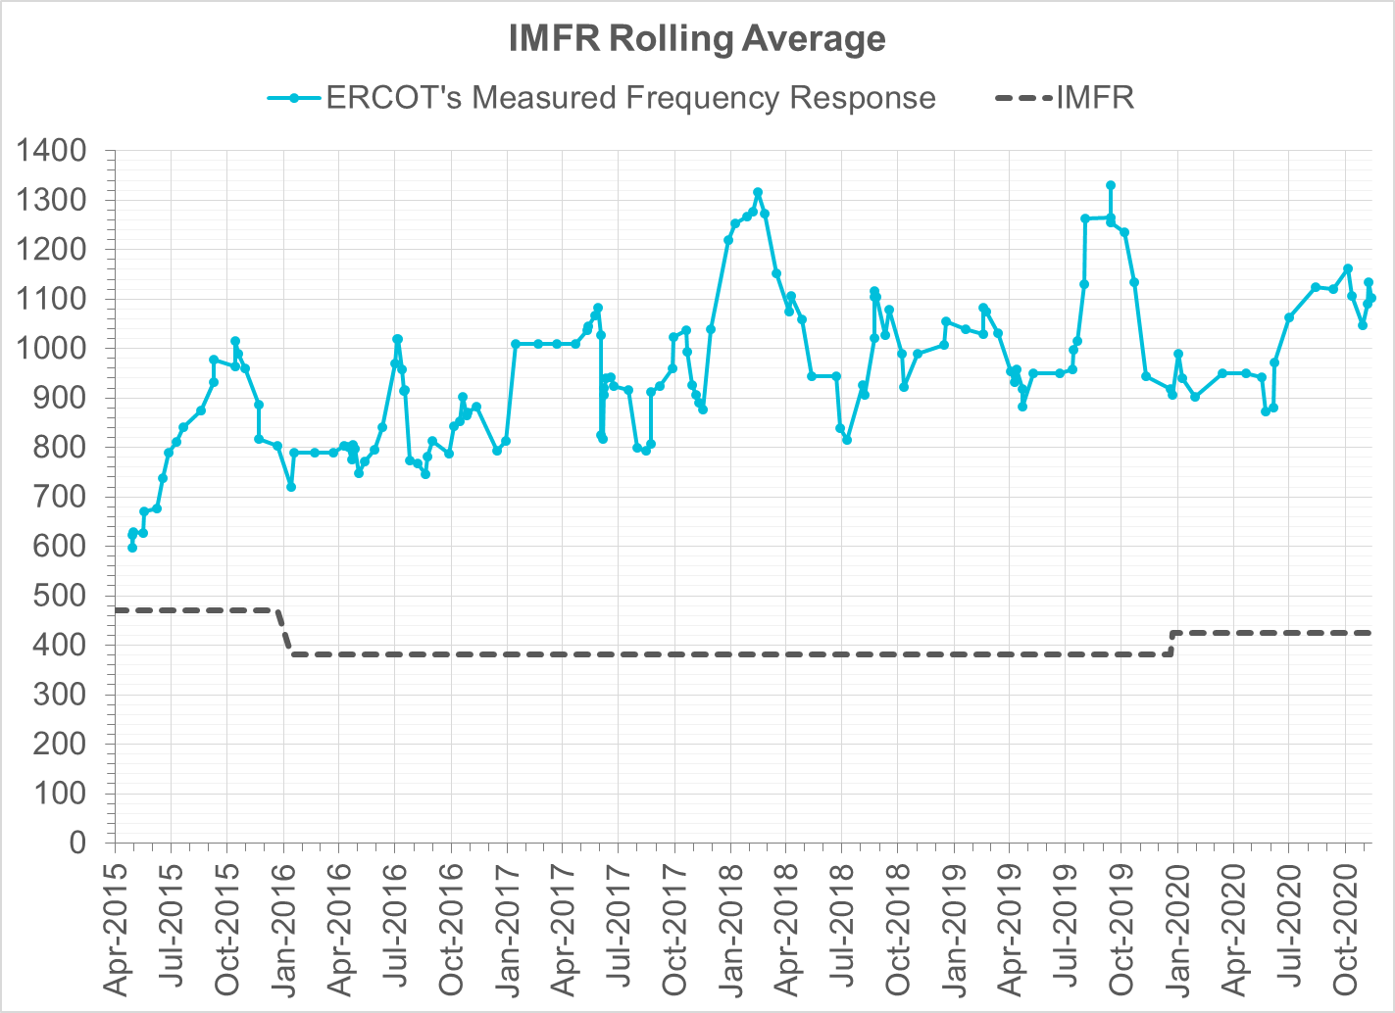
Interconnection Minimum Frequency Response (IMFR) Performance
IMFR Performance currently 1101.96 MW/0.1Hz
Frequency Response Obligation (FRO): 425 MW/0.1 Hz

Slide 9
Frequency Control Report
October 2020

Slide 10
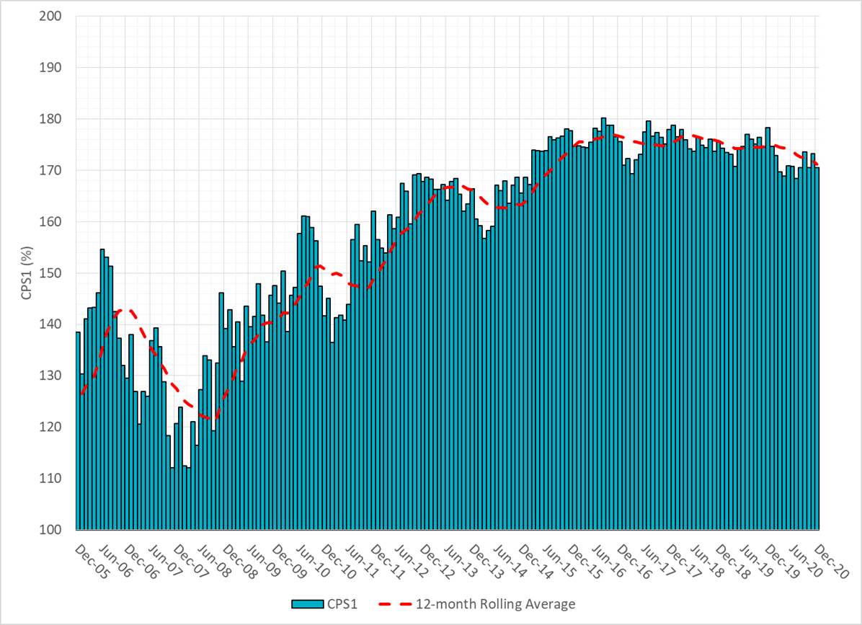
CPS1 Performance

Slide 11
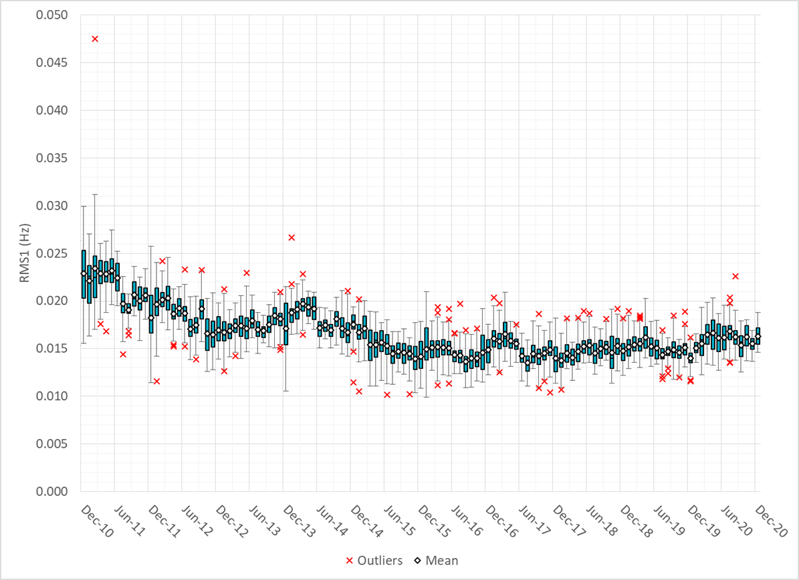
RMS1 Performance of ERCOT Frequency

Slide 12
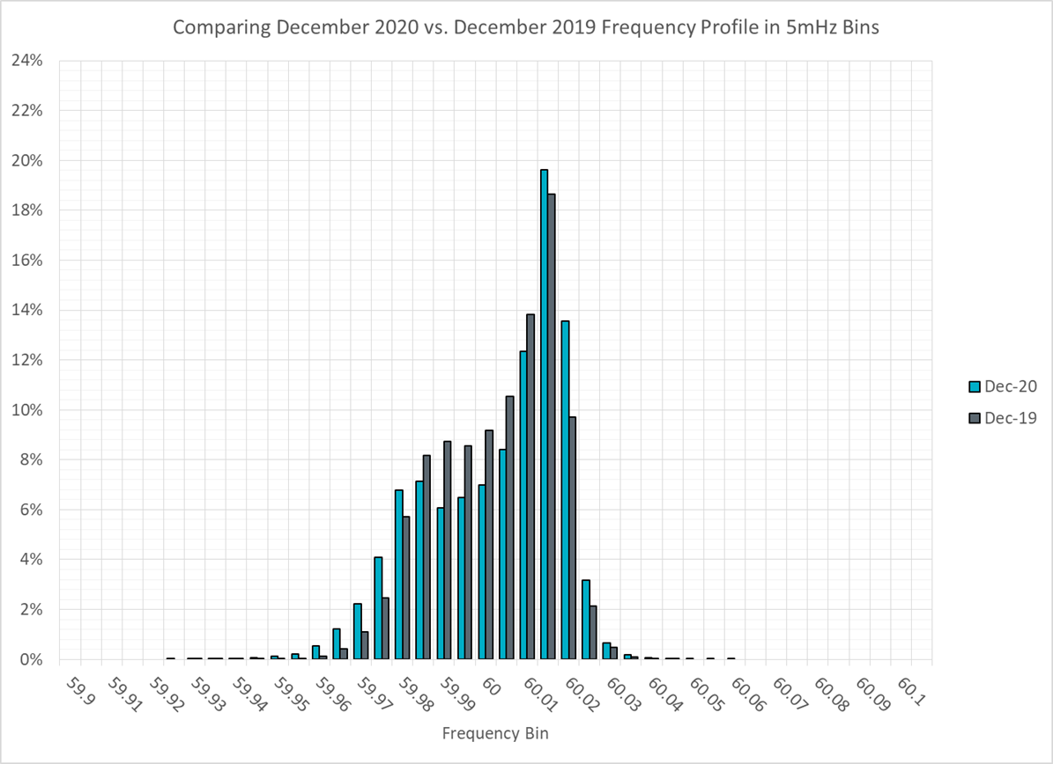
Frequency Profile Analysis

Slide 13
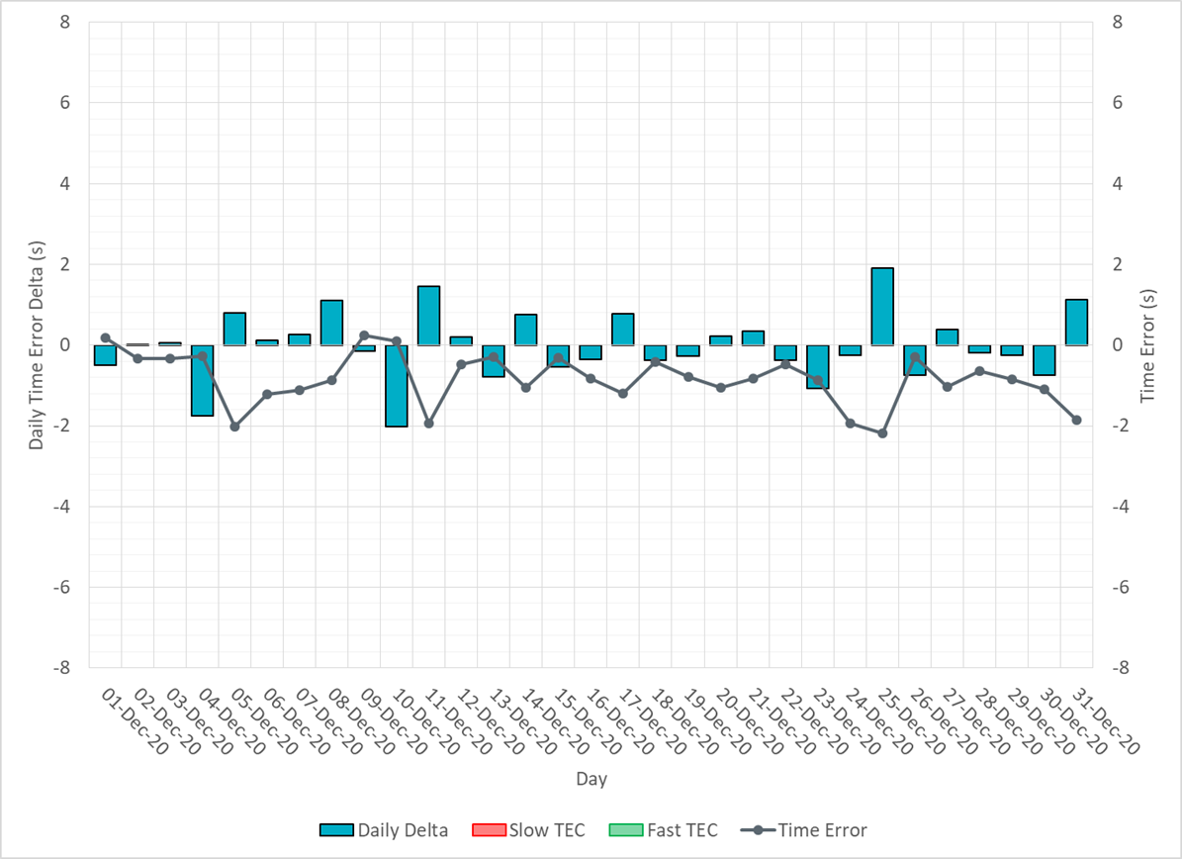
Time Error Corrections

Slide 14
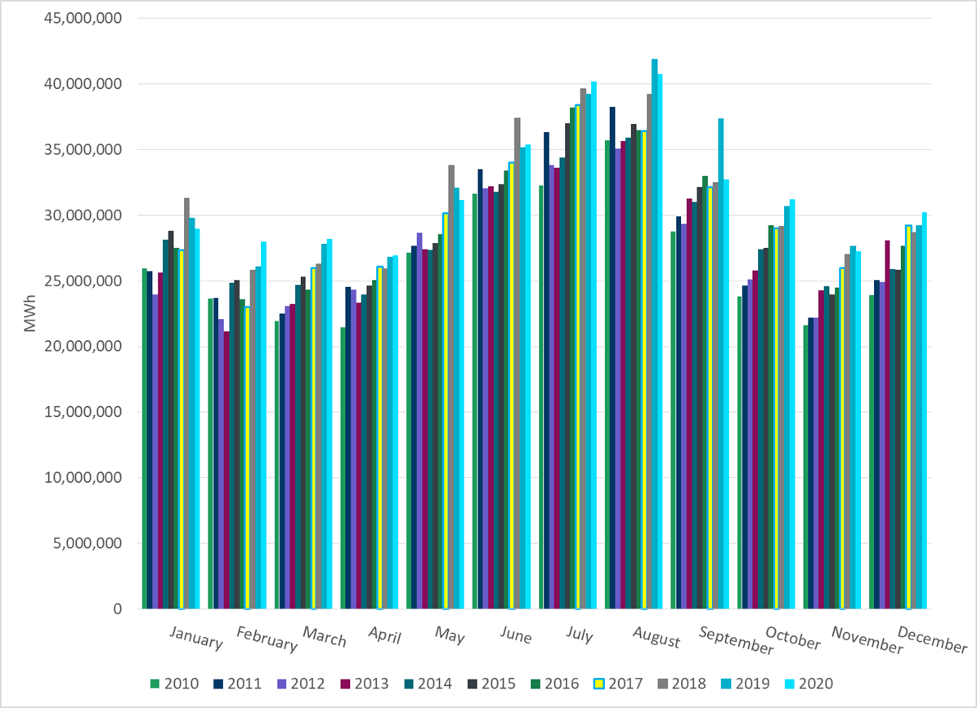
ERCOT Total Energy
Notes:
31,210,036 MWh

Slide 15
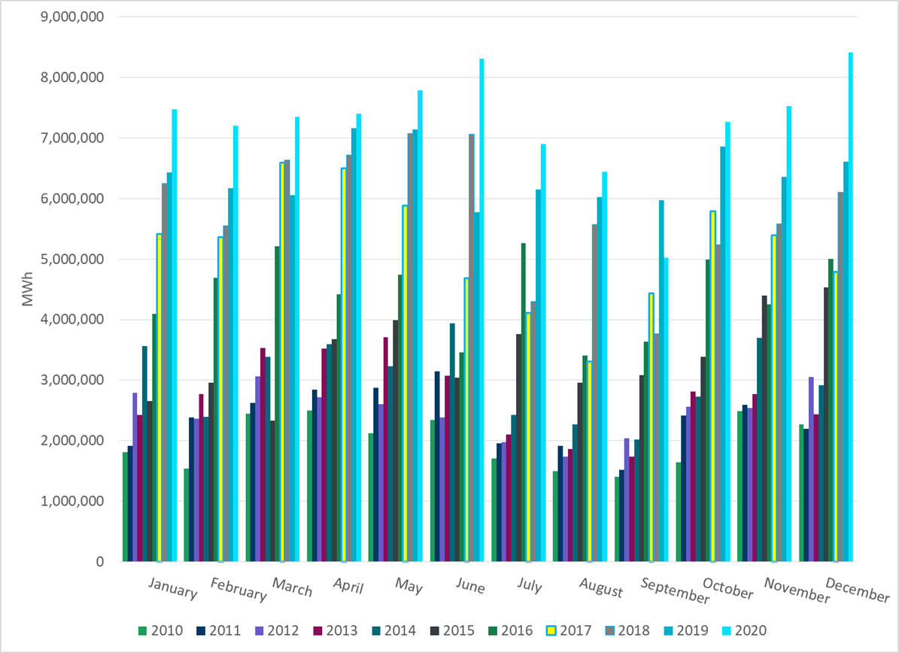
ERCOT Total Energy from Wind Generation
Notes:
7,264,919 MWh

Slide 16
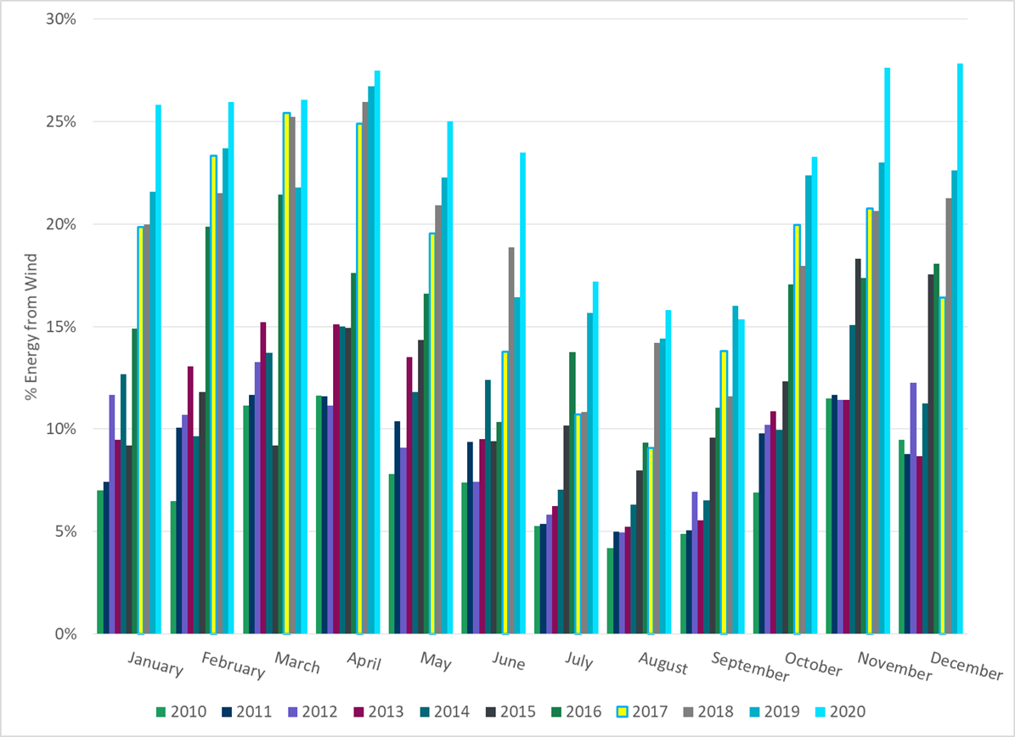
ERCOT % Energy from Wind Generation
Notes:
23.28%

Slide 17
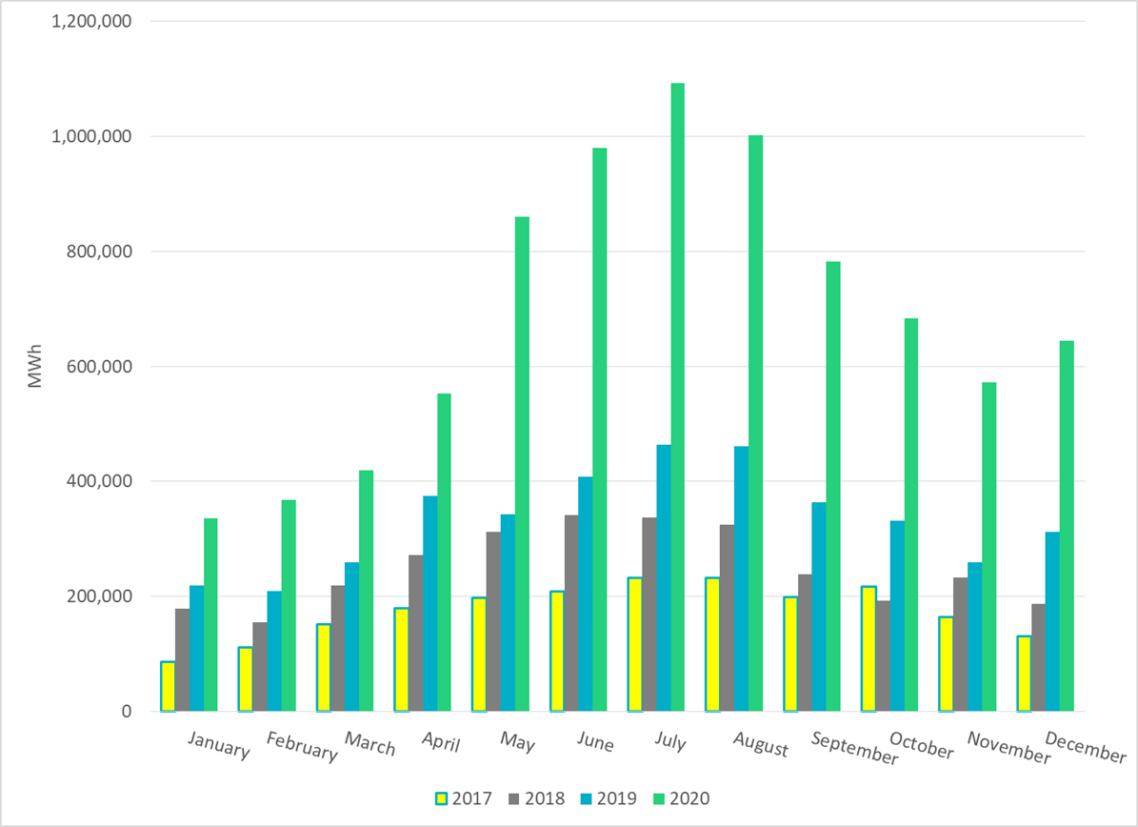
ERCOT Total Energy from Solar Generation
Notes:
682,932 MWh

Slide 18
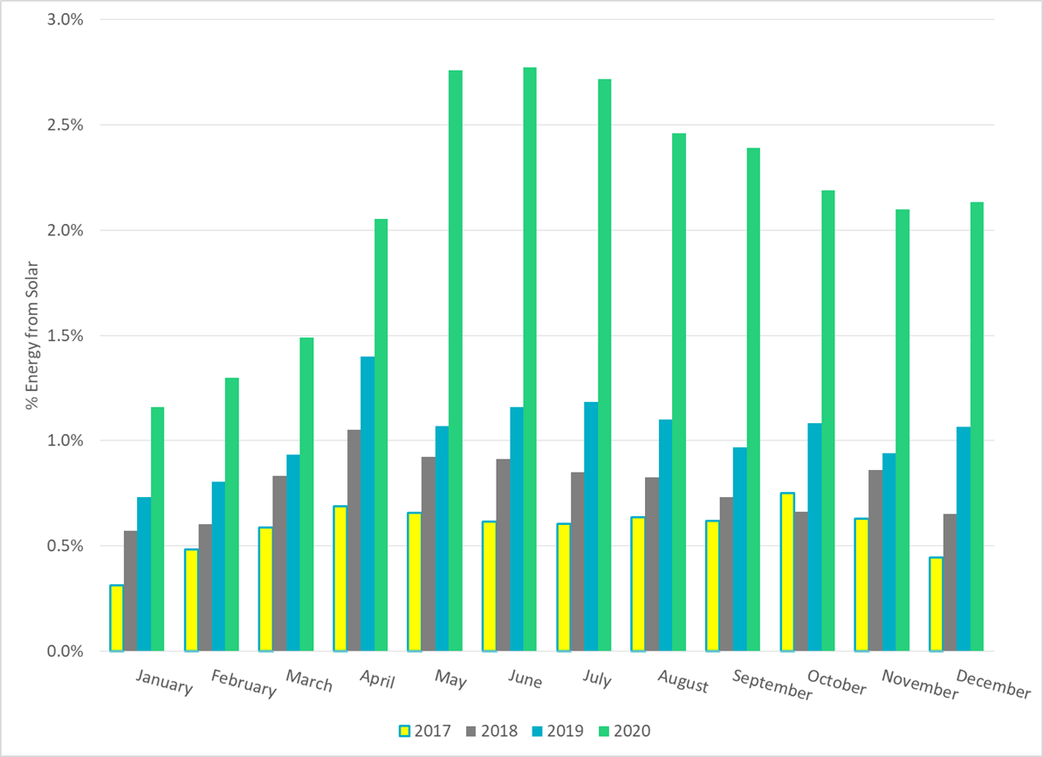
ERCOT % Energy from Solar Generation
Notes:
2.19%

Slide 19
Questions?

