Slide 1
CRR Activity Calendar Update
Donald House
Supervisor, CRR
WMS
February 3, 2021

Slide 2
CRR activity calendar – overview
Protocol 7.5.1(4)(c) requires ERCOT to post an updated calendar no later than April 1 of each calendar year
Each calendar includes auction activity dates for the remainder of the current calendar year and for the two subsequent calendar years
The calendar must be approved by WMS prior to the annual posting
Calendar was shared with CMWG on January 11, 2021
No requested revisions, but there was some discussion on the frequency of updates (more on slide 3)
Seeking final approval today from WMS

Slide 3
CRR activity calendar – frequency of updates
NPRR852, CRR Activity Calendar Approval Process, was approved on 2/20/2018
This NPRR added the requirement for ERCOT to post the updated calendar no later than April 1 of each year
It also moved the required approval from TAC to WMS
Is there any desire to change the frequency of updates?
CMWG discussed the idea of posting an update every 2 years
Or, is it acceptable for ERCOT to post the updated calendar each year without seeking WMS approval for the changes?
Changes to the frequency and/or required approval will need to be addressed with an NPRR

Slide 4
CRR activity calendar – description of changes
Current calendar
Dates from the currently approved calendar remain unchanged (through the 2023.MAR.Monthly.Auction)
Added dates to cover CRR activity through the 2024.MAR.Monthly.Auction
Applied the same patterns to assign the dates as have been used for previous calendars to maintain Protocol requirements and consistency
Nothing unusual to note about this update
Did not need to delay or move any auction submission windows to avoid holidays
PCRR-eligible NOIEs are encouraged to view the dates on the “PCRRs” tab of the calendar

Slide 5
CRR activity calendar – general reminders
The model build process begins 2 weeks prior to the model posting date (get outages and Common Information Model snapshot)
We hold a monthly auction and a long-term auction every month of the year
Typical pattern is monthly auction bid window in the first half of the month followed by the long-term auction bid window the very next week (occasionally, there will be a one-week gap to avoid holidays)
Monthly auction results are posted one week after the bid window closes; long-term auction results are posted two weeks after the bid window closes
Monthly auction credit is usually released 1 day after the long-term auction credit is locked

Slide 6
CRR activity calendar – general reminders
There are two additional tabs on the calendar
“Calendar Protocol References” includes any references to protocol sections relating to the selection of dates
“PCRRs” gives activity dates and protocol sections related to the annual PCRR allocation process

Slide 7
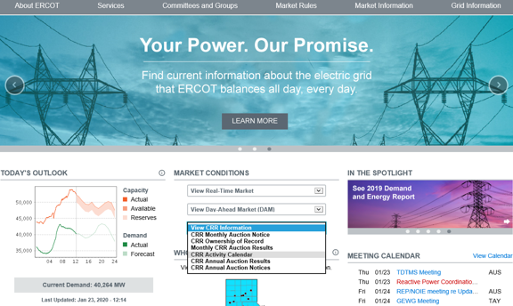
CRR activity calendar – next steps
ERCOT is seeking final approval today from WMS
Once approved, the new version of the calendar will be posted on the ERCOT public site by April 1, 2021

