Slide 1
Unregistered Distributed Generation Report:
2020 Q4 Update
Resource Adequacy
2/3/2021

Slide 2
2020 Q4 Unregistered Distributed Generation Report
Load Zone | 2020 Q4 Distributed Generation Installed Capacity in MW (AC)
 | SOLAR |  | WIND |  | OTHER RENEWABLE |  | OTHER NON-RENEWABLE |  | TOTAL
 | < 50 kW | ≥ 50 kW | < 50 kW | ≥ 50 kW | < 50 kW | ≥ 50 kW | < 50 kW | ≥ 50 kW | < 50 kW | ≥ 50 kW | Combined
LZ_AEN | 63 | 24 | - | - | - | - | - | - | 63 | 24 | 87
LZ_CPS | 159 | 33 | - | - | 2 | - | - | 20 | 161 | 53 | 214
LZ_HOUSTON | 77 | 2 | - | - | - | - | - | 4 | 77 | 6 | 83
LZ_LCRA | 55 | 14 | - | - | - | - | - | - | 56 | 14 | 70
LZ_NORTH | 247 | 26 | 2 | 1 | - | - | - | 1 | 249 | 28 | 277
LZ_RAYBN | 16 | 3 | - | - | - | - | - | - | 16 | 3 | 19
LZ_SOUTH | 74 | 17 | 1 | - | - | - | - | 1 | 75 | 18 | 93
LZ_WEST | 35 | 5 | 1 | - | - | - | - | - | 35 | 6 | 41
TOTAL | 726 | 125 | 4 | 2 | 2 | - | - | 25 | 732 | 152 | 883
Totals may not match the sum of their columns/rows due to rounding
Notes:
This quarterly report does not include all NOIE < 50 kW capacity. That capacity will be included in the 2020 Annual Report, to be posted along with the next quarterly update.
NOIE data is submitted through surveys. Competitive TDSP data is submitted through load profile codes.
Competitive vs. NOIE breakdown:
Competitive: 447 MW
NOIE: 436 MW

Slide 3
2020 Q3 → Q4 Change
Load Zone | 2020 Q3 → Q4 Change in Distributed Generation Installed Capacity in MW (AC)
 | SOLAR |  | WIND |  | OTHER RENEWABLE |  | OTHER NON-RENEWABLE |  | TOTAL
 | < 50 kW | ≥ 50 kW | < 50 kW | ≥ 50 kW | < 50 kW | ≥ 50 kW | < 50 kW | ≥ 50 kW | < 50 kW | ≥ 50 kW | Combined
LZ_AEN | -0.39 | +0.22 | - | - | - | - | - | - | -0.39 | +0.22 | -0.17
LZ_CPS | +10.45 | +1.49 | - | - | +0.16 | - | - | +3.29 | +10.61 | +4.78 | +15.39
LZ_HOUSTON | +10.90 | +0.11 | - | - | - | - | - | - | +10.90 | +0.11 | +11.01
LZ_LCRA | +4.34 | - | - | - | - | - | - | - | +4.34 | - | +4.34
LZ_NORTH | +27.82 | +2.47 | - | - | - | - | - | - | +27.82 | +2.47 | +30.28
LZ_RAYBN | +1.97 | - | +0.01 | - | - | - | - | - | +1.97 | - | +1.97
LZ_SOUTH | +5.56 | +1.41 | - | - | - | - | - | - | +5.56 | +1.41 | +6.97
LZ_WEST | +6.86 | - | - | - | - | - | - | - | +6.86 | - | +6.86
TOTAL | +67.49 | +5.70 | +0.01 | - | +0.16 | - | - | +3.29 | +67.66 | +8.99 | +76.65
Notes:
- Negative numbers reflect reported data corrections

Slide 4
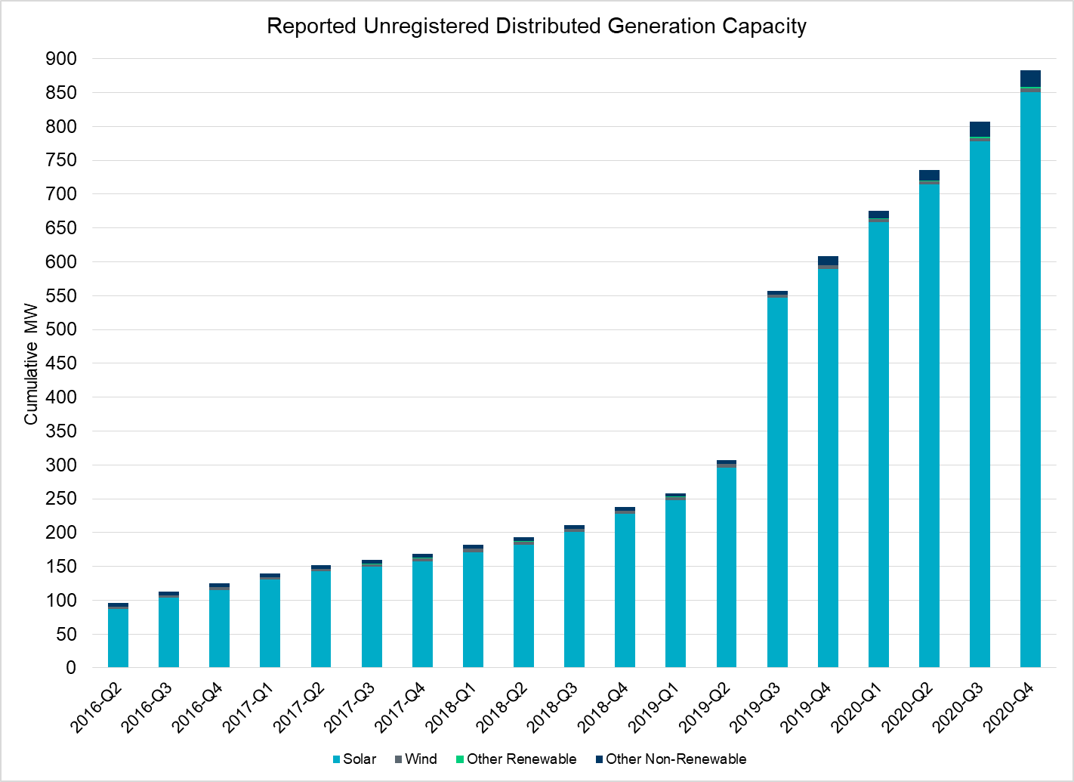
Unregistered DG Growth: 2016-Q2* to 2020-Q4
Large increase due to reporting requirement change**
* 2016-Q2 was the first report published after implementation of report changes per NPRR794/COPMGR044
** 2019-Q3 was the first report published after implementation of report changes per NPRR891

