Slide 1
DAM Delays- Regression Analysis
January 25th, 2021 WMWG
ERCOT Staff

Slide 2
Overview
Objective: To determine inputs that have significant influence on the total time taken to complete DAM Optimization
Performed simple linear regression analysis on 22 variables against DAM run time and ranked them based on R-squared (R-squared is a statistical measure of how close the data are to the fitted regression line)
Performed multiple linear regression using 6 most significant variables against DAM Run Time and provide Model Interpretations

Slide 3
Methodology
Performed simple linear regression on 22 variables against DAM run time and ranked them based on model’s goodness of fit (R-squared)
  PTP-related variables
    PTPTOTAL_INT
    PTP_>10 MWs
    PTPTOTAL_DLY
    PTP_multiHourBLK
    PTP_5.1-10 MWs
    PTP_0-5 MWs
  Energy-Only Offer-related variables
    EOO_INT
    EOO_NOFixedQ_NOmultiHourBLK
    EOO_FixedQTY_MultiHourBLK
    EOO_MultiHourBLK
    EOO_DLY
    EOO_FixedQTY_NoMultiHourBLK
  Energy Bid-related variables
    EB_FixedQTY_MultiHourBLK
    EB_INT
    EB_NOFixedQ_NOmultiHourBLK
    EB_FixQ_NoMultiHourBLK
    EB_MultiHourBLK
    EB_DLY
  Three Part Offers
    TPO_INT
    TPO_DLY
  Other variables
    Outages Count
    Number of DAM Constraints (binding)
R-squared
  the amount of variability in the dependent variable (i.e. DAM Run Time) explained by the independent variable (i.e. EOO_INT)
  On a scale of 0 to 1, higher value implies a better model fit
  If R squared is 1, it means that the two variables are perfectly correlated.

Slide 4
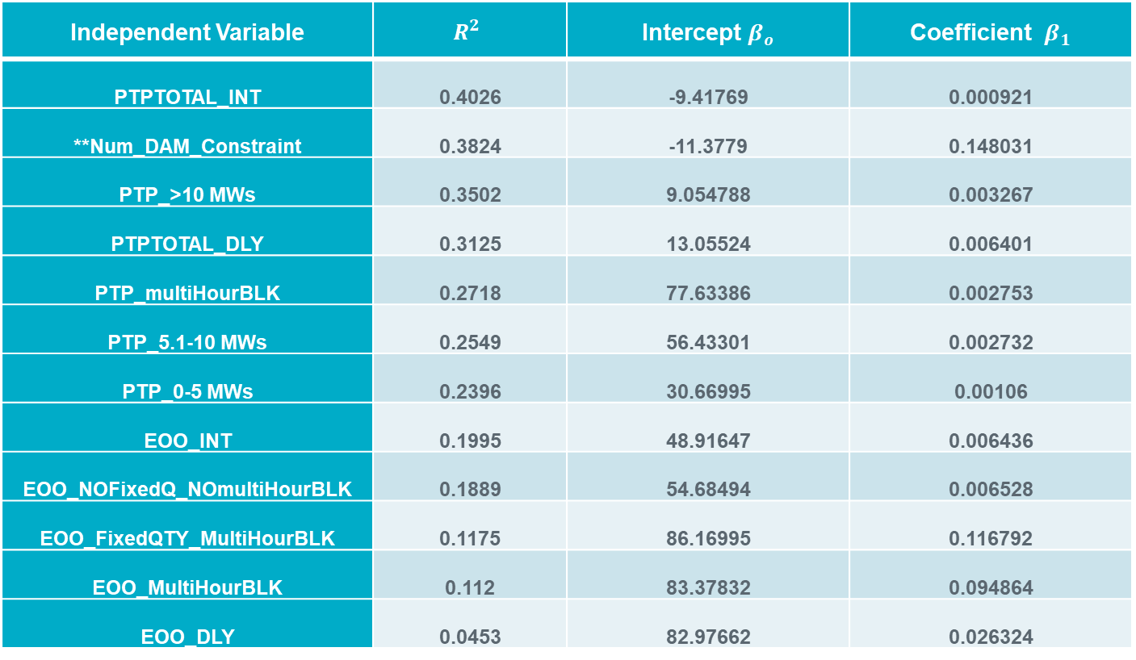
Simple Linear Regression Analysis (1)
Independent Variable | $$R^{2}$$ | Intercept $β_{o}$ | Coefficient $β_{1}$
PTPTOTAL_INT | 0.4026 | -9.41769 | 0.000921
**Num_DAM_Constraint | 0.3824 | -11.3779 | 0.148031
PTP_>10 MWs | 0.3502 | 9.054788 | 0.003267
PTPTOTAL_DLY | 0.3125 | 13.05524 | 0.006401
PTP_multiHourBLK | 0.2718 | 77.63386 | 0.002753
PTP_5.1-10 MWs | 0.2549 | 56.43301 | 0.002732
PTP_0-5 MWs | 0.2396 | 30.66995 | 0.00106
EOO_INT | 0.1995 | 48.91647 | 0.006436
EOO_NOFixedQ_NOmultiHourBLK | 0.1889 | 54.68494 | 0.006528
EOO_FixedQTY_MultiHourBLK | 0.1175 | 86.16995 | 0.116792
EOO_MultiHourBLK | 0.112 | 83.37832 | 0.094864
EOO_DLY | 0.0453 | 82.97662 | 0.026324
*Sorted in descending order by R-squared
** Num_DAM_Constraint is not an input to DAM

Slide 5
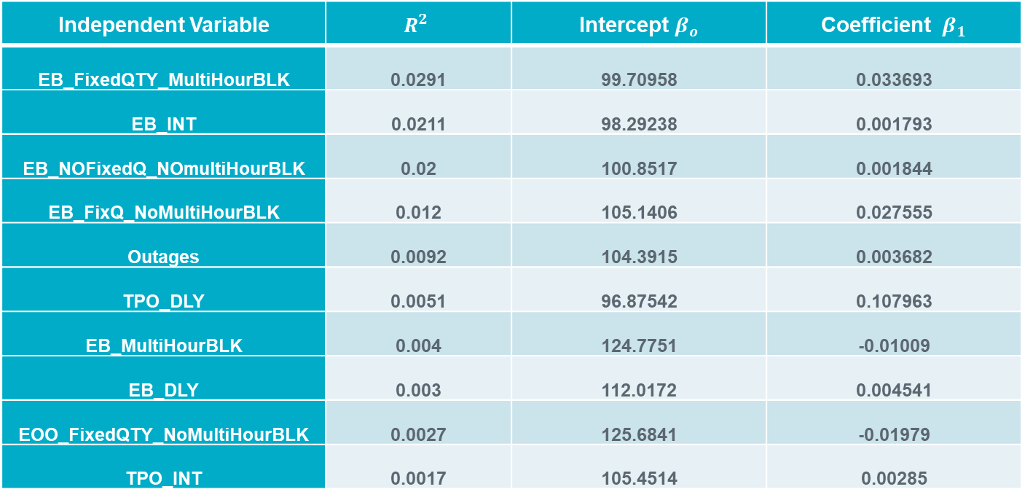
Simple Linear Regression Analysis (2)
Independent Variable | $$R^{2}$$ | Intercept $β_{o}$ | Coefficient $β_{1}$
EB_FixedQTY_MultiHourBLK | 0.0291 | 99.70958 | 0.033693
EB_INT | 0.0211 | 98.29238 | 0.001793
EB_NOFixedQ_NOmultiHourBLK | 0.02 | 100.8517 | 0.001844
EB_FixQ_NoMultiHourBLK | 0.012 | 105.1406 | 0.027555
Outages | 0.0092 | 104.3915 | 0.003682
TPO_DLY | 0.0051 | 96.87542 | 0.107963
EB_MultiHourBLK | 0.004 | 124.7751 | -0.01009
EB_DLY | 0.003 | 112.0172 | 0.004541
EOO_FixedQTY_NoMultiHourBLK | 0.0027 | 125.6841 | -0.01979
TPO_INT | 0.0017 | 105.4514 | 0.00285
*Sorted in descending order by R-squared

Slide 6
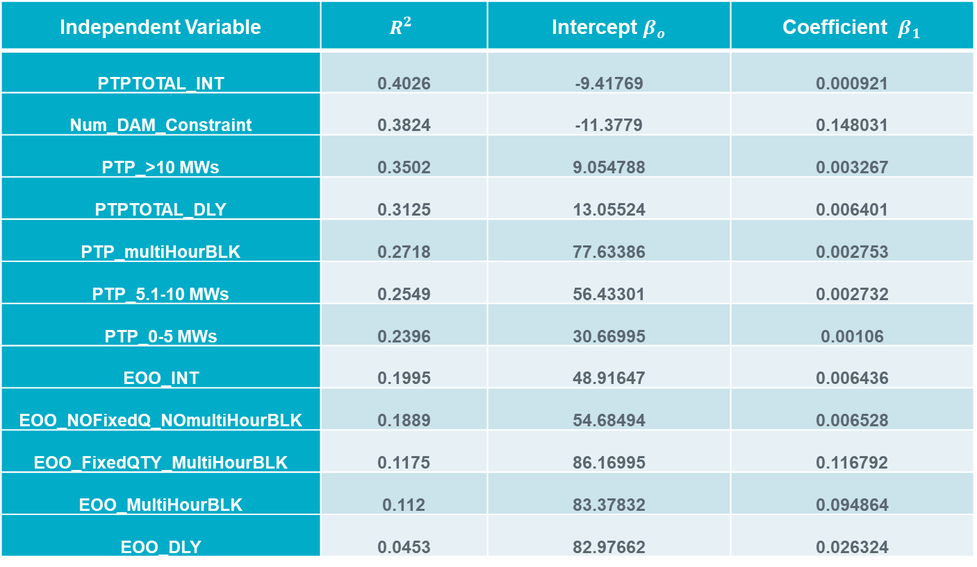
Multicollinearity- When an independent variable is highly correlated with one or more independent variable (s), it can increase the variance of the coefficient estimates, causing coefficient estimates to be unstable (i.e. switched sign(+/-)) and sensitive to minor change to the model.
Independent Variable | $$R^{2}$$ | Intercept $β_{o}$ | Coefficient $β_{1}$
PTPTOTAL_INT | 0.4026 | -9.41769 | 0.000921
Num_DAM_Constraint | 0.3824 | -11.3779 | 0.148031
PTP_>10 MWs | 0.3502 | 9.054788 | 0.003267
PTPTOTAL_DLY | 0.3125 | 13.05524 | 0.006401
PTP_multiHourBLK | 0.2718 | 77.63386 | 0.002753
PTP_5.1-10 MWs | 0.2549 | 56.43301 | 0.002732
PTP_0-5 MWs | 0.2396 | 30.66995 | 0.00106
EOO_INT | 0.1995 | 48.91647 | 0.006436
EOO_NOFixedQ_NOmultiHourBLK | 0.1889 | 54.68494 | 0.006528
EOO_FixedQTY_MultiHourBLK | 0.1175 | 86.16995 | 0.116792
EOO_MultiHourBLK | 0.112 | 83.37832 | 0.094864
EOO_DLY | 0.0453 | 82.97662 | 0.026324
Strongly correlated with PTPTOTAL_INT
Strongly correlated with EOO_INT

Slide 7

Multicollinearity- When an independent variable is highly correlated with one or more independent variable (s), it can increase the variance of the coefficient estimates, causing coefficient estimates to be unstable (i.e. switched sign(+/-)) and sensitive to minor change to the model.
Independent Variable | $$R^{2}$$ | Intercept $β_{o}$ | Coefficient $β_{1}$
EB_FixedQTY_MultiHourBLK | 0.0291 | 99.70958 | 0.033693
EB_INT | 0.0211 | 98.29238 | 0.001793
EB_NOFixedQ_NOmultiHourBLK | 0.02 | 100.8517 | 0.001844
EB_FixQ_NoMultiHourBLK | 0.012 | 105.1406 | 0.027555
Outages | 0.0092 | 104.3915 | 0.003682
TPO_DLY | 0.0051 | 96.87542 | 0.107963
EB_MultiHourBLK | 0.004 | 124.7751 | -0.01009
EB_DLY | 0.003 | 112.0172 | 0.004541
EOO_FixedQTY_NoMultiHourBLK | 0.0027 | 125.6841 | -0.01979
TPO_INT | 0.0017 | 105.4514 | 0.00285
Mildly correlated with EB_FixedQTY_MultiHourBLK

Slide 8
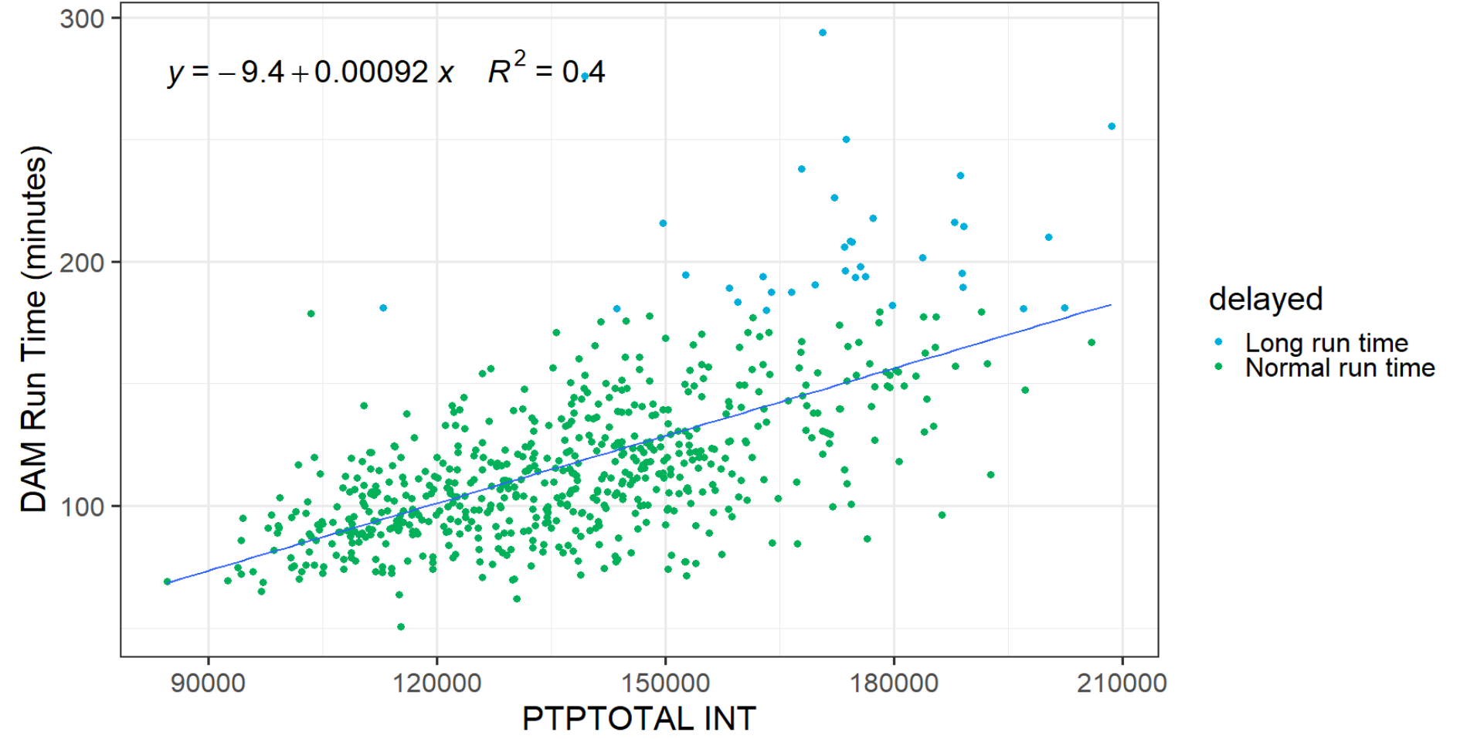
PTPTOTAL INT
Strong positive relationship between PTPTOTAL INT and DAM Run Time

Slide 9
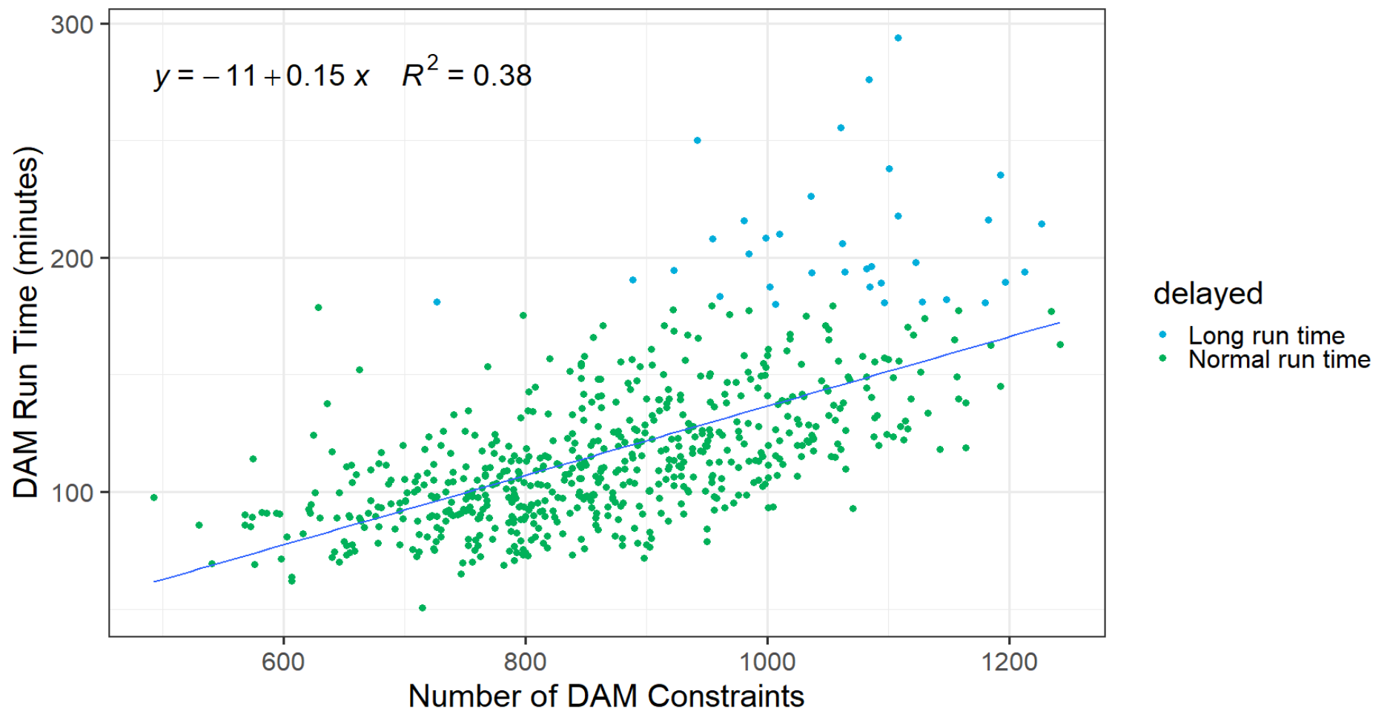
Number of Constraints
Strong positive relationship between Number of constraints and DAM Run Time

Slide 10
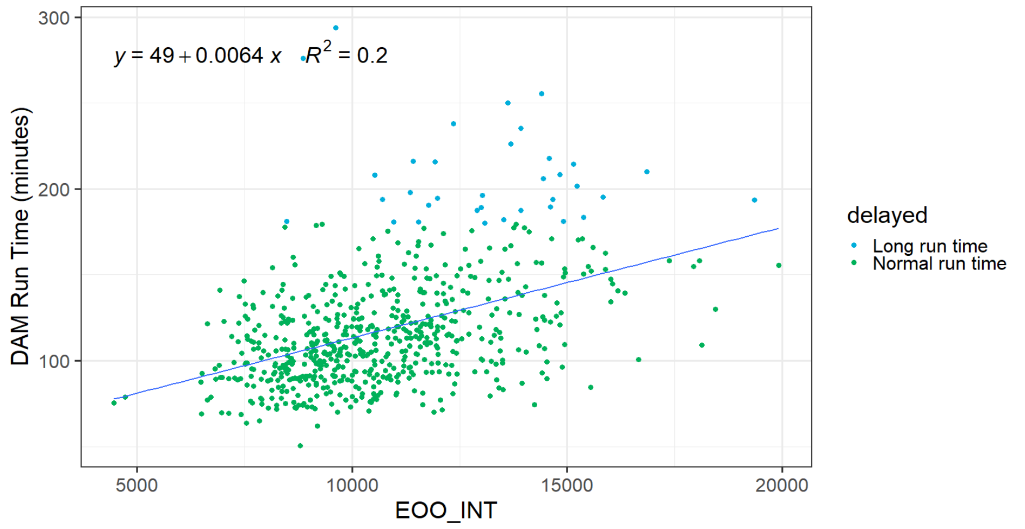
Energy Only Offer – EOO_INT
Mildly positive relationship between EOO_INT and DAM Run Time is identified

Slide 11
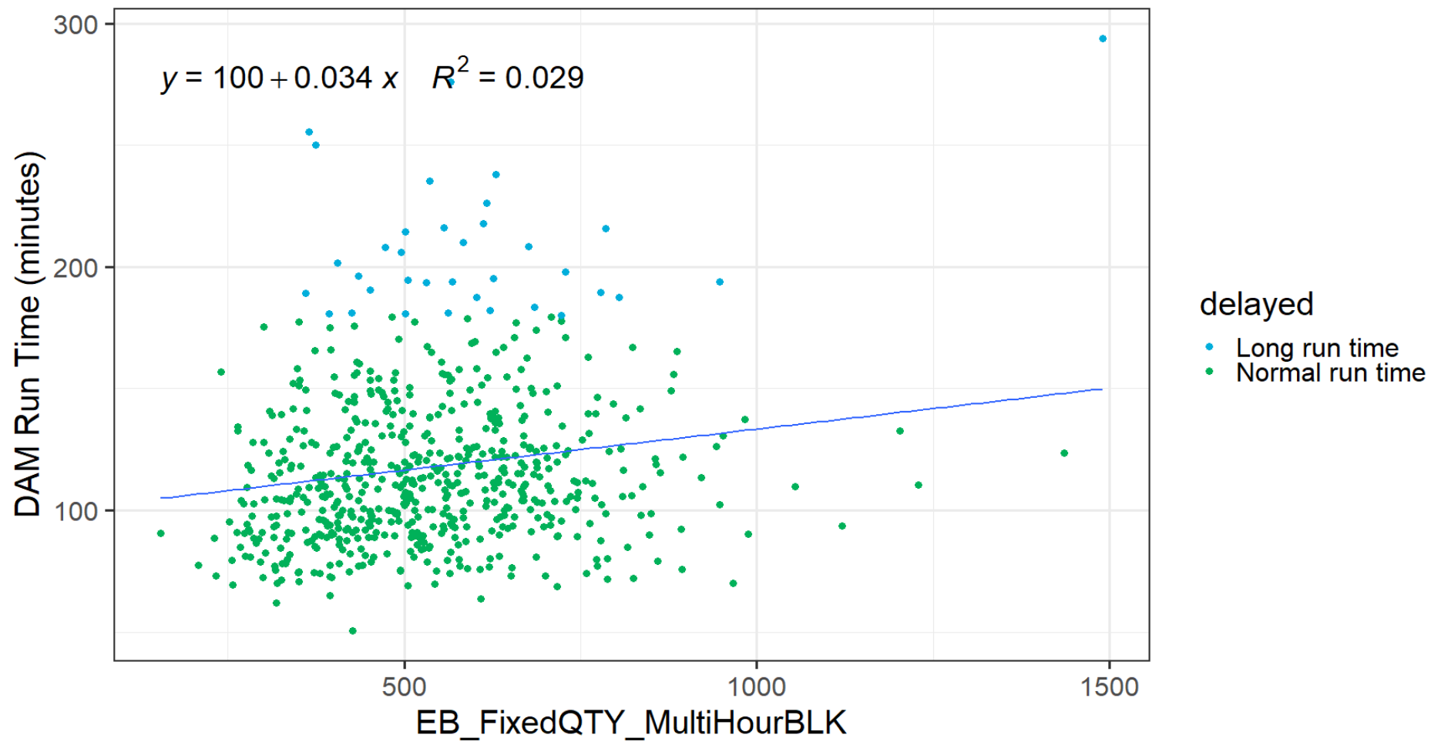
Energy Bid- EB_FixedQTY_MultiHourBLK
Small positive relationship between EB_FixedQTY_MultiHourBLK and DAM Run Time is identified

Slide 12
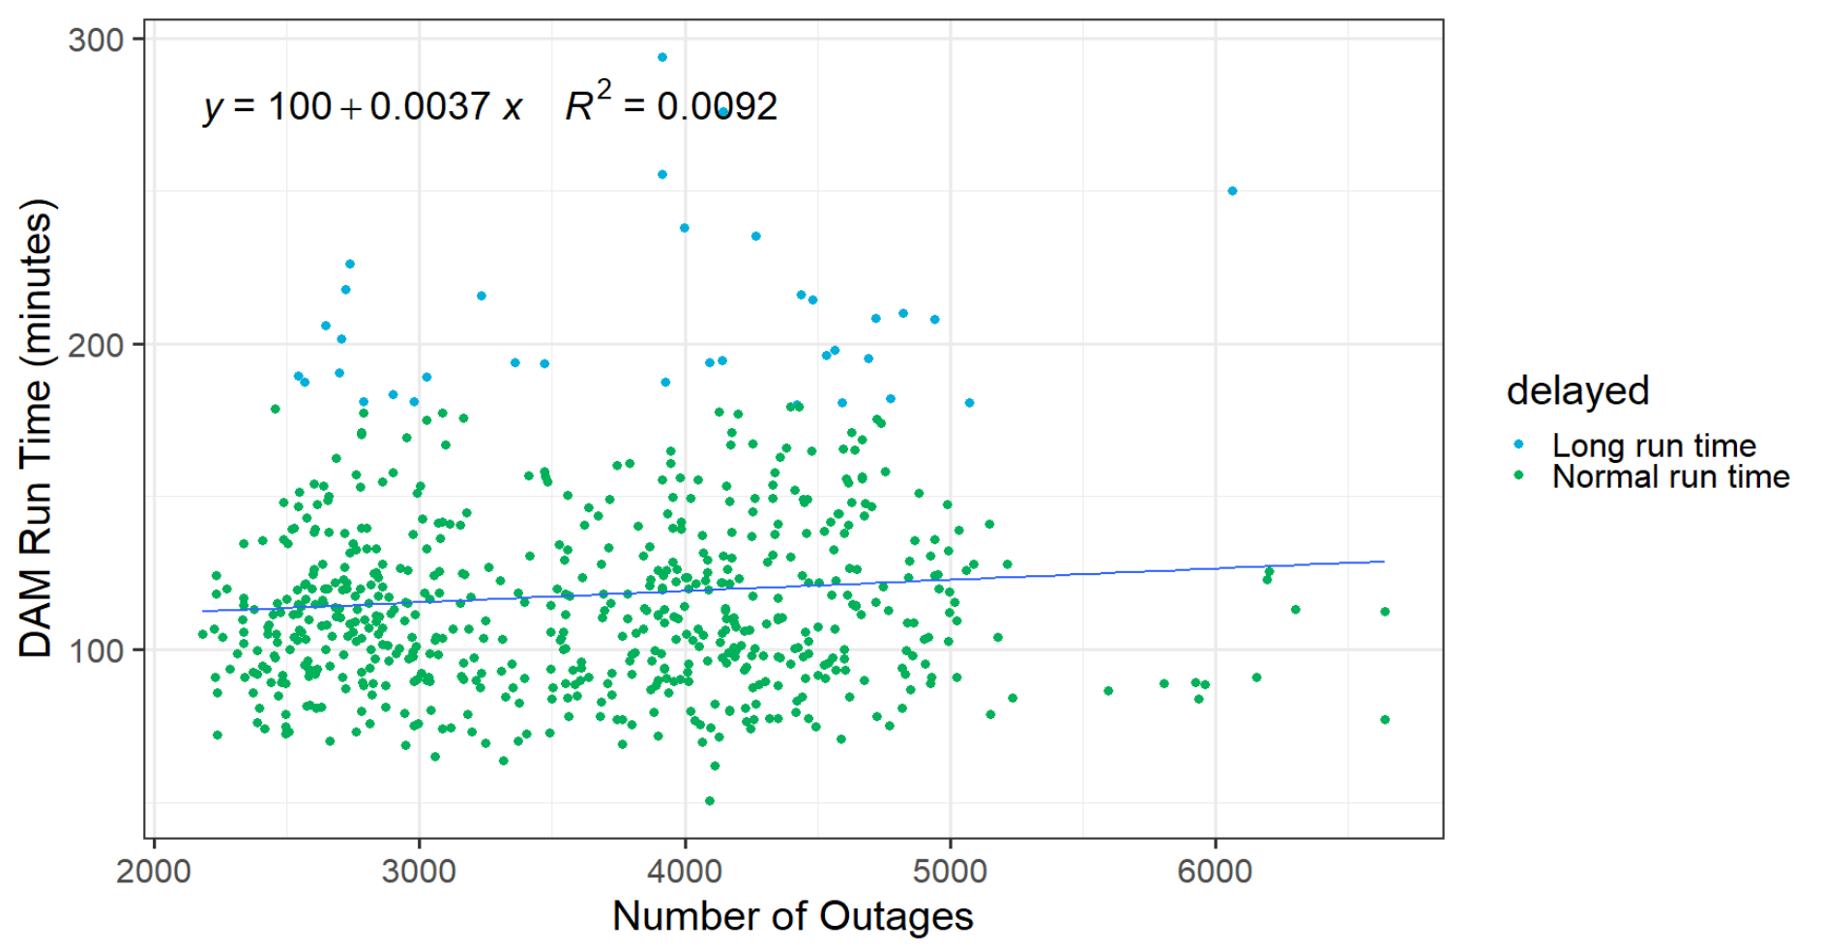
Outage
No strong relationship between Outage and DAM run time is identified.

Slide 13
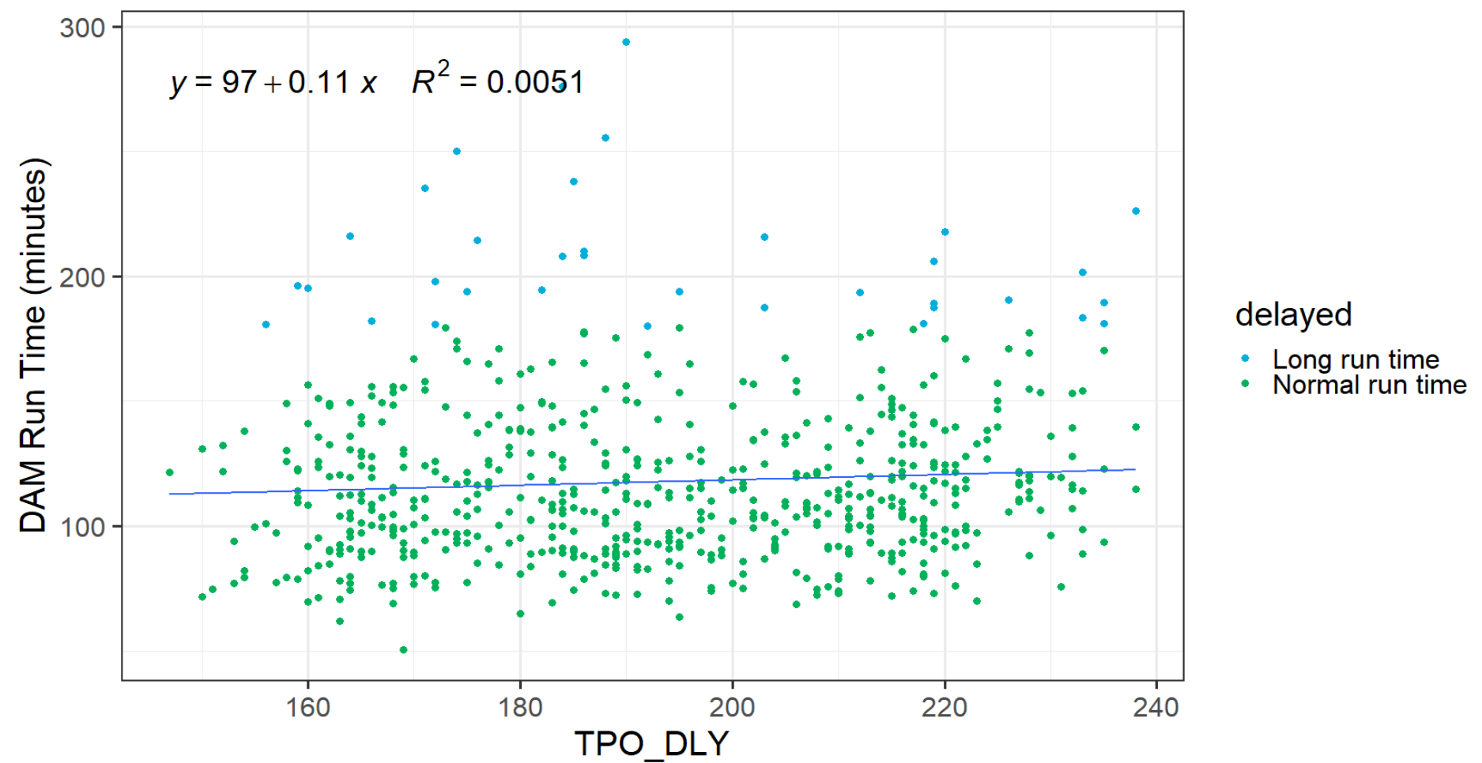
Three Part Offer- TPO_DLY
No strong relationship between TPO_DLY and DAM Run Time is identified

Slide 14
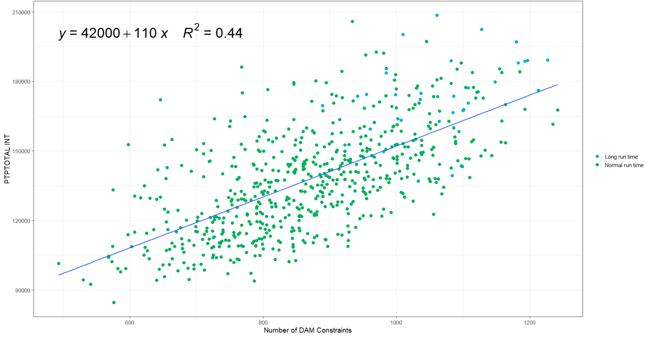
PTPTOTAL INT vs. Number of Constraints
Strongly positive relationship between PTPTOTAL INT and Number of Constraints is identified

Slide 15
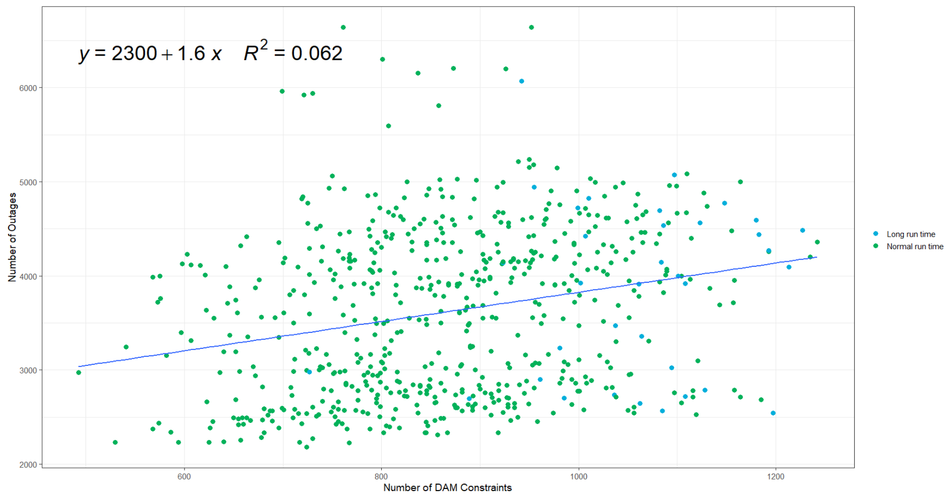
Outages vs. Number of Constraints
Mildly positive relationship between Outage Count and Number of Constraints is identified

Slide 16
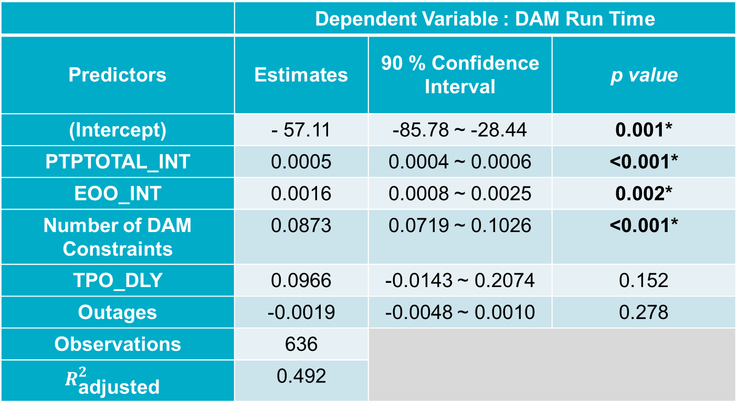
Multiple Regression Analysis
 | Dependent Variable : DAM Run Time
Predictors | Estimates | 90 % Confidence Interval | p value
(Intercept) | - 57.11 | -85.78 ~ -28.44 | 0.001*
PTPTOTAL_INT | 0.0005 | 0.0004 ~ 0.0006 | <0.001*
EOO_INT | 0.0016 | 0.0008 ~ 0.0025 | 0.002*
Number of DAM Constraints | 0.0873 | 0.0719 ~ 0.1026 | <0.001*
TPO_DLY | 0.0966 | -0.0143 ~ 0.2074 | 0.152
Outages | -0.0019 | -0.0048 ~ 0.0010 | 0.278
Observations | 636
$$R_{\text{adjusted} }^{2}$$ | 0.492
*The effect of PTPTOTAL_INT, EOO_INT and Number of DAM Constraints on
DAM Run Time are found to be significant at 5% statistical significance level
Notes:
Note: Variance-Inflation Factors (A measure of severity of Multicollinearity) for all variables are less than 3 (typically below 10 is considered acceptable), implying that the multicollinearity issue is pretty mild.

Slide 17
Regression Model Interpretation
For every 10,000 unit increase in PTPTOTAL_INT (Max: 208,512),
DAM Run Time is increased by 5 minutes (4~6 minutes)
For every 1,000 unit increase in EOO_INT (Max: 19,915),
DAM Run Time is increased by 1.6 minutes (0.8~2.5 minutes)
For every 100 unit increase in the Number of Constraints (Max: 1,242),
DAM Run Time is increased by 8.3 minutes (6.76~9.81 minutes)
** Model Interpretations for Outage and TPO_DLY are omitted since their effect on
DAM Run Time are deemed to be insignificant at 5% significance level.

Slide 18
Average Volume of PTP Intervals by Year
Average yearly PTP intervals have increased from 2011 (consistently since 2016)
Year | Avg. PTP intervals
2011 | 35,059
2012 | 46,719
2013 | 70,791
2014 | 58,892
2015 | 72,080
2016 | 61,645
2017 | 79,983
2018 | 123,674
2019 | 128,762
2020 | 147,232

Slide 19
Summary
Total PTP_Intervals, Total number of Constraints and Total Energy Only Offer (EOO) intervals appears to be the three most significant variables affecting the Total DAM Run time
  Of these three variables Total PTP Intervals is the most influential variable affecting Total DAM Run time, and
  Growing trend of Total PTP Intervals will exasperate the DAM performance issue
  Total number of Constraints is not an input to the DAM Optimization
  Total Number of Constraints appears to be highly correlated with the volume of total PTP intervals
Outages does not appear to be significant variable affecting the Total DAM Run time. There was some very small positive correlation between Outage Count and Number of Constraints
ERCOT at the January 6th WMS meeting had presented removing block bids as a way to reduce complexity and improve DAM Run time. The data does not show limiting block bids will be most effective in solving the performance problem.

