Slide 1
January 27, 2021 RMS Update to TAC
Jim Lee
RMS Chair

Slide 2
Updates – Dec 1 & Jan 12 RMS Meeting
2021 RMS Leadership elections:
Chair: Jim Lee – AEP
Vice Chair: John Schatz – Luminant
Voting Items:
Approved 2021 Retail Market IT Services SLA
Approved 2021 Market Data Transparency SLA

Slide 3
Updates – Dec 1 & Jan 12 RMS Meetings
Texas Standard Electronic Transaction (TXSET):
5.0 Release – First major TXSET release since 2012, includes:
Inadvertent Gain transactional solution
Adds indicator within transaction to allow TDSP’s system to recognize and systematically process IAG/IAL transactions
Hurricane Harvey Lessons Learned
Adding Premise Type attribute to identify dwelling type
Emergency Disconnect/Reconnect process improvements
General Retail Processes & Communication Enhancements
Adding “County” in address for better Weather Moratorium handling
Right sizing the list of market reject reasons
Construction Hold enhancements

Slide 4
Updates – Dec 1 & Jan 12 RMS Meetings
TXSET 5.0 RELEASE TIMELINE
Q4 2020 - Q1 2021
Q2-Q3 2024
Project Conceptualization
Market Requirements
ERCOT Requirements
Conceptual Design
Detail Design
Build and Unit Test
ERCOT UAT
Market Flight Test
11 Weeks
6 Weeks
8 Weeks
4 Weeks
10 Weeks
12 Weeks
16 Weeks
7 Weeks
Projected Timeline - 65 Weeks or 15 Months

Slide 5
Updates – Dec 1 & Jan 12 RMS Meetings
Profiling WG: endorsed draft Revision Requests related to market effort of replacing IDR meters with AMS meters. Impacts to:
ERCOT Settlement
Load Profiling
Metering requirements – AMS install & IDR removal
Data Transport from TDSP to ERCOT to LSE/QSE
NPRR1062, Modify IDR Meter Requirement and Eliminate IDR Meter Requirement Report
RMGRR164, Related to NPRR1062, Modify IDR Meter Requirement and Eliminate IDR Meter Requirement Report
Draft LPGRR – adds 16 new Load Profiles for “BUSLRG” & “BUSLRGDG”

Slide 6
Updates – Dec 1 & Jan 12 RMS Meetings
Texas Data Transport & MarkeTrak Systems (TDTMS):
Supported ERCOT’s NAESB/TLS1.2 upgrade
Endorsed 2021 Retail SLAs to RMS
Supported ERCOT’s development of Consolidated IT Application Service Report & Issue Tracking page
Nearing completion of MarkeTrak Enhancements – anticipate SCR in early 2021

Slide 7
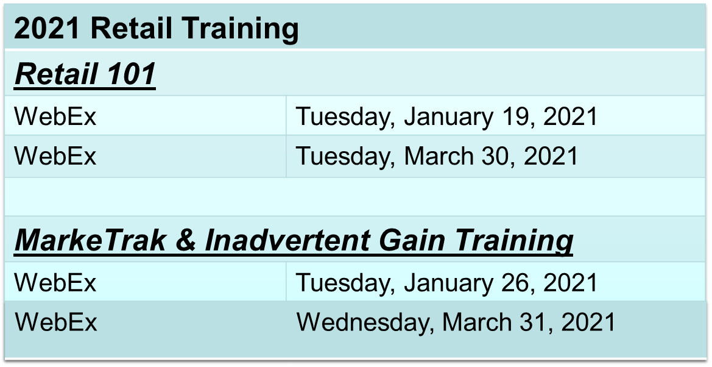
Updates – Dec 1 & Jan 12 RMS Meetings
Retail Market Training Task Force (RMTTF):

Slide 8
Questions?
Next RMS Meeting – February 2, 2021

