Slide 1
MIS & ERCOT.com User Workshop
January 20, 2021

Slide 2
Agenda
2021 Project Goals
Release Schedule
Market Data User Survey
Public Dashboard Preview
Combined Site Concepts

Slide 3

Release Timeline
Jan
May
Sep
Nov
Feb
May
Nov
Q1- Q4
EMIL
Web
Interface
New
MIS Sandbox
MIS Soft
Launch for MP
Testing
MIS Prod
Release
Deploy Dashboards, GCC, Mobile API
Transition Market Info and Grid Info sections.
Business Process Flows in Alfresco
Fully transition all ERCOT.com content to new platform
Decommission Old MIS
2020
2021
2021
02/06 | Decommission old MIS
05/06 | Public Dashboards Market Info and Grid Info sections of ERCOT.com to new platform.
11/15 | Fully combined MIS/ERCOT.com website.
Q1 22 | Decommission “Get Report” Pop-Up

Slide 4
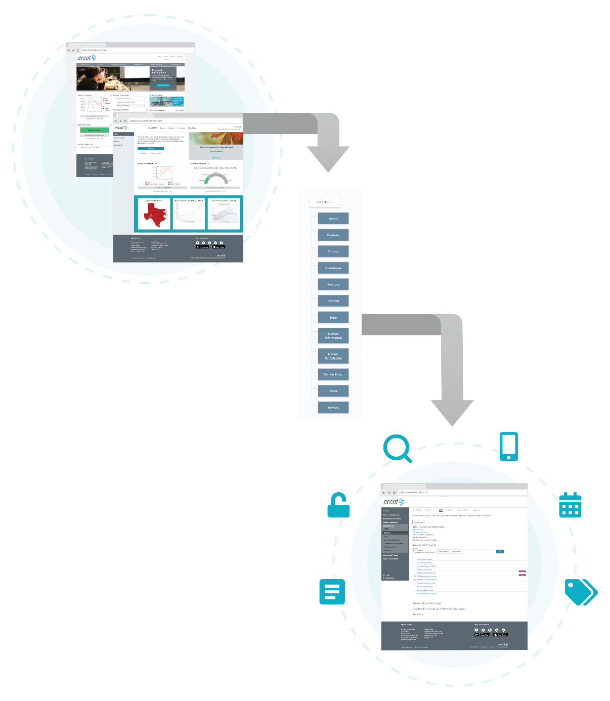
New, combined ERCOT Website
  Improved Market Data Transparency
  Public, Secure and Certified Information
  Data Catalog (EMIL)
  Improved Search
  Access to ERCOT Applications
  Single source of truth

Slide 5

Data Transparency Survey
https://form.jotform.com/210123831888052

Slide 6
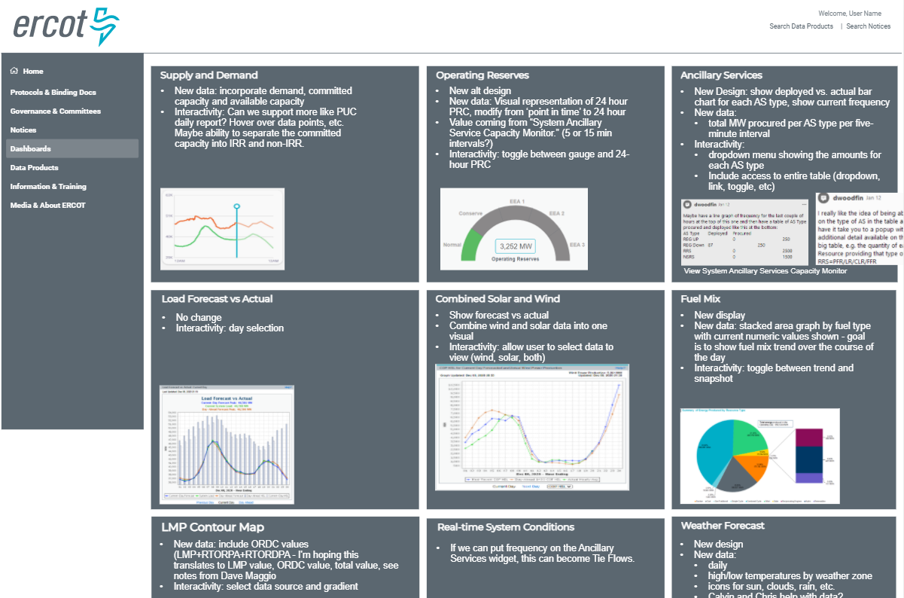
Public Dashboard Preview

Slide 7
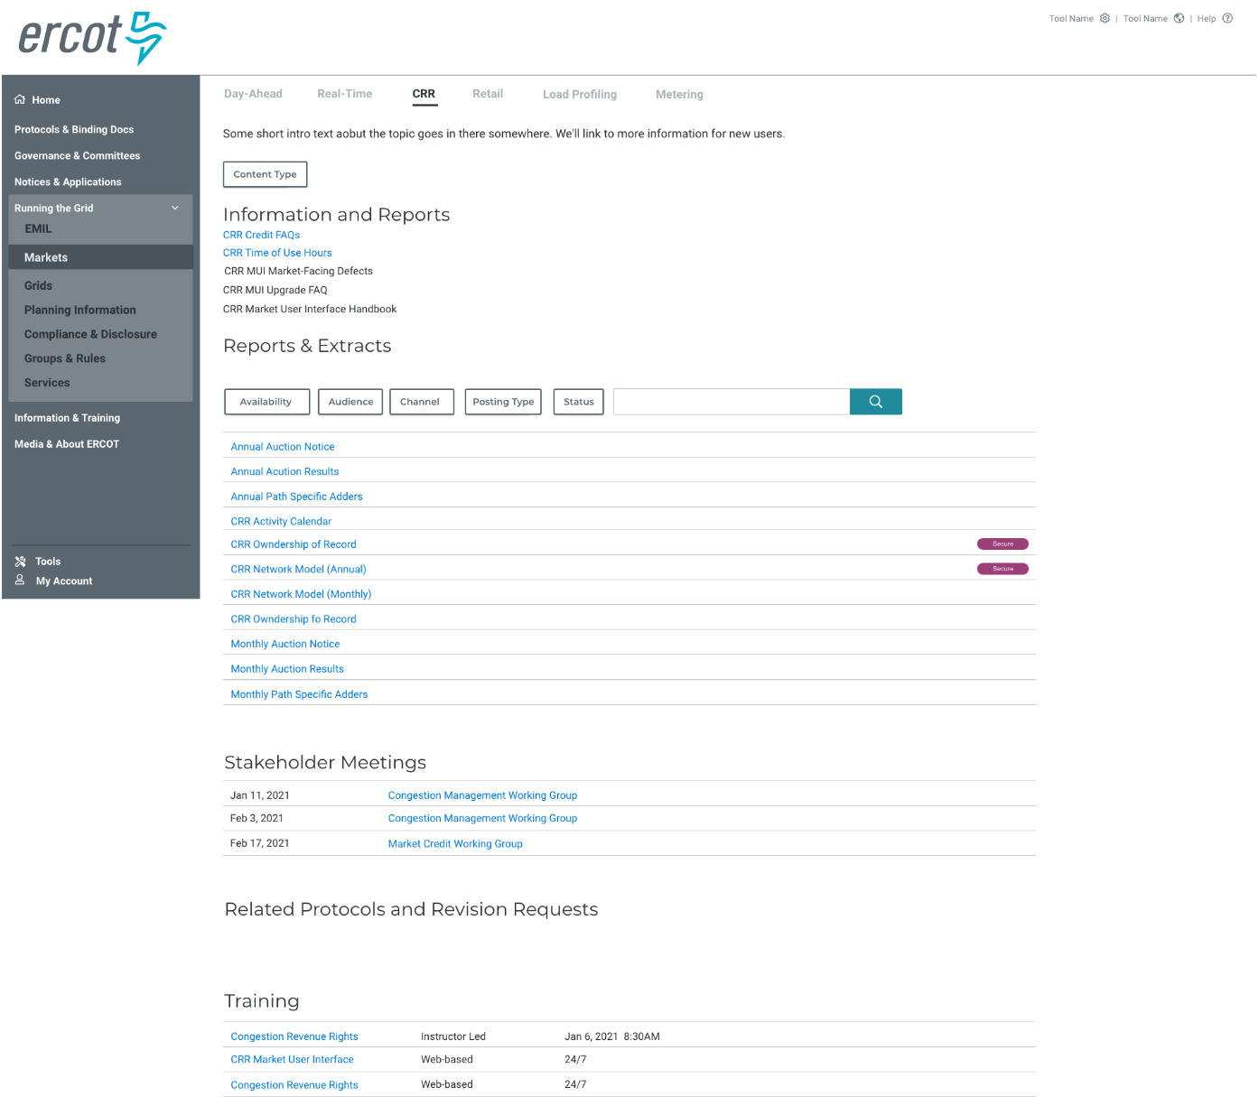
Market focused content organization

Slide 8
Next Steps
February 17 MIS & ERCOT.com User Workshop
Monthly meetings will be scheduled shortly
Possible small user workshops
Feedback at any time to webmaster@ercot.com
Redesign info: www.ercot.com/about/redesign

