Slide 1
Update for RFP “a Study to Evaluate the Need for Limitations on Resources Providing RRS-PFR”
ERCOT Staff
Jan. 13, 2021
PDCWG meeting

Slide 2
Previous Discussion at PDCWG
ERCOT has had a limit of 20% of capacity on a single thermal generation resource providing PFR, due to the 5% governor droop.
This has historically resulted in a distribution of RRS-PFR across multiple Resources.
Recently, technologies such as ESRs and CLRs have qualified to provide RRS-PFR.
Because of these resources’ characteristics, there is the potential that these Resources could technically provide up to 100% of their capacity as RRS-PFR.
As the size of these resources grow, there could be negative outcomes of various types resulting from too much RRS-PFR from a single resource/site.
Per the request of PDCWG, ERCOT presented an analysis, based on historically acceptable quantities per Resource, at the 2020 August PDCWG meeting to recommend a limit to non-thermal Generation Resource and Energy Storage Resources (ESRs) providing RRS-PFR.
Due to lack of models and operational data for ESRs providing RRS-PFR, both ERCOT and PDCWG recognize that a more thorough analysis needs to be performed in a timely manner.
At 2020 December PDCWG meeting, EROCT presented the scope of work and timeline of RFP (A Study to Evaluate the Need for Limitations on Resources Providing RRS-PFR) and solicited comments from stakeholders.

Slide 3
Update for RFP
RFP - A Study to Evaluate the Need for Limitations on Resources Providing RRS-PFR
Perform a study/analysis to investigate whether there are reliability reasons to establish one or more types of limits on Resources providing PFR per Resource, group, and/or at system level for different technologies or a limit on the minimum number of Resources providing PFR. The study should analyze the need for PFR limitations in the context of both NERC standards and ERCOT Nodal Protocols, and consider the characteristics of different technologies providing PFR.
Add a requirement “Complete the proposed work within a duration of 6-8 months” to remove uncertainty in the completion date of the RFP study.

Slide 4
Anticipated Timeline
Procurement Timeline
RFP Release Date | 1/18/2021
Vendor Proposals Due | 2/26/2021
Anticipated Contract Award | 3/29/2021
Anticipated Contract Start Date | 3/29/2021

Slide 5
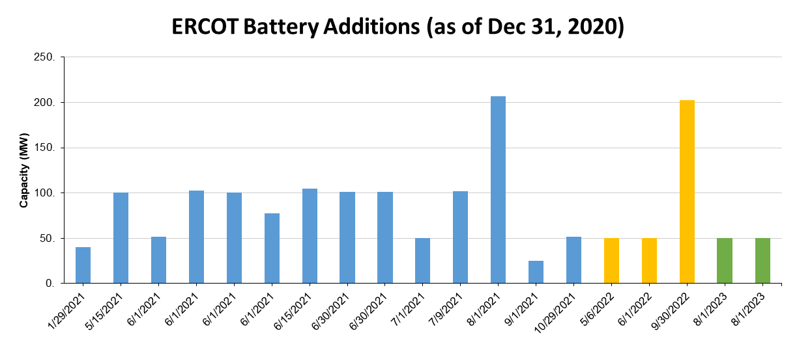
Batteries in Planning Queue
Capacity Changes by Fuel Type Charts, December 2020
Blue: 2021, Yellow: 2022, Green:2023

Slide 6
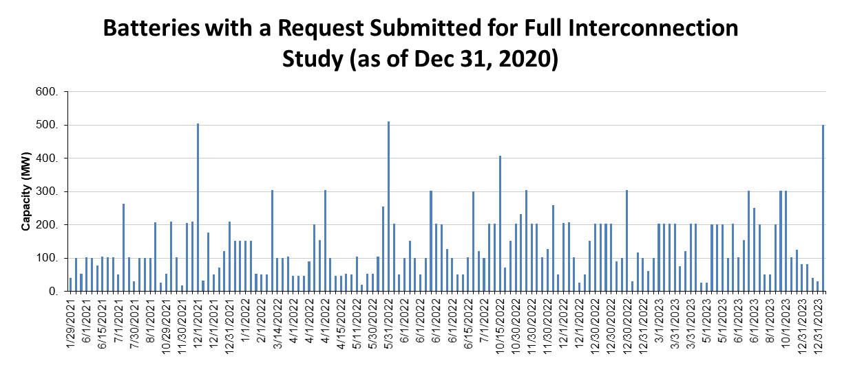
Batteries with a Request Submitted for Full Interconnection Study

Slide 7
Going Forward
The RRS-PFR limit and other AS limits for both existing and future resources will be subject to the limits determined and informed from the RFP study.
No grandfathering will be allowed as the limits are related to reliability reasons.
The RRS-PFR limit and other AS limits, if they exist, will continue be subject to the periodic review of the reliability needs for the ERCOT grid.

Slide 8
Questions + Discussions

