Slide 1
Ongoing Discussion on Proposal for Load Profile Template Changes
Jan 13, 2020

Slide 2
Discussion
Recap summary of offline discussions with TDSPs regarding ERCOT Proposed Load Profile template changes presented at Nov 6 PWG meeting
Primary feedback from TDSPs
  Excel spreadsheet method was originally acceptable for small numbers of Unregistered DG
    Not really viable long-term for larger volumes of information (>2,000/month)
    TDSPs require significant advance notice for implementation of new method
  No current method for updating/revising existing ESIIDs when DG is modified/expanded
  TDSPs generally acknowledge ERCOTs data request but want effort communicated to wider audience

Slide 3
Additional Unregistered Data Requested
Data requested by ERCOT
  Clarify that Max PV output is inverter nameplate in kW-AC
  Eliminate Inverter efficiency
  Total PV array in kW-DC
  Include fuel type for Non-renewable
  Include Energy Storage data
Add the Transmission-level POI name
  Identical to nomenclature used for mapping SODG
Example of 2 UDG of battery co-located with solar shown below:

Slide 4
Next Steps
Desired Timeframe goal is 2023/2024
  Not an immediate ask
No action needed by PRS at this time
  Continue discussions with TDSPs
  Eventually will require an LPGRR to revise data and method
    Move long-term process to another OBD?
Questions?

Slide 5
Appendix
Slides presented at Nov 6, 2020 meeting

Slide 6
Long-Term Proposal: Overview
Distribution Generation Resource (DGR)/ Distribution Energy Storage Resource (DESR), Settlement Only Distribution Generator (SODG), and Unregistered Distributed Generation (DG) modeled as separate aggregations by transmission bus
Aggregation rules based on fuel type and technical specifications
Generator buses have the same nominal kV as the transmission-level POI
ERCOT and TSPs will determine default equivalent impedance to be used
Impedance for specific models may be changed by individual TSPs

Slide 7
Long-Term Proposal: Overview Example

Slide 8
Long-Term Proposal: DGR/DESR
Modeled by ERCOT based on data in RIOO
Unit IDs used to identify fuel type and technical specifications
Generator bus names are “DGR_” + transmission-level POI bus name
Not embedded in ERCOT load forecasts
No ERCOT DGR forecast
Added to models once individual DGR meets milestone for inclusion
Unit ID | Fuel Type | Technical Specs
D0 | Battery | NORGG212
D1 | Solar | NORGG212
D2 | Natural Gas | NORGG212
D3 | Diesel | NORGG212
D4 | Wind | NORGG212
D5 | Landfill Gas | NORGG212
D6 | Hydro | NORGG212
D7 | Other Inverter | NORGG212
D8 | Other Sync | NORGG212
DA | Battery | PUCT 25.212
DB | Solar | PUCT 25.212
DC | Natural Gas | PUCT 25.212
DD | Diesel | PUCT 25.212
DE | Wind | PUCT 25.212
DF | Landfill Gas | PUCT 25.212
DG | Hydro | PUCT 25.212
DH | Other Inverter | PUCT 25.212
DI | Other Sync | PUCT 25.212

Slide 9
Long-Term Proposal: SODG
Modeled by ERCOT based on data in RIOO
Unit IDs used to identify fuel type and technical specifications
Generator bus names are “SODG_” + transmission-level POI bus name
Not embedded in ERCOT load forecasts
  Resource telemetry will be needed
No ERCOT SODG forecast
Added to models once individual SODG meets milestone for inclusion
Unit ID | Fuel Type | Technical Specs
J0 | Battery | IEEE 1547-2018
J1 | Solar | IEEE 1547-2018
J2 | Natural Gas | IEEE 1547-2018
J3 | Diesel | IEEE 1547-2018
J4 | Wind | IEEE 1547-2018
J5 | Landfill Gas | IEEE 1547-2018
J6 | Hydro | IEEE 1547-2018
J7 | Other Inverter | IEEE 1547-2018
J8 | Other Sync | IEEE 1547-2018
JA | Battery | PUCT 25.212
JB | Solar | PUCT 25.212
JC | Natural Gas | PUCT 25.212
JD | Diesel | PUCT 25.212
JE | Wind | PUCT 25.212
JF | Landfill Gas | PUCT 25.212
JG | Hydro | PUCT 25.212
JH | Other Inverter | PUCT 25.212
JI | Other Sync | PUCT 25.212

Slide 10
Long-Term Proposal: Unregistered DG
ERCOT to model aggregate as a generator if the capacity for a given fuel type and technical specification at a transmission-level POI exceeds 1 MW
Unit IDs used to identify fuel type and technical specifications
Generator bus names are “UDG_” + transmission-level POI bus name
Embedded in ERCOT load forecasts
ERCOT will forecast rooftop solar growth
Unit ID | Fuel Type | Technical Specs
K0 | Battery | IEEE 1547-2018
K1 | Solar | IEEE 1547-2018
K2 | Natural Gas | IEEE 1547-2018
K3 | Diesel | IEEE 1547-2018
K4 | Wind | IEEE 1547-2018
K5 | Landfill Gas | IEEE 1547-2018
K6 | Hydro | IEEE 1547-2018
K7 | Other Inverter | IEEE 1547-2018
K8 | Other Sync | IEEE 1547-2018
KA | Battery | PUCT 25.212
KB | Solar | PUCT 25.212
KC | Natural Gas | PUCT 25.212
KD | Diesel | PUCT 25.212
KE | Wind | PUCT 25.212
KF | Landfill Gas | PUCT 25.212
KG | Hydro | PUCT 25.212
KH | Other Inverter | PUCT 25.212
KI | Other Sync | PUCT 25.212

Slide 11
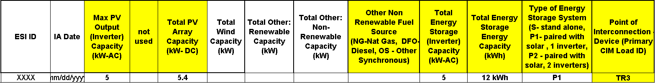
Proposal for Load Profile Data
Revise columns to provide clearer guidance to TDSPs
  Clarify that Max PV output is inverter nameplate in kW-AC
  Eliminate Inverter efficiency
  Total PV array in kW-DC
  Include fuel type for Non-renewable
  Include Energy Storage data
Add the Transmission-level POI name
  Identical to nomenclature used for mapping SODG

Slide 12
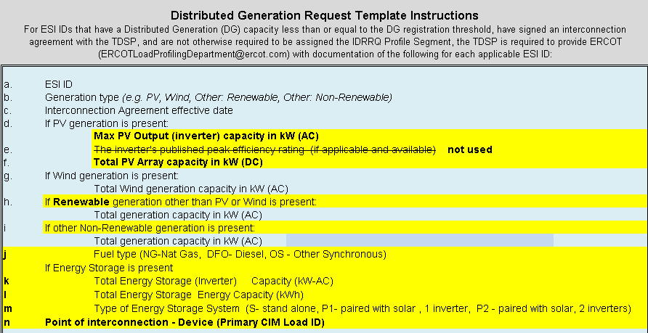
Load Profile Template
Revise nomenclature to match proposed data

Slide 13
Near-Term vs. Long-Term Proposal : Example 3
Fuel Type | Technical Specs | Pmax (MW) | Registration
Battery | PUCT 25.212 | 9 | DESR
Natural Gas | PUCT 25.212 | 3 | SODG
Natural Gas | PUCT 25.212 | 5 | SODG
Solar | PUCT 25.212 | 1.2 | Unregistered
Native Load | - | 30 | -
Long-Term
Near-Term

