Slide 1
Potential August 2020 DAM/CRR Credit Risk Misalignment
CWG/MCWG – January 20, 2021
Clif Lange - STEC

Slide 2
Background
Hurricane Hanna impacted South Texas and the Rio Grande Valley on July 25, 2020
Outages of two AEP transmission lines in the area of Edinburg caused a significant amount of congestion through August 10, 2020 when the lines were returned to service
  South Load Zone prices were significantly higher in both DAM and RTM
Significant increases in collateral requirements were observed as a result of the congestion
The higher collateral requirements were exacerbated by higher DFAFs in mid-August

Slide 3
Identified Issue
DALE (i.e. 7-day average of prior DAM activity) is multiplied by DFAF to capture changes in forward market expectations for QSEs
  Works well when congestion is minimal
CRR settlements are not projected forward using DFAF
  CRR credits/charges netted only for days that are unbilled or invoiced
In instances where DALE*DFAF increases substantially due to congestion, there is not a corresponding projected offset at the Counter-party level for CRRAH activities, particularly for CRRAH with a book heavy with Options
Result is dramatic over-collateralization of Counter-Party, particularly when the CP, QSE, and CRRAH are the same legal entity
The entity can be owed millions by ERCOT, yet the TPEA calculations show the CP to be a significant credit risk to ERCOT, whereas the risk of default is in the opposite direction

Slide 4
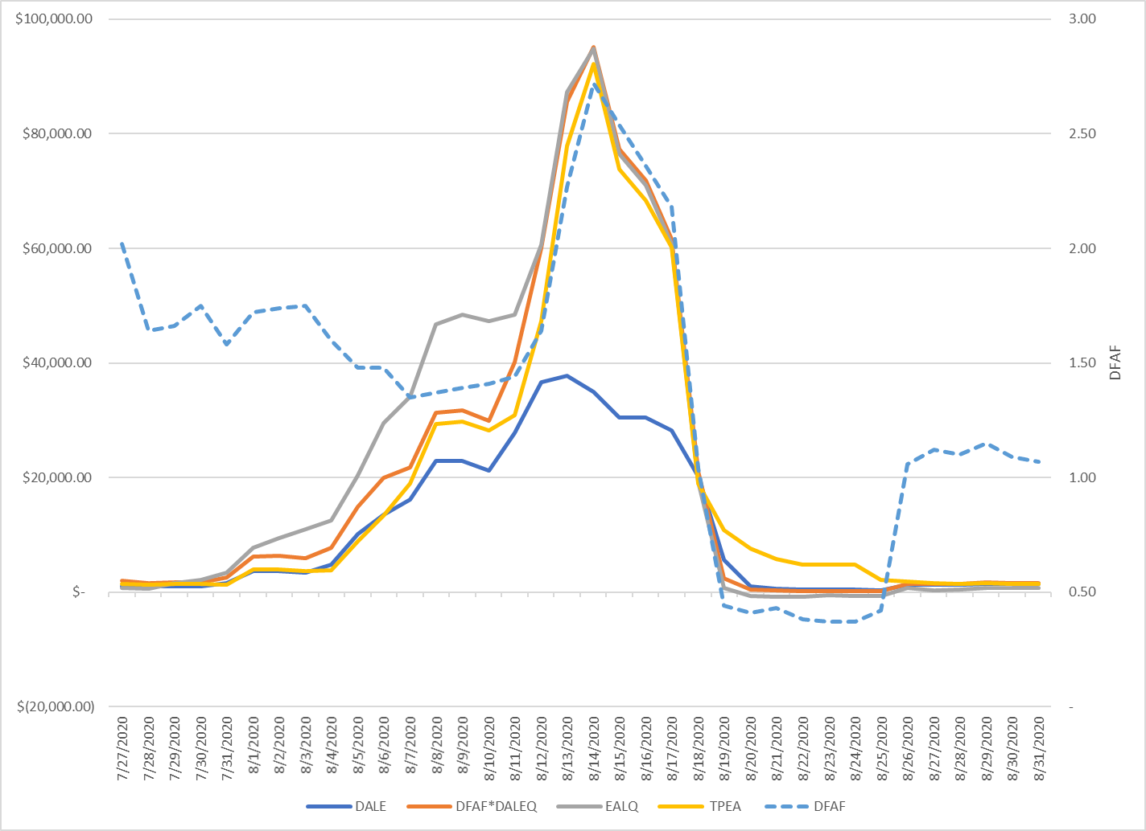
July 27 – Aug 31 Example
Notes:
DFAF increased mid-month as forward prices increased.

Slide 5
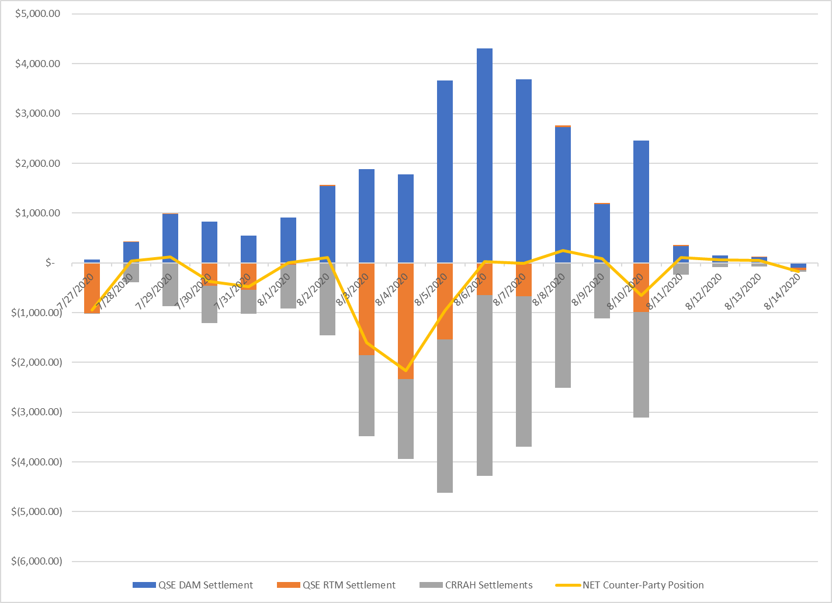
Counter-Party Constituent Settlements
Positive values imply monies paid to ERCOT

Slide 6
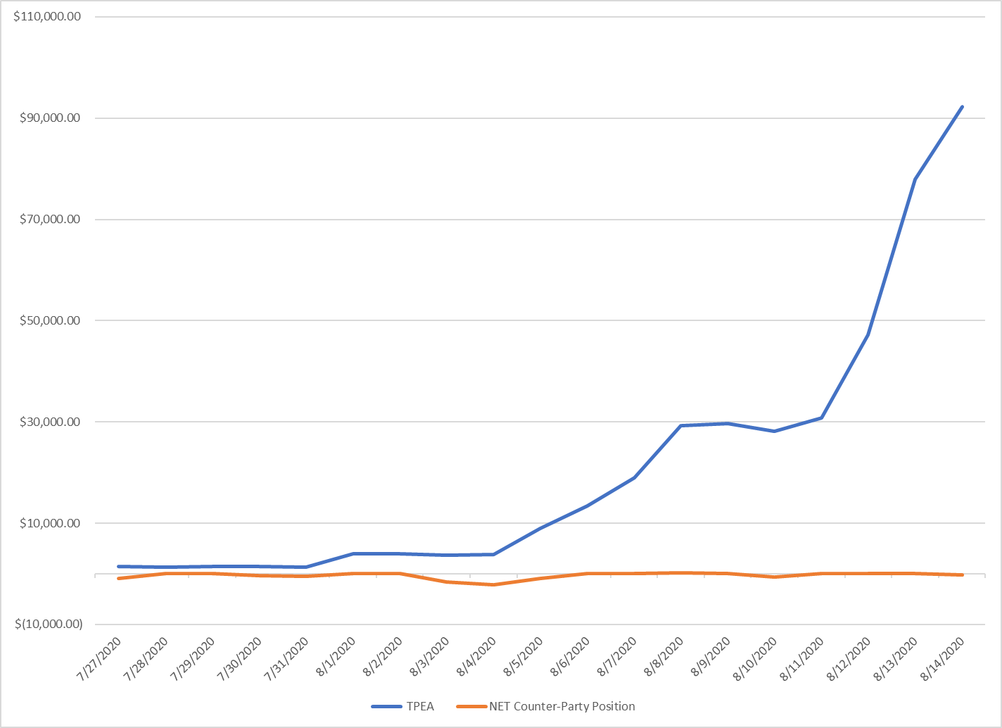
Disconnect Between Perceived Risk and Counter-Party Position
Excessive over-collateralization

Slide 7
Potential Solution
Extrapolate CRRAH activities using a methodology substantially similar to DALE for qualifying Counter-Parties
Modify FCE calculation so that it only accounts for days that are not considered by the DFAF

Slide 8
Current QSE Extrapolation
DALE_{q} x DFAF
DALE = Product of the average of the most recent 7 days of CP QSE statements multiplied by the M1 factor
  M1 is usually 13 – 14 days
DFAF = ICE forward curve for the next 21 days divided by the DAM average price for the same days used in the DALE calculation
DALE x DFAF is major contributor to collateral requirements

Slide 9
Proposed Changes for CRRAH
Include similar extrapolation for CRRAH as current QSE methodology
EAL calculation
  For the Calculation of EAL_{a} for the Counter-Party, introduce a DFAF component to appropriately capture short-term volatility
    EAL _{a} = DFAF * DALE + OUT _{a}
FCE calculation
  Current FCE considers a path specific adder for Options and Obligations that exist for remainder of month, next month, and forward months*
  To prevent double dipping on FCE and EAL, the FCE should only include the days mentioned above if they are not part of the extrapolated DALE
*Path specific adder for forward months is for Obligations only

Slide 10
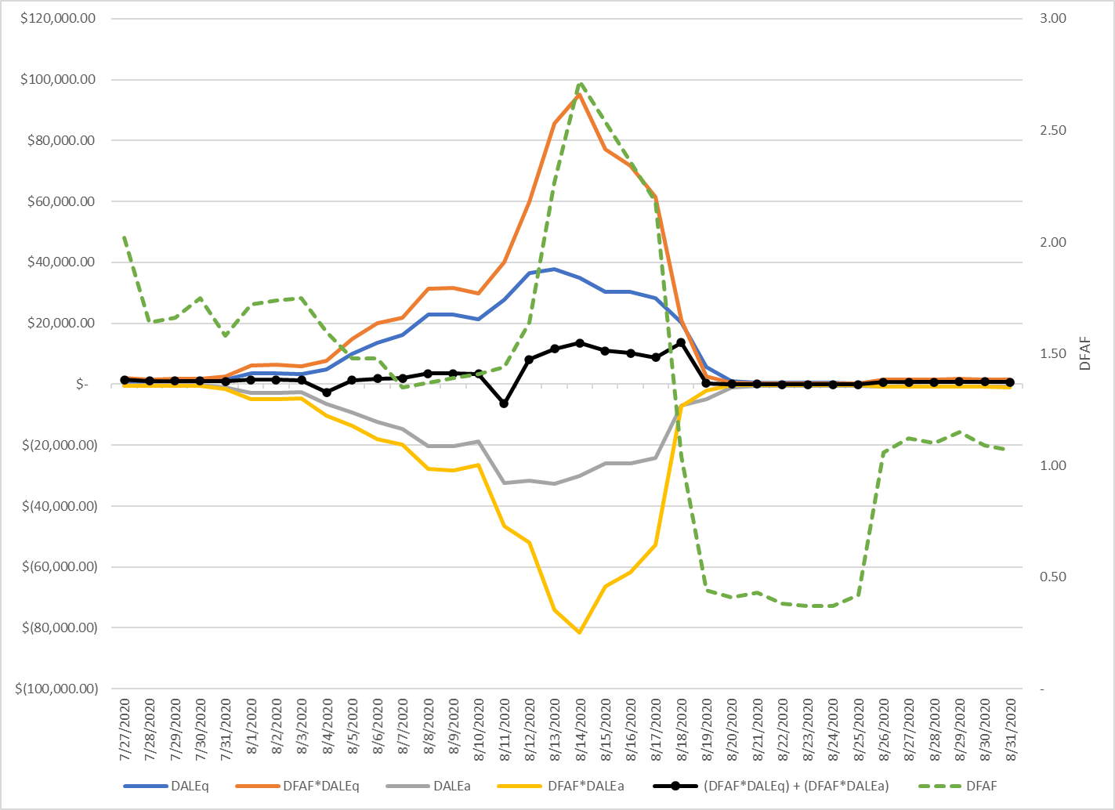
July 27 – Aug 31 with CRRAH Activity Extrapolated
Appropriate rise in calculated exposure as a result of higher ICE forward prices

Slide 11
July 27 – Aug 31 with CRRAH Activity Extrapolated

Slide 12
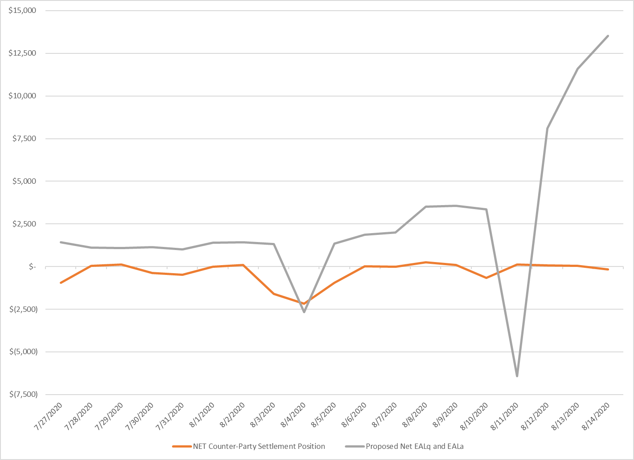
Closer Alignment of Risk to Daily Counter-Party Settlement Position
TPEA calculation will floor these at $0

Slide 13
Next Steps
STEC will submit draft NPRR language
Request additional analysis from ERCOT?

