Slide 1
ERCOT: Transmission Planning Criteria For Valuation of GTC Exit Solutions
January 19th, 2021
Alexandra Miller, Sr. Manager, Transmission Markets and Analytics, EDF Renewables
Karan Joshi, Sr. Manager, Transmission, Pattern Energy

Slide 2
Executive Summary
GTCs are pseudo-thermal limitations used to control stability problems
GTC exit solutions can have additional benefits beyond production cost savings since they solve system-wide stability problems
PUCT already allows for indirect benefits to be included in cost benefit analysis
There are evaluation criteria and modeling changes ERCOT should evaluate for implementation to improve accuracy of GTC exit solution assessments
There is ground for ERCOT to widen the benefits for evaluating GTC exit solutions – this can be enabled by additional language in the Nodal Protocols
After incorporating stakeholder feedback, surveying suggested and implemented measures across RTO’s, and considering impact and ease of implementation, five key concepts were selected for improving the criteria: three modeling improvements, two indirect benefits

Slide 3
GTC Exit Solutions – Proposed Criteria and Modeling Changes
Utilize proxy bids derived from actual market data, rather than default marginal fuel cost ($0/MWh) for renewables in all planning models to properly reflect negative LMP
Model the impact of transmission outages both on the system topology and the impact to GTLs
Planning models must reflect the most likely Operational limits including the derates for IROL or other safety margins rather than the 100% GTL as defined
Account for the cost savings of transmission reliability projects that will be deferred or avoided by a GTC exit solution
Include the impact to reserve margin, and therefore Expected Unserved Energy (EUE), due to suppression of generation by GTC’s

Slide 4
1. Model correct bid price
In order to accurately capture the congestion rent and which specific constraints are most likely to happen in market operations, a more realistic reflection of actual bid price must be included in models
Actual historic bid prices for operating projects are readily available
Future projects can be assumed to bid at prices reflecting PTC based on COD
Note in the West Zone, up to 13% of Wind does not bid negative while 87% of it bids highly negative, creating key differences in which generators are likely to curtail and resulting flows
Wind | Wtd Average* | % < $0 | MW
ERCOT West Zone | -$24.00 | 87% | 20,255
ERCOT South Zone | -$24.21 | 93% | 6,558
ERCOT North Zone | -$28.36 | 90% | 1,340
ERCOT Houston Zone | -$31.70 | 100% | 151
Solar
ERCOT West Zone | -$2.80 | 58% | 3,613
ERCOT South Zone | -$0.51 | 80% | 315
ERCOT North Zone | - | - | -
ERCOT Houston Zone | -$0.29 | 100% | 120
*Source: ERCOT 61-day Generation Resource data in SCED (QSE) for Oct 1, 2020
January 2021 PLWG, GTC Exit Solutions in Transmission Planning

Slide 5
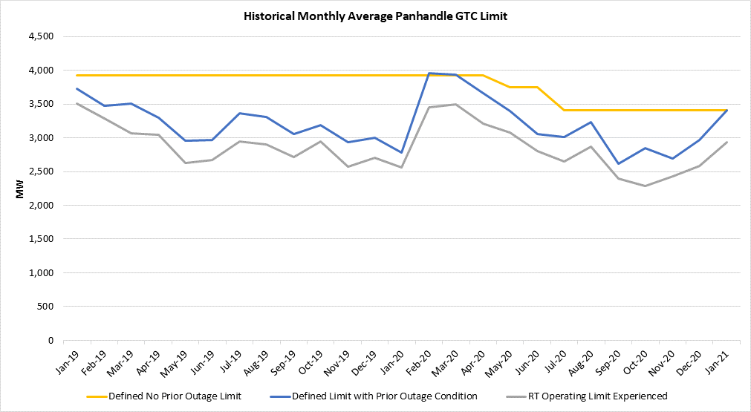
2 & 3. Model Realistic Limits
GTC limits that are IROLs are often lower than limits that are utilized in Planning Models: having a higher limit in Planning Model causes the results from planning studies to diverge from how the system is operated in DAM and RT
During outage conditions which are common and inevitable, the limits are further reduced
Both considerations must be reflected in Planning models
Panhandle example shows much lower limits are experienced in reality than the official GTL
January 2021 PLWG, GTC Exit Solutions in Transmission Planning

Slide 6
2 & 3. Model Realistic Limits
Reflecting required operational IROL margin is straightforward
Also consider any expected system changes such as additional generation build that will likely lower limits
Options for reflecting impact of grid outages on limits – ideally model outages impacting flows and the resulting derates on GTLs
Multiple years of historic outage patterns by voltage level
Define typical “expected” future outage pattern or probabilistic solution
If not modeling outages explicitly in case, at a minimum use average seasonal derate of GTL based on historical limits for older GTC’s and apply to similar newer GTC’s based on number and voltage level of prior outage lines in definitions
Complex GTC’s with many lines and prior outage impacts will be more heavily impacted
January 2021 PLWG, GTC Exit Solutions in Transmission Planning

Slide 7
4. Avoided Reliability Project Cost
Include in benefits the costs of any investments not needed due to the implementation of the GTC exit strategy including avoided costs of
shunt devices
deferred reliability projects or upgrades
ERCOT is doing this already, however, there is limited documentation around how the evaluation is being done
The length of the assessment can be critical - include signals from LTSA and System Needs and Constraints Report to capture reliability upgrades needed to serve major load centers on the longer term that may be avoided
January 2021 PLWG, GTC Exit Solutions in Transmission Planning

Slide 8
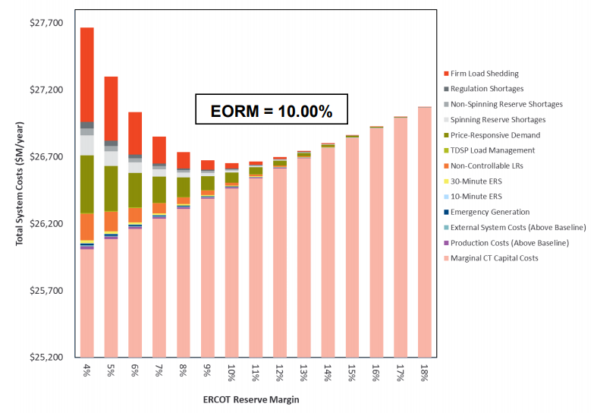
5. Reduced Reserve Margin
The long-term impact of GTC’s on development locations is uncertain but is expected to be negative and more severe in regions with GTCs that separate the best resource areas from the higher demand areas
At a minimum, the short and medium-term impact to operating projects and projects currently meeting planning criteria must be reflected in models
The combined impact of all GTC’s simultaneously will have a bigger effect on Expected Unserved Energy than when considered separately, as the relationship between reserve margin and EUE is non-linear (see graph)
Leverage the Reserve Margin Study by Astrapé to evaluate the increased risk of reliability events due to GTC-constrained generation
Source: 2020 EORM Study SAWG Presentation 10/26/2020
January 2021 PLWG, GTC Exit Solutions in Transmission Planning

Slide 9
5. Reduced Reserve Margin
Steps:
Consider the total impact of all active GTC’s with correct operational limits and typical outage derates
Determine impact on reserve margin due to curtailed generation as the difference in the case with all GTC’s active and a case with no GTC’s
Use Reserve margin Study results to determine expected increase in Firm Load Shedding due to all GTC’s
Allocate total increase in cost of EUE (at Value of Lost Load of $9,000/MWh) to each GTC by their individual contribution to curtailment
January 2021 PLWG, GTC Exit Solutions in Transmission Planning

Slide 10
Next Steps:
Consolidate feedback after today's presentation
EDFR/Pattern to submit NPRR reflecting proposed changes including:
Make language changes to the Nodal Protocols Section 3.11.2: Transmission Planning/Planning Criteria
Add clarification of realistic bid price assumptions to 3.11.2.5
Add a new sub-section 3.11.2.7 to Planning Criteria for evaluation of Exit Strategies for GTCs including:
Appropriate accounting for impact of transmission outages
Planning models reflecting operational limits and reductions for IROL factor of safety
Cost savings of reliability projects that can be avoided
Impact to EUE due to system-wide curtailed generation

Slide 11
3.11.2 Planning Criteria
(1) ERCOT and TSPs shall evaluate the need for transmission system improvements and shall evaluate the relative value of alternative improvements based on established technical and economic criteria.
(2) The technical reliability criteria are established by the Planning Guide, Operating Guides, and the North American Electric Reliability Corporation (NERC) Reliability Standards. ERCOT and TSPs shall strongly endeavor to meet these criteria, identify current and future violations thereof and initiate solutions necessary to ensure continual compliance.
(3) ERCOT shall attempt to meet these reliability criteria as economically as possible and shall actively identify economic projects to meet this goal.
(4) For economic projects, the net economic benefit of a proposed project, or set of projects, will be assessed over the project’s life based on the net societal benefit that is reasonably expected to accrue from the project. The project will be recommended if it is reasonably expected to result in positive net societal benefits.
(5) To determine the societal benefit of a proposed project, the revenue requirement of the capital cost of the project is compared to the expected savings in system production costs resulting from the project over the expected life of the project. Indirect benefits and costs associated with the project should be considered as well, where appropriate. The current set of financial assumptions upon which the revenue requirement calculations is based will be reviewed annually, updated as necessary by ERCOT, and posted on the Market Information System (MIS) Secure Area. The expected production costs are based on a chronological simulation of the security-constrained unit commitment and economic SECTION 3: MANAGEMENT ACTIVITIES FOR THE ERCOT SYSTEM ERCOT NODAL PROTOCOLS – APRIL 11, 2018 3-111 PUBLIC dispatch of the generators connected to the ERCOT Transmission Grid to serve the expected ERCOT System Load over the planning horizon. This market simulation is intended to provide a reasonable representation of how the ERCOT System is expected to be operated over the simulated time period. The market simulation shall reflect a realistic expectation of bid prices for all generation resource types, including negative bidding due to Production Tax Credits (PTC). From a practical standpoint, it is not feasible to perform this production cost simulation for the entire 30 to 40 year expected life of the project. Therefore, the production costs are projected over the period for which a simulation is feasible and a qualitative assessment is made of whether the factors driving the production cost savings due to the project can reasonably be expected to continue. If so, the levelized ERCOT-wide annual production cost savings over the period for which the simulation is feasible is calculated and compared to the first year annual revenue requirement of the transmission project. If this production cost savings equals or exceeds this annual revenue requirement for the project, the project is economic from a societal perspective and will be recommended. I can’t find a better place to add this, which needs to be in all planning models, not just for GTC. The section on planning model doesn’t go into this level of detail on assumptions. This may not need to be specified as a best practice, but does need to be brought to their attention.

Slide 12
3.11.2 Planning Criteria (cont’d)
(6) Other indicators based on analyses of ERCOT System operations may be considered as appropriate in the determination of benefits. In order for such an alternate indicator to be considered, the costs must be reasonably expected to be on-going and be adequately quantifiable and unavoidable given the physical limitation of the transmission system. These alternate indicators include:
(a) Reliability Unit Commitment (RUC) Settlement for unit operations;
(b) Visible ERCOT market indicators such as clearing prices of Congestion Revenue Rights (CRRs); and
(c) Actual Locational Marginal Prices (LMPs) and observed congestion.
(7) When evaluating Exit Strategies for Generic Transmission Constraints (GTC) additional considerations impacting the ERCOT system shall be reflected in determination of benefits:
(a) The impact of transmission outages on the GTC limit due to outages of elements included in the definition shall be reflected in the production cost simulation. Production Cost estimates with the GTC in place shall include a representation of typical outage timing and durations based on history and future expectations. The historical outage frequency and duration of all prior outage lines (or similar lines for new ones without historical reference) shall be considered in creating a reasonable expected case for simulations.
(b) Future expected operational margins for GTLs shall be used in planning models. The limits for GTCs modelled in planning cases shall reflect the most likely future operational limit, including discounts for SOL and IROL required margins or other likely reductions. In the absence of specific planned system improvements that would increase a GTC limit in the planning horizon, the appropriate 10-15% discount shall be applied to the GTL as it is in operations.
(c) Benefits shall include the avoided cost of reliability projects that would be needed in the absence of a proposed exit strategy.
(d) The impact to system reserve margin shall be computed by modelling all GTC’s on the system and determining the simultaneous total impact of GTC’s on EUE due to constrained generation. The cumulative impact across the system of local restrictions on generation is non-linear. When all the system wide GTC’s are considered together, the total potential reduction in capacity available to serve the system load is more significant than if each were in effect alone. Determine the total capacity reduction across all generation types due to all expected GTC curtailment and use annual reserve margin study estimates of increase in EUE for that total loss of available capacity. Distribute the value ($9000/MWh * total lost load change) attributable to each GTC by their contribution to the total capacity reduction.

