Slide 1
ERCOT Frequency Events
December 2020
ERCOT
Operations Planning
PDCWG | January 13th, 2020

Slide 2
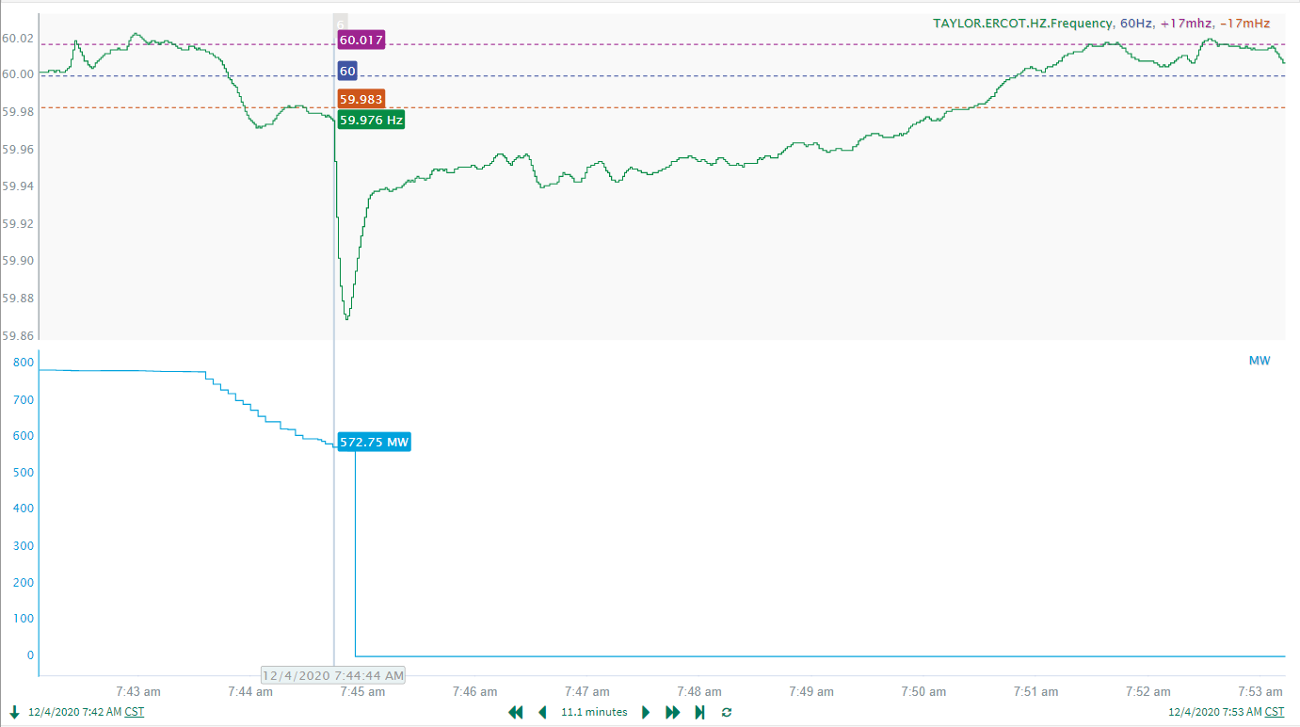
12/4/2020 07:44:44 (Non-FME)
Notes:
Unit experienced a run back while carrying around 779 MW. Loss of 570 MW when the resource completely tripped offline.
Starting Frequency: 59.9760 Hz
Minimum Frequency: 59.8690 Hz
A-C Time: 7 seconds
Recovery Time: 5 minutes and 28 seconds (90th percentile is 7 minutes and 9 seconds)
RRS Deployed: 753 MW
Trip Reason: Resource lost its Forced Draft (FD) fan
Contextual Information: 24 MW of regulation up requested at the time of the event. 200 MW offset applied after the event
No Selection Reason: Frequency was not stable prior to the start of the event due to the experienced runback from the resource. This brought frequency as low as 59.972 Hz. Delta frequency was small (39mHz).

Slide 3
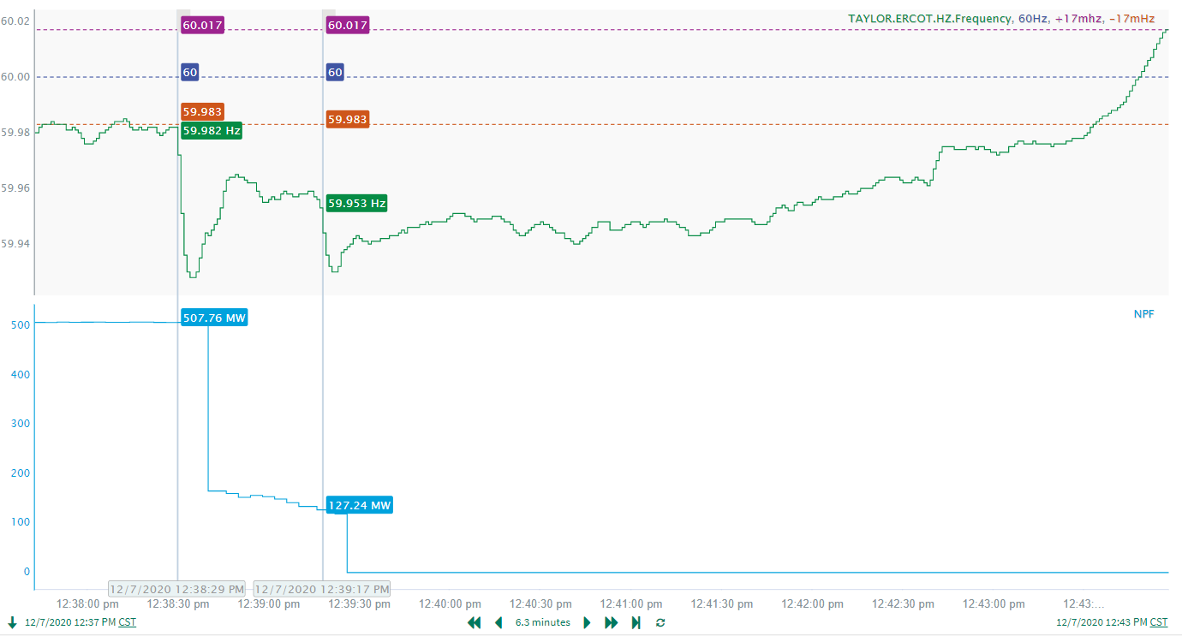
12/7/2020 12:38:29 (Non-FME)
Notes:
Unit experienced two partial trips before coming offline completely. The first trip was for 341 MW. The second trip occurred after a slight run back and eventually for 127 MW
Starting Frequency: 59.9820 Hz
Maximum Frequency: 59.9280 Hz
A-C Time: 5 seconds
Recovery Time (back to deadband): 5 minutes and 3 seconds (90th percentile is 7 minutes and 9 seconds)
RRS Deployed: 0 MW
Trip Reason: Relay tracing work led to the loss of a breaker which tripped the unit
Contextual Information: 37 MW of regulation up was being requested at the time of the event. Total of 165 MW of regulation up was deployed during the event.
No Selection Reason: The initial loss of generation was smaller than the 550 MW we typically look for. Also, frequency only fell to 59.928 Hz so this event was just too small.

Slide 4
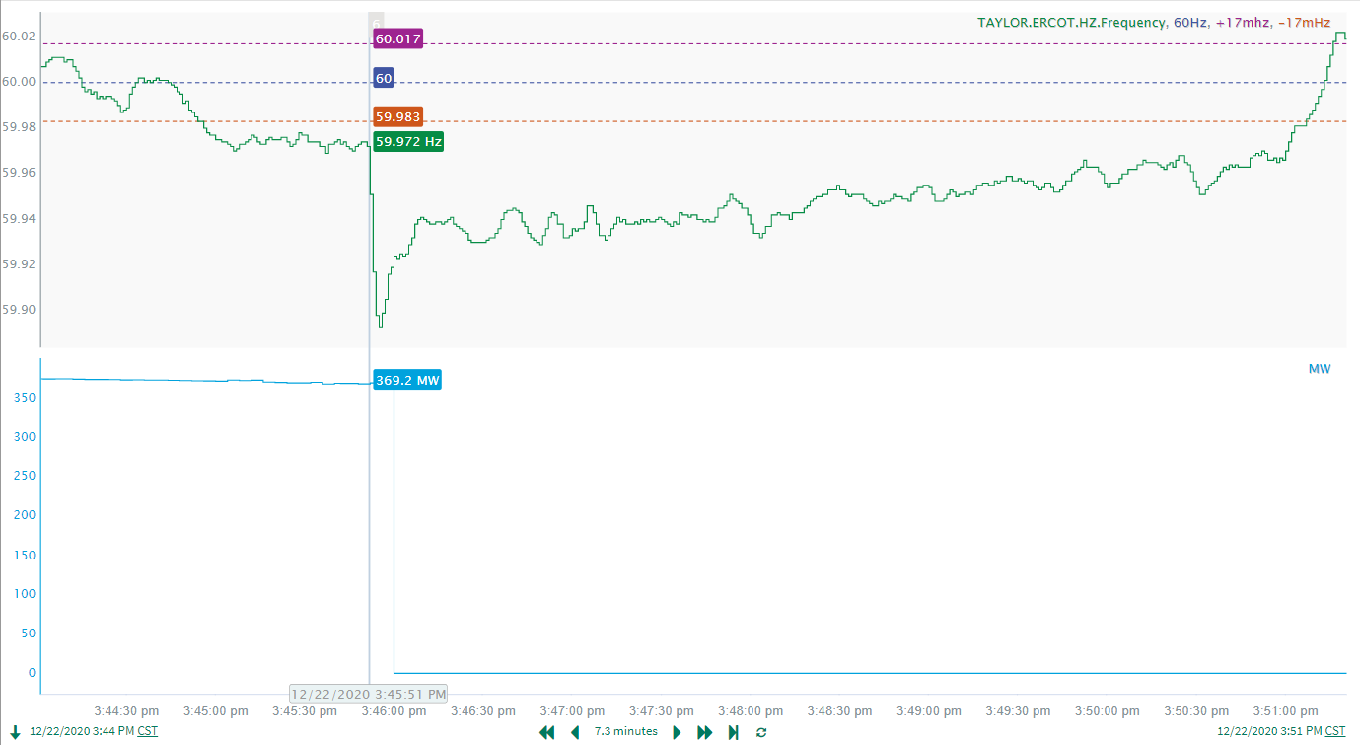
12/22/2020 15:45:51 (Non-FME)
Notes:
Unit tripped offline while carrying 369 MW
Starting Frequency: 59.972 Hz
Maximum Frequency: 59.8930 Hz
A-C Time: 4 seconds
Recovery Time (back to deadband): 5 minutes and 10 seconds (90th percentile is 7 minutes and 9 seconds)
RRS Deployed: 564 MW
Trip Reason: Issue with furnace pressure. Resource was in startup at the time of trip.
Contextual Information:
No Selection Reason: MW loss was too low

Slide 5
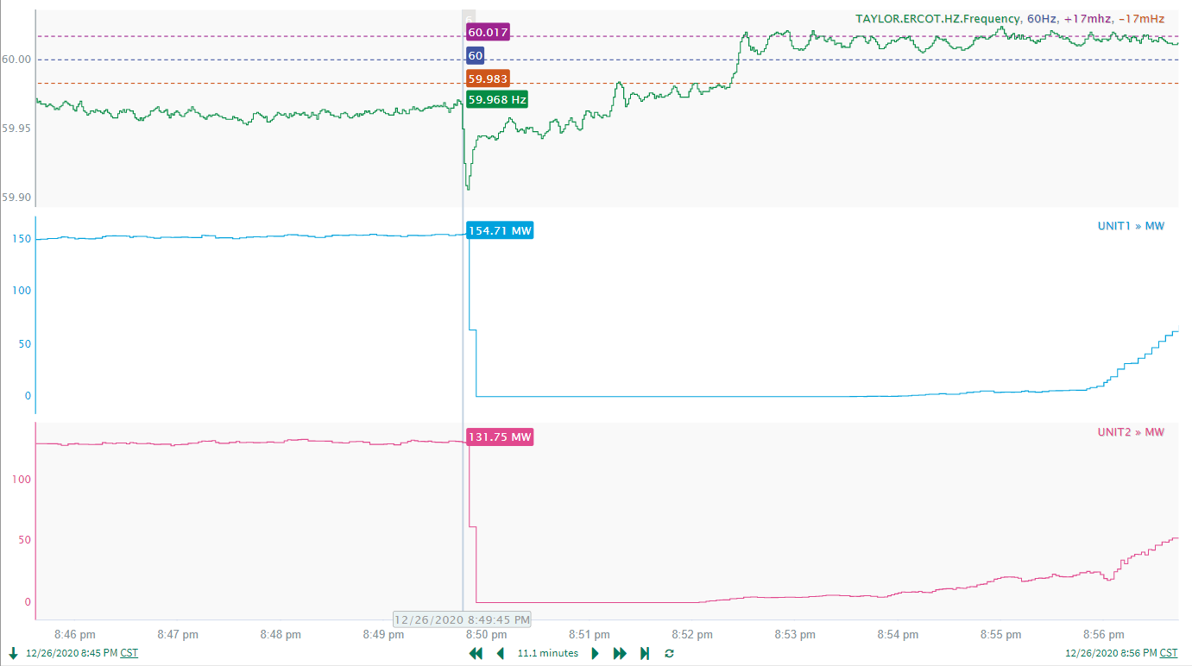
12/26/2020 20:49:45 (Non-FME)
Notes:
Two wind resources tripped offline while carrying a combined 286 MW
Starting Frequency: 59.968 Hz
Maximum Frequency: 59.906 Hz
A-C Time: 5 seconds
Recovery Time (to starting freq.): 1 minutes and 28 seconds (90th percentile is 7 minutes and 12 seconds)
RRS Deployed: 662 MW
Trip Reason: No information available.
Contextual Information: Regulation up was exhausted (91 MW) at the time of the event.
No Selection Reason: Pre-perturbation frequency and MW loss was too low.

Slide 6
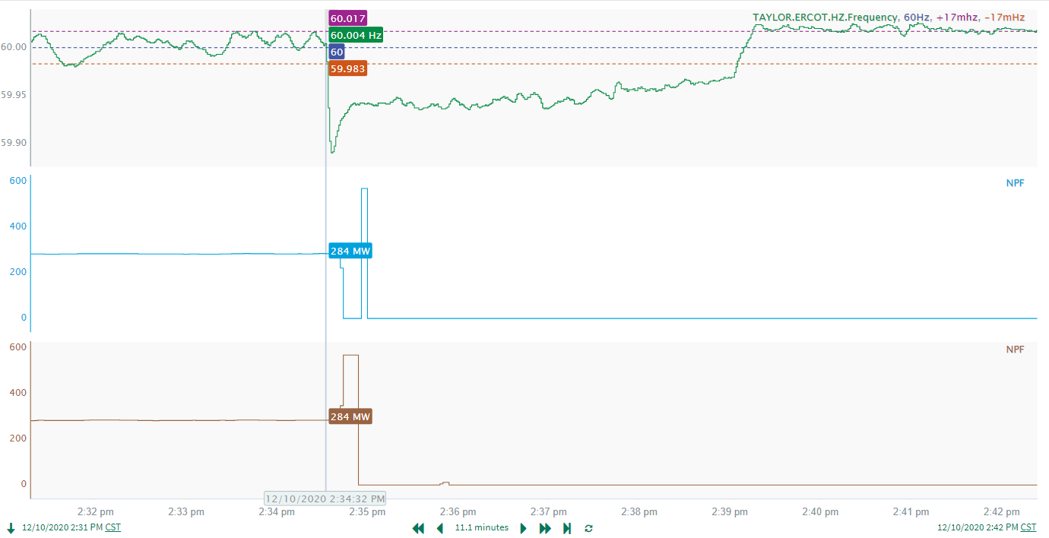
12/10/2020 14:34:32 (FME)
Notes:
Two combined cycles tripped offline for a combined loss of 571 MW
Starting Frequency: 60.004 Hz
Maximum Frequency: 59.890 Hz
A-C Time: 5 seconds
Recovery Time (back to deadband): 4 minutes and 37 seconds (90th percentile is 7 minutes and 12 seconds)
RRS Deployed: 596.38 MW
Trip Reason: Unit trip due to relay operation at station getaway
Contextual Information: 83 MW of regulation down requested at the time of the event.

Slide 7
Questions?
Thank you!

