Slide 1
Extension of Self-Limiting Facility Concept to Settlement Only Generators and Settlement Only Energy Storage Systems
January 13, 2021

Slide 2
Background on Self-Limiting Facility Concept
NPRR1026 introduced Self-Limiting Facility concept
  http://www.ercot.com/mktrules/issues/NPRR1026
  Framework developed at BESTF
  Provides definitions, COP/telemetry requirements, and compliance reporting obligations
  Limited to Generation Resources and Energy Storage Resources
PGRR081 provides that MW Injection/Withdrawal limit is used for Generator Interconnection or Modification (GIM) process.
  http://www.ercot.com/mktrules/issues/PGRR081
NPRR1026 and PGRR081 approved by ERCOT BOD on 12/8/20

Slide 3
Summary of Proposed NPRR Changes
Extend Self-Limiting Facility concept to include SOGs/SOESSs
  definition of “Self-Limiting Facility”
  Section 3.8.7, Self-Limiting Facility
Proposes real-time telemetry of injection/withdrawal values for Self-Limiting Facilities with SOGs/SOESSs (Section 6.5.5.2)
No COP or VSS requirements for SOGs or SOESSs
Modify MW Injection/MW Withdrawal definitions to include both Point of Interconnection (POI) and Point of Common Coupling (POCC), and introduce POCC definition (unique to distribution-level generators)
  NPRR1026 already contemplated distribution-level generation

Slide 4
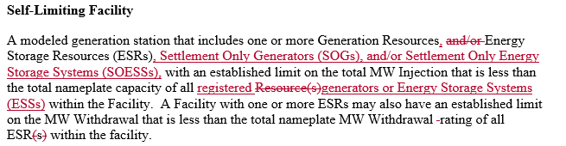
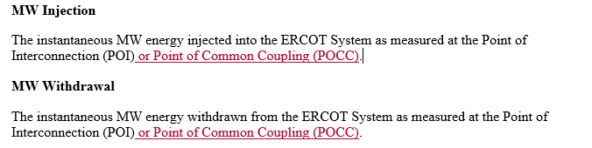

Proposed NPRR Language

Slide 5
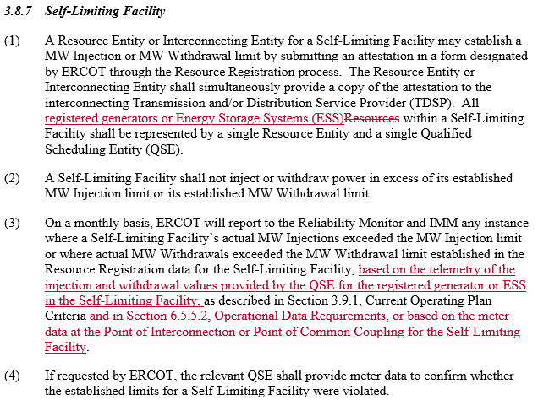
Proposed NPRR Language (cont’d)

Slide 6
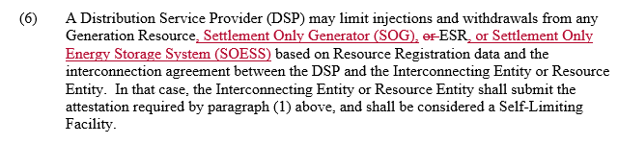

Proposed NPRR Language (cont’d)

Slide 7
Next Steps
Consider workshop feedback
Submit NPRR after January Protocol revisions with NPRR1026 grey-box language.
Propose/submit RRGRR to add field to SODG Registration Data

