Slide 1
ERCOT Frequency Control Report
December 2020
ERCOT
Operations Planning
PDCWG | January 13th, 2020

Slide 2
Summary of December 2020
CPS1: 170.47%
Current CPS1 12-Month Rolling Average: 171.19%
0 BAAL Exceedance(s)
3 hourly CPS1 score below 100%
BAAL-003 Events have updated through 2019
2019 BAAL-003 FRM Performance: -811.14
2020 RMS1 Statistics
Mean: 16.04 mHz
Min: 12.25 mHz
Max: 22.6 mHz
Energy Statistics
Total Energy: 30,241,845 MWh
Wind Energy: 8,415,591 MWh
Percent Energy from Wind: 27.83%
Solar Energy: 645,288 MWh
Percent Energy from Solar: 2.13%
Minimum System Inertia
Mean: 176,982 MW*s
Max: 258,856 MW*s on Dec 4th
Min: 136,593 MW*s on Dec 23rd
Notes:
2018 BAAL-003 FRM Performance: -843.17

Slide 3
Frequency Control
CPS1, BAAL, & RMS1

Slide 4
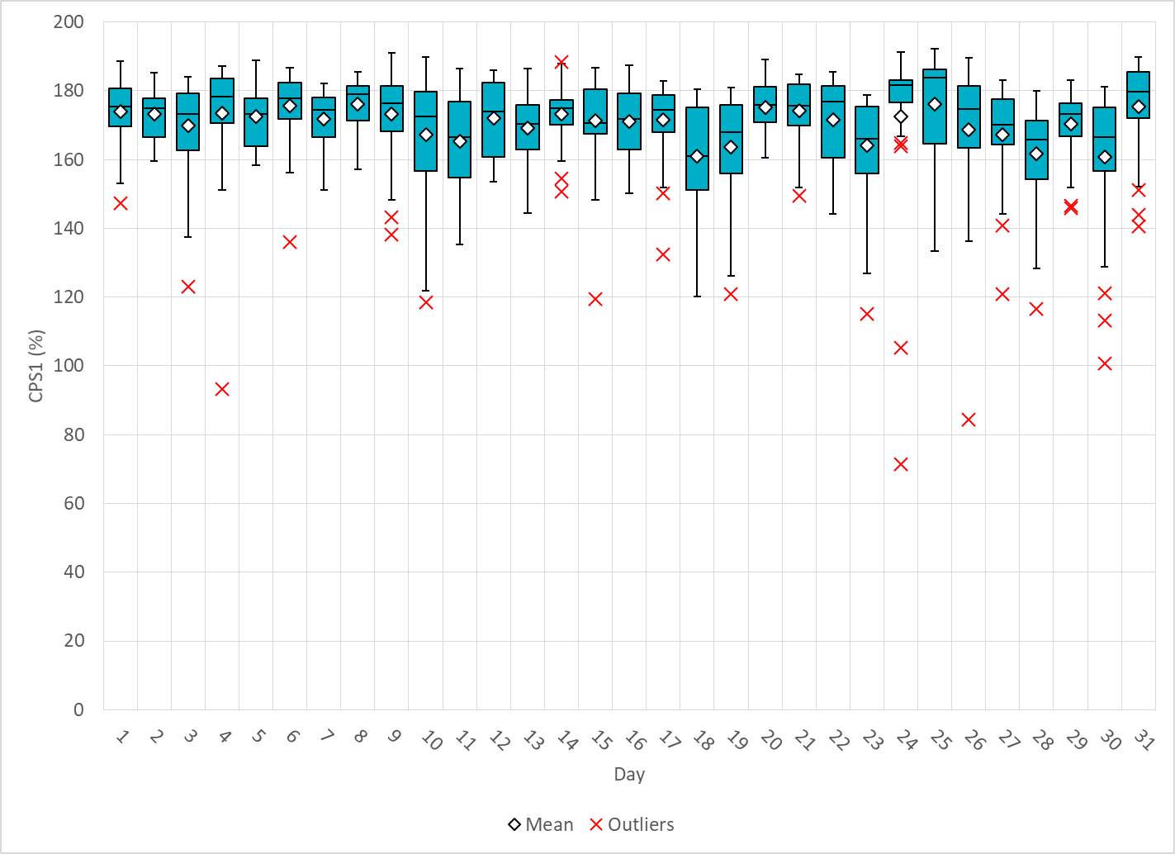
Hourly CPS1 by Day
Dec-20 CPS1 (%): 170.47
Notes:
Outliers (Total of 3 below 100%) :
93.37% @ 12/4/2020 22:00
Expected Generation Deviation of -1135 MW @ 10:16:05
At this time, there was a contribution of about -1035 MW from thermal resources with top contributors related to resources shutting down (2 resources with a combined HSL of 1121 MW). Manual offset of 300 MW was applied in response.
Loss of generation, about 260 MW @ 22:28:59
Frequency fell to 59.946 Hz and took about 13 minutes and 7 seconds for frequency to recover to the dead band. Frequency recovered to 59.96 Hz immediately after the loss of generation before dropping below 59.95 Hz due to an increase in non-conform load. Frequency hovered around 59.96 Hz from 22:33:27 to 22:42:06. Regulation Down was deployed for about 190 MW prior to the event. Total of 148 MW of Regulation up was requested after the event. No manual offset applied and no RRS requested.
71.34% @ 12/24/2020 16:00
IRR Ramp
Between 16:24 and 16:54, solar generation ramped down by about 1450 MW (~242 MW/5 min). Between 16:40 and 17:30, wind generation ramped down by about 6080 MW (~608 MW/5 min).
Expected Generation Deviation of -1000 MW @ 16:28
Most contributions from solar down ramp
Expected Generation Deviation of -1951 MW @ 16:46
Contributions from solar and wind down ramp, some conventional resources were slow to respond
Manual Offsets
Offset of 250 MW @ 16:45, 500 MW @ 16:50, 500 MW @ 16:53, 300 MW @ 16:55, 300 MW @ 17:05 to recover regulation during low frequency
84.31% @ 12/26/2020 16:00
Expected Generation Deviation of -371 MW @ 16:04
Between 16:01 and 16:05, solar and wind ramped down about 203 MW. Delayed response to higher basepoints from conventional and curtailed resources.
Expected Generation Deviation of -800 @ 16:40
Main contributions from wind and solar resources ramping down.
Manual Offsets
A 250 MW manual offsets was applied at the end of the hour and recalled 5 minutes into the next hour.

Slide 5
BAAL Exceedances & Violations
There were 0 BAAL exceedance(s) in Dec
Notes:
Occurred on 11/21/2020

Slide 6
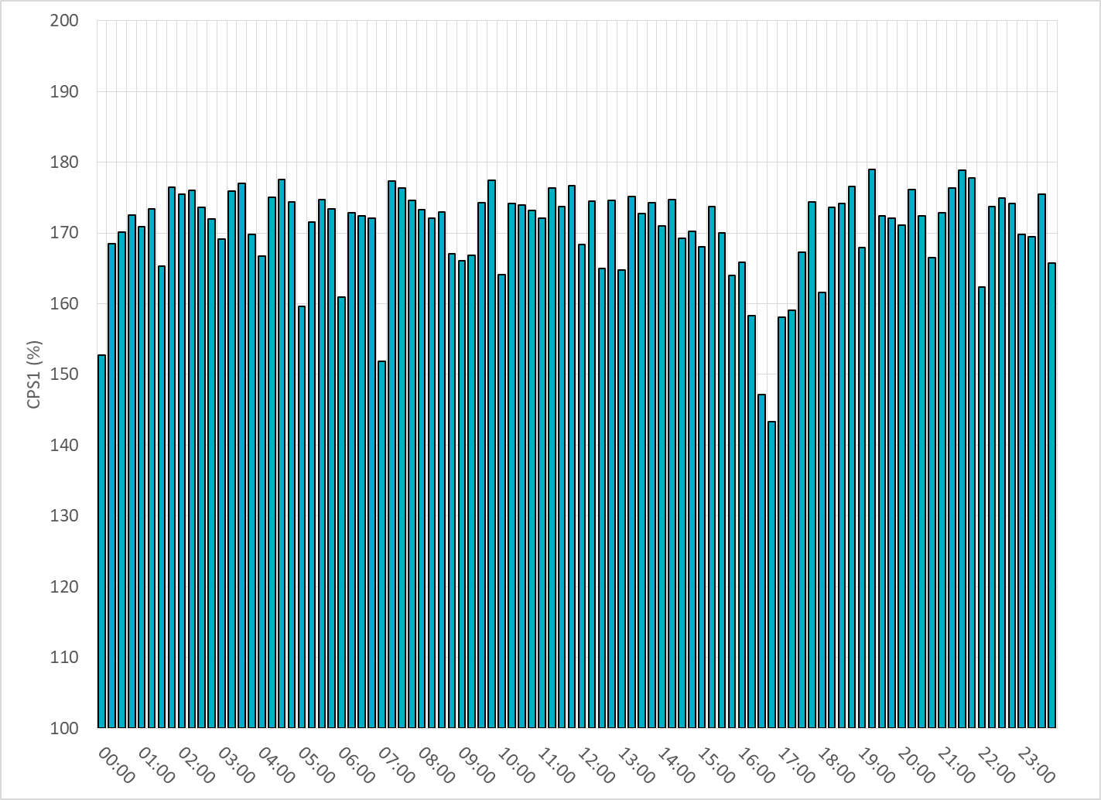
15-Minute Average CPS1%
Dec-20 CPS1 (%): 170.47

Slide 7
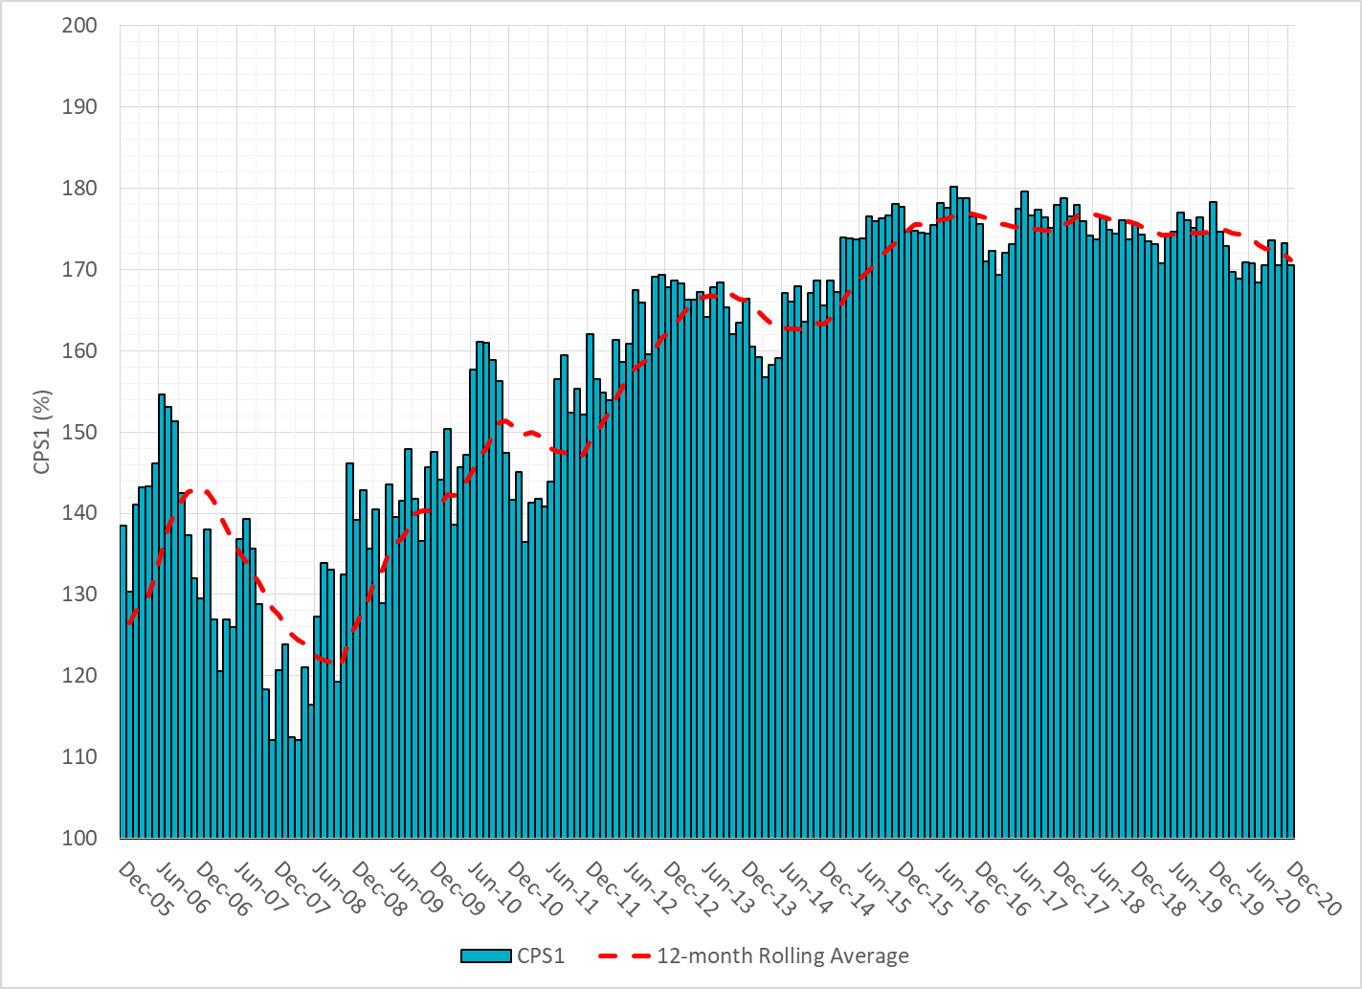
12-Month Rolling Average CPS1
Current 12-Month Rolling Average: 171.19%

Slide 8
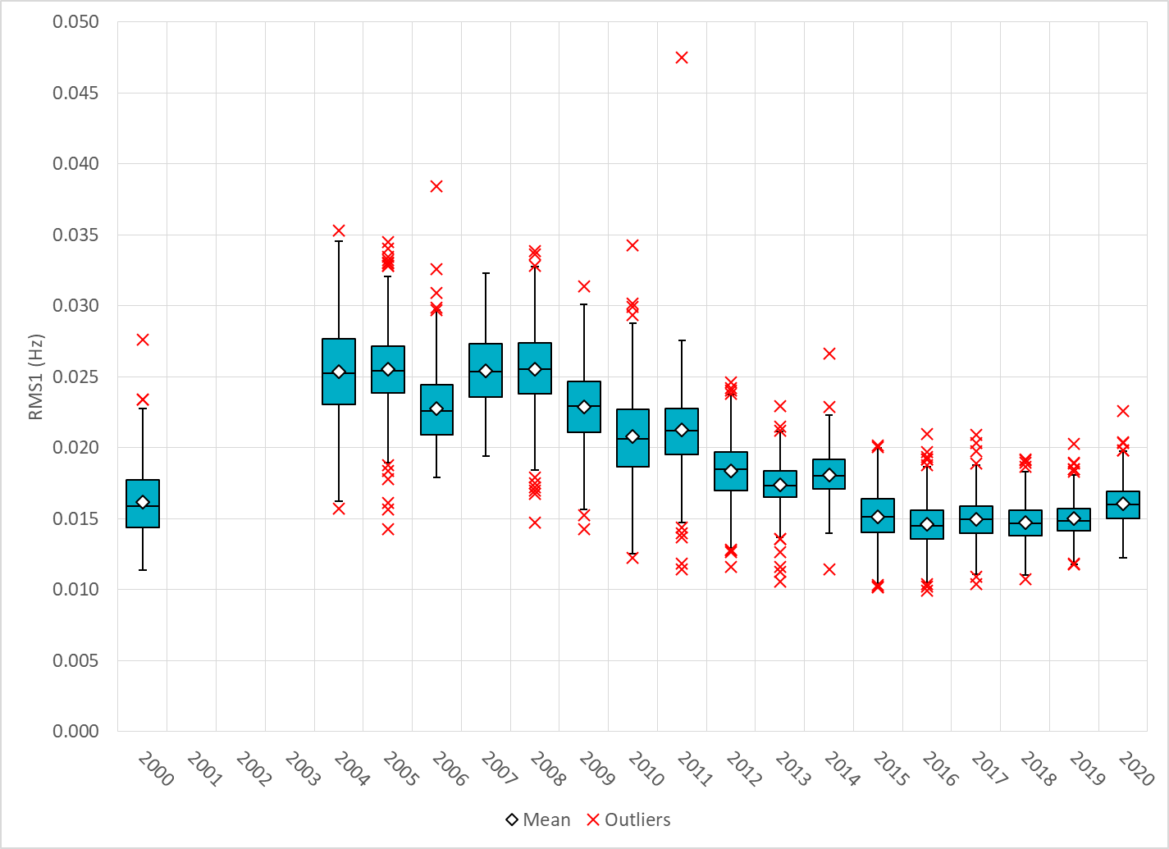
Daily RMS1 of ERCOT Frequency by Year
Notes:
Mean: 16.04 mHz
Min: 12.25 mHz
Max: 22.6 mHz

Slide 9
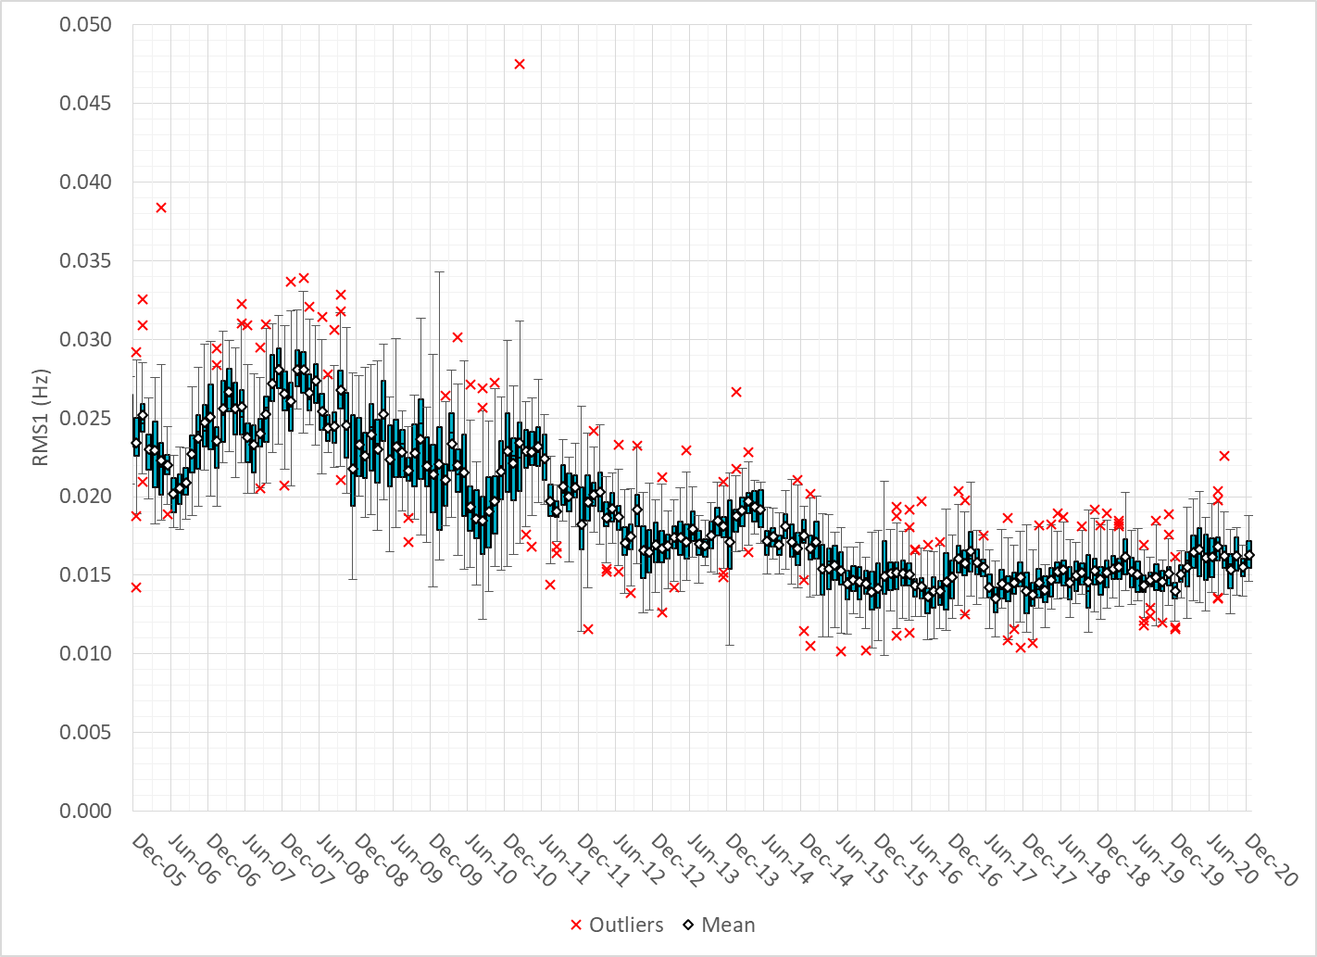
Daily RMS1 of ERCOT Frequency by Month

Slide 10
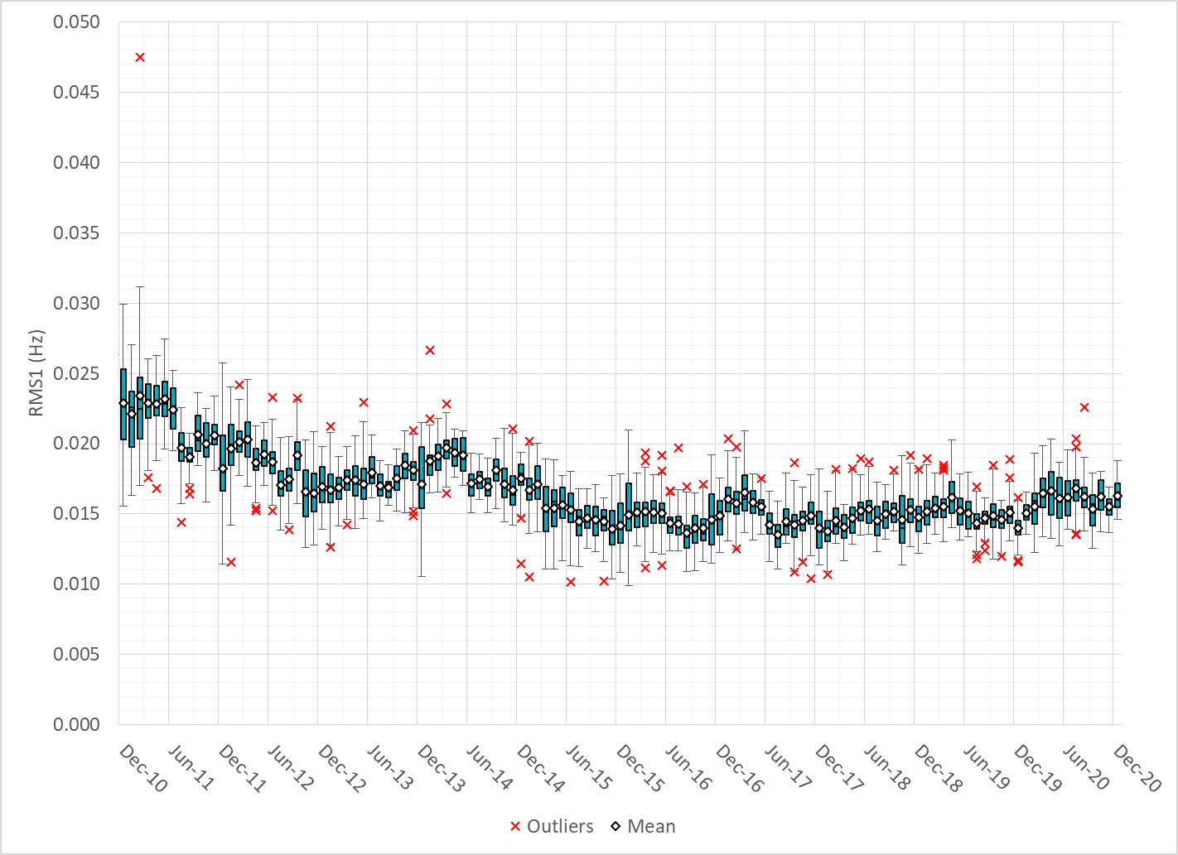
Daily RMS1 of ERCOT Frequency by Month

Slide 11
Frequency Profile Comparison

Slide 12
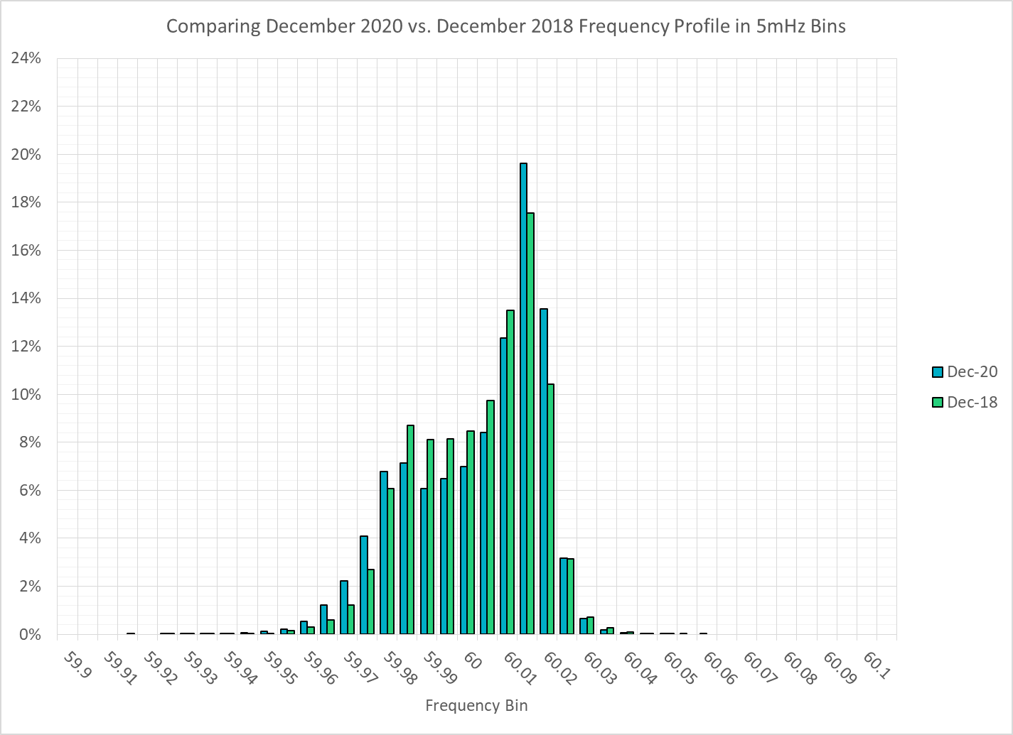
Frequency Profile Comparison

Slide 13
Frequency Profile Comparison

Slide 14
Time Error Correction

Slide 15
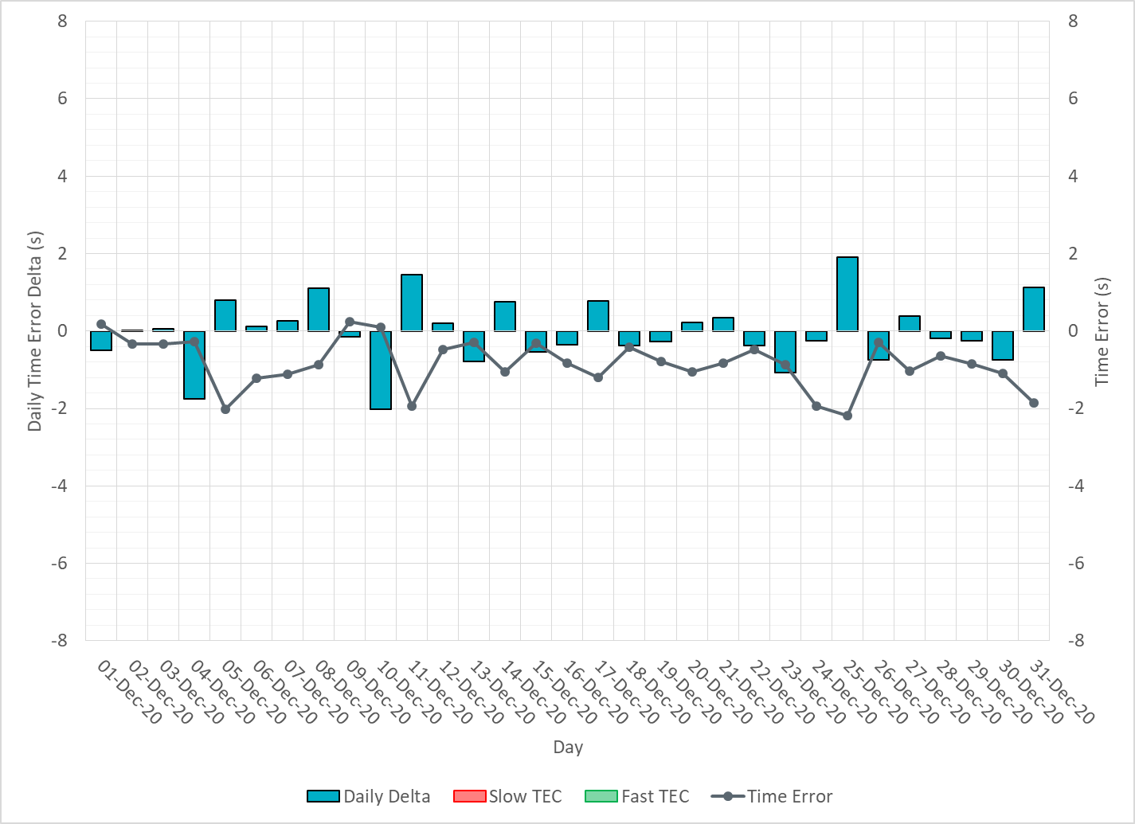
ERCOT Daily Time Error

Slide 16
Time Error Corrections Log Summary
There have been no time error corrections since December 2016

Slide 17
BAL-003 Performance

Slide 18
Op. Year 2019 BAL-003 Selected Events – Update
Notes:
BAL-003

Slide 19
Op. Year 2019 BAL-003 FRM Performance - Update
Notes:
OP2018: FRO = -381.0, FRM_median = -843.17, FRM_average = -959.7
OP2019: FRO = -381.0, FRM_median = -811.14, FRM_average = -892.5
OP2020: FRO = -425.0,

Slide 20
ERCOT Energy Statistics

Slide 21
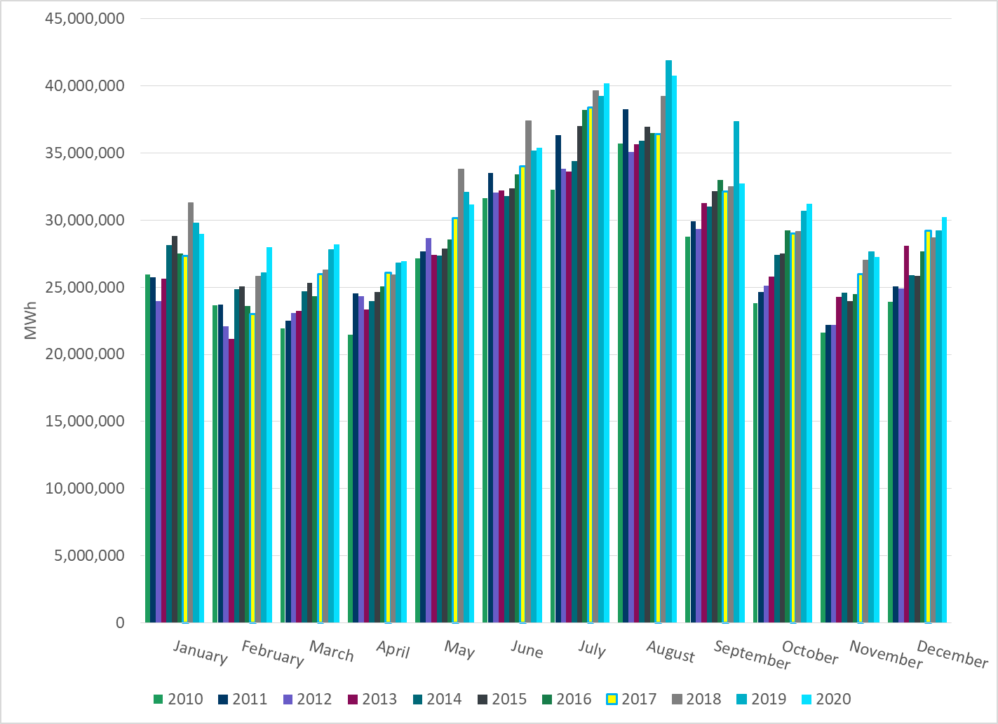
Total Energy
Notes:
30,241,845 MWh

Slide 22
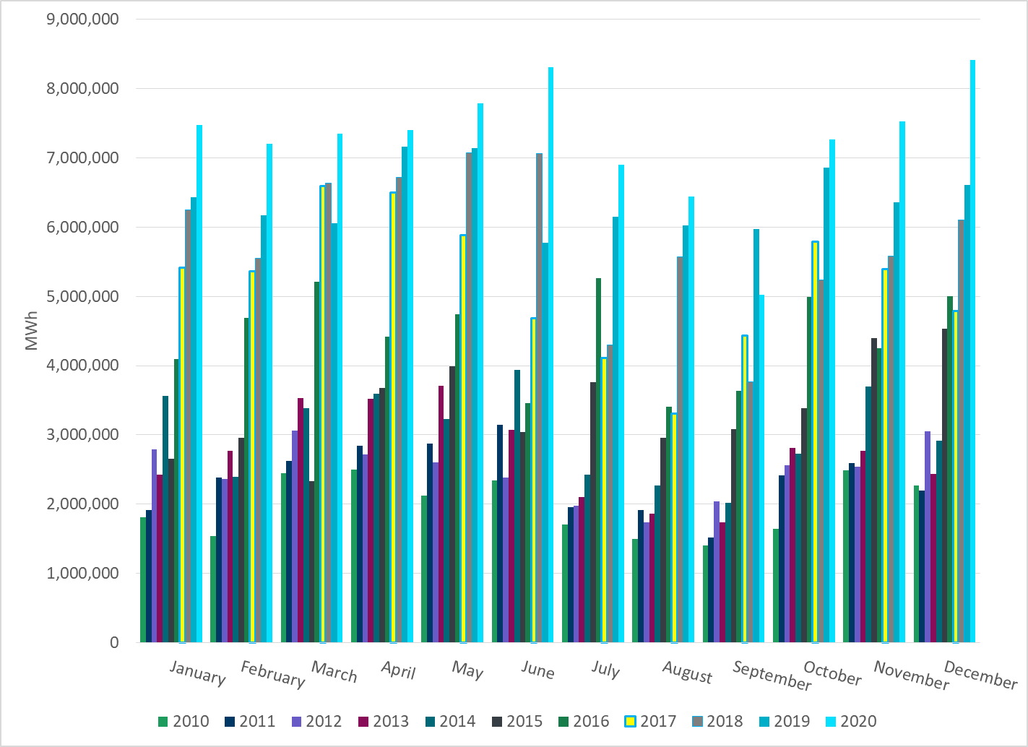
Total Energy from Wind Generation
Notes:
8,415,591 MWh

Slide 23
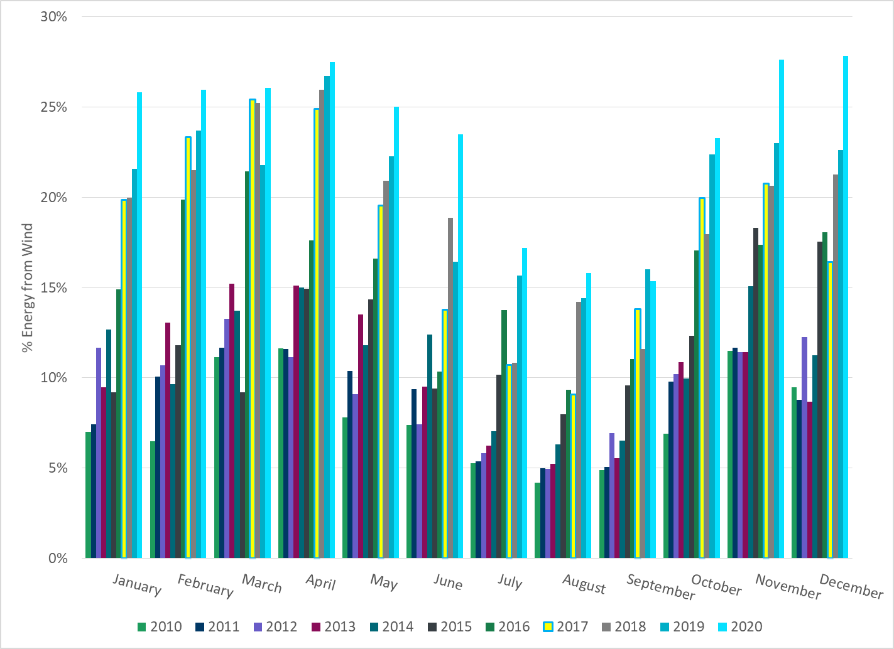
% Energy from Wind Generation
Notes:
27.83%

Slide 24
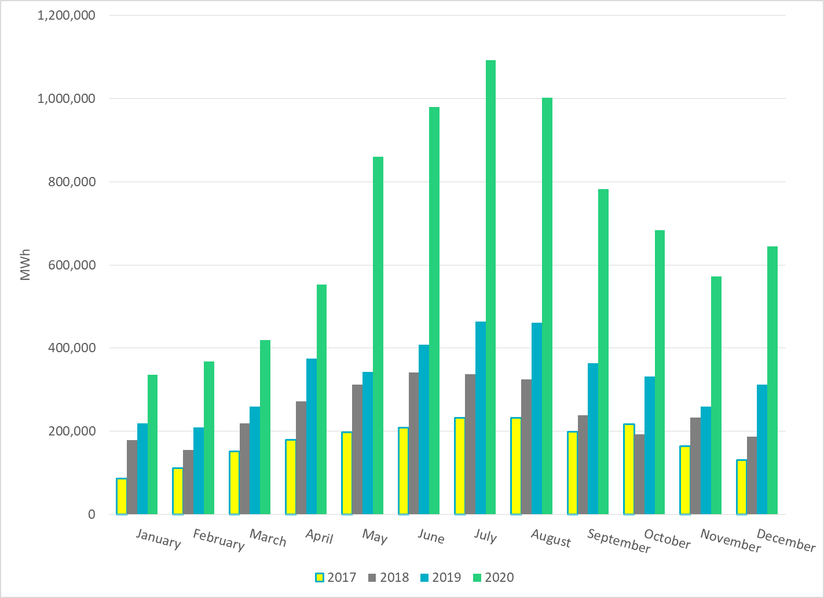
Total Energy From Solar Generation
Notes:
645,288 MWh

Slide 25
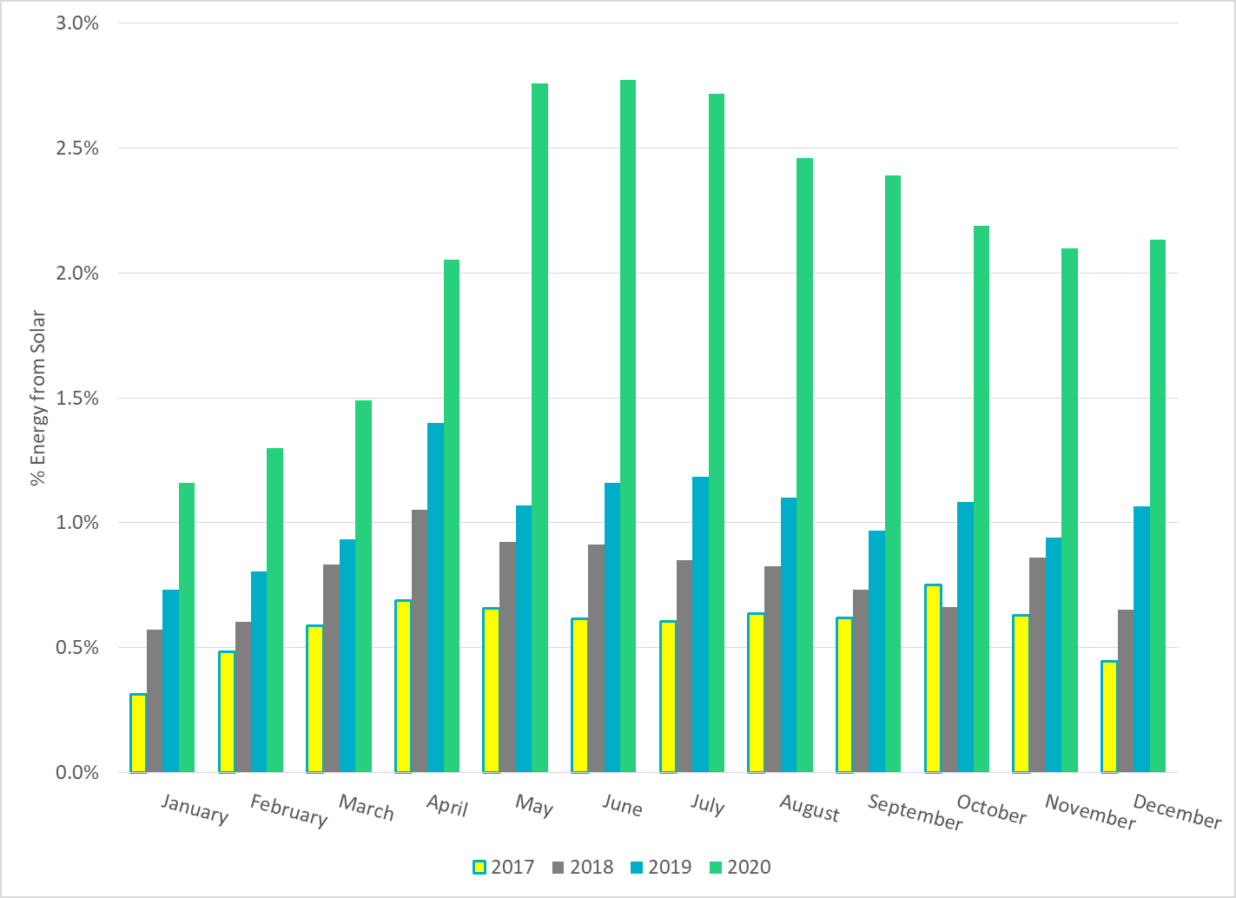
% Energy from Solar Generation
Notes:
2.13%

Slide 26
ERCOT System Inertia

Slide 27
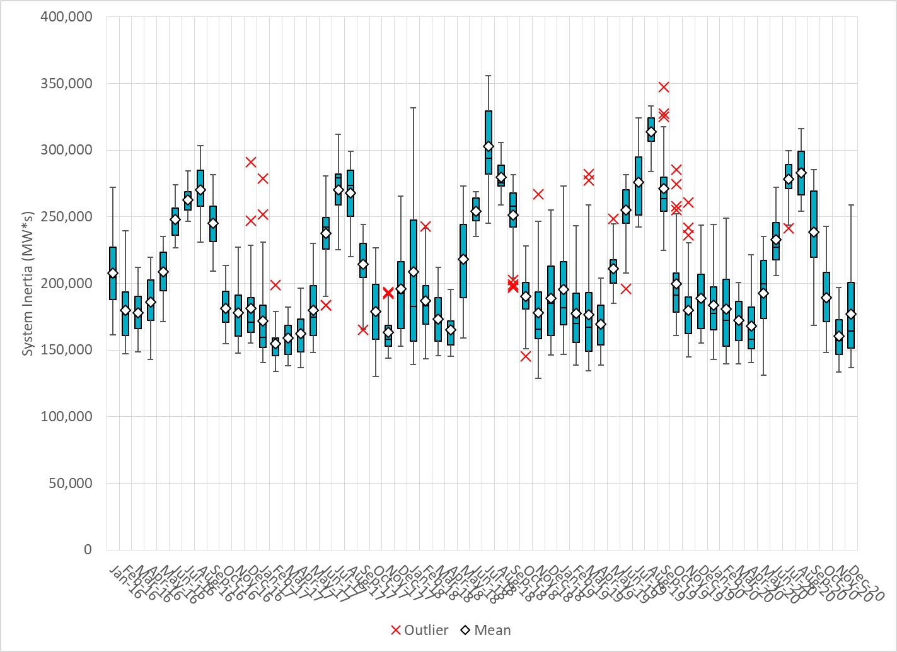
Daily Minimum System Inertia
Notes:
Minimum Inertia = 136,593 MW*s on 12/23/2020
Previous Minimum was 128,759 MW*s on 11/18/2018.
Data:
Mean: 176,982
Max: 258,856 on Dec 4th
Min: 136,593 on Dec 23rd

Slide 28
Questions?
Thank you!

