Slide 1
ERCOT Interconnection Inertia Analysis
Julia Matevosyan
Resource Adequacy
ERCOT
01/13/2021

Slide 2
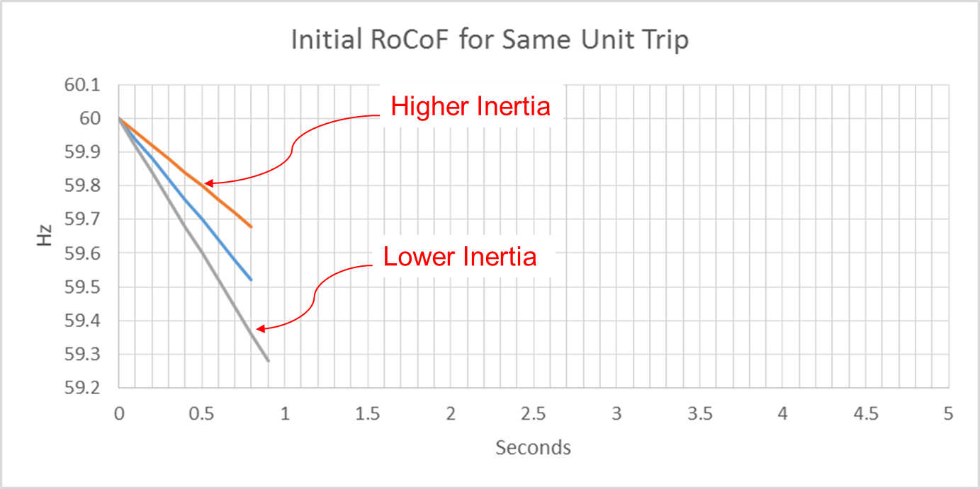
Effect of Synchronous Inertia on System Frequency
With increasing integration of inverter-based generation, there could be periods when total inertia of the system could be low since less synchronous machines will be online.
UFLS trigger
Notes:
UFLS trigger indicates the frequency (59.3 Hz) at which the first stage of involuntary underfrequency load shedding will happen. ERCOT plans and operates the system such that for the simultaneous trip of two largest generating units (2750 MW), UFLS should not be triggered, though it still can happen in some extreme unexpected situations.

Slide 3
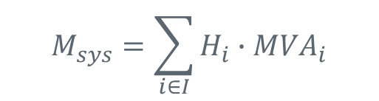
Inertia Calculation
In 2013, as instantaneous wind power penetration reached 30%, ERCOT started analyzing impacts of inverter-based generation on system inertia.
In 2015, ERCOT implemented a real-time inertia calculation using inertia parameters of each individual synchronous generator and its status (on/off) telemetry.
$$M_{sys}=\sum_{i∈I}{H_{i}∙{MVA}_{i}}$$
where I is the set of online synchronous generators or condensers,
MVA_{i} is MVA base of on-line synchronous generator or synchronous condenser i, and
H_{i} is inertia constant for on-line generator or synchronous condenser i in a system (in seconds on machine MVA_{i})

Slide 4
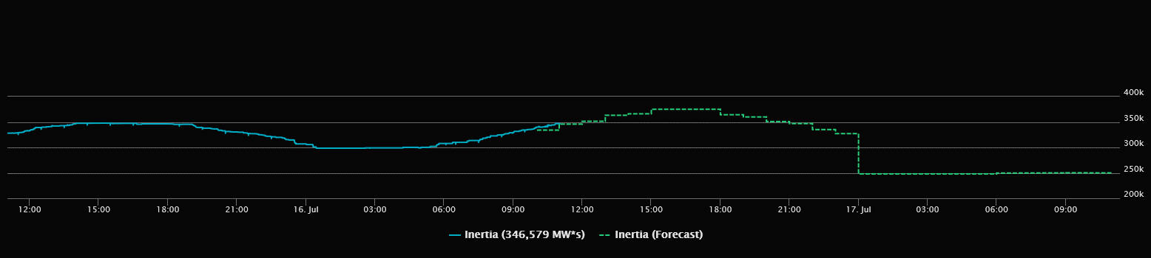

Inertia Monitoring in Real-Time and Forecasting
In 2016, inertia monitoring was implemented in the control room.

Slide 5
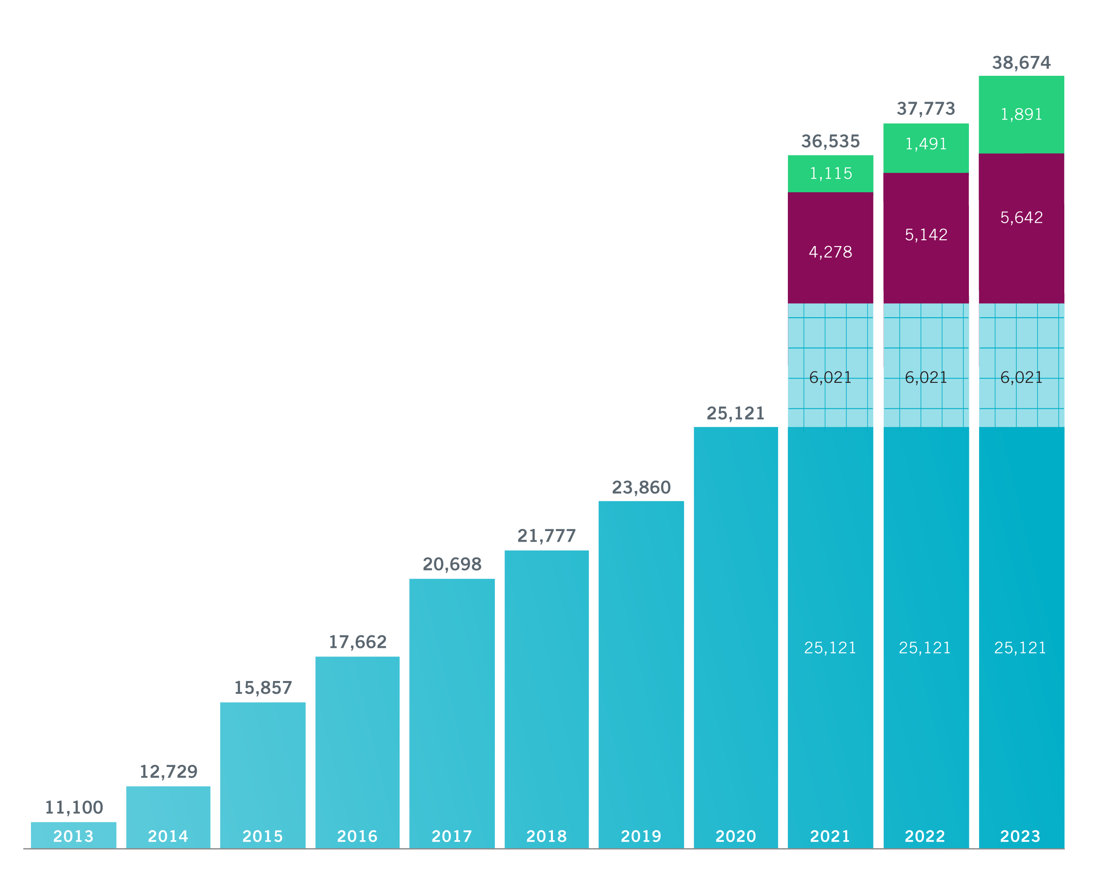
Wind Generation Capacity as of Dec 31st, 2020
MW amounts in blue font are projects that are synchronized with ERCOT grid but not yet approved for commercial operation.
+1,261 MW+3,866 MW
+2,083 MW+1,999 MW
+1,079 MW+148 MW
+3,035+7 MW
+1,805 MW
+3,129 MW
+1,629 MW

Slide 6
ERCOT Inertia 2013-2020
Date and Time | 2013 3/10 3:00 AM | 2014 3/30 3:00 AM | 2015 11/25 2:00 AM | 2016 4/10 2:00 AM | 2017 10/27 4:00 AM | 2018 11/03 3:30 AM | 2019 3/27 1:00 AM | 2020 05/01 2:00 AM
Min synch. Inertia (GW*s) | 132 | 135 | 152 | 143 | 130 | 128.8 | 134.5 | 131.1
System load at minimum synch. Inertia (MW) | 24,726 | 24,540 | 27,190 | 27,831 | 28,425 | 28,397 | 29,883 | 30,679
Non-synch. Gen. in % of System Load | 31 | 34 | 42 | 47 | 54 | 53 | 50 | 57
Notes:
For each box, the central mark (red line) is the median, the edges of the box (in blue) are the 25th and 75th percentiles, the whiskers correspond to +/- 2.7 sigma (i.e., represent 99.3% coverage, assuming the data are normally distributed. The corresponding lowest inertia in each year is given in the table.
The circle on each boxplot is showing inertia during time when highest portion of load was served by wind generation in that year. In 2019 it was on November 26 3:52 am, 57.87%.
ERCOT tripled installed wind capacity between 2013 and 2020, adding nearly 20 GW of wind generation (including all synchronized projects)
An equal amount of coal capacity has about 55 GW*s of inertia contribution.
Counterintuitively, the inertia trend is not declining as installed IBR capacity increases, as was anticipated, due to other factors, such as load growth, gas prices, wind curtailments etc.

Slide 7
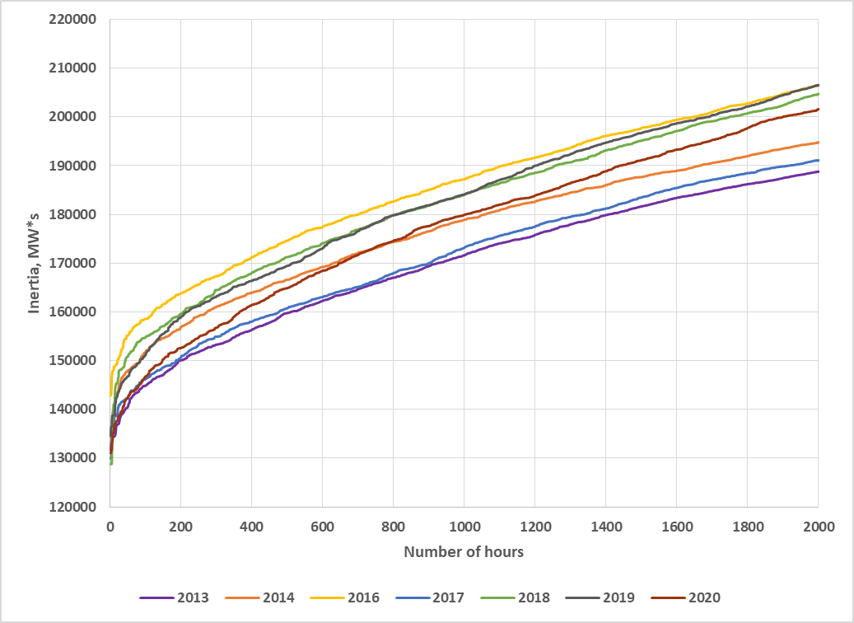
Inertia 2013-2020 (sorted from lowest to highest)
Zooming on lower inertia hours
2015 inertia was higher due to low gas price, and low wind (not included here)

Slide 8
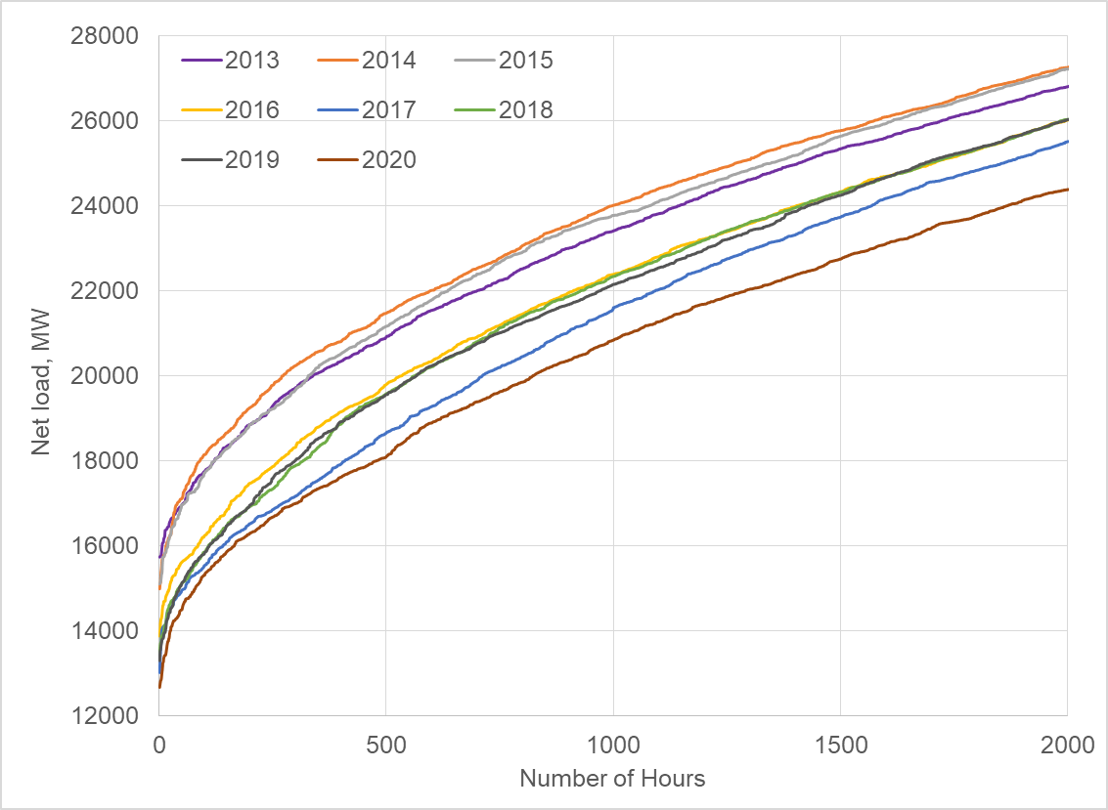
Net-load 2013-2020 (sorted from lowest to highest)

Slide 9
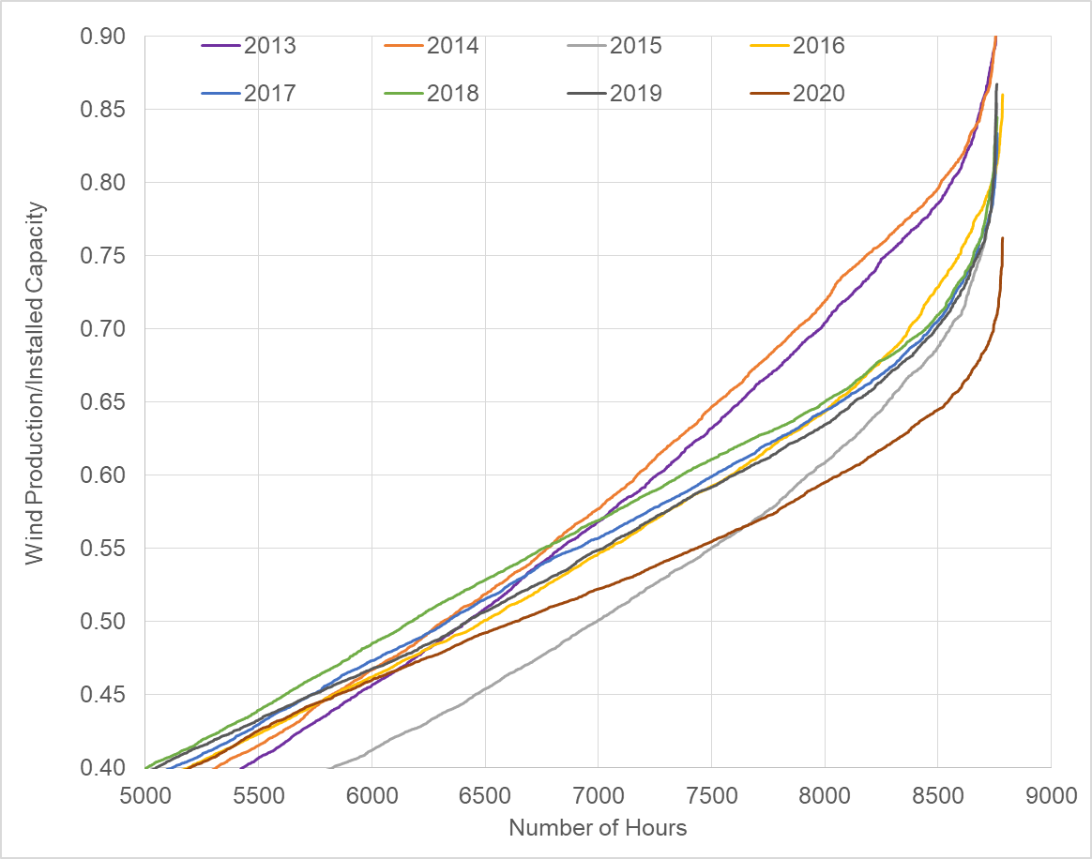
Relative Wind Production 2013-2020 (sorted from lowest to highest and zoomed)
Actual hourly wind power production is normalized by installed capacity at the time and ordered from lowest to highest level for each year to compare how “productive” each year was.

Slide 10
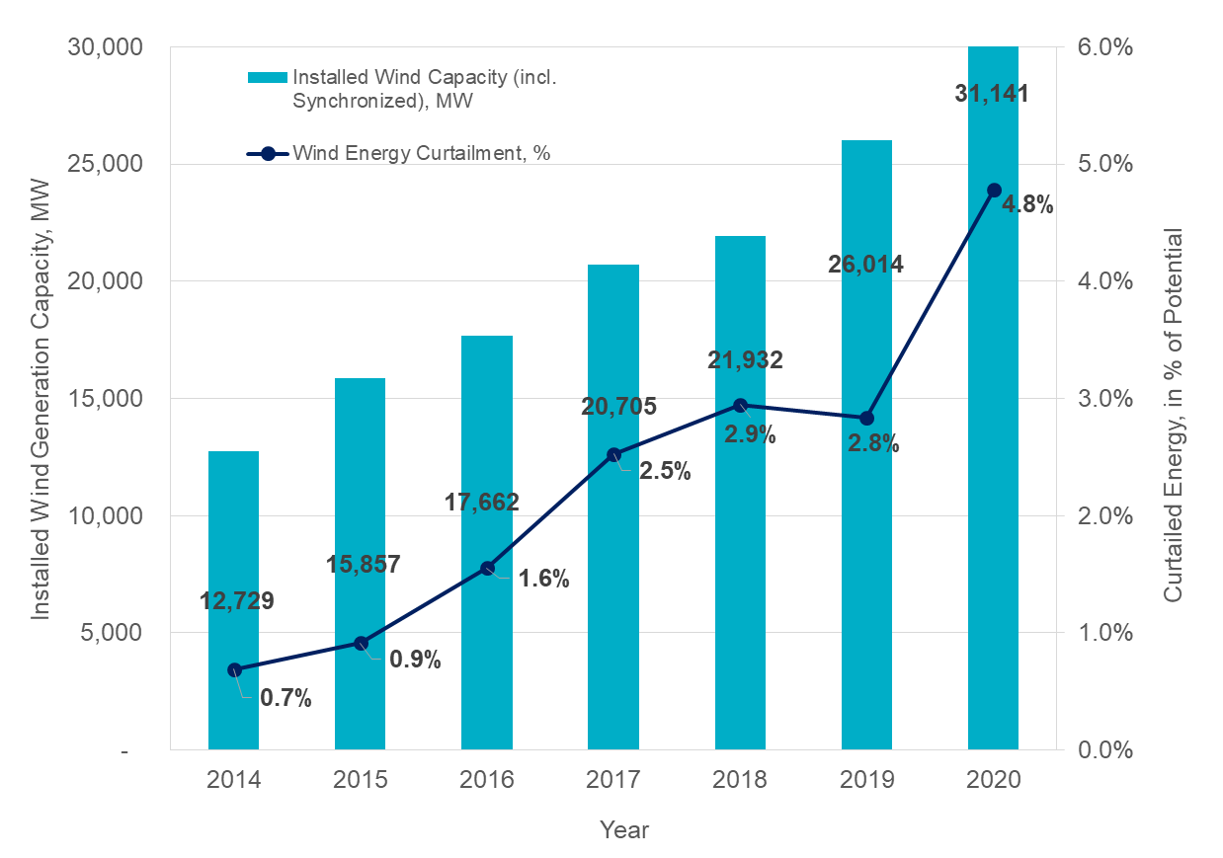
Curtailments
Curtailment % is calculated based on potential uncurtailed annual energy yield

Slide 11
Natural Gas Prices
Notes:
About 50% of ERCOT’s generation fleet is natural gas based
Fluctuations in natural gas prices affect generating unit commitment patterns and, thus, system inertia
More combined cycle units are committed during periods with low gas prices (higher inertia than coal)
More Coal units are committed in periods with high gas prices (lower inertia than combined cycle)

Slide 12
Coal vs Combined Cycle Interplay
Combine Cycle Plant Inertia
Coal Plant Inertia
Combined Cycle Plant has about 1.5 time higher inertia than a Coal Plant with the same MVA rating

Slide 13
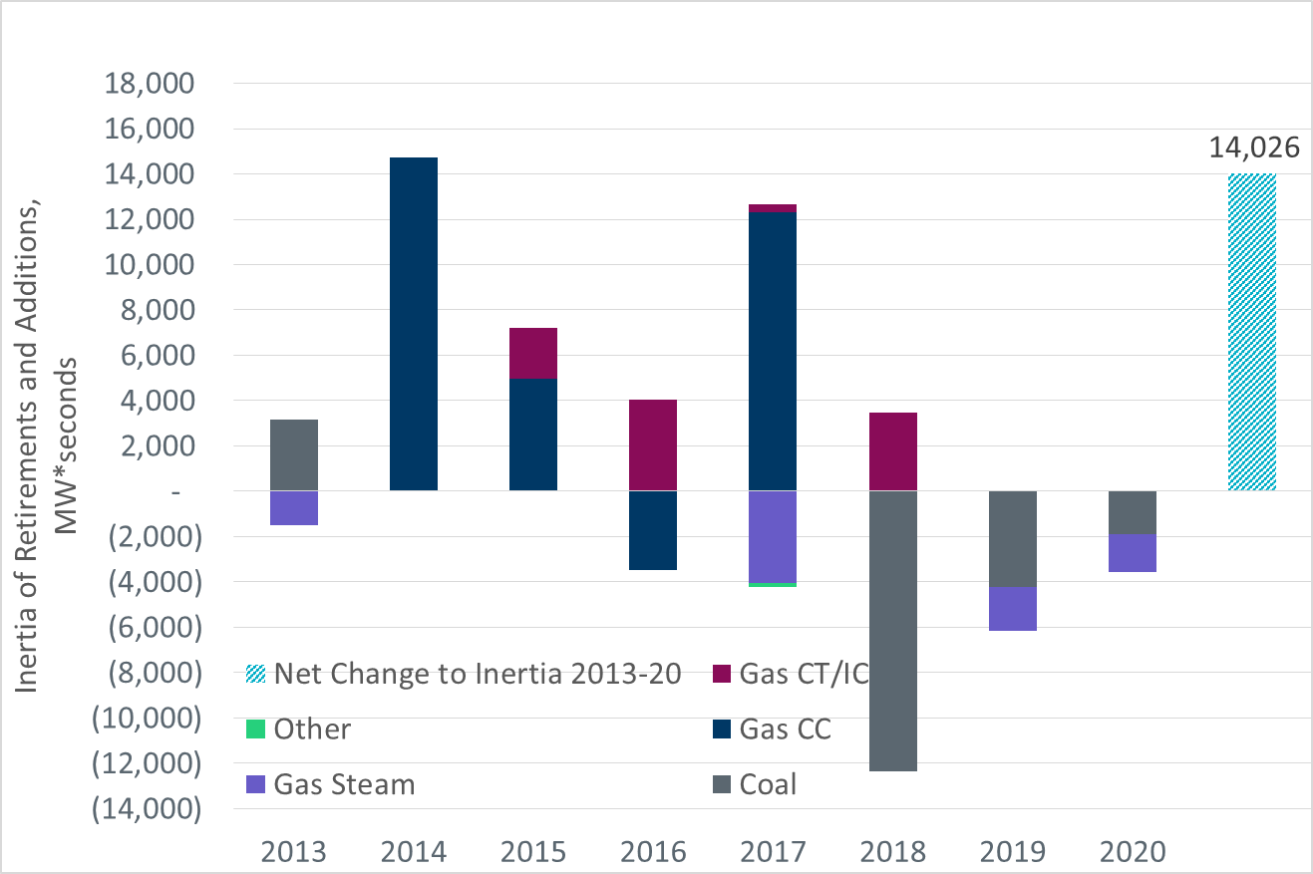
Synchronous Generation Retirements, Mothballing and Additions
∼11600 MW of capacity retired or mothballed (primarily coal and gas-steam), and ∼9300 MW of capacity was added (primarily CC and CTs) from 2013 through 2020.

Slide 14
PUN Inertia
Jan- Nov
Notes:
PUN generators may be online at all times regardless of electricity market conditions.
Even when PUNs are not exporting power, they are contributing to system inertia, because they are synchronized to the ERCOT grid.
Inertia of PUN generation is at least 35 GW*s from 2014-2020, i.e. >30% of critical inertia.

Slide 15
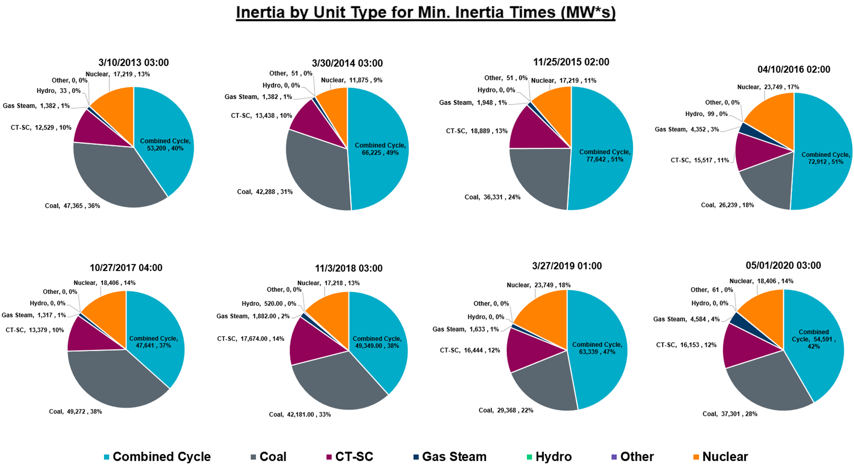
Inertia by Unit Type during Minimum Inertia Hour in Each Year

Slide 16
Summary
All other factors being constant, inertia would decline in proportion to installed capacity of inverter-based generation;
However, ERCOT load is growing, which affects unit commitment and, consequently, inertia trend;
Lower natural gas prices result in more Combined Cycle (CC) generation committed and higher overall inertia. If retired Coal generation is replaced by CCs in unit commitment, then inertia increases as well.
Private Use Networks generation provide significant portion of system inertia and currently does not respond to energy price variations similarly to other Resources
Finally, levels of wind output during low load periods in a given year affects inertia

Slide 17

Thank you! Questions?
Julia Matevosyan
jmatevosjana@ercot.com

Slide 18
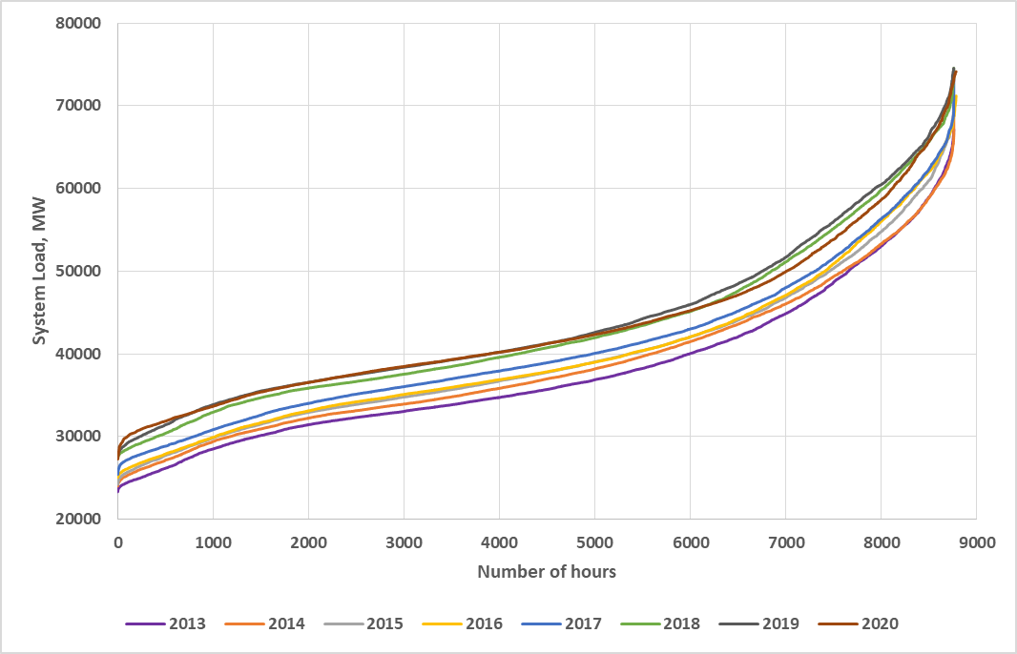
Load Duration Curves (2013-2020)
Hourly load is ordered from lowest to highest level for each year to illustrate load growth from 2013 to 2020

