Slide 1
NOGRR 215
CMWG/OWG
January 11, 2021

Slide 2
RAS Impacted Generation
Evaluated Generation ramp/trip RASs related Constraints for past 2 years
  Identified which RAS triggered for which constraint
  Calculated constraint overload without RAS
  Approximated generation shift factor for each triggered RAS constraint across 2 years
  Calculated curtailed MWs for single associated generator based on shift factor and overloads
  Evaluation does not account for nearby generation with Shift factors or offer curves.
RAS’s Evaluated
  Eskota RAS
  Horse Hollow RAS
  Mitchell Bend RAS
  Stryker RAS
  Wirtz RAS

Slide 3
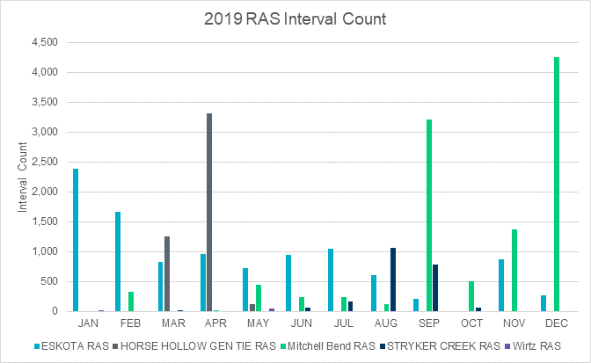
2019 RAS Trigger Count
12 interval/hr.
24 hr/day
~30 days/month
8000-9000 SCED intervals/month

Slide 4
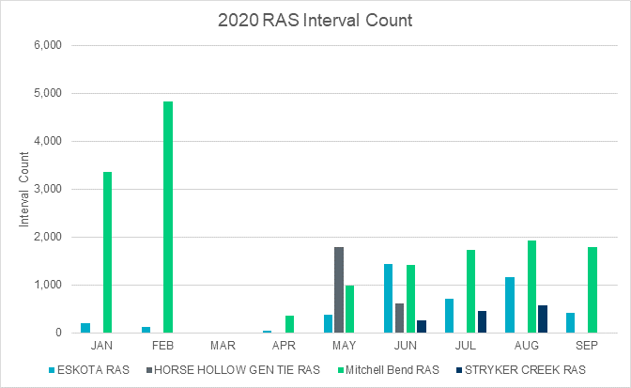
2020 RAS Trigger Count
12 interval/hr.
24 hr/day
~30 days/month
8000-9000 SCED intervals/month

Slide 5
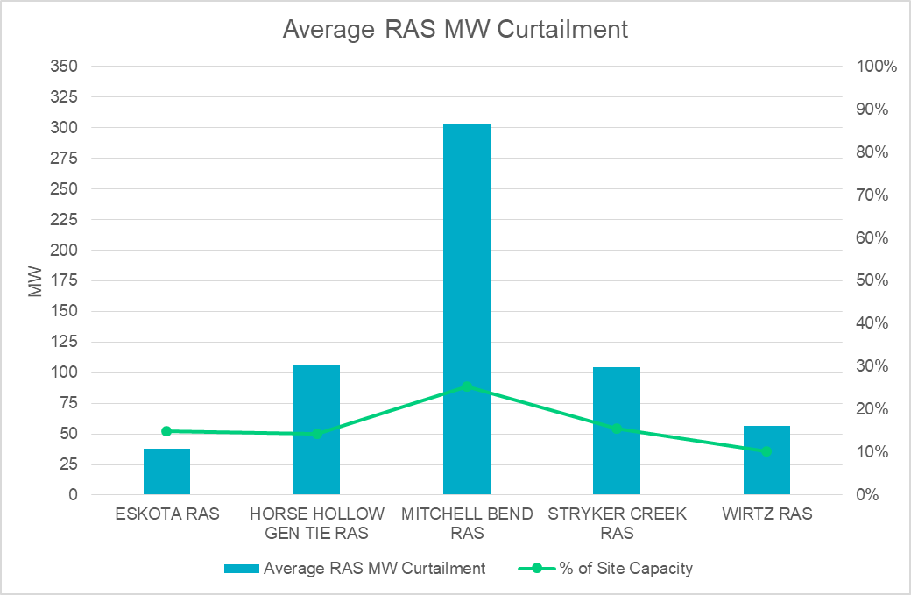
Average Possible MW Curtailment
Approximation that does not include nearby generators with shift factors on constraint or offer curves
Approximation that uses a general shift factor applied across 2 years of constraint data
Amount of curtailment on average if RAS was not available when RAS triggered in RTCA
Curtailed amount as a percent of total site capacity shown in green

Slide 6
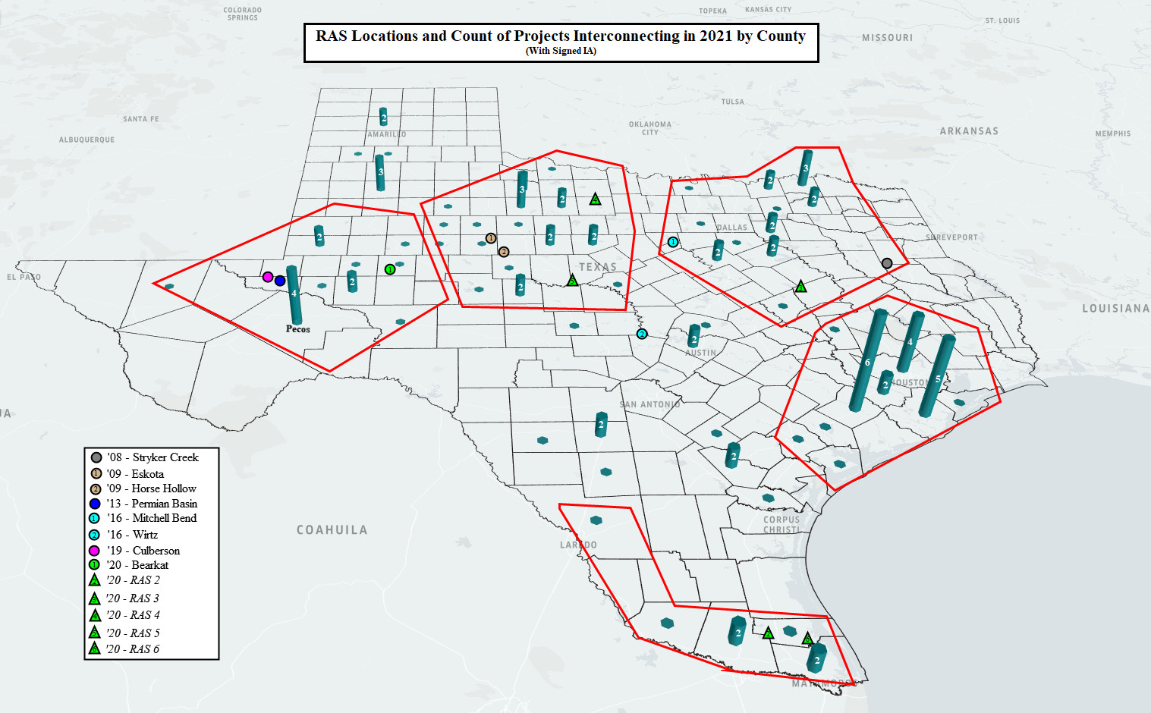
Location of RAS and 2021 Interconnection Projects
103 Generation Interconnections, with signed IA, planned 2021
1900 MW in Wharton County
  1 Conventional
  5 IRRs
Rio Grande Valley
  6 Generation Projects
  GTC Interactions
  2 RAS Proposals
Growth in number of GTC’s & IROLs have changed local constraints into regional reliability concerns.

Slide 7
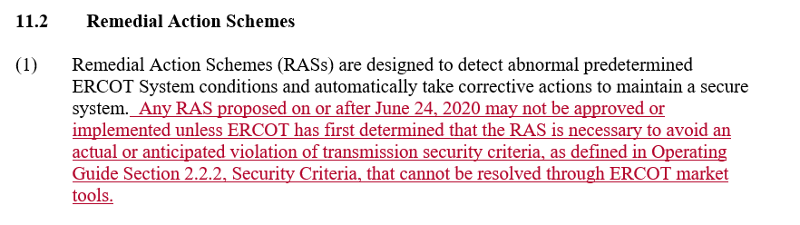
Language Overview
Reliability RAS
  Limit RASs to those needed to avoid actual or anticipated transmission security criteria in Operating Guide 2.2.2.
  RAS may not be used for constraints that can be resolved through market tools.

Slide 8
Language Overview
Exit Strategy
  Exit Strategy no longer required as part of RAS proposal.
  Provide strategy if one has been identified, for example through planned transmission project.
ERCOT RAS review
  Align with current practice of reviewing new, modified, retirement RAS proposals.
  Issue Market Notice for proposals and approvals.
Retirement
  Retirement may be proposed by RAS Entity and evaluated through normal processes.
  ERCOT can determine a RAS is no longer needed through an ERCOT initiated review (ex: 5 yr. review) or through transmission planning process.

Slide 9
Discussion
Questions?

Slide 10
Appendix
Presentation Slides from November CMWG/OWG meeting

Slide 11
Business Case
Significant increase in interest regarding RASs for new generators being developed in areas where interconnection studies for those new generators have demonstrated that the local transmission system cannot handle delivery of the capacity from the new and existing generation.
ERCOT is expecting many more requests of this type.

Slide 12
Business Case
An increase in number of RASs may negatively impact system reliability and increase risk to ERCOT System.
  Increased risk on ability to recognize an Outage’s impact on RAS.
  Increasing difficulty with recognizing impact of combinations of Outages on multiple RAS.
  Increased risk associated with RAS-RAS interactions in RAS-concentrated areas.
  Needed generation not committed in MMS due to treatment of RASs and related contingencies.

Slide 13
Business Case
  Increased compliance burden on RAS Entities and ERCOT.
  Other risks are described in the NOGRR Business Case section.
  Post-contingency, pre-RAS system conditions are meeting the criteria for potential cascading Outages (need RAS + GTC to ensure reliability, which is 2x risk compared to no RAS)
    Under normal conditions and during Outages
    RAS misoperation could lead to cascading Outages

Slide 14
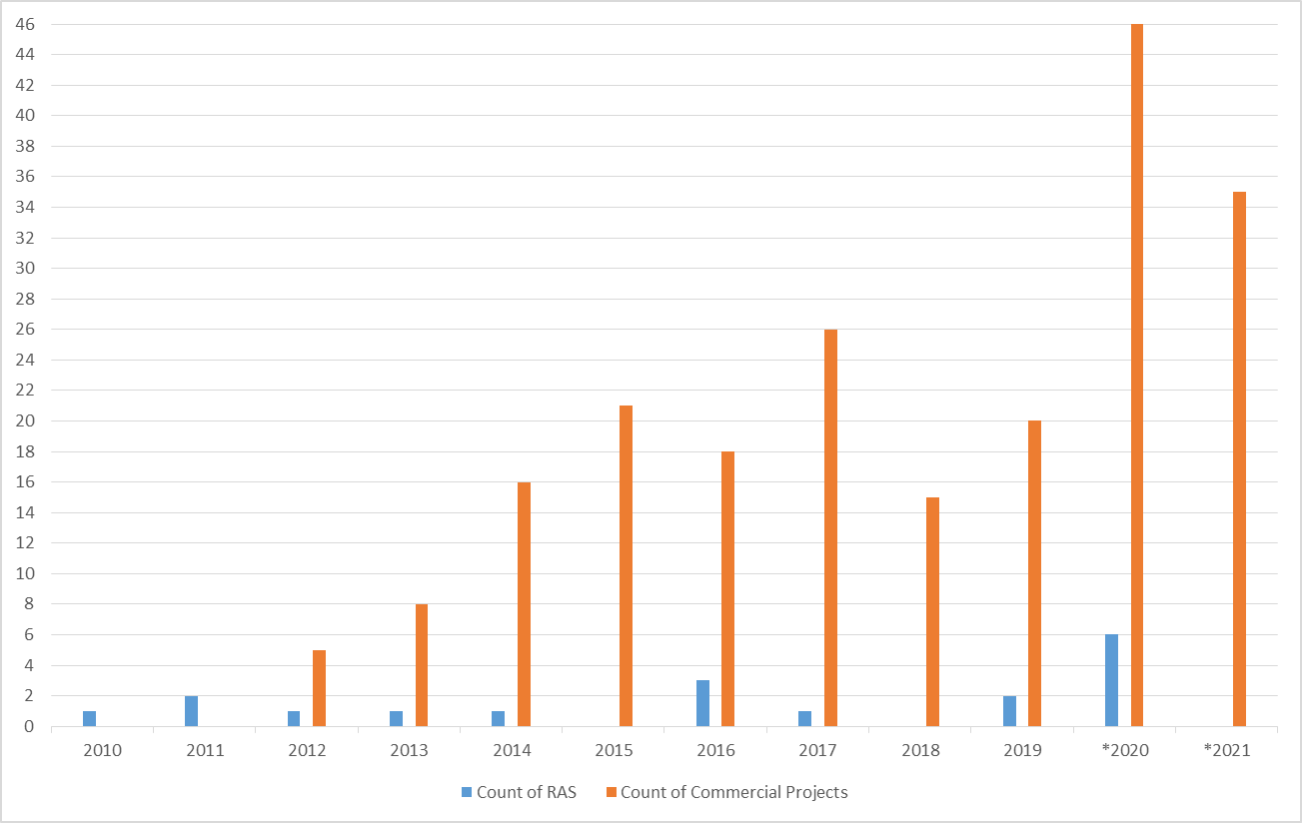
RAS’s vs. New Generation
South W. Black out
Nodal Go Live
PRC-012-1
PRC-012-2
Sharp increase of new Resources
New Resource Integration process is more precise
Better tools to recognize Instability and other reliability concerns
Increased number of RAS decrease Operators visibility
New Resources are connecting in or near GTC’s & IROL’s
Historic RASs impact system differently than new RASs
  Thermal vs. Stability
*2020 and 2021 Count of Commercial Projects include projects with CODs for those respective years that have also met Section 5.9 Planning Guide criteria (qualify for QSA)

Slide 15
RAS History
Remedial Action Schemes | Approval Date | Recently Proposed Date | Retired
Roanoke Switch | 5/11/2004 |  | N/A
Venus Switch | 5/11/2004 |  | N/A
Monticello A | 5/11/2004 |  | 2005
Paris Switch A |  |  | 2002
Paris Switch B |  |  | 2006
Hackberry Switch |  |  | 2007
Commerce Switch |  |  | 2007
Centerville Switch |  |  | 2007
McDonald Road Switch |  |  | 2010
Stanton East |  |  | 2010
Centerville Switch – Kirkland Park Series Reactor |  |  | N/A
Drumwright |  |  | 2010
Willow Valley Sw Sta |  |  | 2013
No Trees Switching Station |  |  | 2011
Sandow Switch – two RASs |  |  | N/A
Valley 345kV Local | 5/11/2004 |  | N/A
Valley - Anna 345kv Remote | 5/11/2004 |  | N/A
Valley-Payne 138kV | 5/11/2004 |  | N/A
Valley Auto | 5/11/2004 |  | N/A
E. Mesquite 138kV | 5/11/2004 |  | N/A
Monticello B | 6/1/2004 |  | 6/18/2018
Mount Enterprise | 6/6/2005 |  | 11/2/2012
Ennis West 138 kV | 7/25/2005 |  | 12/10/2013
Collin 345/138 kV Auto # 1 Series Reactor* | 2/27/2006 |  | 3/3/2015
Parkway-Schertz | 2/27/2006 |  | 8/5/2015
Liggett Switch Series Reactor* | 1/19/2007 |  | 9/15/2015
Whirlwind-Matador | 3/19/2008 |  | 6/1/2012
Remedial Action Schemes | Approval Date | Recently Proposed Date | Retired
Elkton | 9/10/2008 |  | 3/15/2016
Stryker Creek | 9/10/2008
Allen Switch 345/138 kV Auto # 1Series Reactor* | 10/28/2008 |  | 8/31/2016
China Grove Series Reactor* | 10/28/2008 |  | 7/6/2016
Golden Switch | 10/28/2008 |  | 11/16/2013
Monticello Mining | 10/28/2008 |  | 3/16/2016
Temple Switch 345/138 kV Auto # 1 Series Reactor* | 10/28/2008 |  | 9/21/2015
Benbrook 345/138 kV Auto A Series Reactor* | 2/26/2009 |  | 8/6/2014
Benbrook 345/138 kV Auto B Series Reactor* | 2/26/2009 |  | 8/6/2014
Eskota | 8/12/2009
Horse Hollow Gen Tie | 12/2/2009
Stanton East | 4/14/2010 |  | 11/9/2014
Mount Enterprise | 5/5/2010 |  | 11/2/2012
Allen Switch-Ben Davis 345 kV Line Series Reactor* | 3/28/2011 |  | 1/9/2013
Barney Davis | 5/16/2011 |  | 12/1/2020
Permian Basin | 7/9/2013 |  | 6/6/2018
Morgan Creek | 1/15/2014 |  | 12/1/2020
Wirtz | 6/1/2016
Mitchell Bend | 9/21/2016
Culberson Loop | 10/30/2019
Rocksprings |  | 11/1/2019
RAS 1 |  | 2/14/2020
RAS 2 |  | 4/8/2020
RAS 3 |  | 4/14/2020
RAS 4 |  | 6/10/2020
Bearkat | 7/2/2020
RAS 5 |  | 7/17/2020
All RAS’s have been and are TSP owned
  Changing with PRC-012-2
Transmission system is different than it was 10-20 years ago
Nodal Market provides for more efficient dispatch
LMP designed to provide price signal for Resource location
PRC-012-2 effective Jan 1, 2021
  *Would not currently qualify as a RAS
Southwest Blackout Sept. 2011
Nodal Go Live
Dec. 2010

Slide 16
Misoperations
Quarterly Data | Arm/Disarm Count | Operation Count | Misoperations Count
2011 Q3 | 802 | 4 | 0
2011 Q4 | 4115 | 1 | 0
2012 Q1 | 1483 | 0 | 0
2012 Q2 | 2401 | 2 | 0
2012 Q3 | 1485 | 0 | 0
2012 Q4 | 624 | 1 | 1
2013 Q1 | 113 | 3 | 0
2013 Q2 | 587 | 3 | 0
2013 Q3 | 586 | 0 | 0
2013 Q4 | 257 | 0 | 0
2014 Q1 | 127 | 2 | 0
2014 Q2 | 135 | 0 | 0
2014 Q3 | 873 | 0 | 0
2014 Q4 | 350 | 0 | 0
2015 Q1 | 23 | 0 | 0
2015 Q2 | 645 | 0 | 0
2015 Q3 | 2741 | 0 | 0
2015 Q4 | 247 | 0 | 0
2016 Q1 | 232 | 0 | 0
2016 Q2 | 28 | 4 | 0
2016 Q3 | 1204 | 0 | 0
2016 Q4 | 230 | 0 | 0
2017 Q1 | 67 | 0 | 0
2017 Q2 | 746 | 3 | 0
2017 Q3 | 806 | 0 | 0
2017 Q4 | 45 | 0 | 0
2018 Q1 | 102 | 0 | 0
2018 Q2 | 109 | 0 | 0
2018 Q3 | 354 | 3 | 0
2018 Q4 | 7 | 0 | 0
2019 Q1 | 6 | 0 | 0
2019 Q2 | 1 | 1 | 0
2019 Q3 | 0 | 0 | 0
2019 Q4 | 0 | 0 | 0
2020 Q1 | 1 | 1 | 0
2020 Q2 | 0 | 0 | 0
2020 Q3 | 2 | 2 | 1
Total | 21534 | 30 | 2
Operations and Misoperations for past 9 years
Misoperations can and do occur
  Must evaluate as if will misoperate
Increase in RASs = Increase Risk of Misopertion
Difficult to asses all scenarios
RAS intended to mitigate Post Contingency exceedances
  Hi Arm Count shows monitored element is near trigger point basecase
Unintended Operation due to outage
RAS disabled
RAS disabled

Slide 17
Discussion
Questions?

