Slide 1
CRR Activity Calendar Update
Donald House
Supervisor, CRR
CMWG
January 11, 2021

Slide 2
CRR activity calendar – overview
Protocol 7.5.1(4)(c) requires ERCOT to post an updated calendar no later than April 1 of each calendar year
Each calendar includes auction activity dates for the remainder of the current calendar year and for the two subsequent calendar years
The calendar must be approved by WMS prior to the annual posting
Would like feedback from CMWG on the draft calendar before seeking final approval from WMS on February 3, 2021

Slide 3
CRR activity calendar – description of changes
Current calendar
Dates from the currently approved calendar remain unchanged (through the 2023.MAR.Monthly.Auction)
Added dates to cover CRR activity through the 2024.MAR.Monthly.Auction
Applied the same patterns to assign the dates as have been used for previous calendars to maintain Protocol requirements and consistency
Nothing unusual to note about this update
Did not need to delay or move any auction submission windows to avoid holidays
PCRR-eligible NOIEs are encouraged to view the dates on the “PCRRs” tab of the calendar

Slide 4
CRR activity calendar – general reminders
The model build process begins 2 weeks prior to the model posting date (get outages and Common Information Model snapshot)
We hold a monthly auction and a long-term auction every month of the year
Typical pattern is monthly auction bid window in the first half of the month followed by the long-term auction bid window the very next week (occasionally, there will be a one-week gap to avoid holidays)
Monthly auction results are posted one week after the bid window closes; long-term auction results are posted two weeks after the bid window closes
Monthly auction credit is usually released 1 day after the long-term auction credit is locked

Slide 5
CRR activity calendar – general reminders
There are two additional tabs on the calendar
“Calendar Protocol References” includes any references to protocol sections relating to the selection of dates
“PCRRs” gives activity dates and protocol sections related to the annual PCRR allocation process

Slide 6
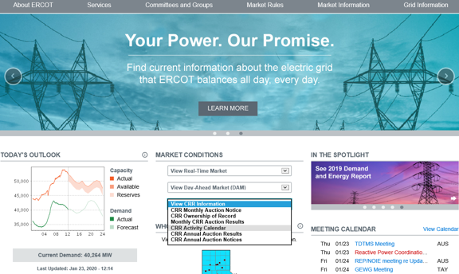
CRR activity calendar – next steps
Will take to WMS for final approval on February 3
If changes are needed, will take to WMS on March 3
An approved calendar will be posted on the ERCOT public site by April 1

