Slide 1
Supply Analysis Working Group Report to WMS
January 6, 2021
Caitlin Smith, Chair
Pete Warnken, Vice Chair
Ian Haley, Vice Chair

Slide 2
2020 Reserve Margin Study
Background:
In 2014 the PUCT asked Brattle and Astrapé to estimate the economically-optimal reserve margin in ERCOT to inform their review of market design for resource adequacy
EORM/MERM study updated every two years starting in mid-2018
Impacts & 2020 Results:
2020 study quantifies the 2024 values for:
Economically Optimal Reserve Margin - EORM → 11%
Market Equilibrium Reserve Margin - MERM (in energy-only equilibrium) → 12.25%
As evaluated every two years, the study can show the changing values of EORM and MERM to show changes in resource adequacy in ERCOT
Major changes to 2020 study from 2018:
Increased wind and solar penetration
Updated methodology for modeling PRD
ORDC Changes
Reference technologies

Slide 3
2020 Reserve Margin Study
Final Draft Report released 12/1
30-day comment period for stakeholder comment
December SAWG Q&A topics:
Comparison of EORM shape from 2018 Study to 2020 Study
CT production cost savings in 2020 Study vs CC savings in 2018 Study
System cost asymmetry around MERM
Impact of forced outage rates on MERM
Battery duration assumptions
Impact of co-optimization of energy and ancillary services
Renewable resource accounting
Next Steps:
“RM Report Question Comments” document will be updated with further questions http://www.ercot.com/calendar/2020/12/18/195774-SAWG
Requests for more data from the Astrapé report go to Pete Warnken Pete.Warnken@ercot.com & ERCOT will return to SAWG with a summary on requests and plan for if/how much data will be provided to stakeholders
Astrapé to come back after comment period and report finalized

Slide 4
December CDR Summary
The planning reserve margin for summer 2021 is forecasted to be 15.5%, down 1.8% from the May CDR.
Between 2022 and 2025, the planning reserve margin is expected to reach as high as 27%.

Slide 5
December CDR Summary
Capacity:
Decrease May CDR was due to solar and wind project delays and cancellations
Note: SAWG will continue GINR analysis in February with the topics: summer 2020 planned projects success review and revisiting project COD delays, GINR trends in delays and cancellations
Demand:
CDR incorporates demand served by Lubbock Power and Light beginning in June 2021
The forecasted peak demand for summer 2021 is 77,244 MW
used revised economic data released by Moody’s Analytics in August.
this is a decrease in expected peak demand from the May CDR
Rooftop Solar:
Note: due to continued and accelerated growth in rooftop solar projects, ERCOT included its first, separate rooftop solar PV forecast in the CDR. The forecast was created to show the incremental capacity growth beyond the historical growth trend reflected in the load forecast.
The Rooftop Solar Scenarios Tab is separate from the information on residential rooftop solar in the summary and uses an s-curve approach

Slide 6
December CDR Summary
Waterfall chart showing itemized changes in the reserve margins reported in the 2020 May/December CDRs

Slide 7
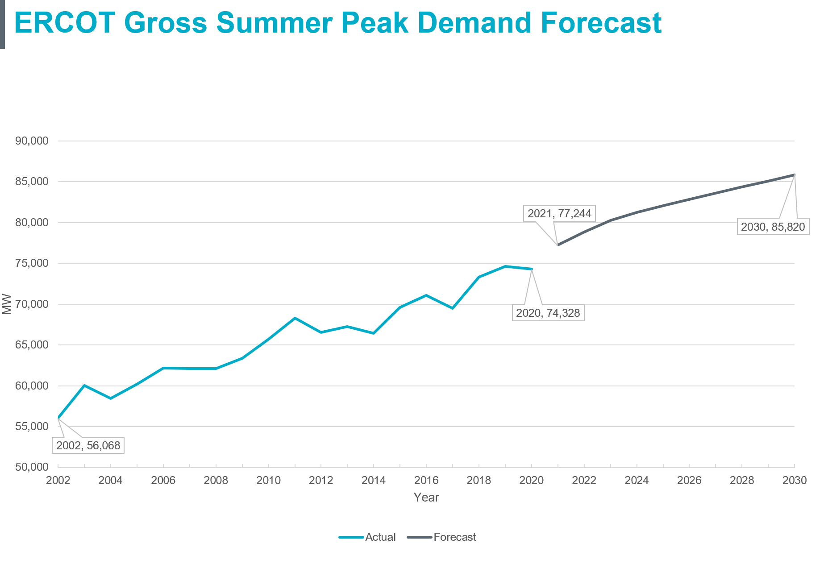
December Long-Term Load Forecast

Slide 8
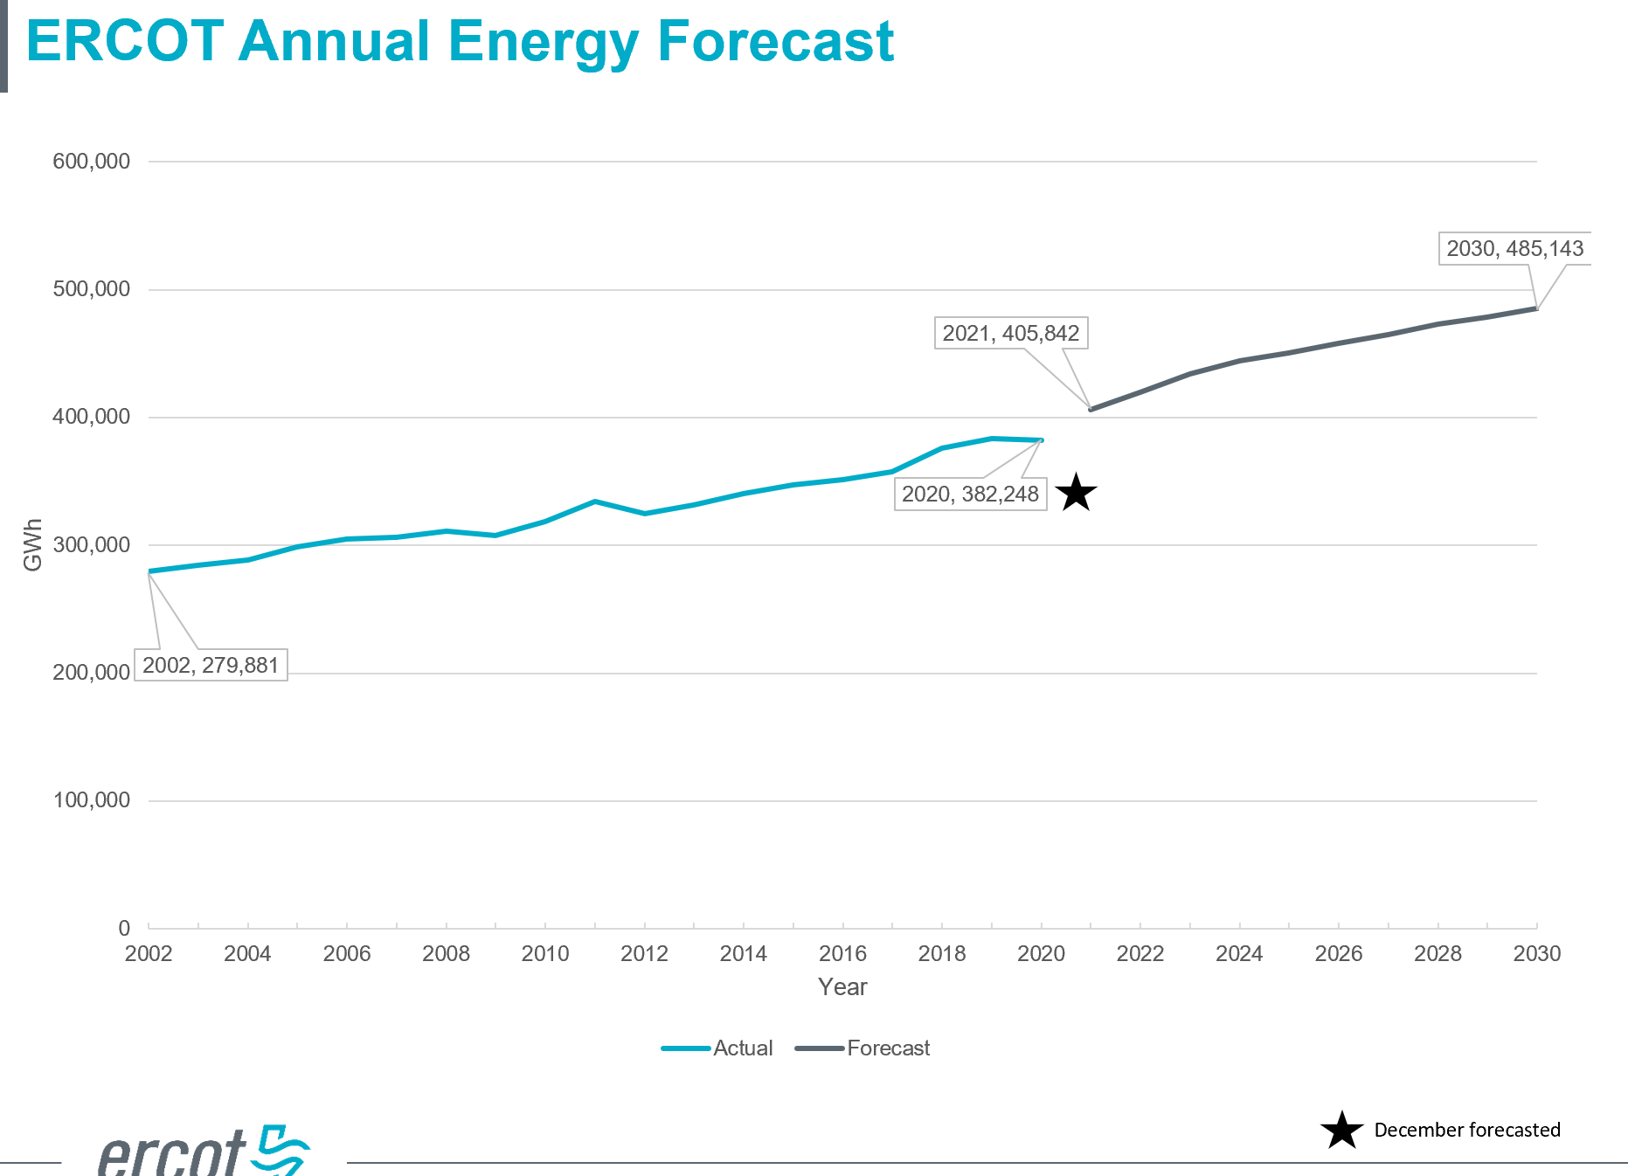
December Long-Term Load Forecast

Slide 9
December Long-Term Load Forecast
Rooftop PV Forecast
A forecast was created for residential ESIIDs using the load profile assignment for each weather zone
Total installed capacity was approximately 700 MW as of August 2020
Forecast is for the total installed capacity to increase to approximately 2,100 MW by August 2030
The assumed capacity factor at the time of the summer peak is 46%
Rooftop PV Forecast Notes:
Residential ESIIDs with PV have greater average usage per hour than ESIIDs without PV during the early morning and evening hours
Some studies suggest that customers with PV tend to use more energy
To compensate for this, should the shapes be unitized?
Note that the Rooftop Solar Scenarios Tab on CDR uses s-curve
More analysis to follow at SAWG and by ERCOT

Slide 10
December Long-Term Load Forecast
Load Forecast Adjustments
Lubbock added to North Forecast from 2021
Rayburn added to East Forecast from 2021
Adjustments added for Large Industrial Facilities
Coast: 425 – 650 MW phased in over time
South: 75 – 930 MW phased in over time
South Central: 24 – 480 MW phased in over time
Next steps:
Long-term Load Forecast methodology and data files to be posted to ercot.com with market notice by end of this week

Slide 11
Net Load Forecast Update
ERCOT will return to SAWG with, and continue to work on, options for methods regarding the capacity contributions for wind and solar
Probable options:
Use existing CDR capacity contributions
Use net load capacity contributions
Use probabilistic assumptions

Slide 12
SAWG Leadership 2021
Propose keeping same leadership:
Chair – Caitlin Smith, AB Power Advisors
Vice Chair – Ian Haley, Vistra
Vice Chair – Pete Warnken, ERCOT

Slide 13
SAWG Upcoming 2021
Questions/Requests:
Requests for more data from the Astrapé report go to Pete Warnken Pete.Warnken@ercot.com & ERCOT will return to SAWG with a summary on requests and plan for if/how much data will be provided to stakeholders
Questions on December CDR & Long Term Load Forecast
Questions on CDR to Pete Pete.Warnken@ercot.com
Questions on Long Term Load Forecast to Calvin Opheim Calvin.Opheim@ercot.com
Q&A to go to SAWG listserv and possibly be presented at February 5th SAWG
Long-term Load Forecast methodology and data files to be posted to ercot.com with market notice by end of this week
Upcoming 2021 topics:
Battery energy storage capacity contribution
Probabilistic SARA
Net Load Forecast
Regions for Solar Capacity Contribution CDR
GINR Analysis on project delays
Next SAWG meeting February 5th

