Slide 1
Review Day-Ahead Market (DAM) Performance (DAM delays)
ERCOT Staff
01-06-2021

Slide 2
List of items
DAM Delays Dec-2010 through Dec-15, 2020
DAM Overview
Factors that can lead to long DAM run time
What does DAM Delay mean?
DAM Performance Improvement – Options
Next Steps

Slide 3
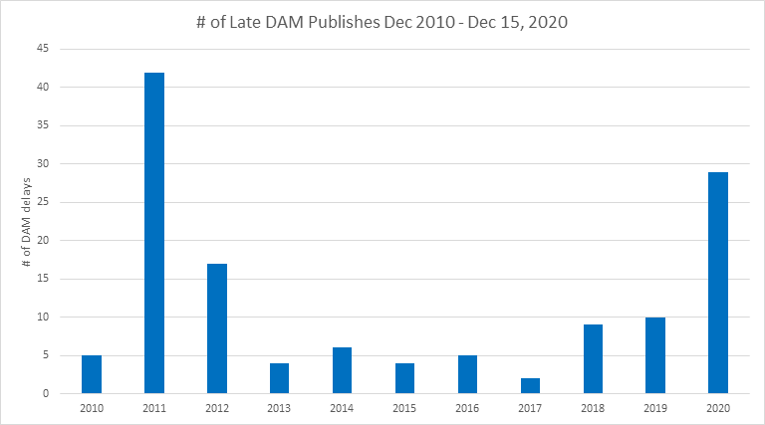
DAM Delays

Slide 4
DAM Overview
DAM co-optimizes energy, Ancillary Services, and PTPs over a constrained network by maximizing bid-based revenues minus offer-based costs
Allotted Time for DAM Execution
3 ½ Hours (10:00am - 1:30pm)
Allotted time includes optimization time, data input validation, PVT execution/validation, DAM output posting process, etc.
Security Constrained Unit Commitment & Dispatch
Iterations between the optimization engine (MIP & QP) that commits/dispatches Resources, and the network analysis that determines transmission feasibility of commitment/dispatch and supplies transmission constraints to the optimization engine

Slide 5
Factors that can lead to long run time
Large volume of variables – both continuous and integer variables
More Integer variables can exponentially increase run-time
Currently experiencing performance issues when volume of PTP interval submissions exceed 170K
Large number of modeled transmission constraints, temporal constraints and transmission outages, typically in shoulder months that can lead to more transmission constraints
Increase in number of Settlement Points (Resource Node, Hub, or Load Zone) can lead to long run times

Slide 6
What Does DAM Delay Mean?
DAM delays are disruptive to the market and create additional steps for DAM operators and downstream ERCOT operations to manage the timeline deviation
Upon DAM delay:
ERCOT control room will issue an Advisory and make hotline calls. They will also have to cancel Advisory and make hotline calls following the completion of DAM
Market Participants must manage timeline deviation and respond to ERCOT hotline call
If DAM delays continue to worsen, ERCOT may have to abort DAM which may create risk for stakeholders
Impact on Real-Time energy market
ERCOT procures AS in the DAM

Slide 7
DAM Performance Improvement – Options
Limit Transactions
Select the most economically valuable instruments through transaction fees
Flat transaction fee
First “X” number of transactions free, then impose transaction fee on the remaining transactions
Sliding scale transaction fee
Limit the number of PTP-intervals per Counter-Party that can sink or source at a particular Settlement Point based on PTP less than a certain MW amount. i.e., let’s say for example: limit the total number of PTP- intervals with a MW amount less than 10 MW that can source or sink at a Settlement Point for a Counter-Party to 100.

Slide 8
DAM Performance Improvement – Options
Reduce Complexity
Eliminate block bids across time for PTP transactions (MW award is same across the designated hours)
Extend eliminating fixed quaintly blocks and blocks across time to additional DAM virtual offer/bids if performance problems persist
Improve Technology
ERCOT is continuously looking for software and hardware solutions to further improve DAM performance but any improvements due to software or hardware upgrade will not be sufficient to overcome the performance challenges due to increased volume and complexities

Slide 9
Next Steps
ERCOT wants to engage with stakeholders to manage the increased complexities in a way that provides the greatest value to the market
ERCOT expects stakeholders to propose alternative ideas to mitigate the DAM performance issues
ERCOT requests WMS to assign this topic to WMWG so that more detailed discussions can take place at the working group level on different options to mitigate DAM performance issues

