Slide 1
PDCWG Report to ROS
Chair: Chad Mulholland, NRG
Vice Chair: Jimmy Jackson, CPS
ROS
January 7th, 2021

Slide 2
Report Overview & Notes
Report Overview
Meeting Minutes
BAL-001-TRE-2 FMEs & IMFR
4 FMEs in the month of November
Frequency Control Report

Slide 3
Meeting Minutes
PDCWG Meeting 12/09/2020
ERCOT Discussion of RFI – combined cycle unit frequency response for high frequency events
NPRR 1040 – Compliance Metrics for Ancillary Service Supply Responsibility
Status Update of PUCT Directives 3 & 9
Discussion of ERCOT Study Proposal for RRS Limits
Update on BAL-001-TRE, SAR 12
Analysis of ESR frequency response performance
ERCOT Reports

Slide 4
Interconnection Minimum Frequency Response (IMFR) Performance

Slide 5
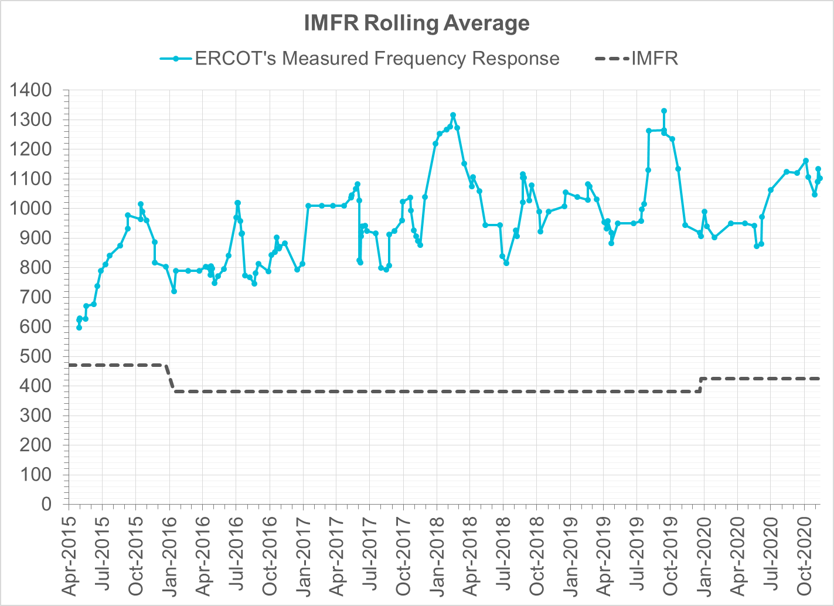
Interconnection Minimum Frequency Response (IMFR) Performance
IMFR Performance currently 1101.96 MW/0.1Hz
Frequency Response Obligation (FRO): 425 MW/0.1 Hz

Slide 6
Frequency Control Report
October 2020

Slide 7
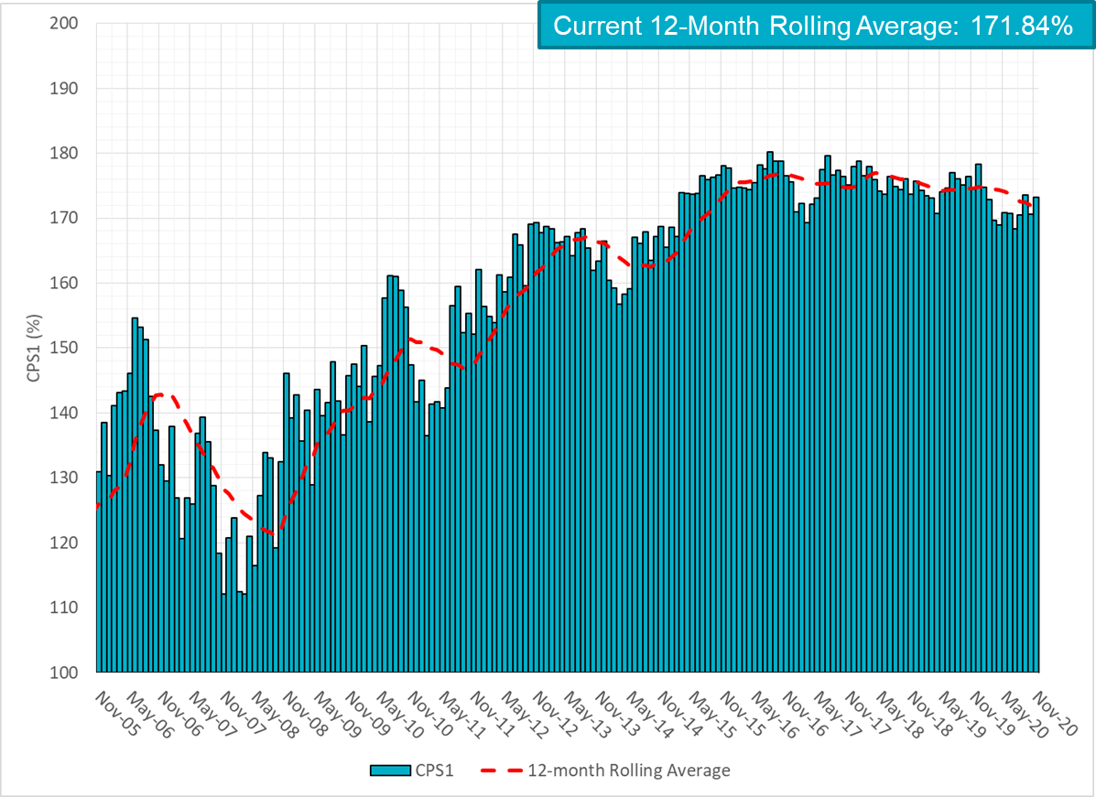
CPS1 Performance

Slide 8
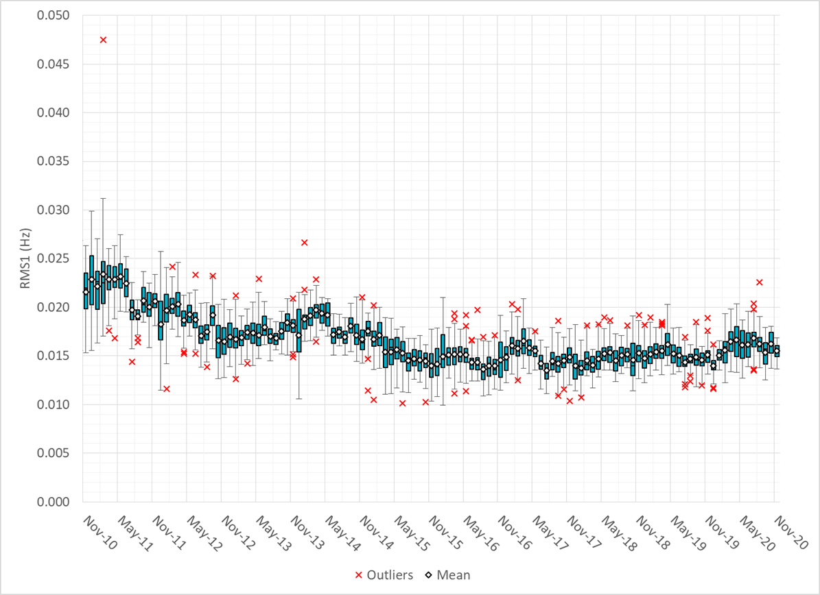
RMS1 Performance of ERCOT Frequency

Slide 9
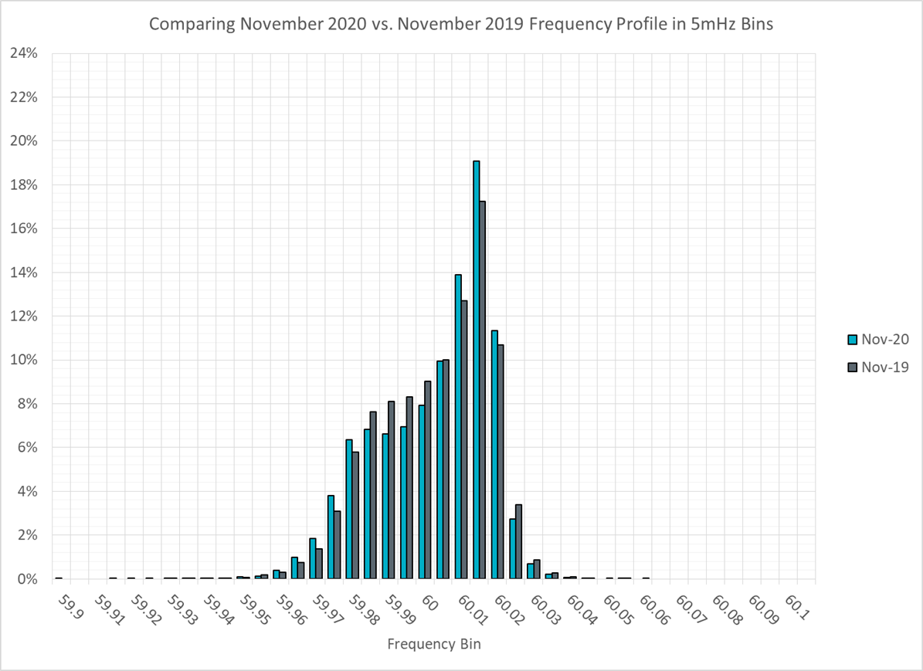
Frequency Profile Analysis

Slide 10
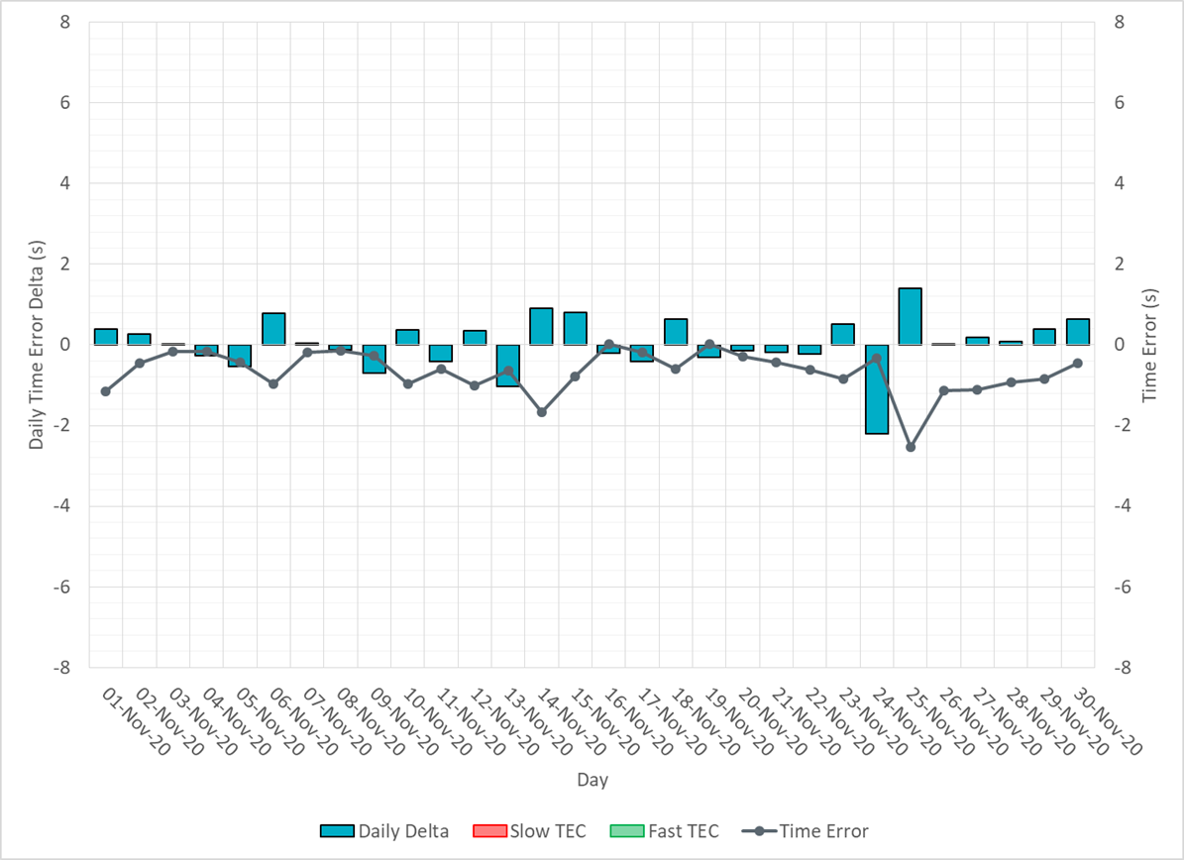
Time Error Corrections

Slide 11
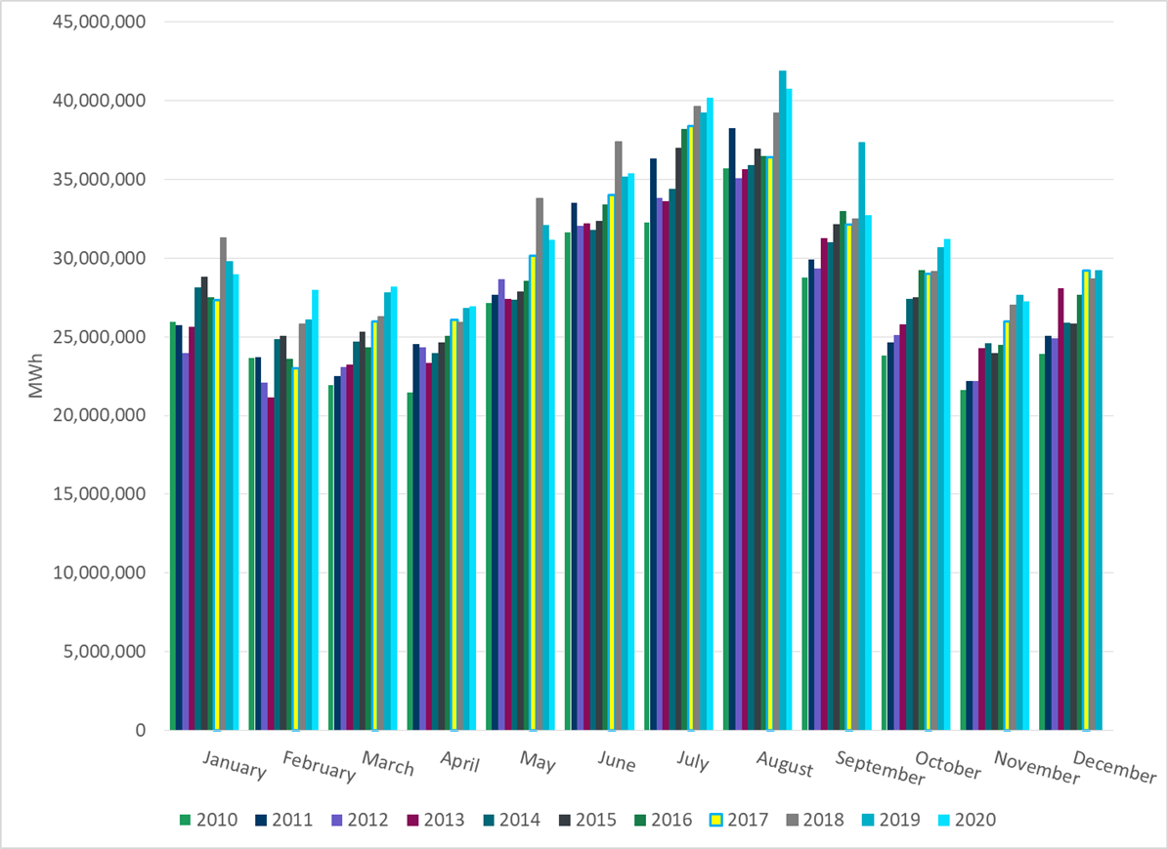
ERCOT Total Energy
Notes:
31,210,036 MWh

Slide 12
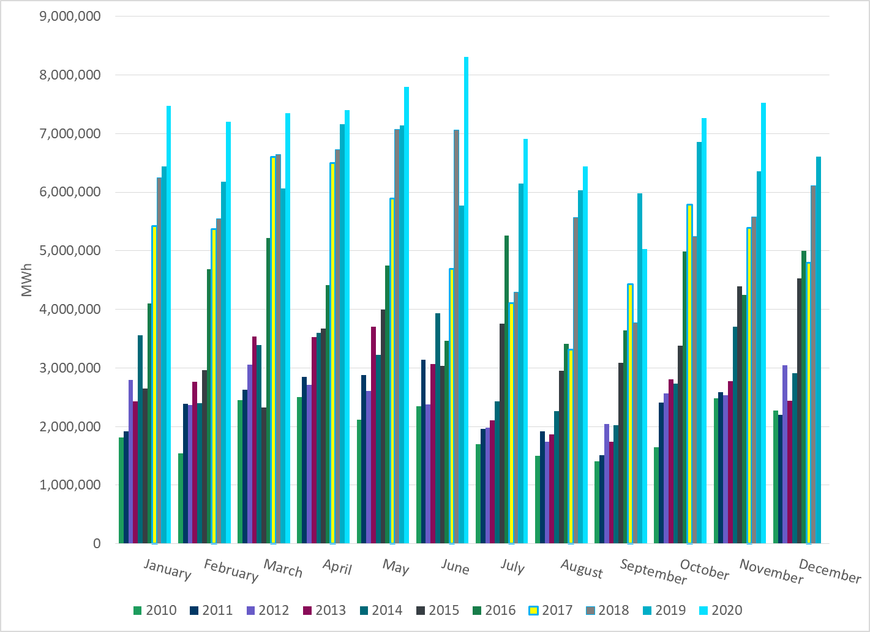
ERCOT Total Energy from Wind Generation
Notes:
7,264,919 MWh

Slide 13
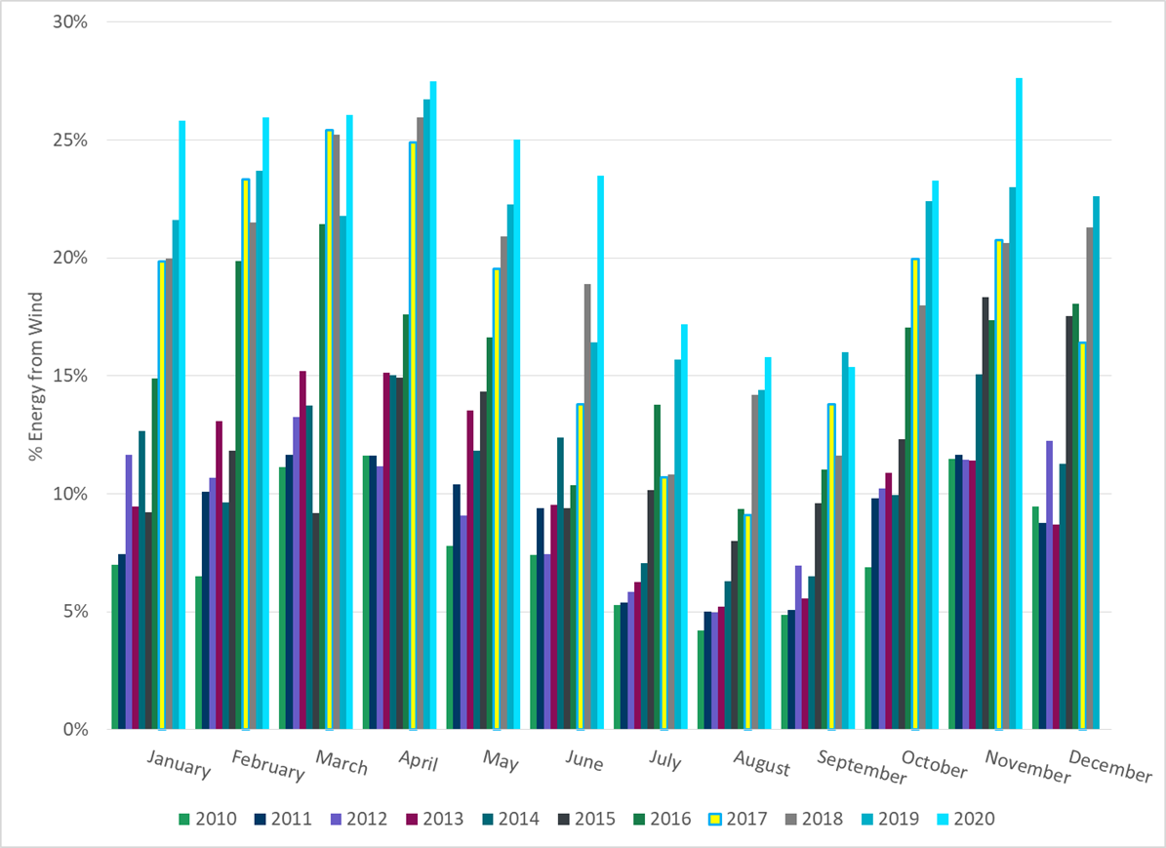
ERCOT % Energy from Wind Generation
Notes:
23.28%

Slide 14
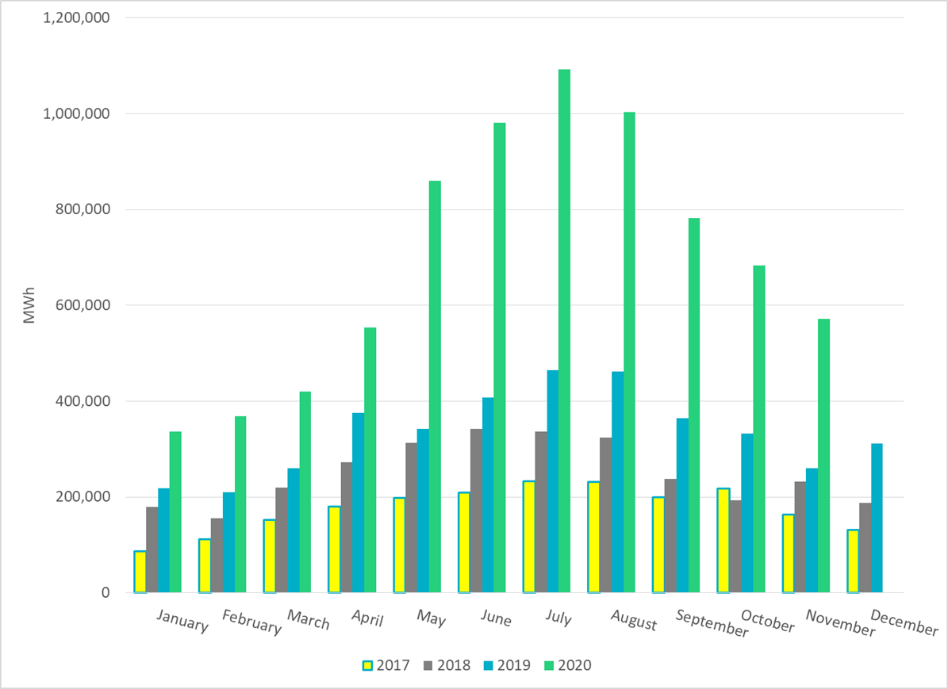
ERCOT Total Energy from Solar Generation
Notes:
682,932 MWh

Slide 15
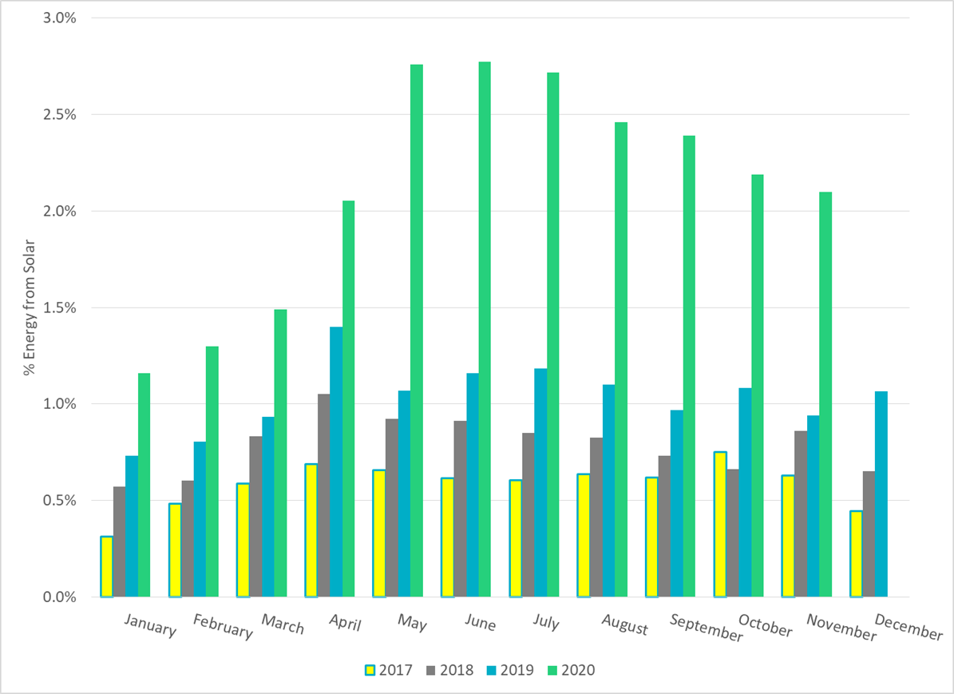
ERCOT % Energy from Solar Generation
Notes:
2.19%

Slide 16
Questions?

