Slide 1
Regions for Solar Capacity Contribution
Connor Anderson
Resource Adequacy
12/18/2020

Slide 2
Background and Objective
Since the approval of NPRR959 in November 2019, ERCOT has calculated the capacity contribution of wind using three regions: Coastal, Panhandle, and Other
With the continued growth of solar and more geographic diversity in installations, ERCOT and stakeholders are increasingly interested in exploring solar regions
ERCOT Operations plans to implement a separate set of solar regions for forecasting purposes (http://www.ercot.com/content/wcm/key_documents_lists/165182/05.__Defining_Solar_Rregions_in_ERCOT_20190404.pptx)
Purpose of today’s discussion is to give an overview of our initial plans for analysis and to ask for feedback

Slide 3
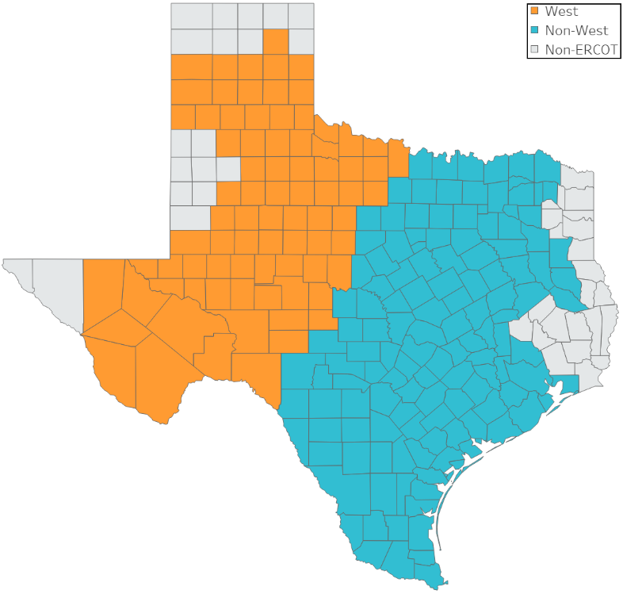
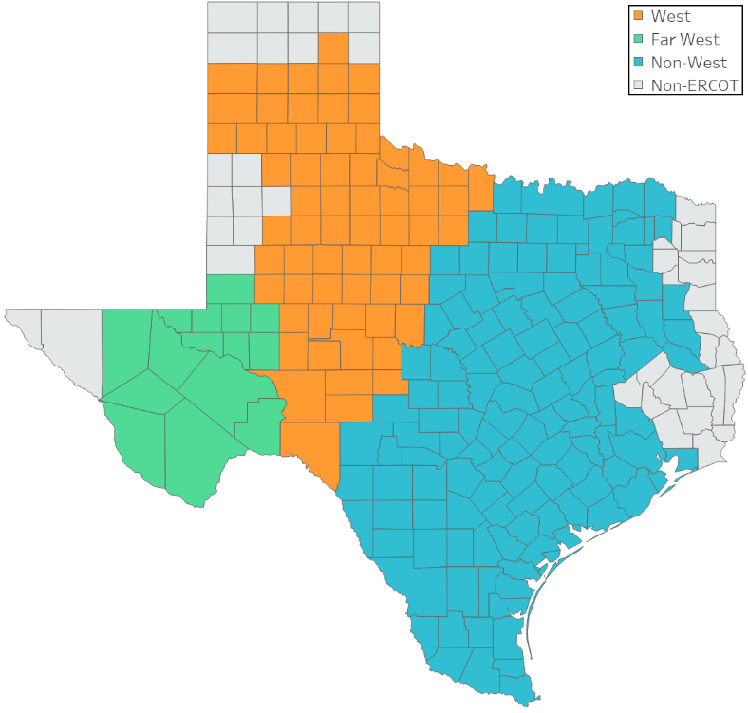
Proposed Options for Regions
Option 1: Two regions
Option 2: Three regions
Region definitions based on CDR zones except for Option 2 Far West region
“Non-West” is every CDR zone except for West and Panhandle
“West” is West and Panhandle CDR zones
Far West in Option 2 is a subset of the West CDR zone

Slide 4
Information and Analysis for Future Discussion
For each region:
Current units and installed capacity
Planned capacity over the next few years
Capacity contribution calculations
Effect of implementing the change on the 2021 summer reserve margin (using the December CDR as a base)
Any comments or requests?

