Slide 1
2021 Long-Term Load Forecast
Calvin Opheim
Load Forecasting & Analysis
SAWG
December 18, 2020

Slide 2
Agenda
Data Used in Model Development
Growth Driver
Creating Weather Zone Load Forecasts
Creating the ERCOT System Load Forecast
ERCOT System Load Forecast

Slide 3
Agenda - continued
Rooftop PV Forecast
Forecast Adjustments
Assumptions and Challenges
Weather Zone Forecast Summary
Questions

Slide 4
Data Used in Model Development

Slide 5
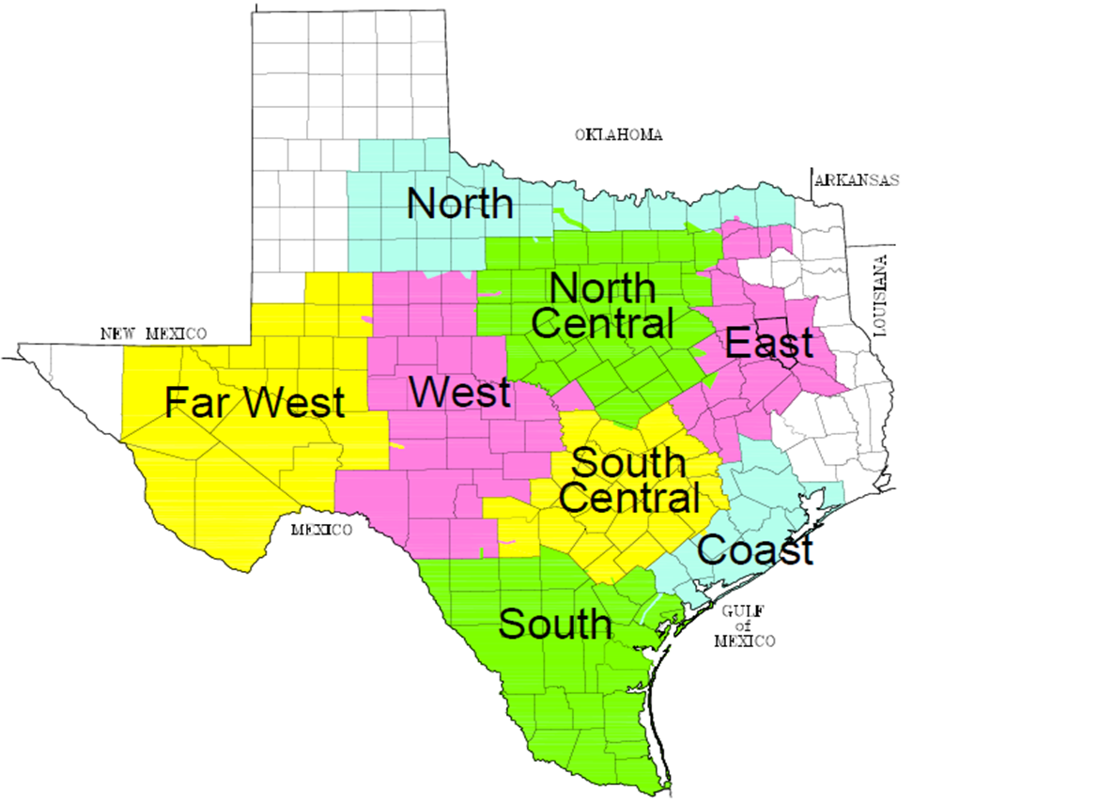
Weather Zones
2 or 3 Weather Stations in each Weather Zone

Slide 6
Load Models
Unique Model for
Each Weather Zone
Each Temperature Group
Hot
Medium
Cold

Slide 7
Input Data
Hourly Models
From January 2015 through August 2020
Recent Snapshot
Appliance Stock
Energy Efficiency
Demand Response
Price Responsive Load

Slide 8
Input Data
Weather
Temperature, Temperature Squared, and Temperature Cubed
Cooling Degree Days and Heating Degree Days
Cloud Cover
Wind Speed
Dew Point

Slide 9
Input Data
Calendar
Month
Day of the Week
Holidays
Hour
Interact Hour with Day of the Week

Slide 10
Input Data
Variable Interactions
Interact a Weather Variable with a Calendar Variable
Temperature with Hour
Dew Point with Hour
Interact multiple Weather Variables with a Calendar Variable
Temperature with Dew Point and Hour

Slide 11
Growth Driver

Slide 12
Premise Forecast
Unique Model for
Each Weather Zone
Each Premise Class
Residential
Commercial
Industrial
Monthly Models

Slide 13
Input Data
From January 2015 through August 2020
Economic Measures
Population
Non-Farm Employment
Housing Stock
Error Correction Term

Slide 14
Challenges
Premise Counts increased significantly via opt-in

Slide 15
Challenges
Premise Counts increased significantly via opt-in

Slide 16
Growth Driver for Far West and West
Economic Measures from Moody’s Base Scenario
Population
Non-Farm Employment
Housing Stock

Slide 17
Creating Weather Zone Load Forecasts

Slide 18
Example - Coast
Coast 2021 Gross Summer Peak Forecasts Based on Historical Weather Years
Year | Month | Day | Hour | Forecast (MW) | Rank
2021 | 8 | 14 | 17 | 21,157 | 1
2021 | 8 | 8 | 16 | 20,532 | 2
2021 | 8 | 8 | 17 | 20,431 | 3
2021 | 8 | 14 | 16 | 20,411 | 4
2021 | 8 | 13 | 17 | 20,401 | 5
Sort from high to low

Slide 19
Example - Coast
Coast 2021 Gross Summer Peak Forecasts Based on Historical Weather Years
Year | Month | Day | Hour | Forecast (MW) | Rank
2021 | 8 | 14 | 17 | 21,157 | 1
2021 | 8 | 8 | 16 | 20,532 | 2
2021 | 8 | 8 | 17 | 20,431 | 3
2021 | 8 | 14 | 16 | 20,411 | 4
2021 | 8 | 13 | 17 | 20,401 | 5
Sort from high to low
Rank | 2005 | 2006 | 2007 | 2008 | 2009 | 2010 | 2011 | 2012 | 2013 | 2014 | 2015 | 2016 | 2017 | 2018 | 2019
1 | 21,157 | 21,103 | 21,600 | 21,091 | 21,968 | 21,539 | 22,344 | 22,793 | 21,628 | 21,167 | 22,157 | 21,745 | 21,049 | 21,289 | 22,044
2 | 20,532 | 20,936 | 21,472 | 20,728 | 21,374 | 21,425 | 22,312 | 21,321 | 21,281 | 21,131 | 22,091 | 21,452 | 21,029 | 21,231 | 21,973
3 | 20,431 | 20,864 | 21,426 | 20,716 | 21,311 | 21,258 | 22,287 | 21,261 | 21,251 | 21,089 | 21,659 | 21,391 | 20,847 | 21,151 | 21,922
4 | 20,411 | 20,583 | 21,374 | 20,627 | 21,254 | 21,257 | 22,170 | 21,197 | 21,213 | 20,993 | 21,615 | 21,367 | 20,810 | 21,105 | 21,909
5 | 20,401 | 20,546 | 21,316 | 20,617 | 21,199 | 21,204 | 22,119 | 21,169 | 21,202 | 20,990 | 21,570 | 21,301 | 20,807 | 21,072 | 21,892

Slide 20
Example - Coast

Slide 21
Example - Coast
Coast 2021 Gross Summer Forecasts Based on Historical Weather Years
Rank | 2005 | 2006 | 2007 | 2008 | 2009 | 2010 | 2011 | 2012 | 2013 | 2014 | 2015 | 2016 | 2017 | 2018 | 2019 | Average
1 | 21,157 | 21,103 | 21,600 | 21,091 | 21,968 | 21,539 | 22,344 | 22,793 | 21,628 | 21,167 | 22,157 | 21,745 | 21,049 | 21,289 | 22,044 | 21,645
2 | 20,532 | 20,936 | 21,472 | 20,728 | 21,374 | 21,425 | 22,312 | 21,321 | 21,281 | 21,131 | 22,091 | 21,452 | 21,029 | 21,231 | 21,973 | 21,353
3 | 20,431 | 20,864 | 21,426 | 20,716 | 21,311 | 21,258 | 22,287 | 21,261 | 21,251 | 21,089 | 21,659 | 21,391 | 20,847 | 21,151 | 21,922 | 21,258
4 | 20,411 | 20,583 | 21,374 | 20,627 | 21,254 | 21,257 | 22,170 | 21,197 | 21,213 | 20,993 | 21,615 | 21,367 | 20,810 | 21,105 | 21,909 | 21,192
5 | 20,401 | 20,546 | 21,316 | 20,617 | 21,199 | 21,204 | 22,119 | 21,169 | 21,202 | 20,990 | 21,570 | 21,301 | 20,807 | 21,072 | 21,892 | 21,160

Slide 22
Example - Coast

Slide 23
Creating Weather Zone Load Forecasts
Summary
For every weather zone
For every forecasted year (2021-2030)
Forecasted values are ranked from high to low for each month
The average is calculated for each rank
This is the gross normal weather load forecast
Does not include impacts of the rooftop PV forecast

Slide 24
Creating the ERCOT System Load Forecast

Slide 25
Creating the ERCOT System Forecast - Example
For every weather zone, retrieve the actual load values from calendar year 2008
Sort the values from high to low
Historical Year | Month | Day | Hour | Rank | Coast Actual Load (MW)
2008 | 8 | 1 | 17 | 1 | 17,623
2008 | 8 | 1 | 16 | 2 | 17,478
2008 | 8 | 1 | 18 | 3 | 17,463
2008 | 8 | 8 | 17 | 4 | 17,222
2008 | 8 | 8 | 18 | 5 | 17,184
Sort from high to low
Coast 2008 Summer Actual Load

Slide 26
Creating the ERCOT System Forecast - Example
Assign the average forecast values by rank (from slide 22) to the same rank based on the actual load from 2008
Month | Day | Hour | Rank | Coast 2021 Gross Forecast (MW)
8 | 1 | 17 | 1 | 21,645
8 | 1 | 16 | 2 | 21,353
8 | 1 | 18 | 3 | 21,258
8 | 8 | 17 | 4 | 21,192
8 | 8 | 18 | 5 | 21,160
Coast 2021 Gross Forecast Based on 2008 Calendar

Slide 27
Creating the ERCOT System Forecast - Example
Month | Day | Hour | Rank | Coast 2021 Gross Forecast (MW)
8 | 1 | 17 | 1 | 21,645
8 | 1 | 16 | 2 | 21,353
8 | 1 | 18 | 3 | 21,258
8 | 8 | 17 | 4 | 21,192
8 | 8 | 18 | 5 | 21,160
Forecast Year | Month | Day | Hour | Coast | East | Fwest | Ncent | North | Scent | South | West
2021 | 8 | 4 | 17 | 20,880 | 2,726 | 4,850 | 26,055 | 1,898 | 12,957 | 5,808 | 2,069
2021 | 8 | 1 | 17 | 21,645 | 2,811 | 4,818 | 25,263 | 1,850 | 12,202 | 5,756 | 1,896
2021 | 8 | 4 | 18 | 20,628 | 2,751 | 4,835 | 25,630 | 1,867 | 12,688 | 5,698 | 2,003
2021 | 8 | 4 | 16 | 20,792 | 2,742 | 4,804 | 25,568 | 1,860 | 12,527 | 5,773 | 1,998
2021 | 8 | 7 | 17 | 21,064 | 2,734 | 4,736 | 25,151 | 1,800 | 12,407 | 5,938 | 1,944

Slide 28
Creating the ERCOT System Forecast - Example
Month | Day | Hour | Rank | Coast 2021 Gross Forecast (MW)
8 | 1 | 17 | 1 | 21,645
8 | 1 | 16 | 2 | 21,353
8 | 1 | 18 | 3 | 21,258
8 | 8 | 17 | 4 | 21,192
8 | 8 | 18 | 5 | 21,160
ERCOT Gross Forecast (MW) Based on 2008 Calendar
Forecast Year | Month | Day | Hour | Coast | East | Fwest | Ncent | North | Scent | South | West | ERCOT
2021 | 8 | 4 | 17 | 20,880 | 2,726 | 4,850 | 26,055 | 1,898 | 12,957 | 5,808 | 2,069 | 77,244
2021 | 8 | 1 | 17 | 21,645 | 2,811 | 4,818 | 25,263 | 1,850 | 12,202 | 5,756 | 1,896 | 76,242
2021 | 8 | 4 | 18 | 20,628 | 2,751 | 4,835 | 25,630 | 1,867 | 12,688 | 5,698 | 2,003 | 76,101
2021 | 8 | 4 | 16 | 20,792 | 2,742 | 4,804 | 25,568 | 1,860 | 12,527 | 5,773 | 1,998 | 76,066
2021 | 8 | 7 | 17 | 21,064 | 2,734 | 4,736 | 25,151 | 1,800 | 12,407 | 5,938 | 1,944 | 75,772

Slide 29
ERCOT Forecast
Summary
Forecasts for each Weather Zone are mapped into a Historical Calendar by Rank
2008 Historical Calendar was selected
Evaluated 2007 through 2018
2008 had the least amount of diversity between Weather Zone peaks and ERCOT peak

Slide 30
Historical Coincident Factors Scenario Forecasts

Slide 31
ERCOT System Load Forecast

Slide 32
ERCOT Gross Summer Peak Demand Forecast

Slide 33
ERCOT Gross Summer Peak Forecast

Slide 34
ERCOT Annual Energy Forecast

Slide 35
ERCOT Annual Energy Forecast
December forecasted

Slide 36
Rooftop PV Forecast

Slide 37
Rooftop PV Forecast
This is the first year that a rooftop PV forecast was created
A forecast was created for residential ESIIDs using the load profile assignment for each weather zone
Total installed capacity was approximately 700 MW as of August, 2020
Forecast is for the total installed capacity to increase to approximately 2,100 MW by August, 2030
The assumed capacity factor at the time of the summer peak is 46%
The gross forecast minus the rooftop PV forecast results in the net forecast

Slide 38
Rooftop PV Forecast - Approach

Slide 39
Rooftop PV Forecast - Approach

Slide 40
Rooftop PV Forecast - Approach
Data from ERCOT’s monthly peak day in July (7/13/2020) and August (8/14/2020) was used
Calculate the total hourly demands for residential ESIIDs with PV
Calculate the total hourly demands for residential ESIIDs without PV
Divide the total hour demand values by the number of ESIIDs (result is an average use per ESIID with and without PV)
Divide the average use per ESIID with PV by the average use per ESIID without PV for each hour (call this the PV hourly factors)
Multiply the PV hourly factors by the forecasted number of PV Premises

Slide 41
Rooftop PV Forecast - Approach
Use the PV hourly factor for hour 17 to create the PV Summer Peak forecast
Subtract out the current contribution of PV (as of August, 2020)
Assume no PV output at the time of the winter peak which is typically 8 a.m.
Assume the same PV hourly factor for residential and business ESIIDs
This is a work in progress. More analysis will be performed in 2021.

Slide 42
Rooftop PV Forecast

Slide 43
Observations
Residential ESIIDs with PV have greater average usage per hour than ESIIDs without PV during the early morning and evening hours
Some studies suggest that customers with PV tend to use more energy
To compensate for this, should the shapes be unitized?

Slide 44
Forecast Adjustments

Slide 45
Load Forecast Adjustments
Lubbock added to North Forecast from 2021 on
Based on Lubbock’s Peak Forecast of its growth
“Fiber Services in Lubbock, TX.” About NTS, NTS Communications, Inc., 2018, www.ntscom.com/aboutnts/primary-locations/lubbock-tx.

Slide 46
Load Forecast Adjustments
Rayburn added to East Forecast from 2021 on
Based on Rayburn’s Actual Seasonal Peaks in 2019
“RCEC.” PROJECTS>OFFICE>RCEC, Alliance Architects, 2019, www.alliancearch.com/projects/office/rcec/.

Slide 47
Load Forecast Adjustments
Adjustments added for Large Industrial Facilities
Coast
425 – 650 MW phased in over time
South
75 – 930 MW phased in over time
South Central
24 – 480 MW phased in over time

Slide 48
Assumptions and Challenges

Slide 49
Assumptions
Inherent Levels from the Input Data of
Appliance Stock and Energy Efficiency
Demand Response
4 CP Impact
Behind-the-Meter DG (non rooftop solar)
Price Responsive Load
Electric Vehicles (significant impact on future forecasts)

Slide 50
Challenges
Weather Volatility
Economic Uncertainty
Policy Impacts

Slide 51
Weather Zone Forecast Summary

Slide 52
Coast Gross Summer NCP Forecasts

Slide 53
East Gross Summer NCP Forecasts

Slide 54
Far West Gross Summer NCP Forecasts

Slide 55
North Gross Summer NCP Forecasts
Lubbock added 2021

Slide 56
North Central Gross Summer NCP Forecasts

Slide 57
South Gross Summer NCP Forecasts

Slide 58
South Central Gross Summer NCP Forecasts

Slide 59
West Gross Summer NCP Forecasts

Slide 60
Coast Gross Summer NCP Forecast

Slide 61
East Gross Summer NCP Forecast

Slide 62
Far West Gross Summer NCP Forecast

Slide 63
North Gross Summer NCP Forecast

Slide 64
North Central Gross Summer NCP Forecast

Slide 65
South Central Gross Summer NCP Forecast

Slide 66
South Gross Summer NCP Forecast

Slide 67
West Gross Summer NCP Forecast

Slide 68
Questions?

