Slide 1
Chronic Congestion Verification
Joel Koepke
12/15/2020

Slide 2
Chronic Congestion – Nodal Protocols 3.20
3.20 - Identification of Chronic Congestion
A constraint that has been active or binding on three or more Operating Days within a rolling 30-day period shall be considered to be experiencing chronic congestion.
3.20.1 – Evaluation of Chronic Congestion
(1) …shall provide the results of its evaluation to TAC
3.20.2 – Topology and Model Verification
(1) …ERCOT shall discuss and validate with the appropriate TSP and RE that the data from the Network Operations Model and Updated Network Model are correct, including the Ratings of the Transmission Facility causing an active or binding transmission constraint. When analysis differs between ERCOT and a TSP or Resource Entity, ERCOT shall verify the configuration of the ERCOT Transmission Grid matches that of the model in use by the TSP or Resource Entity.

Slide 3
Initial Email - Verification Request
Verification emails sent to majority of TSPs on 12/7/2020
Verification instructions:
Review and verify your company’s ratings, impedances, and nearby topology for each piece of equipment listed in the attached spreadsheet. Other entities providing ratings for this equipment have been asked to perform the same analysis.
Verification can be done through the MAGE application, or
Verification can be done using the reports located in the PTC_POSTINGS folder.
Example attachment:

Slide 4
Initial Email - Verification Request
Response instructions:
If no changes are needed please reply to this email stating that no changes are required.
If changes are needed please:
Create and submit a NOMCR resolving the found inconsistencies. Please use the subject “Chronic Congestion Update” and only include changes related to this verification request.
Reply to this email and provide the above NOMCR number and the equipment updated.

Slide 5
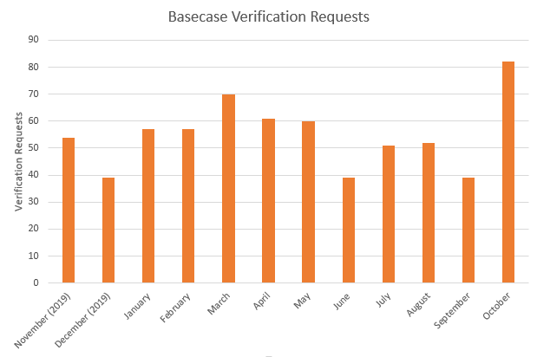
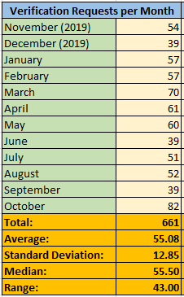
Back Casting Verifications – Previous Year
Analyzed previous year of data (Nov 2019 – Oct 2020)
Criteria: Active or Binding for 3 or more days in the month

Slide 6
Upcoming NPRR to 3.20
3.20 - Identification of Chronic Congestion
A constraint that has been active or binding on three or more Operating Days within a rolling 30-day period calendar month shall be considered to be experiencing chronic congestion.
Likely Changes:
(Probable) Changing the period from a rolling window to a calendar month
(Potential) Removing the “active” criteria
Active – The contingency/element pair is being sent to SCED from the State Estimator
Binding – The contingency/element pair contributed in the need for generation redispatch. Binding pairs are inherently active.
Active But Not Binding – The pair is sent to SCED but did not require redispatch to resolve. Can occur when pre-posturing the system for expected congestion (that may never occur).

