Slide 1
ERCOT Frequency Control Report
November 2020
ERCOT
Operations Planning
PDCWG | December 9th, 2020

Slide 2
Summary of November 2020
CPS1: 173.19%
Current CPS1 12-Month Rolling Average: 171.84%
1 BAAL Exceedance(s)
1 hourly CPS1 score below 100%
BAAL-003 Events have updated through 2019
2019 BAAL-003 FRM Performance: -811.14
2020 RMS1 Statistics
Mean: 16.02 mHz
Min: 12.25 mHz
Max: 22.6 mHz
Energy Statistics
Total Energy: 27,239,022 MWh
Wind Energy: 7,527,857 MWh
Percent Energy from Wind: 27.64%
Solar Energy: 572,015 MWh
Percent Energy from Solar: 2.10%
Minimum System Inertia
Mean: 160,502 MW*s
Max: 196,633 MW*s on Nov 21st
Min: 133,395 MW*s on Nov 8th
Notes:
2018 BAAL-003 FRM Performance: -843.17

Slide 3
Frequency Control
CPS1, BAAL, & RMS1

Slide 4
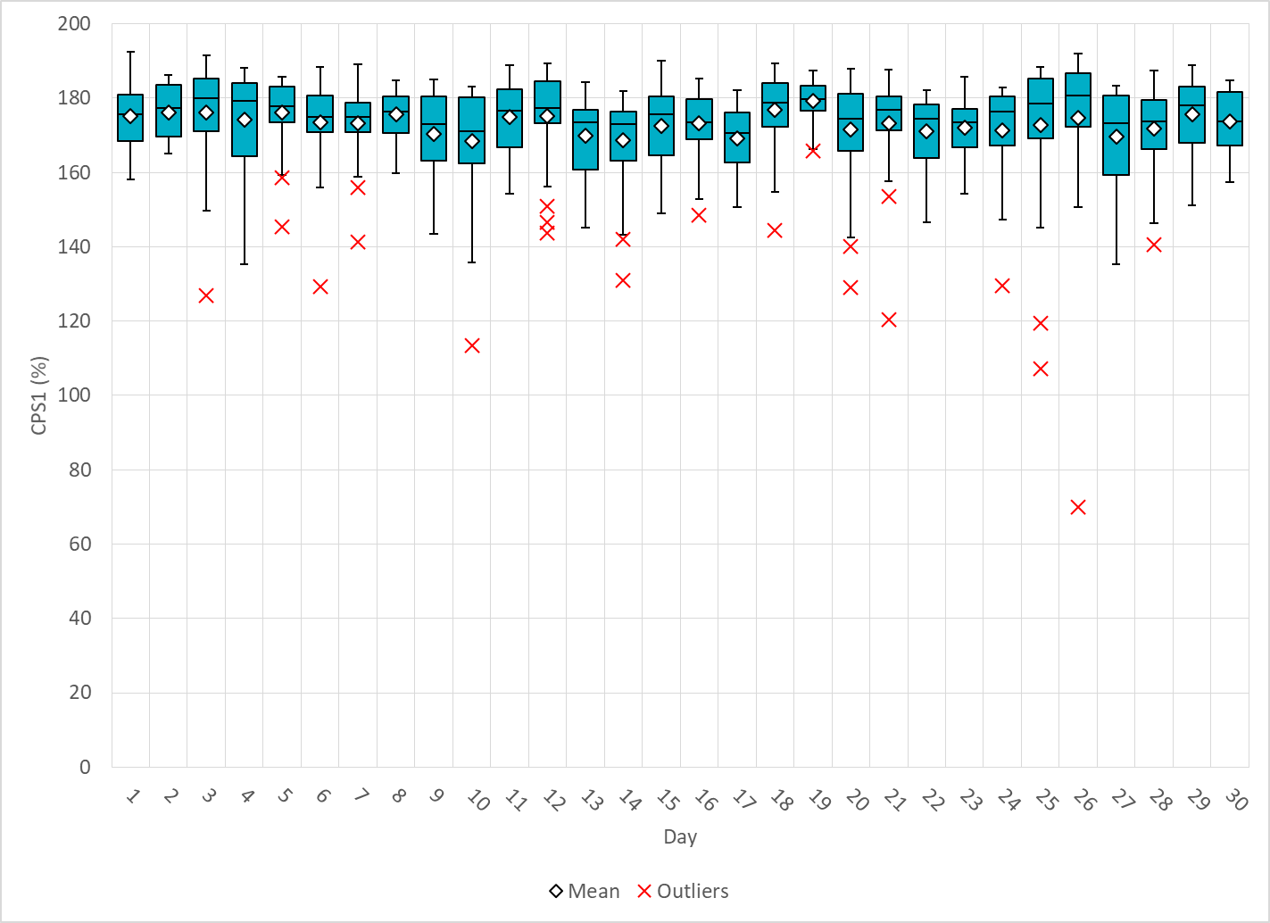
Hourly CPS1 by Day
Oct-20 CPS1 (%): 173.19
Notes:
Outliers:
70.07% @ 11/26/2020 16:00
Expected Generation Deviation of -2358.49 MW @ 16:52:40
At this time, ~-1600 was from wind and solar resources and ~-700 was from cogeneration, fossil, GTs, and steam resources. Two conventional resources were observed to have had significantly deviated from base point due to an earlier fire damaging start up transformer.
IRR Ramps
Both wind and solar were on a down ramp throughout the whole hour. Both wind and solar saw the greatest 5 minute down ramps between 16:40 and 16:55.
Largest wind ramp was about -215 MW/5 Min between 16:50 and 16:55. Largest solar ramp of about -225 MW/ 5 Min between 16:45 and 16:50.
Largest combined wind and solar ramp of about -428 MW/ 5 Min between 16:50 and 16:55.
Forecasts
PWRR was slightly under-forecasted throughout the hour and the most under-forecasted between 16:45 to 16:55.
Other
Manual offset of 300 MW was applied @ 16:44 due to observations of sharp fall of wind generation.

Slide 5
BAAL Exceedances & Violations
There was 1 BAAL exceedance(s) in Nov
Notes:
Occurred on 11/21/2020

Slide 6
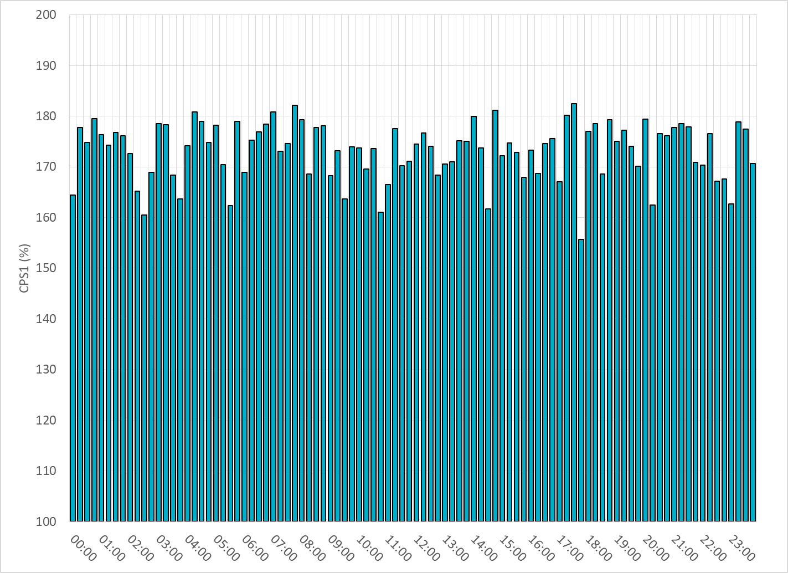
15-Minute Average CPS1%
Oct-20 CPS1 (%): 173.19

Slide 7
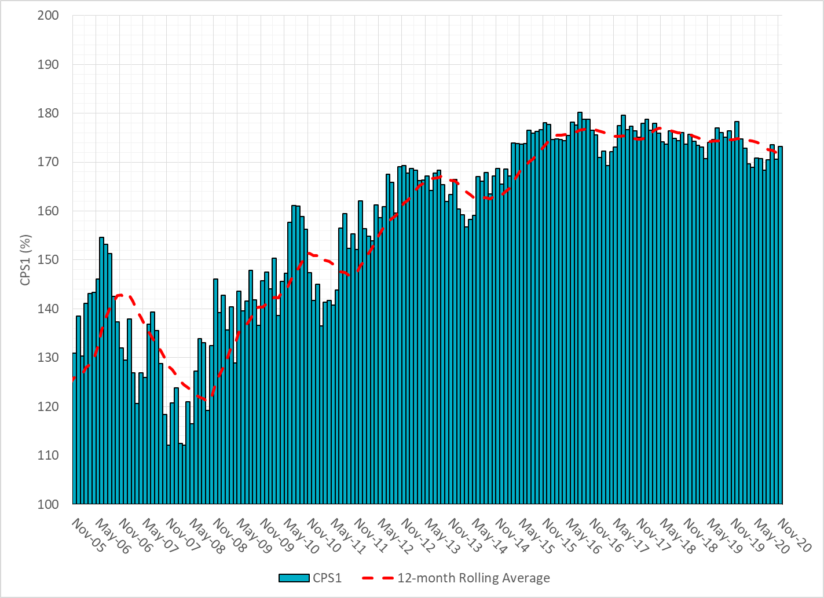
12-Month Rolling Average CPS1
Current 12-Month Rolling Average: 171.84%

Slide 8
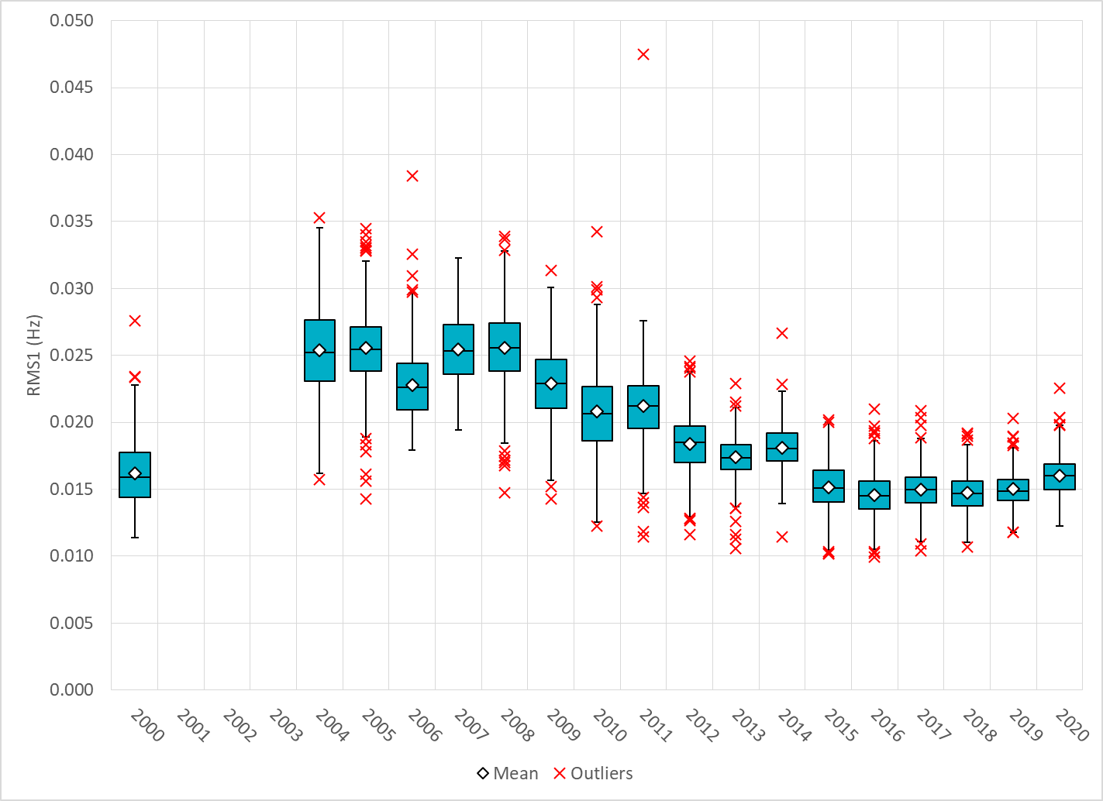
Daily RMS1 of ERCOT Frequency by Year
Notes:
Mean: 16.02 mHz
Min: 12.25 mHz
Max: 22.6 mHz

Slide 9
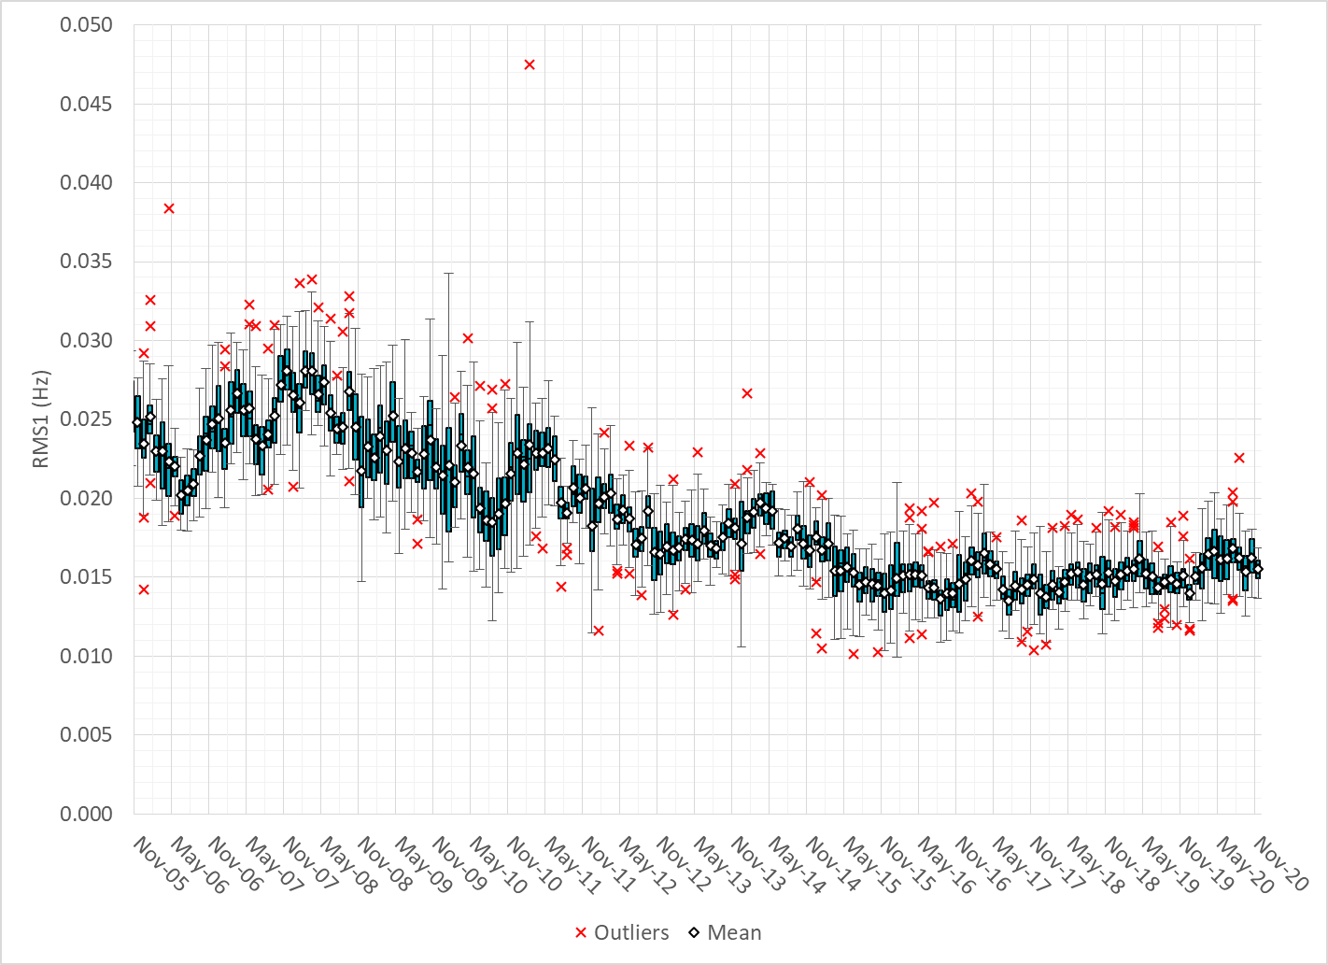
Daily RMS1 of ERCOT Frequency by Month

Slide 10
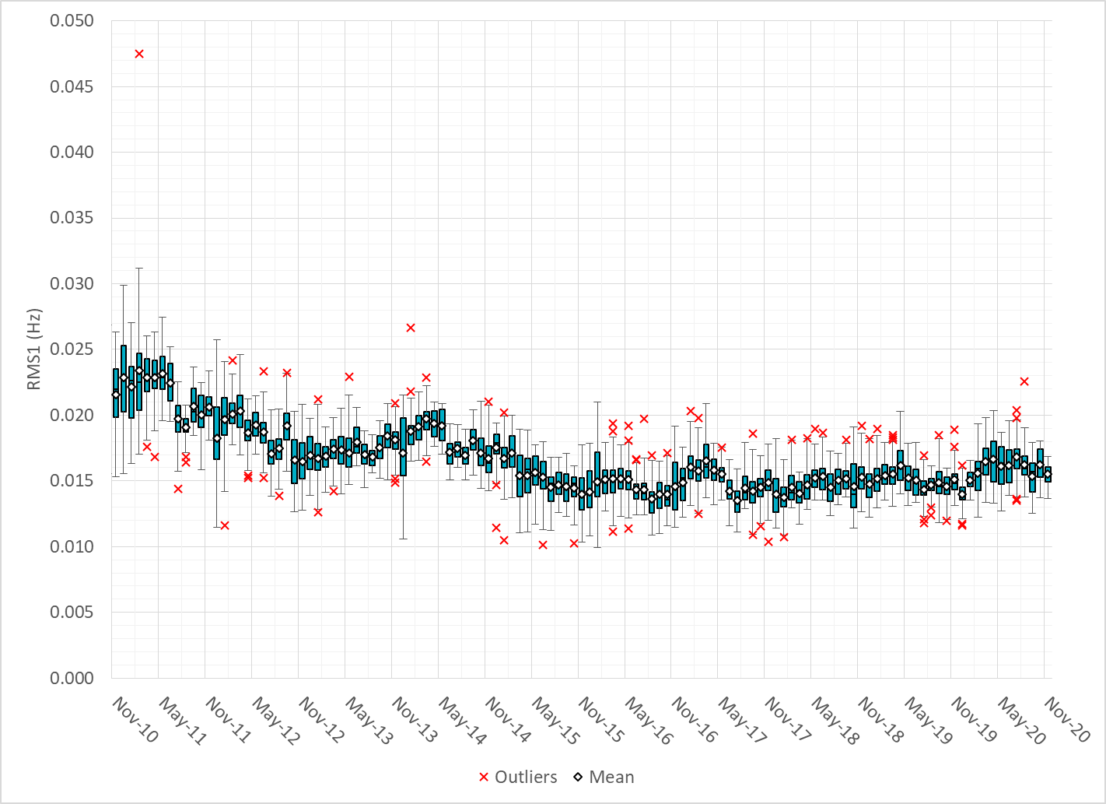
Daily RMS1 of ERCOT Frequency by Month

Slide 11
Frequency Profile Comparison

Slide 12
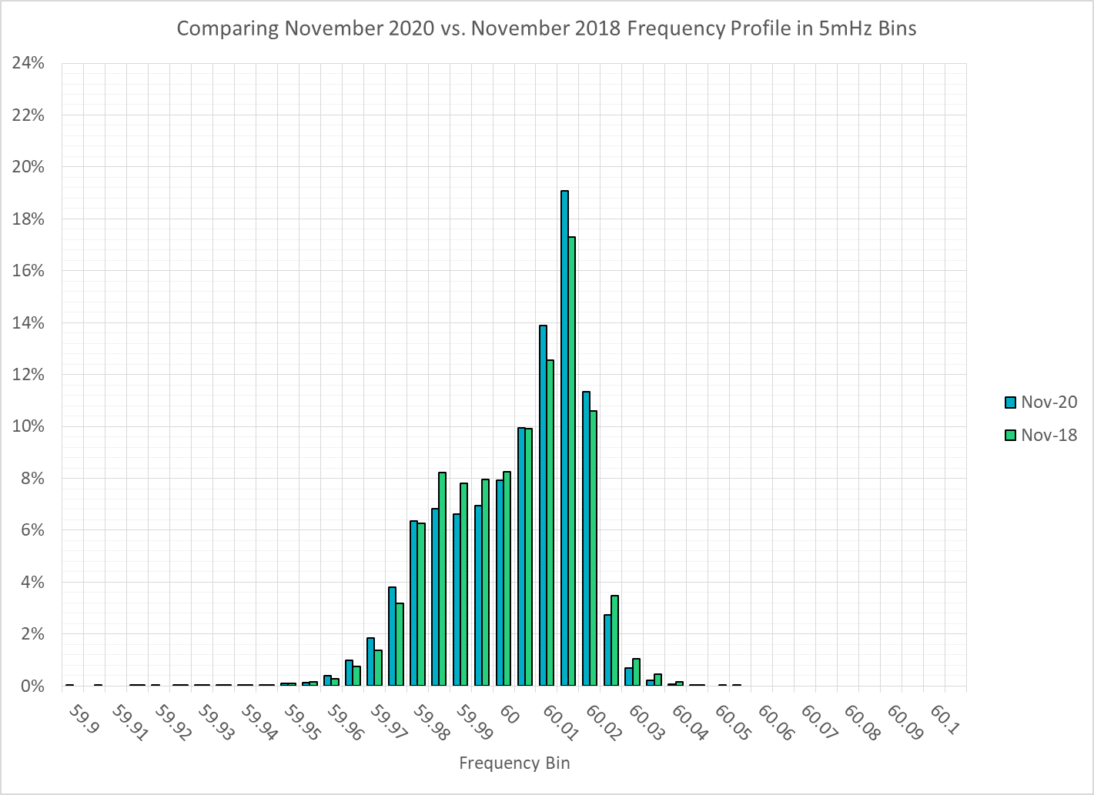
Frequency Profile Comparison

Slide 13
Frequency Profile Comparison

Slide 14
Time Error Correction

Slide 15
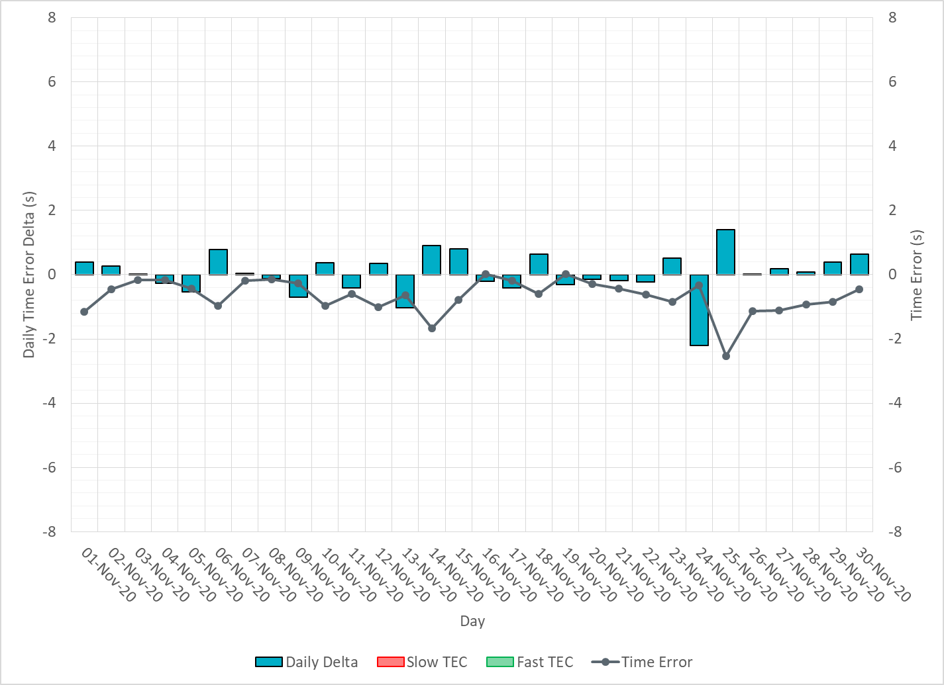
ERCOT Daily Time Error

Slide 16
Time Error Corrections Log Summary
There have been no time error corrections since December 2016

Slide 17
BAL-003 Performance

Slide 18
Op. Year 2019 BAL-003 Selected Events – Update
Notes:
BAL-003

Slide 19
Op. Year 2018 BAL-003 FRM Performance - Update
Notes:
OP2018: FRO = -381.0, FRM_median = -843.17, FRM_average = -959.7
OP2019: FRO = -381.0, FRM_median = -811.14, FRM_average = -892.5
OP2020: FRO = -425.0,

Slide 20
ERCOT Energy Statistics

Slide 21
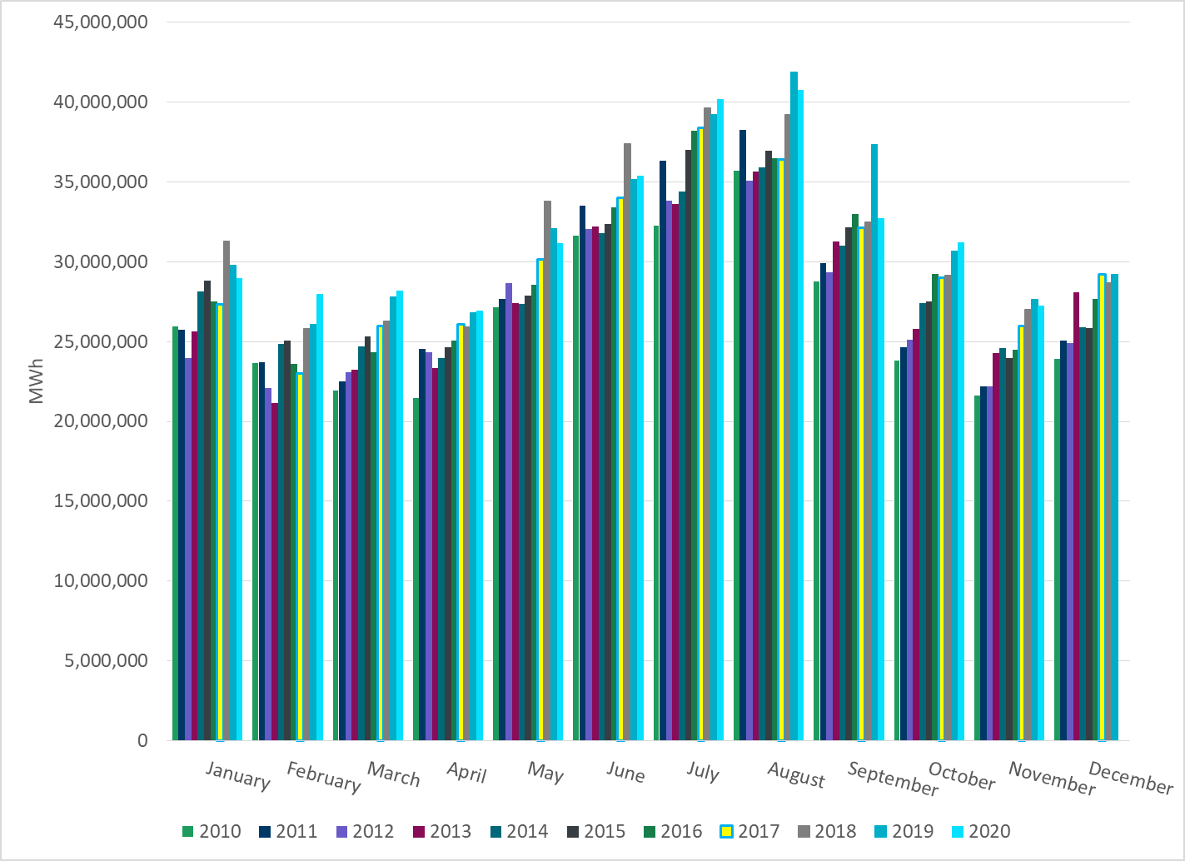
Total Energy
Notes:
31,210,036 MWh

Slide 22
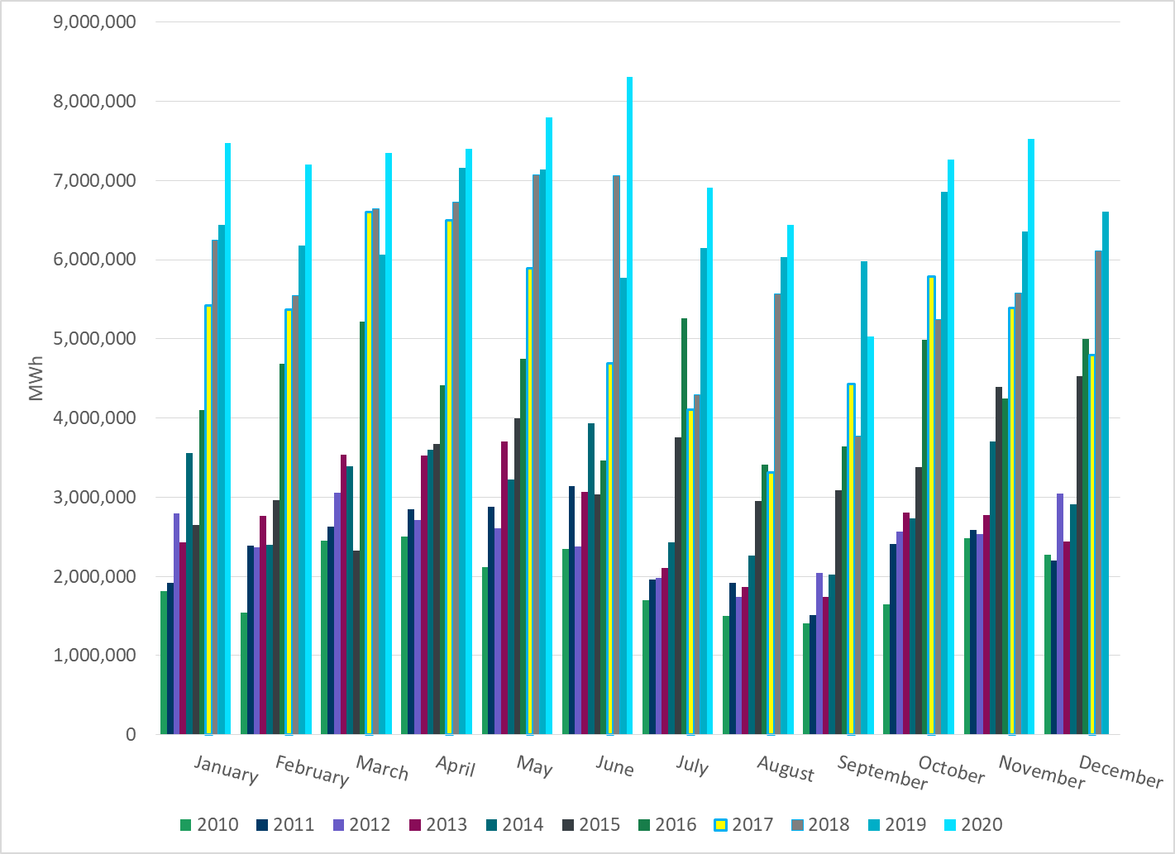
Total Energy from Wind Generation
Notes:
7,264,919 MWh

Slide 23
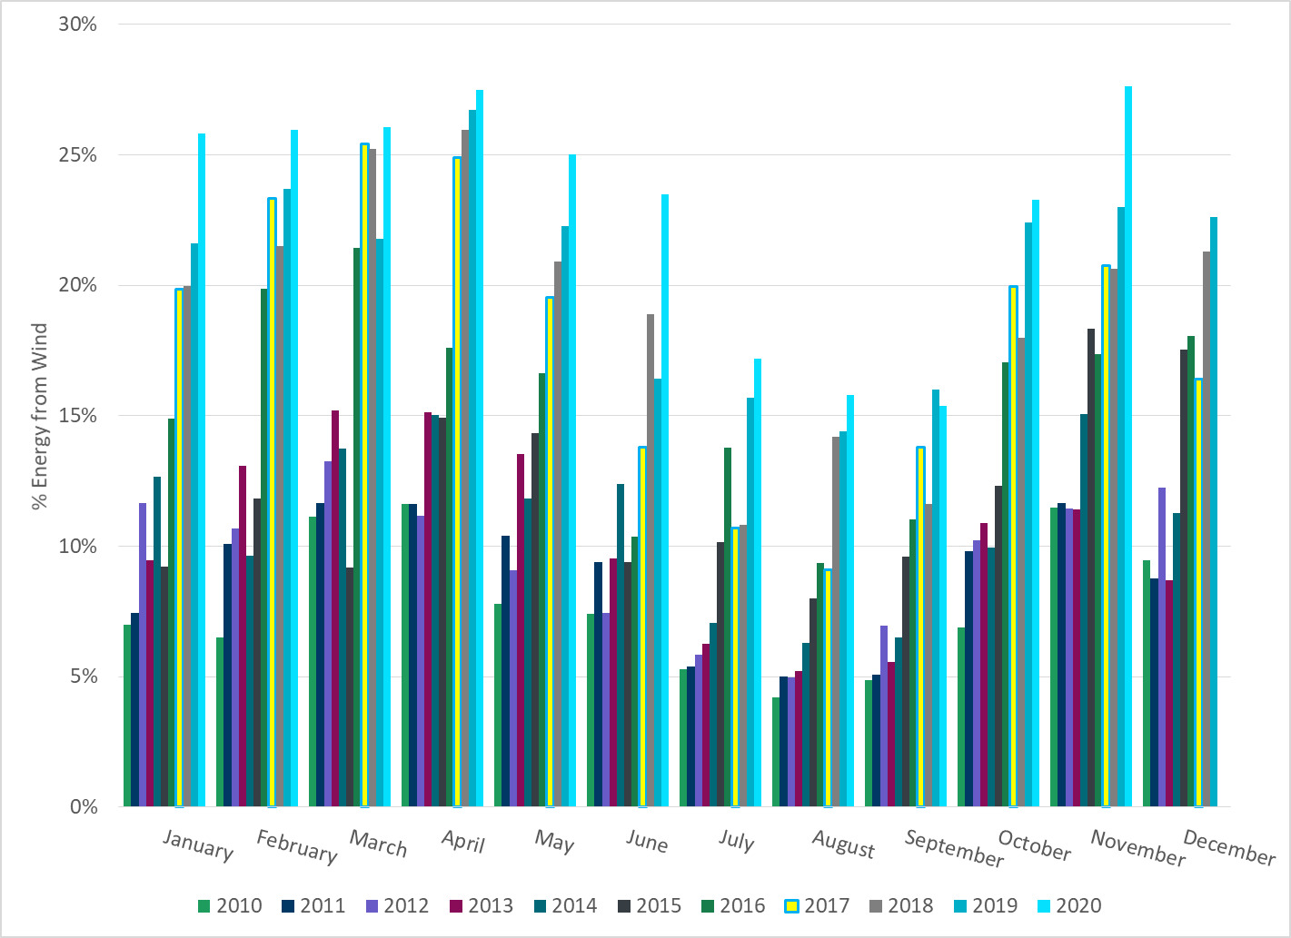
% Energy from Wind Generation
Notes:
23.28%

Slide 24
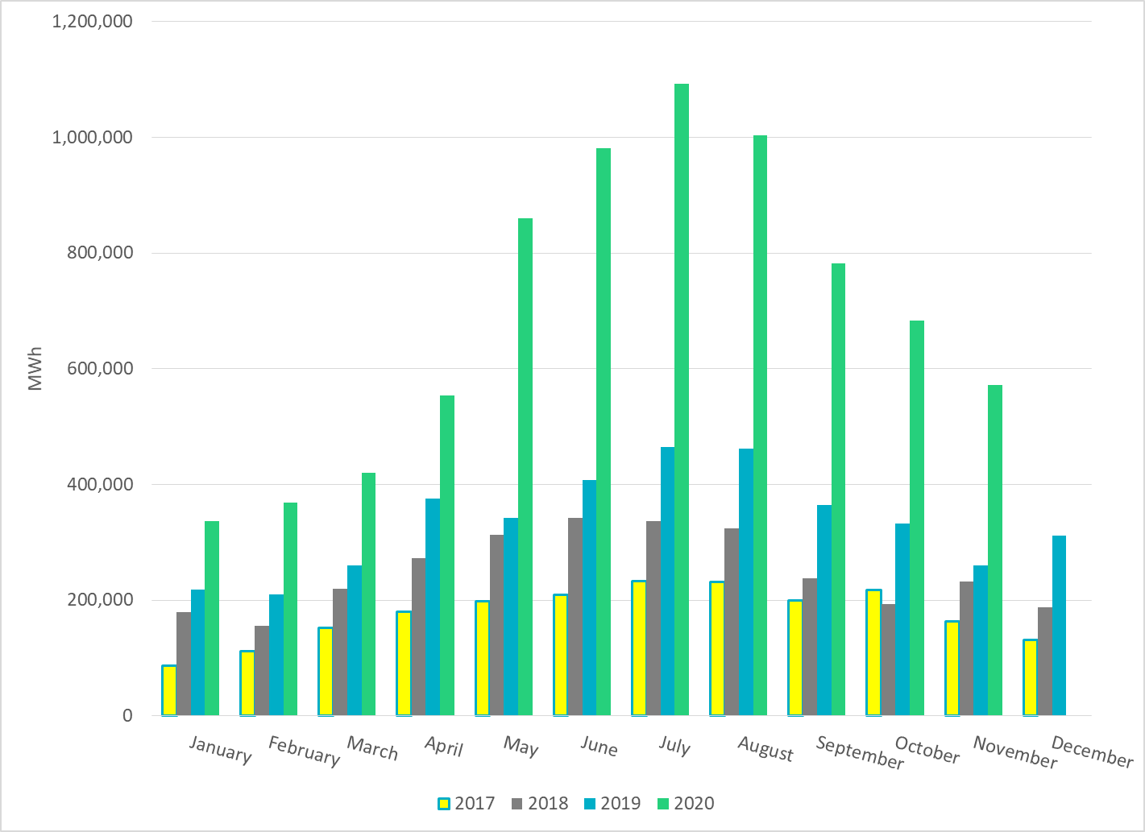
Total Energy From Solar Generation
Notes:
682,932 MWh

Slide 25
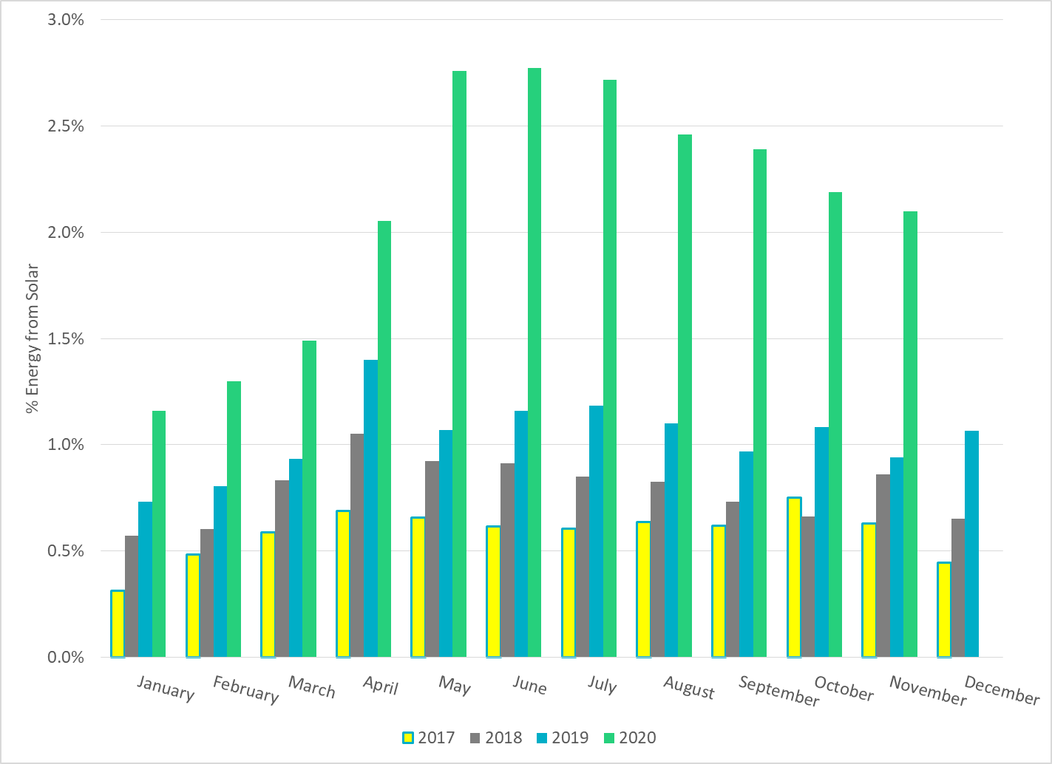
% Energy from Solar Generation
Notes:
2.19%

Slide 26
ERCOT System Inertia

Slide 27
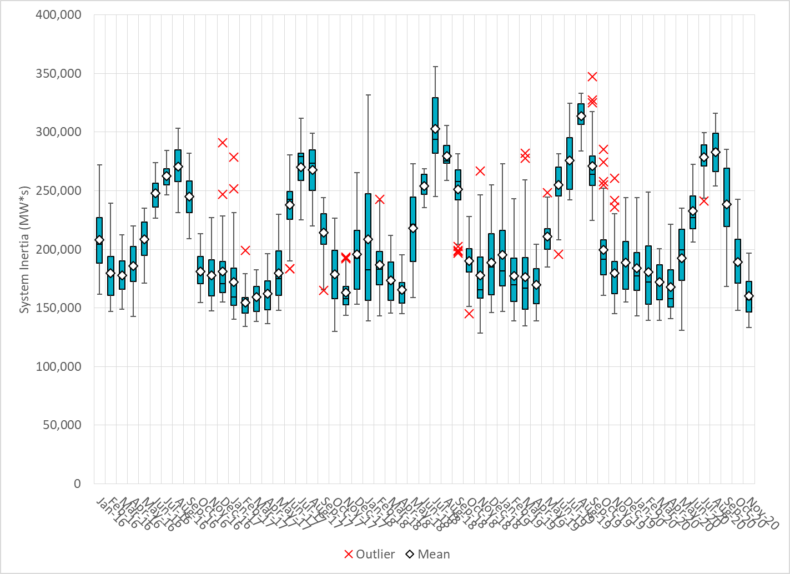
Daily Minimum System Inertia
Notes:
Minimum Inertia = 133,395 MW*s on 11/8/2020
Previous Minimum was 128,759 MW*s on 11/18/2018.
Data:
Mean: 160,502
Max: 196,633 on Nov 21st
Min: 133,395 on Nov 8th

Slide 28
Questions?
Thank you!

