Slide 1
NSA Constraints Reports
Chad Thompson, ERCOT
Sr. Manager, Operations Support & Engineering
CMWG Meeting
December 17 2020

Slide 2
Background
NPRR951 added MVA ratings and flows to the NSA Active and Inactive Constraints reports
The reports were updated during the system release on August 7
Market Notice M-A072820-1 NPRR, issued July 28
The new values reflect the desired ask in NPRR951, but there is some ambiguity these, and other, values, which could be cleaned up

Slide 3
Potential Issues
The SCED Rating in MW takes two things into account simultaneously
MVA -> MW data conversion
System Operator discount to the ratings being sent to SCED
What can’t be seen is how much of the enforced MW limit is due to each of these items individually.
The Percent Violation column doesn’t specify what value that column is calculating
The column headings in the report do not clearly communicate the data contained within those columns

Slide 4
MVA to MW Conversion Example
50 MVA Line limit with 30 MW of flow and 54 MVA of flow
Loading is 54 / 50 = 108% in RTCA
SCED Limit is 30 MW
Operator constraining to 90%
Actual SCED Limit enforced (and posted) is 27 MW
The report shows:
50 MVA limit
54 MVA flow
27 MW limit

Slide 5
Violation Percentage
The violation percentage in the report is based on RTCA loading in MVA, not the values being enforced in SCED.
While the RTCA overload percentage in MVA is valuable, so is knowing the percentage in MW, as that determines how violated the constraint is prior to SCED re-dispatching the system
Using the previous example:
54 MVA flow / 50 MVA limit = 108%
30 MW flow / 27 MW limit = 111%

Slide 6
Column Headings
Report Column Name | Data Element | Comments
SCEDRatingMW | RTCA -> SCED conversion of the MVA rating to a MW rating | This includes any discount factor applied by the System Operator
SCEDRatingMVA | RTCA rating in MVA | Added with NPRR951 For GTCs this is the VSAT / static table limit in MW
PostCTGFlowMW | RTCA -> SCED conversion of the MVA flow to a MW flow
PostCTGFlowMVA | RTCA flow in MVA | Added with NPRR951 For GTCs this is the flow in MW, and should be the same as PostCTGFlowMW
PercentViolation | PostCTGFlowMVA / SCEDRatingMVA | Percentage of loading as indicated in RTCA

Slide 7
Questions for Consideration
MVA to MW Conversion
Is there interest in posting just the MVA to MW conversion?
Is there value in posting the conversion and system operator discount separately?
Percent Violation Record
Is this value clear, or is a change needed?
Column Headings
Is there interest in making the column headers more descriptive?
Is there interest in a “User Guide?”

Slide 8
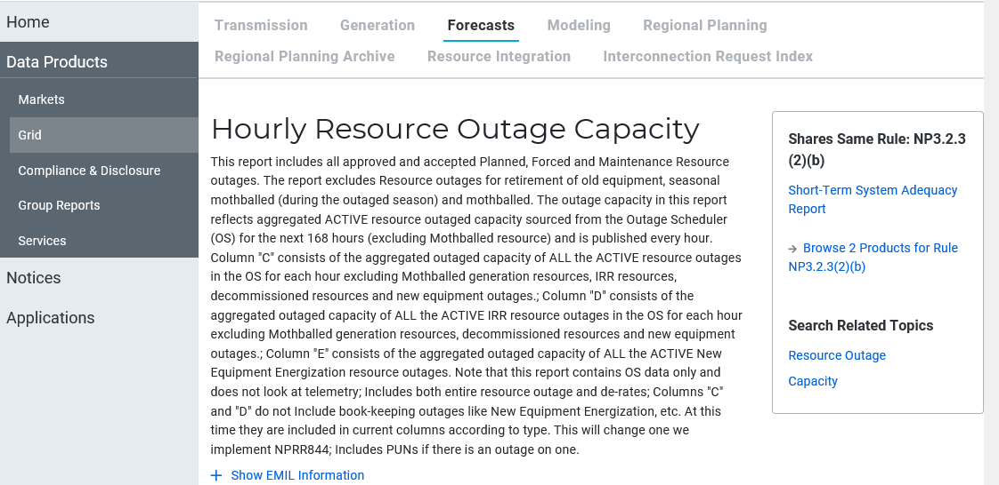
New MIS
https://mis.ercot.com/public

Slide 9
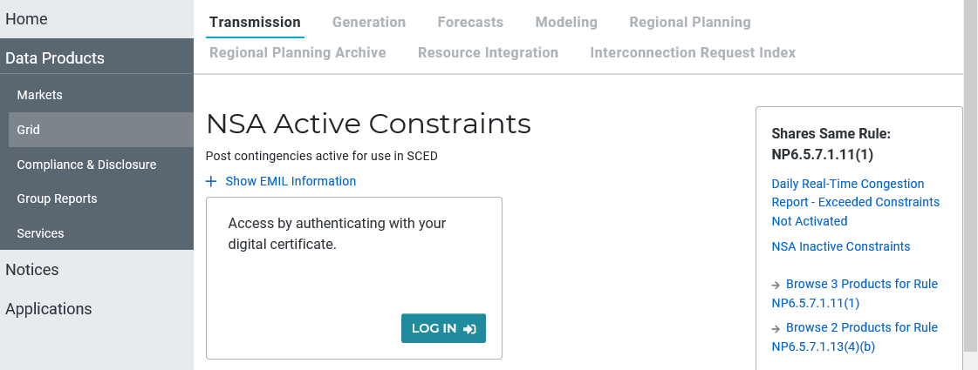
New MIS Public
https://mis.ercot.com/public

