Slide 1
Energy Storage Resource FME Performance while Carrying RRS
Operations Analysis
December 9, 2020

Slide 2
Introduction
There has been a notable increase of Energy Storage Resources that are interconnecting to ERCOT and also qualifying for RRS
In recent PDCWG meetings, there has been a growing interest pertaining to how these resources have been performing during FMEs
At the time of the analysis, there were 7 Energy Storage Resources that were qualified for RRS
Initial and Sustained per unit values were identified for the 7 resources while they were carrying RRS during each of the 2020 FMEs
5 resources had their expected PFR calculated using a 1% droop setting
Remaining 2 resources had their expected PFR calculated using a 1.01% and 1.02% droop setting
Telemetered HSL ranged from 7.5 MW to 9.9 MW (majority telemetered 9.9 MW)
Note: Not all resources were qualified for RRS to begin the year. This means that not all resources were capable of providing RRS during each of the FMEs

Slide 3
PUPFR vs PUSPFR for ESRs while Carrying RRS
Notes:
Looking at CTs and CCs that carried RRS during the 2020 FMEs:
Passed Both: 410 units (88%)
Failed Both: 31 units (7%)
Passed Initial, Failed Sustained: 9 (2%)
Failed Initial, Passed Sustained: 14 (3%)

Slide 4
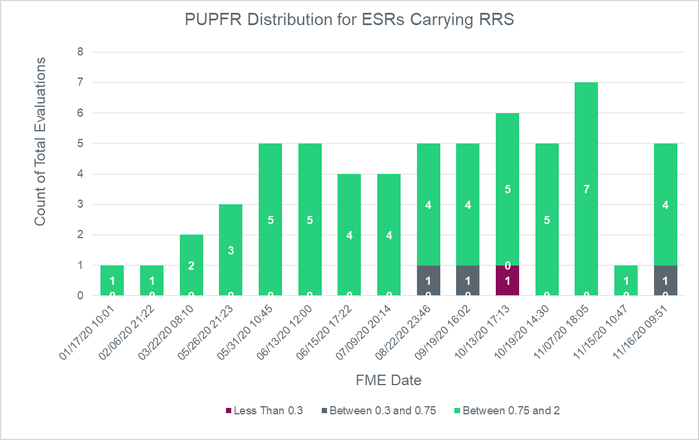
Distribution of Scores during the Initial Period

Slide 5
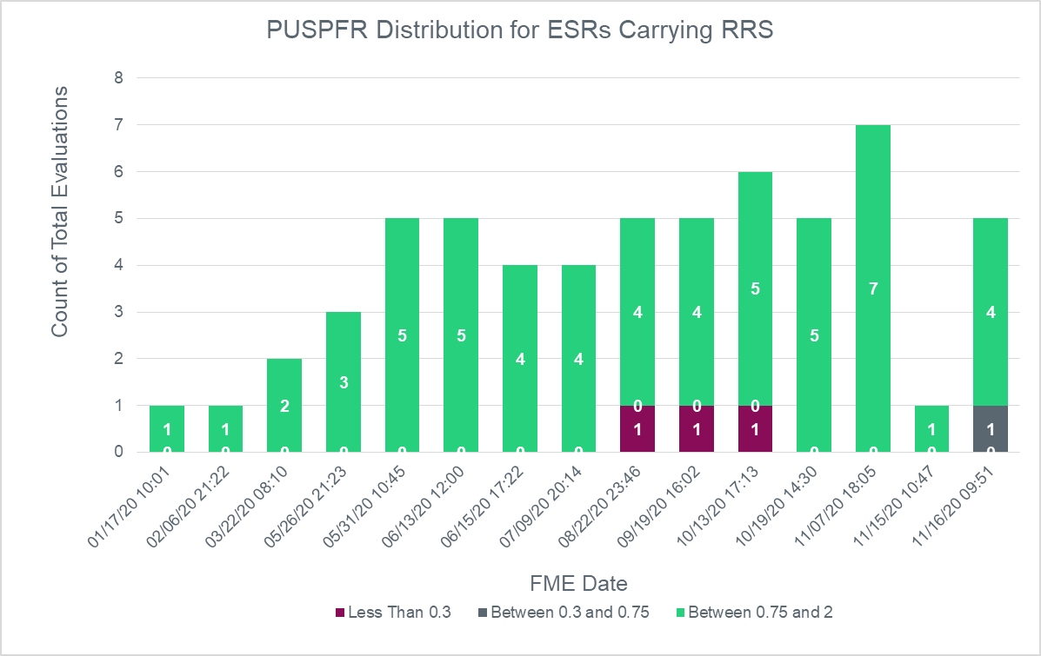
Distribution of Scores during the Sustained Period
Notes:
Only change is that the resources that scored between 0.3 and 0.75 during the initial period scored less than 0.3 during the sustained period (8/22 and 9/19 FMEs).

Slide 6
8/22/2020 23:46:53
PUPFR: 0.352, PUSPFR: 0.295
Reason for failure is still under investigation
Notes:
This performance was an outlier. In 12 other events, the resource has passed with only two other instances where the resource scored below a 1 for either the initial and sustained periods.

Slide 7
9/19/2020 16:02:03
PUPFR: 0.591, PUSPFR: 0.273
Resource performance was reduced due to ramp component
Ramp Magnitude:
+0.3 MW (initial), +0.42 MW (sustained)
Notes:
Resource was receiving a base point to charge

Slide 8
10/13/2020 17:13:40
PUPFR: 0.001, PUSPFR: 0.023
Control system was incorrectly implemented for instances when resource was carrying RRS
Notes:
Initial:
Sustained:
This resource has scored above 1.25 for both initial and sustained periods after communication with ERCOT to ensure they were responding as expected.

Slide 9
11/16/2020 09:51:37
PUPFR: 0.618, PUSPFR: 0.697
Performance is still under investigation

Slide 10
Questions?
Thank you!

