Slide 1
ERCOT Frequency Events
November 2020
ERCOT
Operations Planning
PDCWG | December 9th, 2020

Slide 2
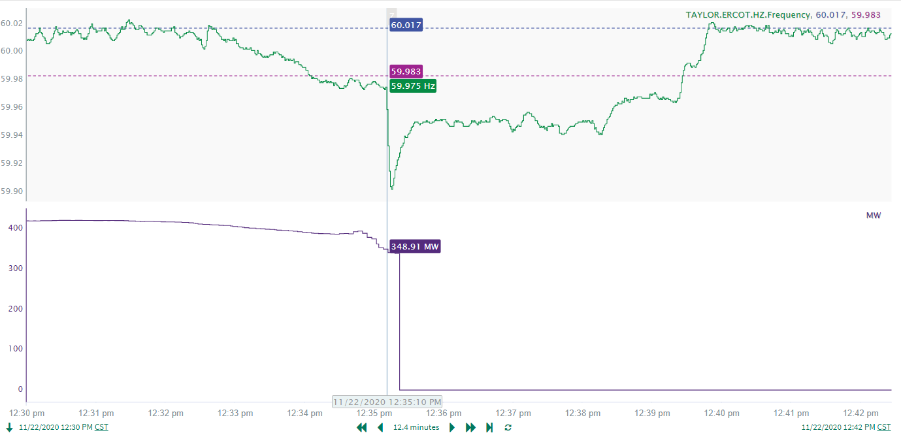
11/22/2020 12:35:10 (Non-FME)
Notes:
Resource experienced a run back while carrying around 393 MW. Loss of 349 MW when the resource completely tripped offline.
Starting Frequency: 59.9750 Hz
Minimum Frequency: 59.9020 Hz
A-C Time: 5 seconds
Recovery Time: 4 minutes and 15 seconds (90th percentile is 7 minutes and 12 seconds)
RRS Deployed: 506 MW
Trip Reason: Resource was forced out of service due to issues with turbine vibration.
Contextual Information: Regulation down was exhausted prior to the event and was being recalled prior to the event. No manual offset was applied.
No Selection Reason: Resource was experiencing a run back which caused frequency to drag and fall below the lower dead-band. The eventual loss of MW that led to the significant frequency decline was only 349 MW which is well below the 550 MW that is usually used as a selection criteria.

Slide 3
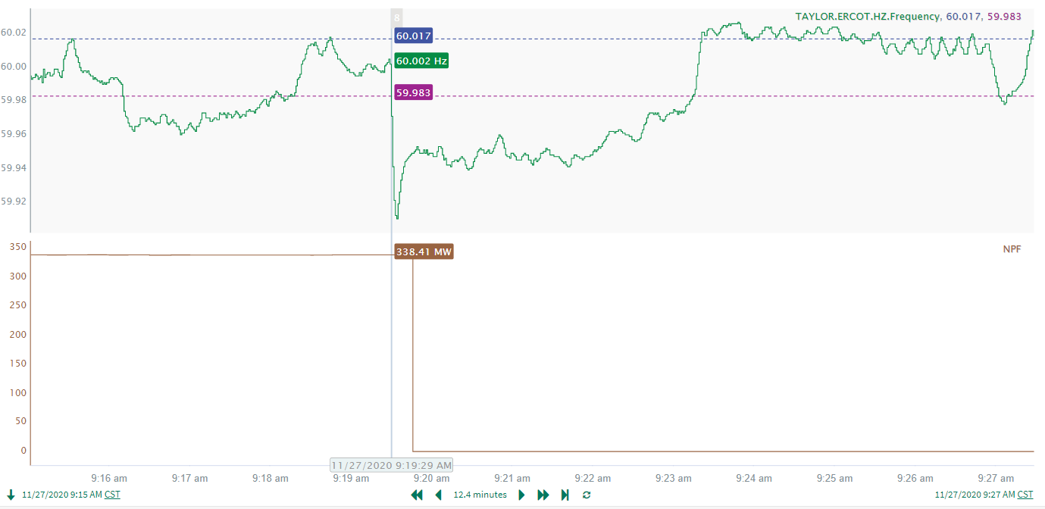
11/27/2020 09:19:29 (Non-FME)
Notes:
Resource tripped offline while carrying 338 MW
Starting Frequency: 60.0020 Hz
Maximum Frequency: 59.9100 Hz
A-C Time: 5 seconds
Recovery Time (back to deadband): 3 minutes and 49 seconds (90th percentile is 7 minutes and 12 seconds)
RRS Deployed: 0 MW
Trip Reason: No information available.
Contextual Information: Manual offset of 200 MW applied at 09:20:13. About a 100 MW increase in Solar near the end of the frequency event over a period of 1 minute. Regulation Up was being recalled at the time of the event and was at 134 MW at the start of the event.
No Selection Reason: Measured Loss of load was too low.

Slide 4
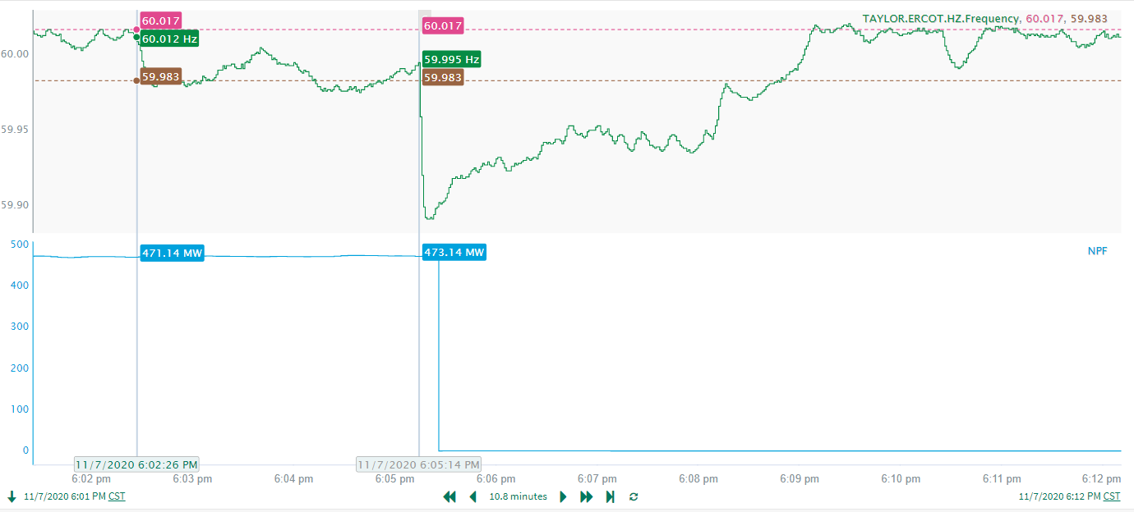
11/7/2020 18:05:14 (FME)
Notes:
Resource tripped offline while carrying 474 MW.
Starting Frequency: 59.9950 Hz
Maximum Frequency: 59.8910 Hz
A-C Time: 5 seconds
Recovery Time (back to deadband): 3 minutes and 40 seconds (90th percentile is 7 minutes and 12 seconds)
RRS Deployed: 596.38 MW
Trip Reason: Due to Lighting Arrestor Failure on Ring Bus causing Breaker Failure Tripping Breakers/Units. ( Transmission Lines out of BRAUNIG Tripped. )
Contextual Information: Manual Offset of 350 MW applied at 18:06:40.

Slide 5
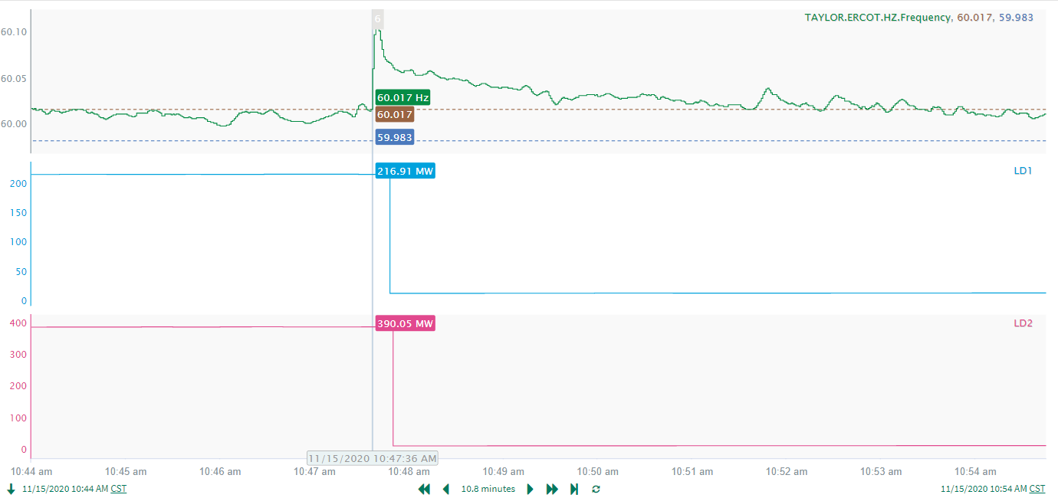
11/15/2020 10:47:36 (FME)
Notes:
Loss of load of 579 MW
Starting Frequency: 60.0170 Hz
Maximum Frequency: 60.1120 Hz
A-C Time: 3 seconds
Recovery Time (back to deadband): 3 minutes and 58 seconds (90th percentile is 7 minutes and 12 seconds)
RRS Deployed: 0 MW
Trip Reason: Industrial load lost due Motors tripping

Slide 6
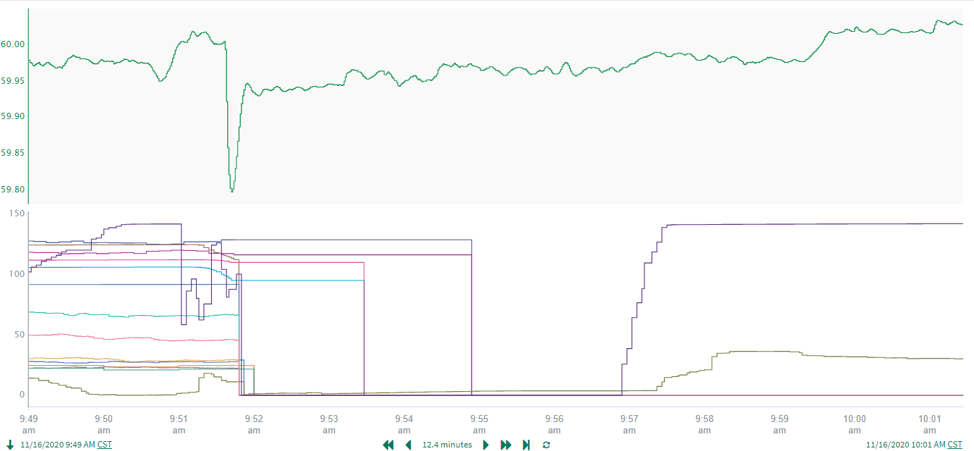
11/16/2020 09:51:37 (FME)
Notes:
15 Resources were tripped offline due to operator action while carrying 1020 MW
Starting Frequency: 59.9940 Hz
Maximum Frequency: 59.7970 Hz
A-C Time: 5 seconds
Recovery Time (back to deadband): 7 minutes and 56 seconds (90th percentile is 7 minutes and 12 seconds)
RRS Deployed: 1163 MW
Trip Reason: High MCCAMY IROL loading was mitigated by opening CBs, which de-energized transmission for the above units. Other contributing outages to the event include planned outages
Contextual Information: Wind was on a down ramp during the event (decrease of 742 MW).

Slide 7
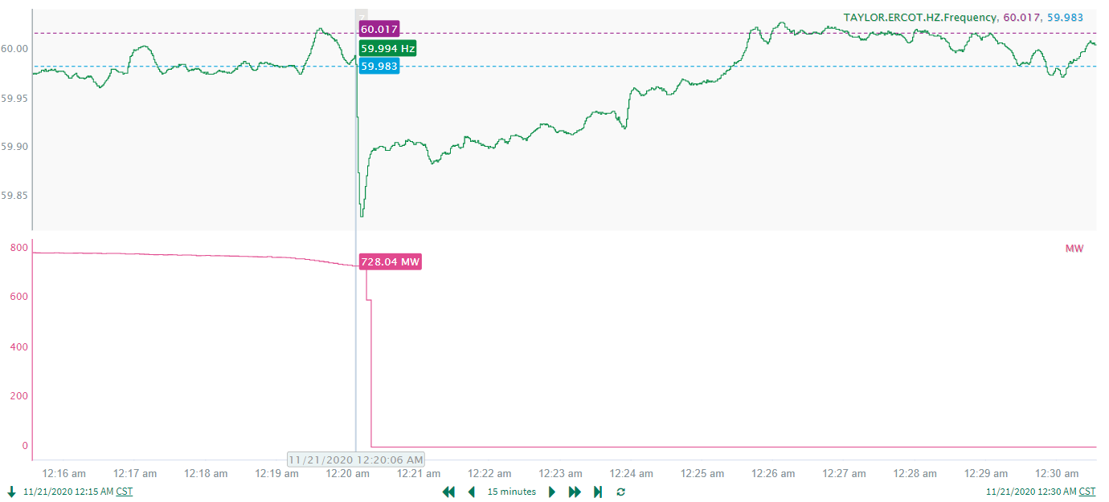
11/21/2020 00:20:06 (FME)
Notes:
Resource tripped offline while carrying 734 MW
Starting Frequency: 59.9940 Hz
Maximum Frequency: 59.829 Hz
A-C Time: 5 seconds
Recovery Time (back to deadband): 5 minutes and 29 seconds (90th percentile is 7 minutes and 12 seconds)
RRS Deployed: 1235 MW
Trip Reason: Loss of air flow

Slide 8
Questions?
Thank you!

