Slide 1
MIS & ERCOT.com User Workshop
December 9, 2020

Slide 2
Agenda
MIS Release Wrap-Up
  Issues
  Feedback
  Decommission Timing
ERCOT.com
  Project Goals
  Release Schedule
  User Research

Slide 3

ERCOT Website Release Timeline
EMIL Web Interface Release
Sandbox Version New MIS
MIS Production Soft Launch
MP Testing
MIS Production Go-Live
Decommission
Old MIS
Transition ERCOT.COM Content into Integrated Platform
Jan 30
May 26
Sept 16
Nov 11
Feb 01
Q1- Q4
2020
2021
2020
Jan 30 | EMIL web interface release ✓
May 26 | Sandbox version of new MIS ✓
Sept 16 | MIS Production soft launch for MP testing ✓
Nov 11 | MIS Production Go-Live✓
Dec 12 | Stabilization Release
2021
Feb 01 | Decommission old MIS
May 06 | Release 1 – Grid/Market Info, Public Dashboards & Page, Site Search
Nov 15 | Release 2 – About ERCOT, Services, Committees, Calendar, Market Rules
Q1 2022 | Decommission “Get Report” Pop Up Window

Slide 4
MIS Issues
Issues we are hearing:
Expired certificates
IE 11.x Configuration
Questions about API
GetReport and Download will be in place until Dec 2021
Contact your Client Services representative with questions
Report bugs to the ERCOT HelpDesk

Slide 5
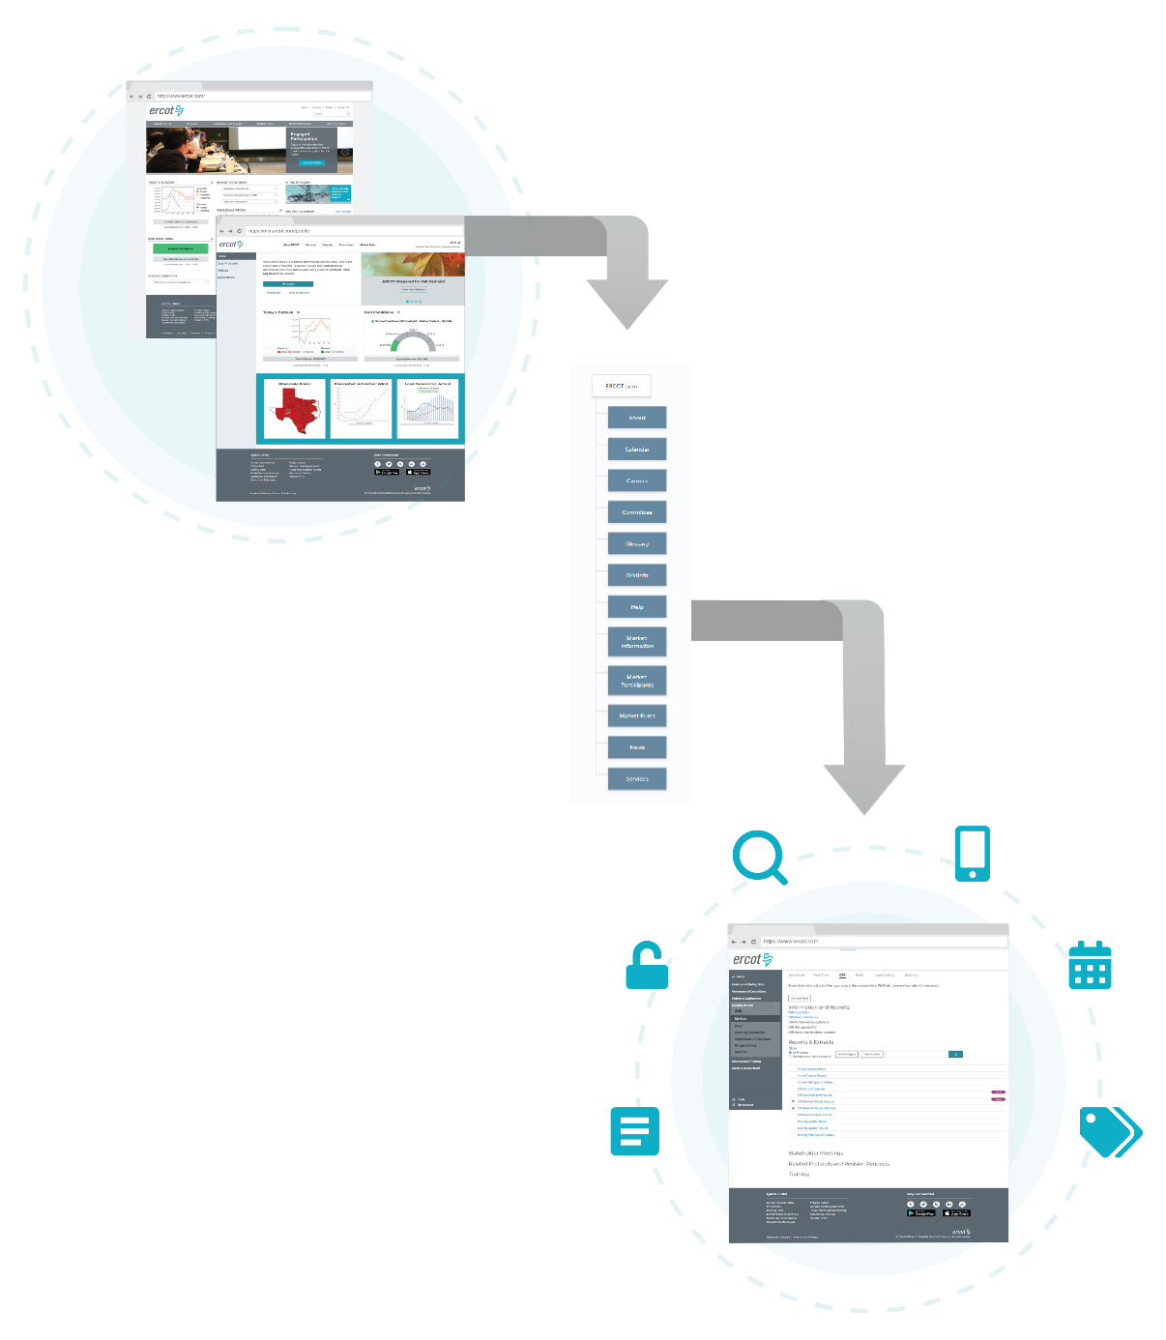
New, combined ERCOT Website
Integrated Navigation
Clearly defined MIS
Comprehensive Search
Mobile Friendly
Improved Calendar
Better cross-section between Calendar, Committees and Market Rules
Expanded use of Topic Tags

Slide 6
Release Details
May 2021 – Phase 1: Migration to new, combined ERCOT Website
Public Dashboards
Consolidated dashboard page: https://www.iso-ne.com/isoexpress/web/charts
Migrate ‘Grid Information’ and ‘Market Information’
Add a site search to the new platform but it will ONLY search Grid and Market Info
Nov 2021 - Phase 2: Migration to new, combined ERCOT Website
Updated Home page that display different content based on user/audience
Migrate About ERCOT, Services, Calendar, Committees and Market Rules
Search fully functional
Nov 2021 and Beyond – ERCOT Website
https://www.ercot.com – ERCOT.com when unauthenticated
https://www.ercot.com/secure – MIS when authenticated

Slide 7
Next Steps
Monthly Workshops will resume in January
User Research
  Public Dashboards
  Site Organization
  Grid and Market Information Organization
  Search Optimization
  Mobile Device Testing
Feedback at any time to webmaster@ercot.com
Redesign info: www.ercot.com/about/redesign

