Slide 1
Resource Integration Topics
Jay Teixeira
ERCOT
Resource Integration Workshop
December 9, 2020

Slide 2
Quarterly Stability Assessment (QSA)
Planning Guide 5.9
Next Deadline for QSA
If a GINR is not included in QSA, its Initial Synchronization date will be automatically delayed to the next quarter
All-Inclusive Generation Resource Initial Synchronization Date | Last Day for an IE to meet prerequisites as listed in paragraph (4) below | Completion of Quarterly Stability Assessment
Upcoming January, February, March | Prior August 1 | End of October
Upcoming April, May, June | Prior November 1 | End of January
Upcoming July, August, September | Prior February 1 | End of April
Upcoming October, November, December | Prior May 1 | End of July

Slide 3
Quarterly Stability Assessment (QSA)
Planning Guide 5.9, Quarterly Stability Assessment
Issue’s seen in previous QSA’s
10 day comment period for FIS
Needs to be complete before QSA deadline
TSPs need to plan for it
Dynamic Model Review
Dependent on FIS Stability study
Need to meet PG 6.9 15 to 30 days prior to QSA deadline
PSSE Model Quality Test Required
TSAT Model Required – If PSSE model is UDM, then TSAT model should be UDM.

Slide 4
GINR Time Line (Fastest)

Slide 5
End of Year Activity
Starting December 18, 2020 to January 4, 2021
Very limited SME availability
Includes Parts 1, 2, and 3
No approval after 2:00 p.m. before holiday or weekend
Submit requests with effective date no later than December 17, 2020.

Slide 6
Self-Limiting Facilities and DC-Coupled Resources in the INR Process
NPRR1026, PGRR081, NPRR1029 and RRGRR023 related to Self-Limiting Facilities and DC-Coupled Resources approved by BOD on 12/8/2020. Implementation to take 7 to 10 months.
RIOO-IS currently does not have capability to explicitly capture Self-Limiting Facilities or DC-Coupled Resources and their MW limits during the interconnection process.
Until approval and implementation of NPRR1026, in which RIOO-IS and other ERCOT systems should be modified to allow Self-Limiting Facilities and DC-Coupled Resources, ERCOT will use an manual process to allow interconnection requests to be submitted.
Any interconnection request using the manual process will not be able to proceed further than the QSA until the implementation and system modifications necessary for all systems are complete.

Slide 7
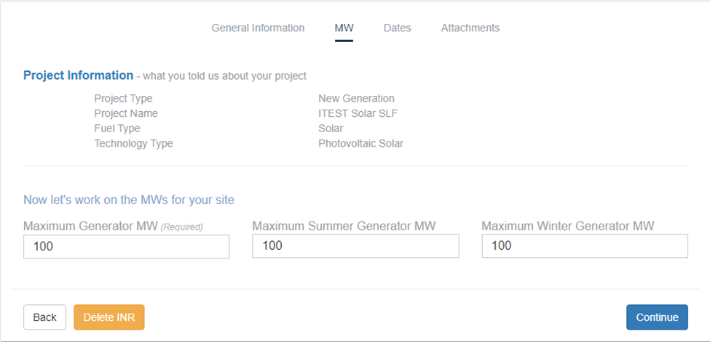
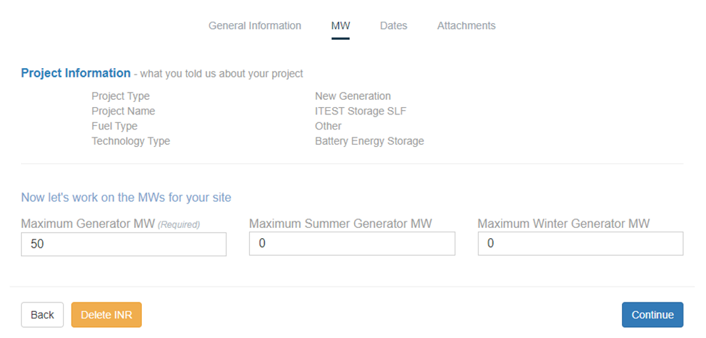
Proposal to Request a Self-Limiting Facility in RIOO-IS
Similar to repowers, a standard naming convention will be used for proposed Self-Limiting Facilities: [Common Name][space][“Solar” or “Storage”][space][“SLF” or “DCC”]
For Self-Limiting Facilities and DC Coupled Resources, whose total MW rating is equal to the rating of the non-battery resource (e.g. PVGR, WGR, etc.):
The non-battery resource’s ratings in RIOO will be its true Maximum MW and Maximum Summer/Winter MW.
The battery’s Maximum MW in RIOO will be its true rating, while Maximum Summer/Winter MW set to 0.

Slide 8
Proposal to Request a Self-Limiting Facility in RIOO-IS
For Self-Limiting Facilities whose MW rating is higher than the rating of the non-battery resource:
The non-battery resource’s ratings in RIOO will be its true Maximum MW and Maximum Summer/Winter MW.
The battery’s Maximum MW in RIOO will be its true capacity, while Maximum Summer/Winter MW will be non-zero to reflect the MW needed to meet the intended Self-Limit.
AC-Coupled resources will be considered Self-Limiting Facilities for RIOO-IS purposes.
GIS Report logic that handles re-powers (looks for “repower” in project name”) will be modified to look for the “SLF” and “DCC” keywords to capture the MW limit.

Slide 9
AVR Test for DGR
Document similar to that presented at September RI Workshop sent to several TSP/DSPs in October that have DGRs connected to their system for review.
Two TSP/DSP’s offered comments and changes were made to reflect those comments.
Revised document sent back out for review in late November.

Slide 10
AVR Test PASS/FAIL Criteria
Each test point is evaluated using the following rules¹:
For when the absolute value of the BESS MW POI flow is > 30% of maximum MW BESS capability
A test measurement will “pass” if the absolute value of the BESS MVAr POI flow is <= 3.5% of absolute value of the BESS MW POI flow
For when the absolute value of the BESS MW POI flow is <= 30% of maximum MW BESS capability
A test measurement will “pass” if the absolute value of the BESS MVAr POI flow is <= 1.3% of the BESS MW capability
¹Taken from discussions with Oncor, TNMP, and PEC

Slide 11
AVR Test PASS/FAIL Criteria (cont’d)
For the test points that “fail” the above 2 rules, the voltage dips (flicker) must be less than the following to minimize MVAr transients to the POI¹.
Voltage dips resulting in a <= 3% change in POI voltage will “pass” if the frequency of voltage dips is <= 10 voltage dips per hour (for typical operations)
Voltage dips resulting in a <= 2% change in POI voltage will “pass” if the frequency of voltage dips is <= 1 voltage dip per minute (for typical operations)
Voltage dips resulting in a <= 1% change in POI voltage will “pass” if the frequency of voltage dips is <= 15 voltage dips per minute (for typical operations)
Voltage dips resulting in a <= 0.5% change in POI voltage will “pass” regardless of frequency of voltage dips (for typical operations )
¹Refer to IEEE Std 1453-2015 IEEE Recommended Practice for the Analysis of Fluctuating Installations on Power Systems – Figure 1 --- GE flicker curve.)

Slide 12
Active PGRR’s
PGRR086 and RRGRR027, submitted by Enel Green Power North America on September 18, 2020, Clarify Models Required to Proceed with an FIS. Endorsed by ROS on 12/3/2020 and sent to TAC.

Slide 13
Other contact information
ResourceIntegrationDepartment@ercot.com is distribution list for Resource Integration department

Slide 14
Questions?
Thank you!

