Slide 1
PDCWG Report to ROS
Chair: Chad Mulholland, NRG
Vice Chair: Jimmy Jackson, CPS
ROS
December 3rd, 2020

Slide 2
Report Overview & Notes
Report Overview
Meeting Minutes
BAL-001-TRE-2 FMEs & IMFR
2 FMEs in the month of October
Frequency Control Report

Slide 3
Meeting Minutes
PDCWG Meeting 11/17/2020
ERCOT Summary of RFI – combined cycle unit frequency response for high frequency events
NPRR 1040 – Compliance Metrics for Ancillary Service Supply Responsibility
Request Indefinite Deferral/Tabling: OBDRR25 - Procedure for Calculating RRS Limits for Units (OBD), capture concepts for limits on Energy Storage Resources
ERCOT Reports and FME Discussion

Slide 4
Frequency Measurable Events Performance

Slide 5
Frequency Measurable Events
There were 2 FMEs in October
10/13/2020 17:13:40
Loss of 473 MW
Interconnection Frequency Response: 1006 MW/0.1 Hz
9 of 40 Evaluated Generation Resources had less than 75% of their expected Initial Primary Frequency Response.
6 of 40 Evaluated Generation Resources had less than 75% of their expected Sustained Primary Frequency Response.
10/19/2020 14:30:46
Loss of 628 MW
Interconnection Frequency Response: 961 MW/0.1 Hz
7 of 40 Evaluated Generation Resources had less than 75% of their expected Initial Primary Frequency Response.
6 of 40 Evaluated Generation Resources had less than 75% of their expected Sustained Primary Frequency Response.

Slide 6
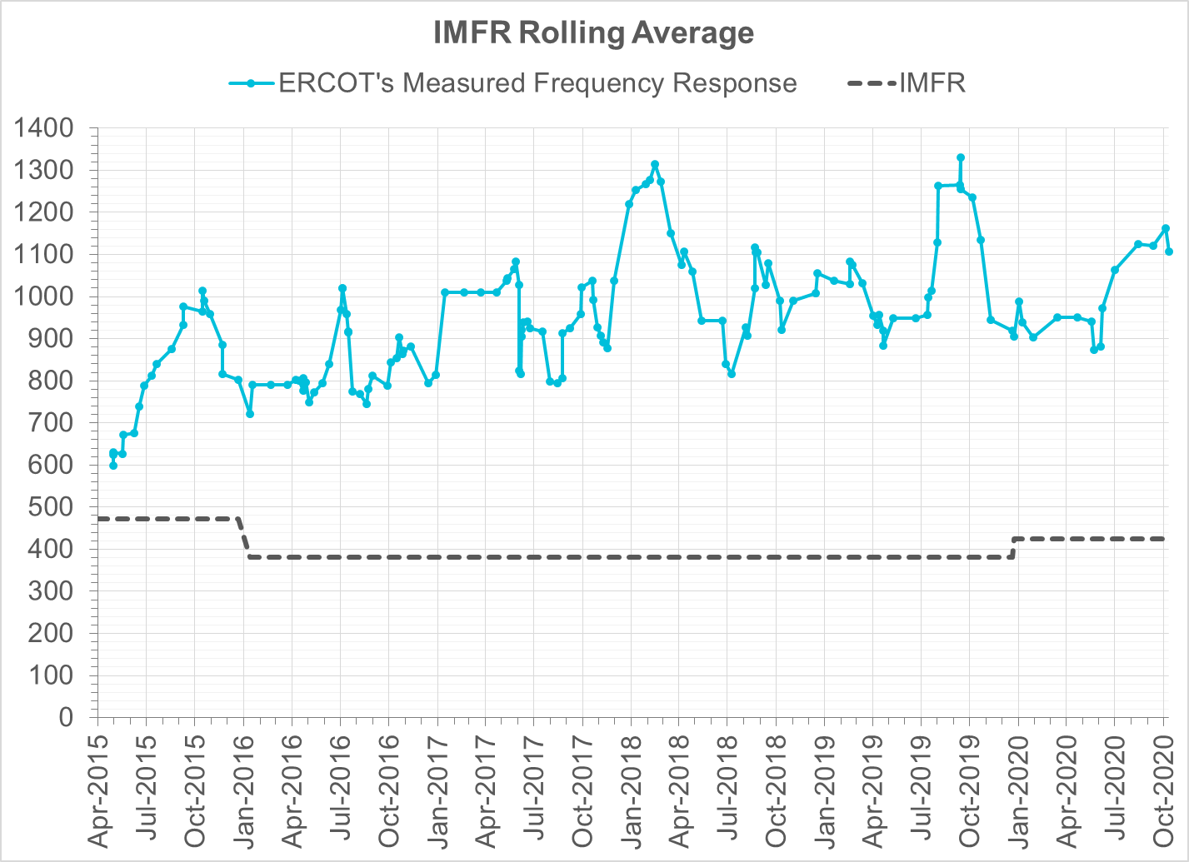
Interconnection Minimum Frequency Response (IMFR) Performance
IMFR Performance currently 1106.25 MW/0.1Hz
Frequency Response Obligation (FRO): 425 MW/0.1 Hz

Slide 7
Frequency Control Report
October 2020

Slide 8
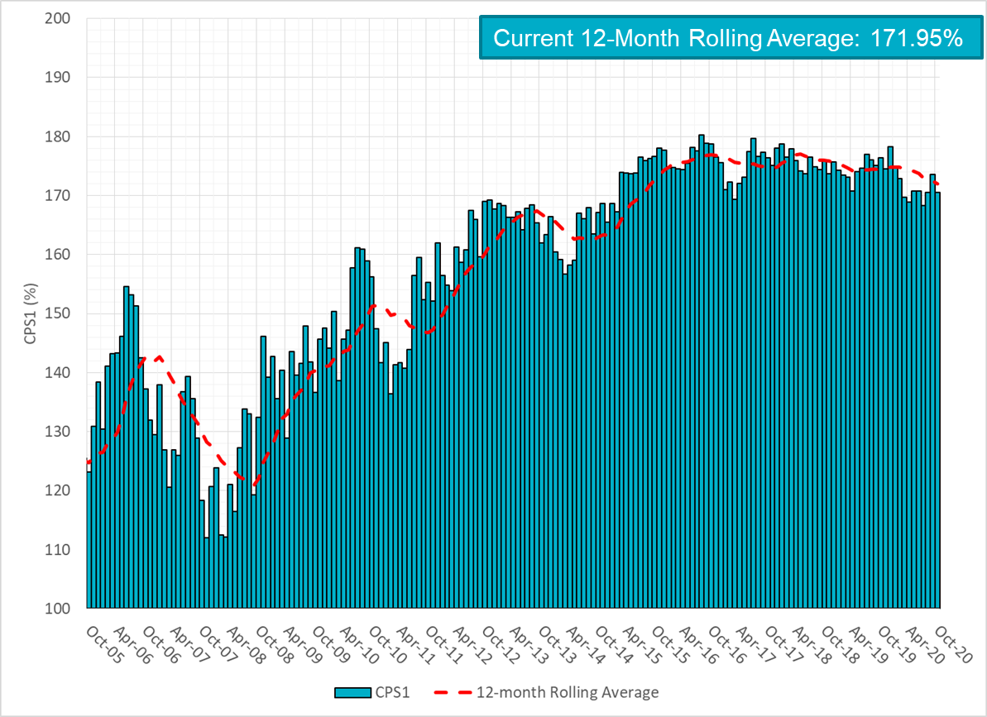
CPS1 Performance

Slide 9
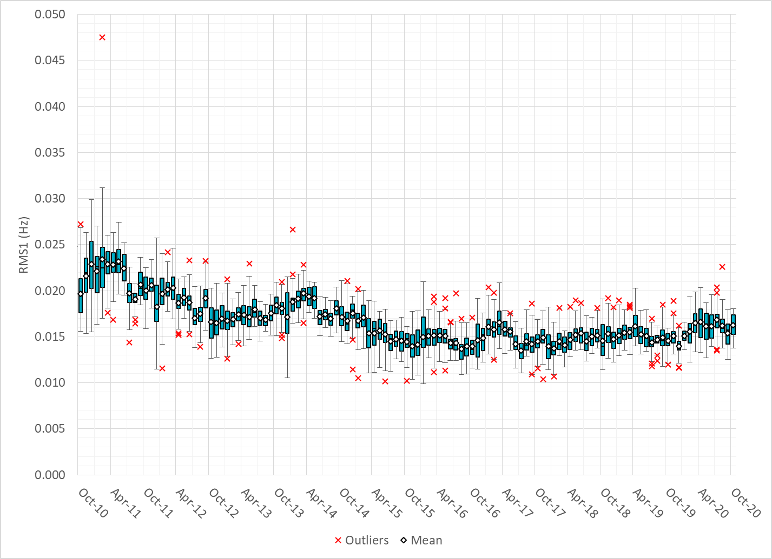
RMS1 Performance of ERCOT Frequency

Slide 10
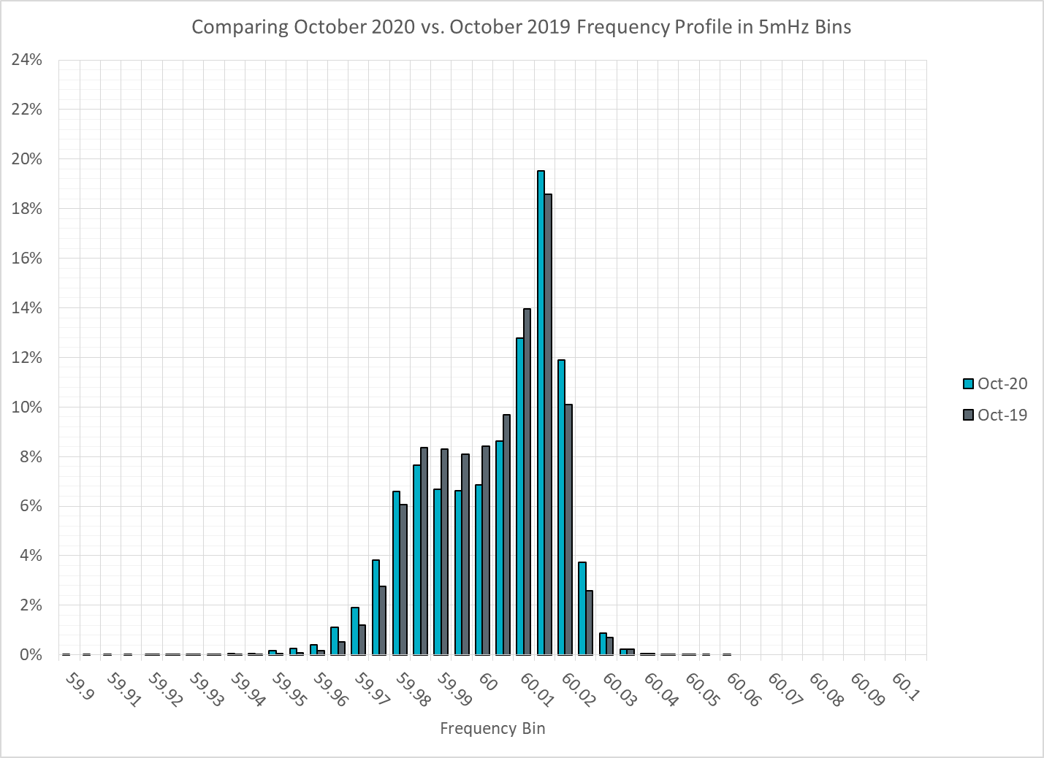
Frequency Profile Analysis

Slide 11
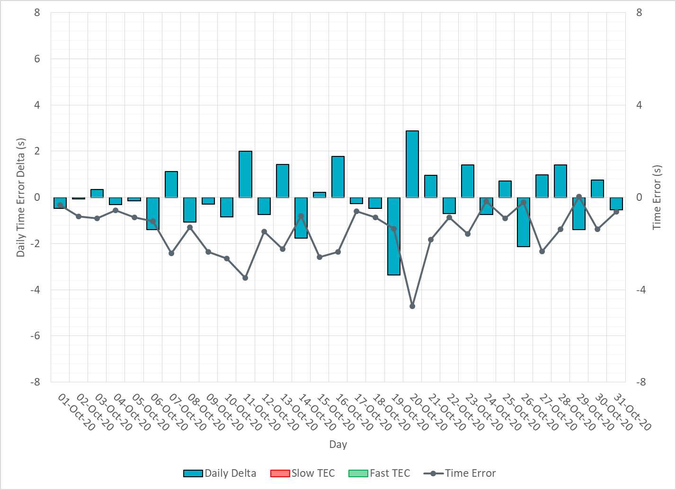
Time Error Corrections

Slide 12
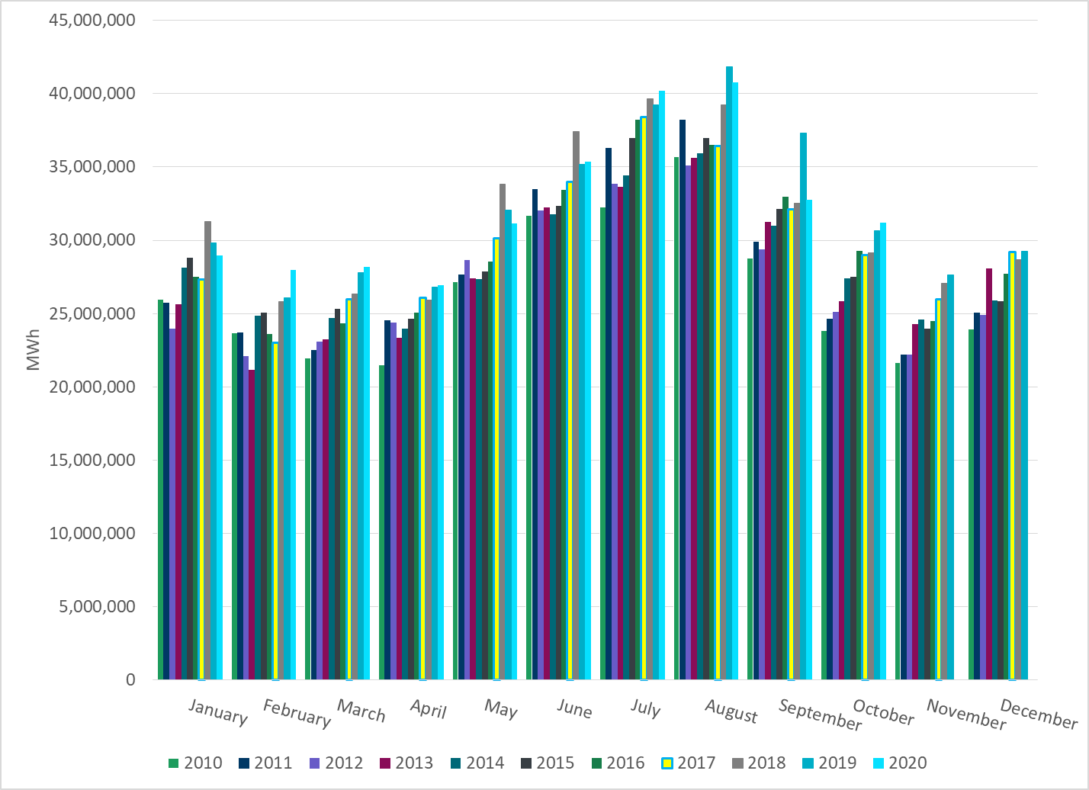
ERCOT Total Energy
Notes:
32,735,862 MWh

Slide 13
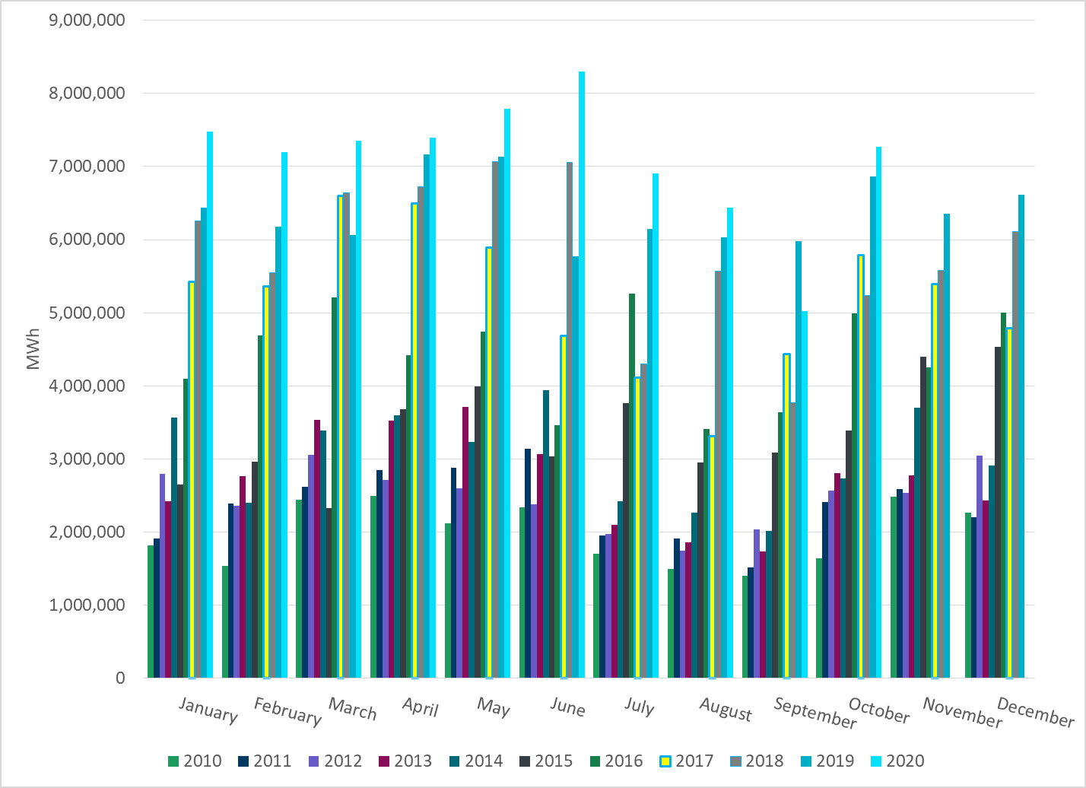
ERCOT Total Energy from Wind Generation
Notes:
5,026,960 MWh

Slide 14
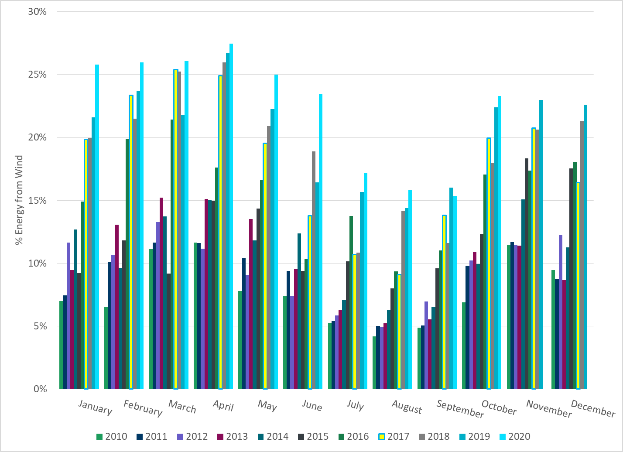
ERCOT % Energy from Wind Generation
Notes:
15.36%

Slide 15
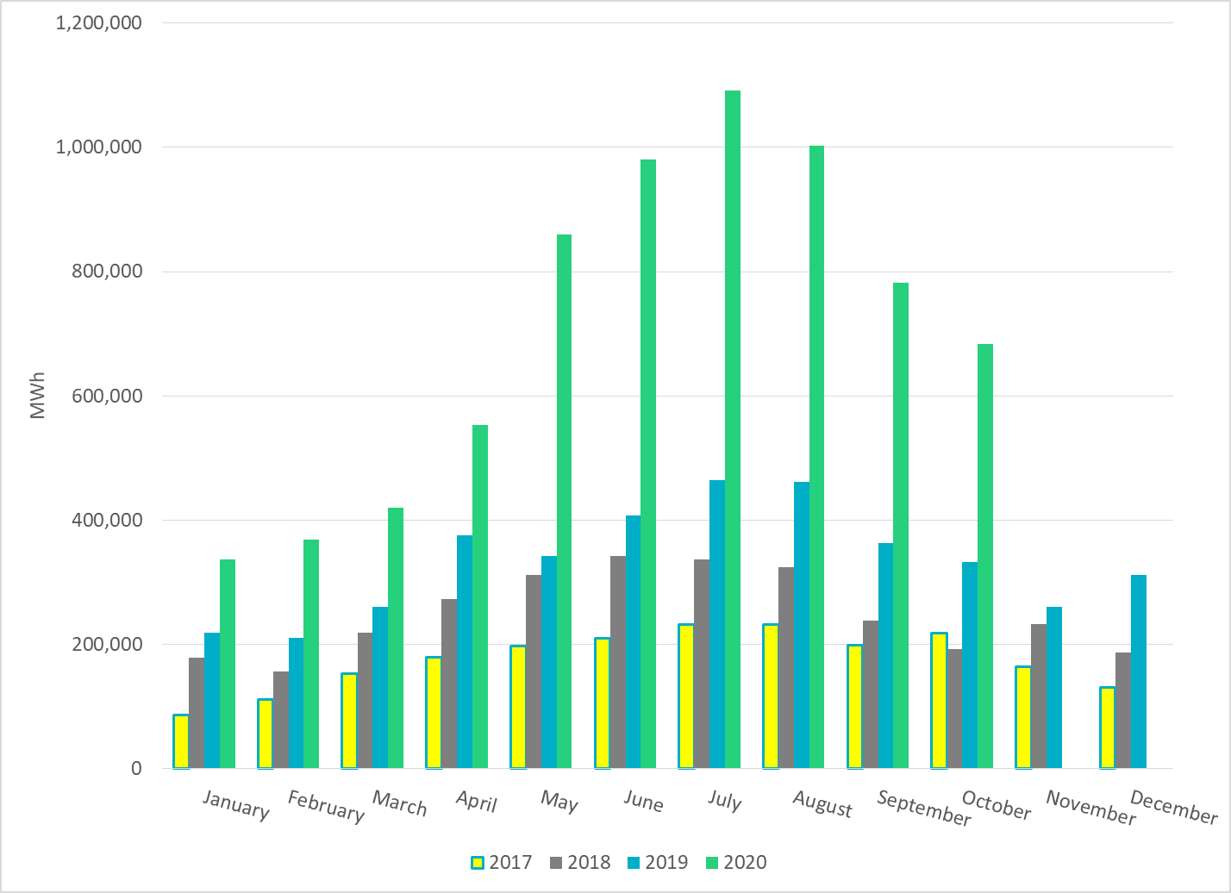
ERCOT Total Energy from Solar Generation
Notes:
782,376 MWh

Slide 16
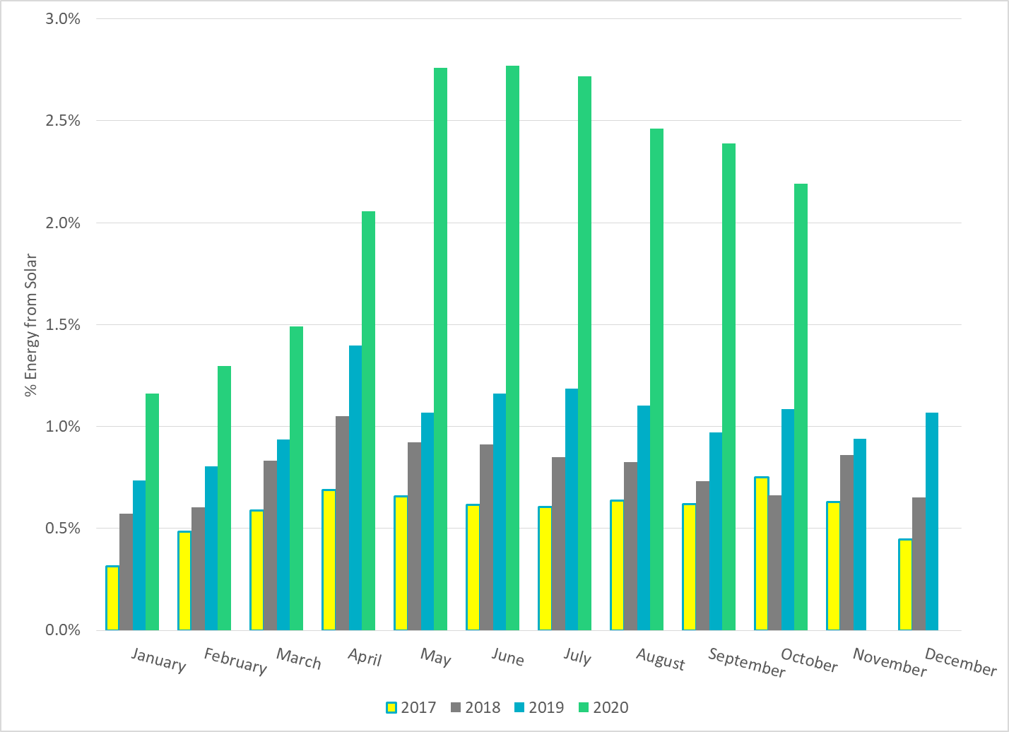
ERCOT % Energy from Solar Generation
Notes:
2.39%

Slide 17
Questions?

