Slide 1
Supply Analysis Working Group Report to WMS
December 2, 2020
Caitlin Smith, Chair
Pete Warnken, Vice Chair
Ian Haley, Vice Chair

Slide 2
2020 Reserve Margin Study
Final Draft Report released 12/1 by Astrapé with ERCOT Market Notice
30-day comment period for stakeholder comment on Final Draft Report
Stakeholders invited to discuss Q&A on Final Draft Report at December 18th SAWG
Will address questions and comments received by December 11th
Astrape to come back to SAWG after comment period (early 2021)

Slide 3
2020 Reserve Margin Study
Background:
In 2014 the PUCT asked Brattle and Astrapé to estimate the economically-optimal reserve margin in ERCOT to inform their review of market design for resource adequacy
EORM/MERM study updated every two years starting in mid-2018
Impacts & 2020 Results:
2020 study quantifies the 2024 values for:
Economically Optimal Reserve Margin - EORM → 11%
Market Equilibrium Reserve Margin - MERM (in energy-only equilibrium) → 12.25%
As evaluated every two years, the study can show the changing values of EORM and MERM to show changes in resource adequacy in ERCOT
Major changes to 2020 study from 2018:
Increased wind and solar penetration
Updated methodology for modeling PRD
ORDC Changes
Reference technologies

Slide 4
2020 Reserve Margin Study
Market Equilibrium Reserve Margin (MERM)
At a market equilibrium reserve margin of 12.25% ERCOT can expect a probability-weighted average of 0.5 loss-of-load events per year.
Simulations found there is likely to be a loss-of-load event about every two years in the range of 1,541 MW of load being shed for 2.9 hours on average, for a total expected unserved energy of 4,507 MWh.

Slide 5
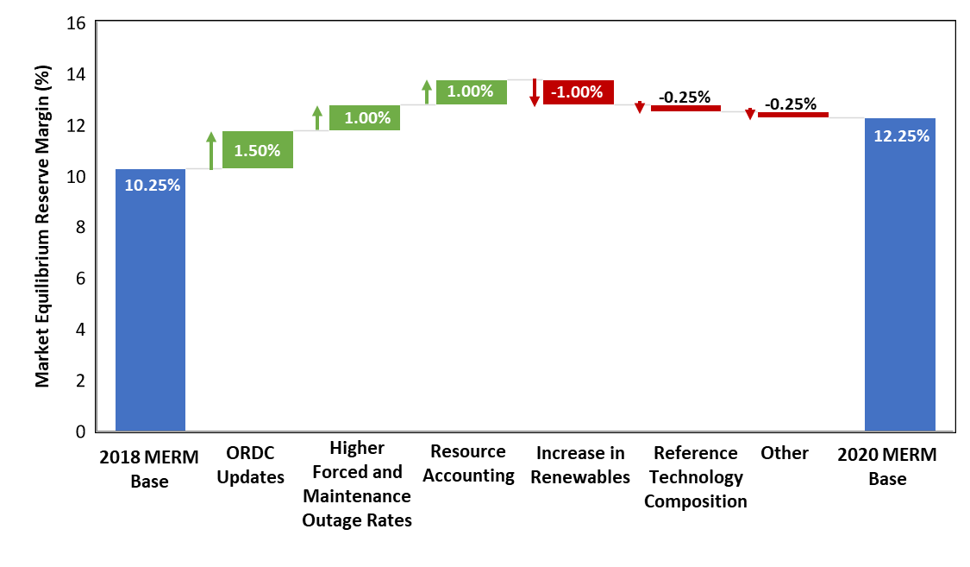
2020 Reserve Margin Study Base MERM Changes from 2018 to 2020 Study

Slide 6
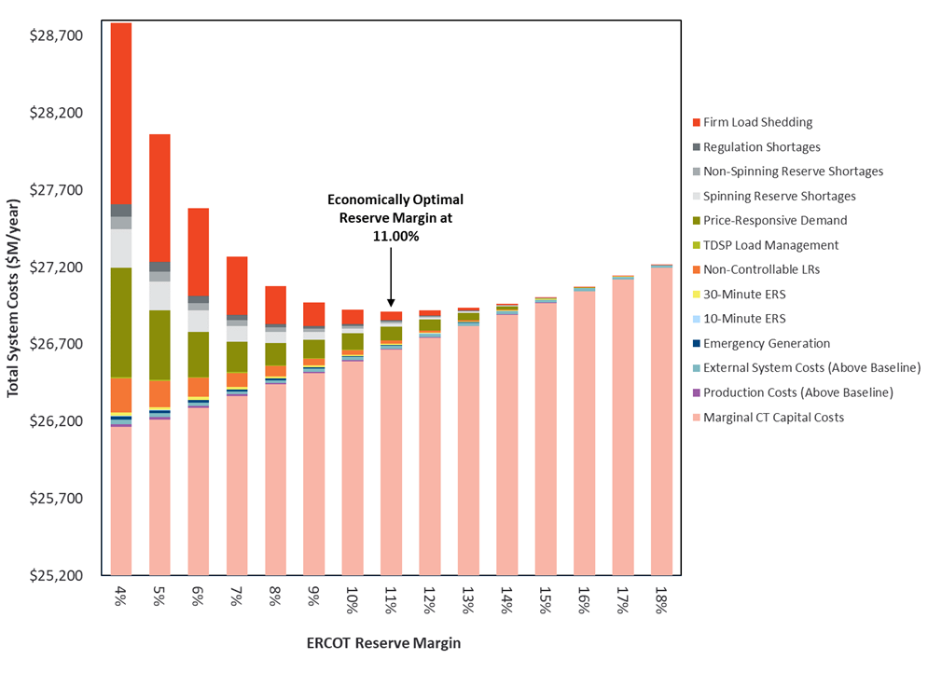
2020 Reserve Margin Study Economically Optimal Reserve Margin (EORM) Curve

Slide 7
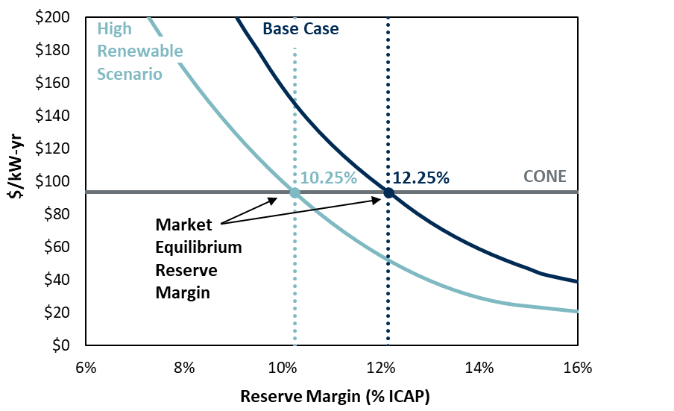
2020 Reserve Margin Study Market Equilibrium Reserve Margin Sensitivity to Renewable Penetration
A 20 GW increase in renewable installed capacity reduces the MERM by 2.00%.

Slide 8
2020 Reserve Margin Study – SAWG Discussions & Materials
October Presentation: http://www.ercot.com/calendar/2020/10/26/195766-SAWG
Scenarios:
High Renewables Penetration
Storage as change case
Gas CT as reference case
Equivalent Forced Outage Rate
Renewable Accounting
Draft Results
Storage Scenario
November Presentation: http://www.ercot.com/calendar/2020/11/19/195770-SAWG
Wind/Solar Effective Load Carrying Capabilities (ELCCs)
Battery storage scenario – Battery storage as the reference technology, combined with high renewables penetration

Slide 9
Battery Energy Storage Capacity Contribution
Currently: 0% capacity contribution in CDR/SARA
Discussions at SAWG:
Need a methodology for future contribution in the CDR/SARA
Start including in CDR/SARA after a certain MW threshold
First inclusion in CDR will likely be a supplemental tab
Until implementation of RRGRR023 Related to NPRR1002, BESTF-5 Energy Storage Resource Single Model Registration and Charging, ERCOT will need to collect the necessary data via RFI

Slide 10
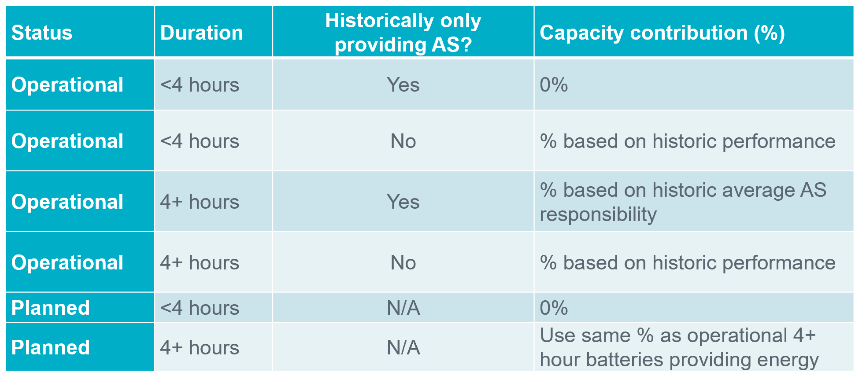
Battery Energy Storage Capacity Contribution
ERCOT Recommendation at November SAWG:
Discussion Points & Next steps:
Why treatment different than conventional generation is required
How to treat a battery, as same battery can discharge a different amount of MWs over different duration
ERCOT to continue to analyze data and return for updated proposal in 2021

Slide 11
Battery Energy Storage Capacity Contribution
New Report on Batteries, Supplemental to GIS:
As of October GIS there are 123 battery projects totaling 16,178 MW of capacity in the interconnection queue
These are reported in detail in the GIS Project Details tab
Starting from November 2020 ERCOT publishes a separate battery report:
Will report on standalone batteries vs. batteries co-located with solar, wind or thermal
ERCOT currently manually identifies projects as co-located, if the projects have the same POI, the same IE or same parent company, and a similar name
Standalone batteries are listed in one tab
If a battery is co-located with another resource the report shows that resource’s information as well on the respective tab
The report also includes a summary and Historic GIS Trend

Slide 12
Post-Summer Update on Probabilistic SARA
Analyzed Summer performance of the probabilistic model
Selected three peak load days for analysis based on highest HE 1700 values
8/13 and 8/14 reveal how wind and solar varied across the two contiguous days with the highest peak loads
7/13 reveals how wind and solar varied for high peak load days in different summer months
Evaluated:
Capacity Available for Operating Reserves” (CAFOR) Estimation Performance Analysis
Peak Demand Estimation Performance Analysis
Wind Output Estimation Performance Analysis
Solar Estimation Performance Analysis
Thermal Forced Outage Estimation Performance Analysis
Private Use Network (PUN) Injection Estimation Performance Analysis

Slide 13
Post-Summer Update on Probabilistic SARA
Conclusions:
Satisfied with overall model performance based on this set of observed results
Summer peak load forecast accuracy was an issue for both the SARA and probabilistic model
For wind output, large forecast errors are unavoidable when predicting several months in advance; modeling refinements can marginally reduce forecast error
Thermal forced outage and PUN injection modeling produces satisfactory results
Solar output prediction was adversely impacted by unexpected changes in operational availability of planned projects; in this case, projects approved for synchronization sooner than predicted
Next Steps:
To assess EEA level 1 simulation performance, the model inputs will be modified to match the 2019 final summer SARA results; comparison to LFC results for the 8/13/2019 and 8/15/2019 EEA1 days will be made
For communications/use of probabilistic model:
Strategy and direction for the Probabilistic SARA model will be discussed at an executive level internal to ERCOT in December
Continue discussions with stakeholders on the model itself:
Discuss potential wind and solar long-term probabilistic forecasting improvements with UL (our wind/solar output profile developer)

Slide 14
SAWG Open Action Items
Review of Resource Adequacy forecasts and development of a Net Load forecast - include possible evaluation and implementation of possible supplemental forecasts to CDR and SARA
Assigned: 07/08/2020
Status: will continue to discuss probabilistic SARA and net load forecast (expected at 12/20 meeting)
TAC Assignment: Develop and implement updated methodology used to determine cost of new entry (CONE)
Assigned: 07/08/2020; 01/29/20; 06/05/2019
Status: ERCOT is finalizing NPRR – to be filed late December 2020
Recommendation: Keep this action item open until NPRR through the process and then add review of CONE study to SAWG scope
In addition to CONE study, also believe the review of MERM/EORM studies should be added to SAWG scope in 2021
**Current SAWG Scope (approved in 2014):
At the direction of the Wholesale Market Subcommittee (WMS), SAWG evaluate proposals for market design as they pertain to Resource adequacy and the resource reporting methodologies. SAWG Annually reviews the components and construction of the Capacity, Demand, and Reserves Report (CDR), the Seasonal Assessment of Resource Adequacy Report (SARA), the Long Term Load Forecast, the NERC Long Term Reliability Assessment, and recommend necessary changes to WMS. SAWG also reviews and recommends market design principles, issues, and proposals related to supply side adequacy as assigned by WMS.

Slide 15
SAWG Upcoming
Final Draft Report released 12/1 by Astrape with ERCOT Market Notice
Stakeholders invited to discuss Q&A on Final Draft Report at December 18th SAWG
Will address questions and comments received by December 11th
CONE NPRR to be filed
CDR to be released December 16th
Next SAWG meeting December 18th

