Slide 1
Market Credit Working Group update to the Wholesale Market Subcommittee
Bill Barnes, NRG, Chair
Josephine Wan, Austin Energy, Vice Chair
12/02/2020

Slide 2
MCWG update to WMS
General Update
November 17 Joint MCWG/CWG WEBEX Meeting
11 NPRRs reviewed for their credit impacts
994NPRR Clarify Generator Interconnection Neutral Project Classification - No Credit Impact
995NPRR RTF-6 Create Definition and Terms for Settlement Only Energy Storage - No Credit Impact
1014NPRR BESTF-4 Energy Storage Resource Single Model - No Credit Impact
1029NPRR BESTF-6 DC-Coupled Resources - No Credit Impact
1034NPRR Frequency-Based Limits on DC Tie Imports or Exports - No Credit Impact
1048NPRR Clarification on NPRR978 Short-Term Adequacy Reports - No Credit Impact
1049NPRR Management of DC Tie Load Zone Modifications - No Credit Impact
1050NPRR Change to the Summer Commercial Operations Date Deadline for Including Planned Generation Capacity in Reports on the Capacity, Demand and Reserves in the ERCOT Region - No Credit Impact
1051NPRR Removal of the Price Floor Applied to Day-Ahead Settlement Point Prices - No Credit Impact
1052NPRR Load Zone Pricing for Settlement Only Storage Prior to NPRR995 Implementation - No Credit Impact
1055NPRR Market Notice and ERCOT Discretion re Late-Filed NOIE Eligibility Attestations for PTP Obligations with Links to an Option Bid Awards - No Credit Impact

Slide 3
MCWG update to WMS
Real-Time Co-optimization Update to Credit Work Group
Aug 19 CWG meeting (today)
Highlight need for CWG review of NPRR1007-NPRR1013
ERCOT provides initial summary of credit impacts
Note that although RTCTF continues to meet until October 21, 2020, all Pricing and Settlement consensus items are complete and posted here: http://www.ercot.com/calendar/2020/9/9/191170-RTCTF
Sept 16 CWG meeting
ERCOT Credit will review prior materials and ask if any issues
Oct 16 CWG meeting
ERCOT Credit (Vanessa) and RTCTF Chair (Matt Mereness) asks if any questions or concerns with RTCTRRs from a credit impact perspective.
Ask CWG for agreement on comments to be filed by Nov 17.
Nov 17 CWG meeting
Last meeting before Board to file CWG comments on credit impacts

Slide 4
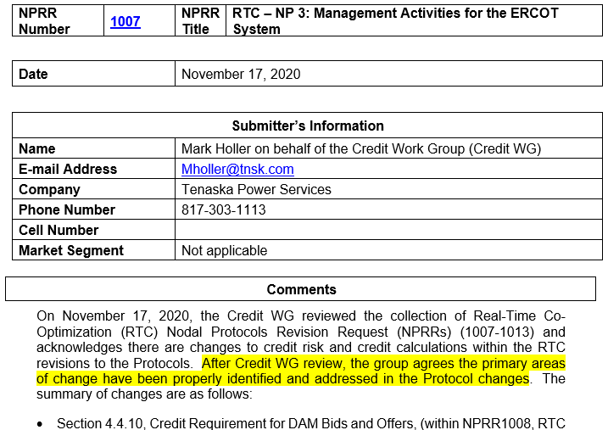
MCWG update to WMS

Slide 5
MCWG update to WMS
Forward Adjustment Factors
The CWG reviewed the potential impact of different weighting methodologies used to calculate the forward adjustment factors to determine the potential changes in TPE.
Those changes were compared to actual exposures from 2019 and 2020 to determine if changes were warranted.
Based on this review the CWG does not recommend a change to the weightings at this time. The CWG will continue to review these weightings on an annual basis as more data becomes available.

Slide 6
MCWG update to WMS
Credit Risk Assessment and Associated Enforcement NPRR
PLEASE REVIEW
http://www.ercot.com/calendar/2020/10/16/192878-CREDITWG-MCWG
http://www.ercot.com/content/wcm/key_documents_lists/192884/xxx_NPRR_Credit_Risk_Assessment_v5.docx

Slide 7
MCWG update to WMS
2020 Credit Working Group Goals
Review the ongoing impact on market participant credit exposure and collateral requirements resulting from the incorporation of a forward price curve-based methodology
Clarify the market’s risk tolerance/appetite level and provide regular updates on credit exposure to the ERCOT Board
Evaluate and quantify potential market risk under current credit rules and examine a framework for reviewing rules in flight
Effectively communicate credit risk to the market
Examine current Protocol language to determine how effective current calculations capture actual credit risk
Review settlement timeline and determine if a reduction is feasible

Slide 8
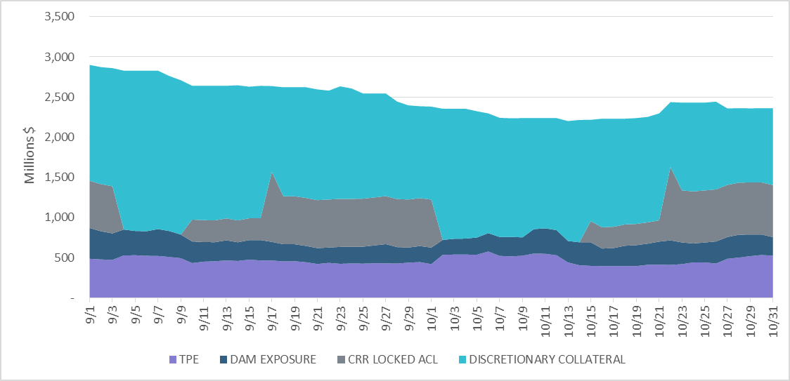
MCWG update to WMS
TPE Updates: Sep 2020- Oct 2020

Slide 9
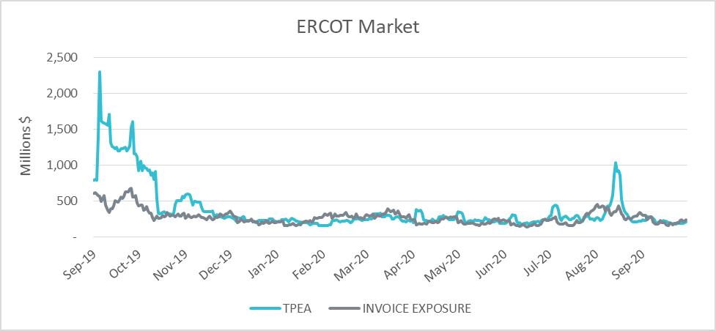
MCWG update to WMS
TPE Updates: Sep 2020- Oct 2020

