Slide 1
Issues with the June 2020 CRR Balancing Account Resettlement
WMS
December 2nd, 2020

Slide 2
Background
CRR Balancing Account activity up until June resettlement on 11/11/20.
CRR Balancing Account Fund Balance

Slide 3
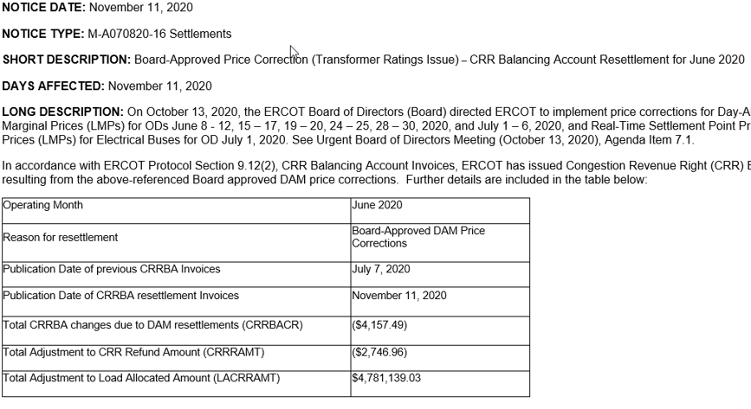
June Resettlement
Small change in CRR payments due to the DAM price corrections and resettlement.
Large change in load settlement.

Slide 4
What Happened?
June Resettlement of the CRR Balancing Account
What Happened? The entire prior CRRBA disbursement to loads in June was pulled back to replenish the CRRBA Fund deficiency in October.
1
2
Why is this an issue? October CRRBA Fund balance used in a prior month (June) resettlement. Settlement and billing of customers does not mix activity from different time periods. Customer bills for June have already been issued and paid.

Slide 5
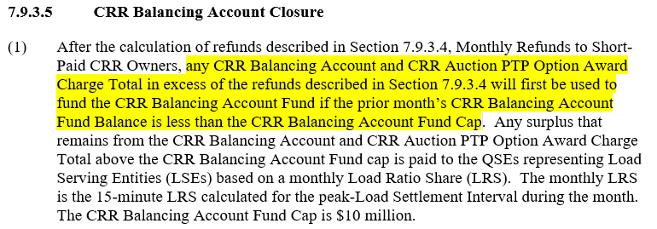
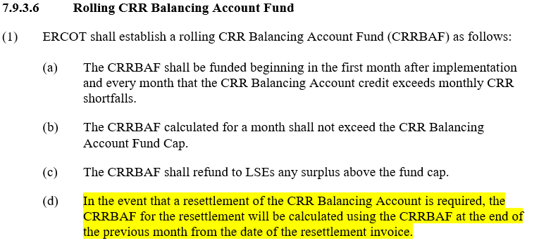
Relevant Protocol Sections
This language assumed load ratio share changes for CRRBA resettlements, not CRRBA Fund replenishment.

Slide 6
What’s a better way?
Option 1: Resettle the difference related to the CRR payments from load, carry the CRR BA Fund balance forward, and replenish from future months. Ex: $5,000 difference in CRR payments.

Slide 7
What’s a better way?
Option 2: Resettle the difference related to the CRR payments from CRRBA Fund, carry the adjusted CRR BA Fund balance forward, and replenish from future months. Ex: $5,000 difference in CRR payments.

Slide 8
What’s a better way?
Option 2: Resettle the difference related to the CRR payments from CRRBA Fund, carry the adjusted CRR BA Fund balance forward, and replenish from future months. Ex: $5,000,000 difference in CRR payments.

Slide 9
Request
Create assignment for WMWG (?) to review the issue and potential solutions.

